Slide 1
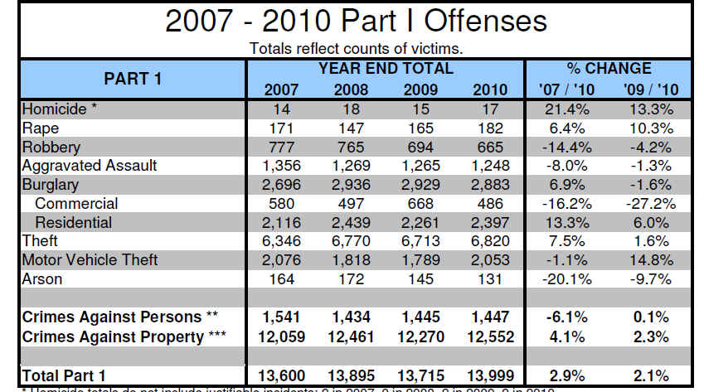
Notes:
What do you think of when you think of a source?
---information from a web page or a report -- numbers or "data"
Can you ask that information a question?
Usually not, because all you're seeing are the "answers" that somebody else has already put out there. Once you have
this "summarized" information -- or the answer -- and you don't have the details, you can't go back and ask a new
question.
Example:
If you go to the St Paul Police dept's website you can find all kinds of crime statistics.
You can look at the overall numbers for the city as a whole. But there are all kinds of things we might want to know
-- where did these crimes occur? when? (time of day, day of week, month of year?)

Slide 2
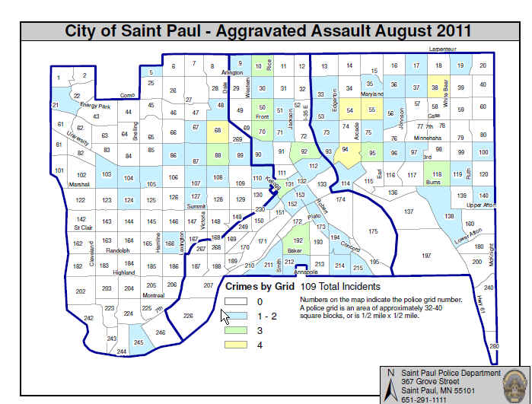
Notes:
They do let us see WHERE the crimes occurred -- they have all kinds of maps already produced. You can get ones for
each month, separate maps showing where robberies occurred or where homicides occurred or where vehicle thefts
occurred.

Slide 3
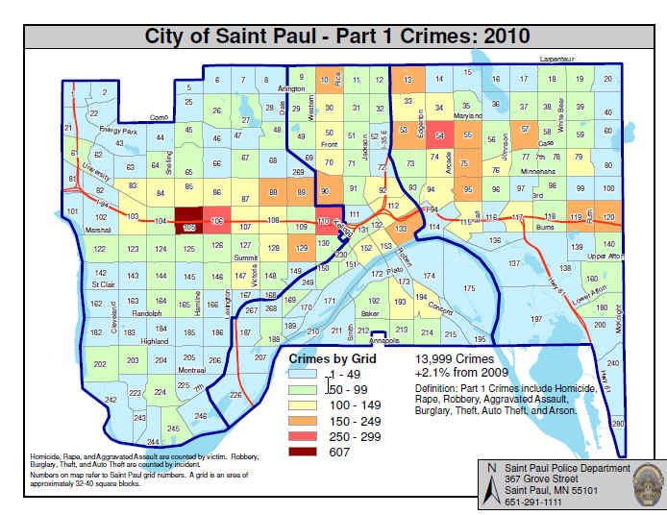
Notes:
ou can also get maps showing the entire year, including one that shows all Part 1 (violent) crimes for a year
But again, there are questions we can't ask. Except for the Part 1 map, all the crimes are in separate maps, so it's
pretty tough to figure out whether robberies are more likely to occur in the same parts of town as vehicle thefts,
or something like that. Sure you can eyeball it by looking at the map, but that's not very definitive and may not
always be accurate.

Slide 4
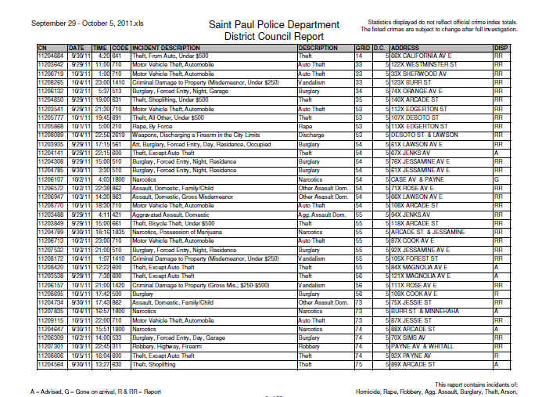
Notes:
They do have one place where you can get details -- but it's separated out by district council/neighborhood and then
separated by month. And it's all in a PDF file.
The detail files show great things like the type of crime, the time and date, the disposition (what the cops did)
and an address. However if you look closely at the address, they've XX'ed out the last digit on most of the
addresses so that you can only figure out what block it occurred on.

Slide 5
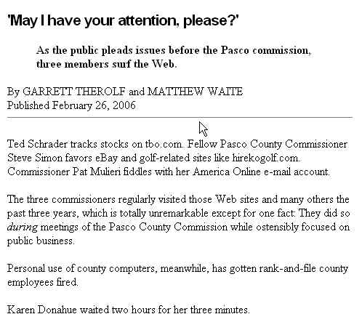
Notes:
This is another story that’s been around for a number of years, but I think it’s one of the most creative uses of CAR ever. A reporter who covered the county commission for the St. Petersburg Times noticed that commissioners spent a great deal of time during meetings doing things on their computers. He wondered if they were really doing govt business or not. So he and another reporter figured out how to find out – without having to ask the commissioners.The computers were on the county computer network, which kept a database of Internet activity. So they requested a copy of that data and looked for the records that were for the commissioner’s computers and that occurred during business meetings.

Slide 6
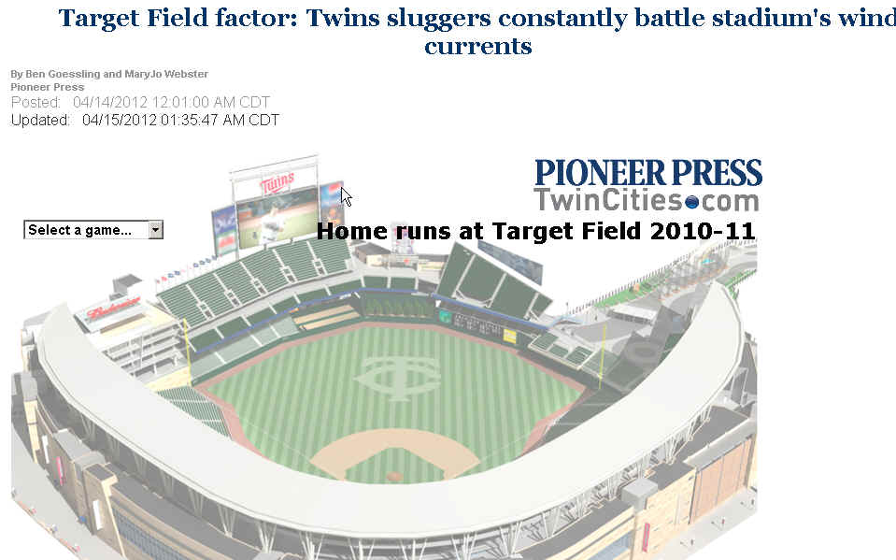

Slide 7
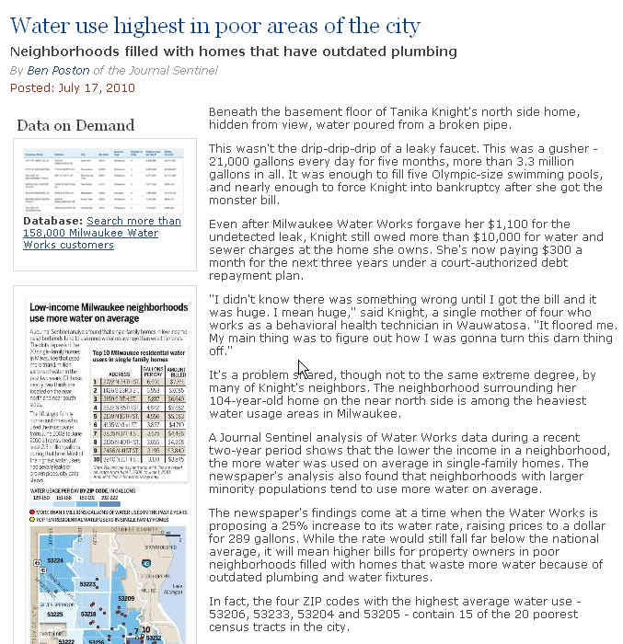
Notes:
This is one of those stories that turns a common belief on its head. The CAR reporter for the Milwaukee Journal Sentinel obtained the city’s water usage database. Other news organizations have used that database to look the biggest water users and have found celebrities with big-time bills, or rich people who constantly water their huge lawns. But the Journal-Sentinel found a correlation between neighborhood income level and the ater usage – the lower the income, the higher average water use per household. The reason wasn’t in the data though. The reporter had to dig out through street reporting that the higher usage was largely due to leaking pipes not being fixed and homes that had older, less efficient fixtures.

Slide 8
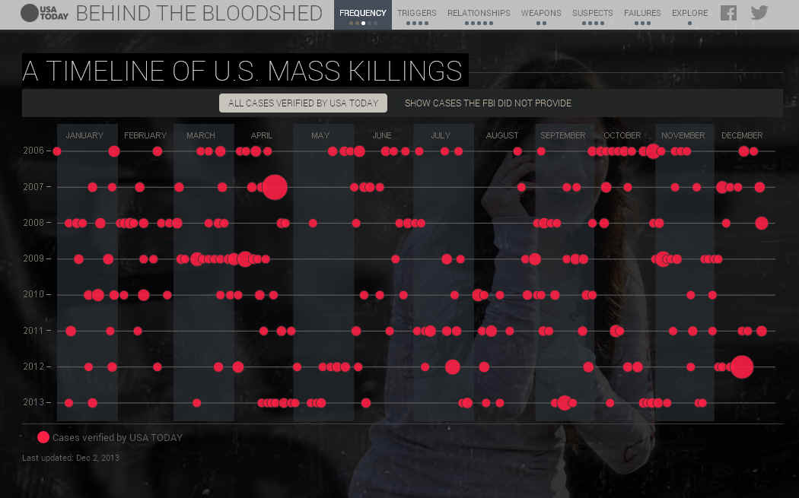

Slide 9
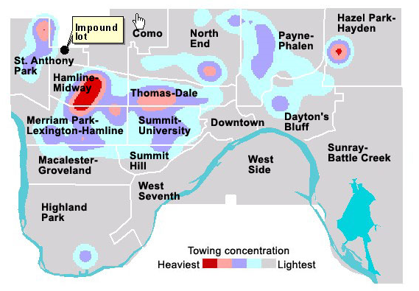

Slide 10
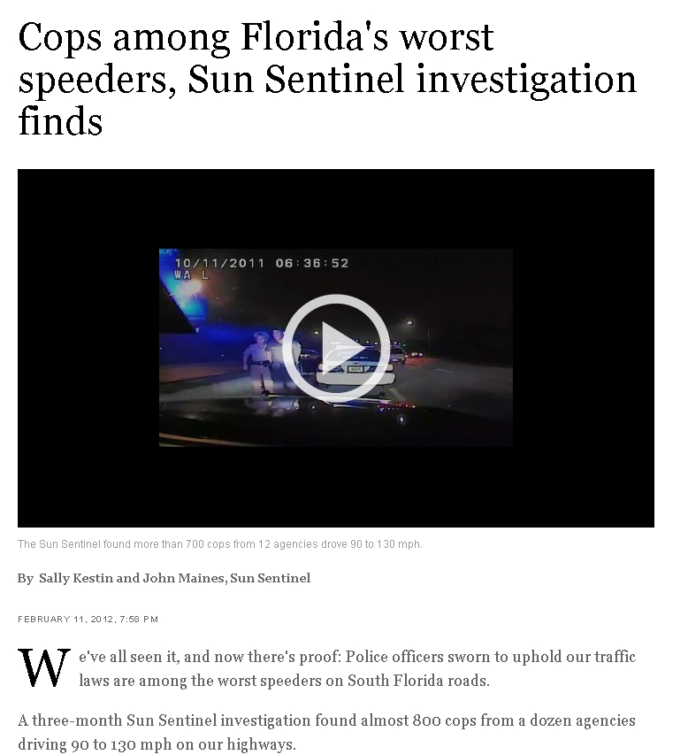
Public Service Pulitzers

Slide 11
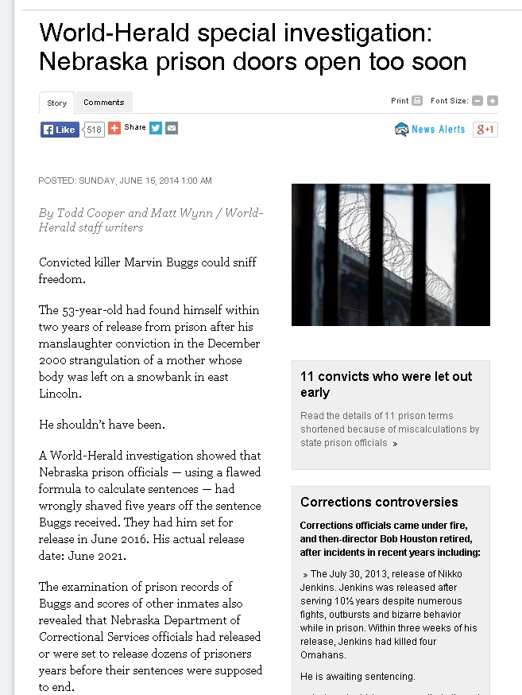

Slide 12
