Slide 1
Fall Detection: Threshold Analysis of Wrist-Worn Motion Sensor Signals
Joseph Caguioa, Andy Nguyen, & Michael J. Wolfe
Advisor: Dr. Jacquelyn Cheun

Slide 2
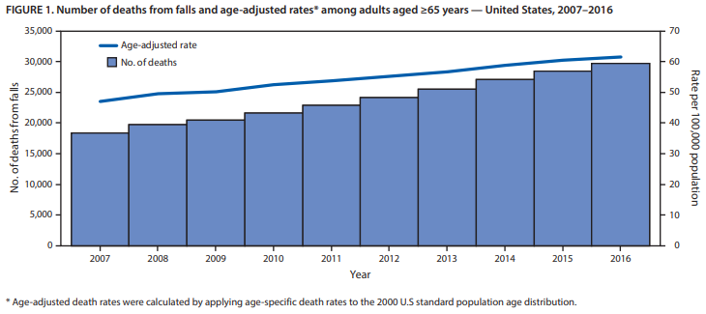
Death Rates from Falls Increasing Annually
Figure 1. Age-adjusted death rates in seniors (2007-2016). Adapted from “Deaths from Falls Among Persons Aged ≥65 Years,” by E. Burns, and R. Kakara, 2018, MMWR Morb Mortal Wkly Rep (67). P. 509-514.
Notes:
In 2016 falls were the leading cause of injury-related deaths in seniors
~30,000 adults 65 years and older experienced fatal falls in 2016 with increasing death rates annually since 2007 in the U.S.
The adjusted-age death rates for this senior population have increased by 31% from 2007 to 2016, with an estimated 43,000 deaths due to fatal falls in 2030 if these current rates remain stable
~ 646,000 reported globally
Falls are often associated with (strokes) or can result in life-threatening situations (TBI) that require immediate medical intervention for patient’s survival
Risk factors of advanced age: reduced activity/gait/balance, neurologic disease, other underlying medical conditions
Other risk factors: hazardous working conditions, substance abuse, socioeconomic factors (World Health Organization)
Reference: Burns E, Kakara R. Deaths from Falls Among Persons Aged ≥65 Years — United States, 2007–2016. MMWR Morb Mortal Wkly Rep 2018;67:509–514. DOI: http://dx.doi.org/10.15585/mmwr.mm6718a1

Slide 3
How can we optimize health outcomes by quickly diagnosing fall events?
Notes:
In an effort to combat these increasing mortality rates in seniors, novel fall detection systems have been developed to swiftly identify falls and mitigate the major incidental risks that result in deaths by providing immediate medical intervention.

Slide 4
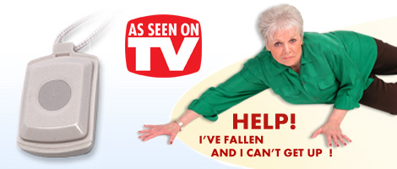
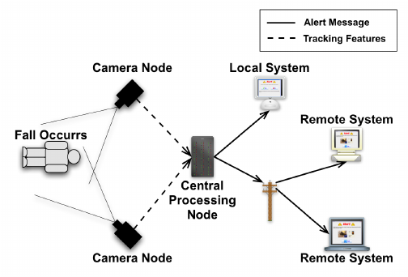
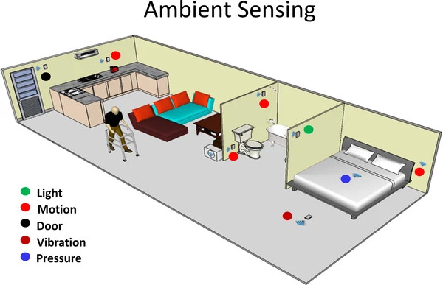
Fall Detection Systems
User-Activated Fall Detection
Autonomous Fall Detection
Notes:
Early fall detection systems required a user-activated device such as a wrist-band or necklace (life-alert) to interface with an emergency help desk operator for help. (De Backere et al., 2015).
However, autonomous fall detection systems have since been introduced that do not require a user to be conscious to call for assistance through the alert signal.
These systems can be categorized into: camera-based systems, ambient environment sensor-based systems, and wearable sensor-based systems.
Image Source (Life-Alert): https://maxvaluesmag.com/findit/business-directory/life-alert-parma-ohio/
Image Source (Camera-Based): https://www.researchgate.net/figure/The-fall-detection-and-alert-process_fig1_228783799
Citation: Williams, Adam & Xie, Dan & Ou, Shichao & Grupen, Roderic & Hanson, Allen & Riseman, Edward. (2010). Distributed smart cameras for aging in place.
Image Source (Ambient-Sensors): https://link.springer.com/article/10.1186/1743-0003-9-21/figures/5
Citation: Patel, S., Park, H., Bonato, P. et al. A review of wearable sensors and systems with application in rehabilitation. J NeuroEngineering Rehabil 9, 21 (2012). https://doi.org/10.1186/1743-0003-9-21

Slide 5
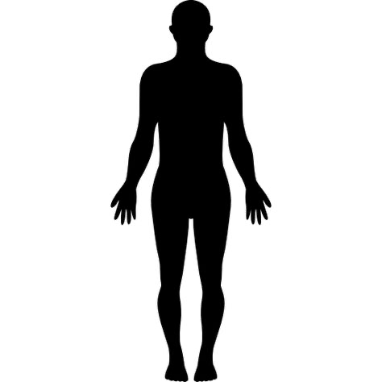
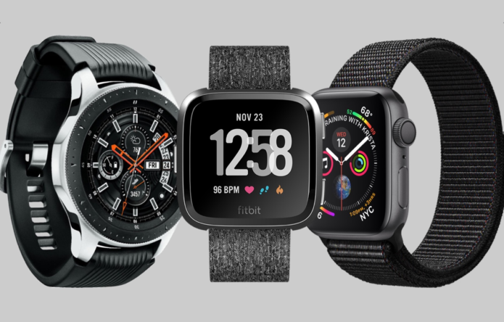
Fall Detection Using Wearable Sensors
Notes:
Waist and head are located on the axis of the human anatomy’s center of gravity (algorithmically preferred)
Wrist is more practical for daily wear
Image Source (Smartwatches): https://gearopen.com/wearables/best-smartwatch-2019-july-update-on-the-top-tech-watches-124796/

Slide 6
Research
Use sensor data (accelerometer and gyroscope) from wearable devices to detect falls and immediately dispatch paramedics to device’s GPS location
Algorithm should differentiate between actual falls and false positive events (activities of daily living, intentional falls)

Slide 7
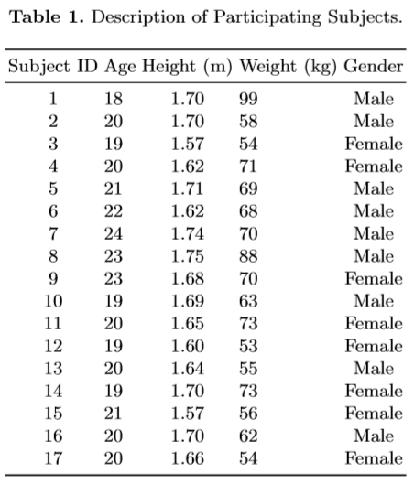
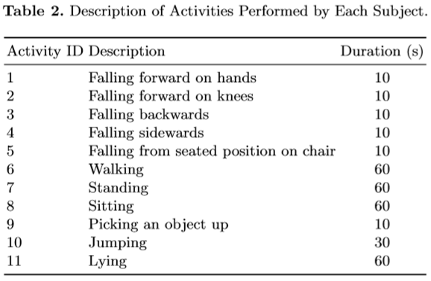
UP-Fall Detection Dataset
Notes:
Multiple sensors - we limited to wrist
17 subjects, 11 activities (6 ADLs, 5 falls), 3 trials each
A trial is an activity period with a measurement each second for 10-60 seconds, sampling rate of 100 Hz for both sensors
559 trials total (2 trials missing for Subject 8, activity 11)

Slide 8
Models
Our Model Approach:
Simple Threshold Model
Multiphase Fall Model
Test Combination of Different Machine-Learning Algorithms
Principal Component Analysis
Linear Discriminant Analysis
Support Vector Machines
Hidden Markov Model
Naïve Bayesian Classifier
Decision Trees
Random Forests
Undifferentiated Range of ADL as majority response

Slide 9
Potential Challenges
Wearable devices are the most common application of past algorithms
Single sensor placement limits the amount of spatial data that can be processed
Multiple sensors are more effective but less practical
Manufacturers of devices are protective of their data and algorithms

Slide 10
Models: Chosen Approach
Our Model Approach:
Simple Threshold Model
Multiphase Fall Model
Test Combination of Different Machine-Learning Algorithms
Principal Component Analysis
Linear Discriminant Analysis
Support Vector Machines
Hidden Markov Model
Naïve Bayesian Classifier
Decision Trees
Random Forests
Undifferentiated Range of ADL as majority response

Slide 11
Models: Chosen Approach
3-phased approach:
Threshold Analysis - Acceleration Magnitude
K-Means Clustering
Linear Kernel SVC

Slide 12
Results
Tested a variety of kernels (linear, Gaussian, polynomial) in classification, as well as triaxial and magnitude threshold analysis
All classifiers were around 50% accurate except magnitude threshold analysis with linear SVC classification, which was 66% accurate

Slide 13
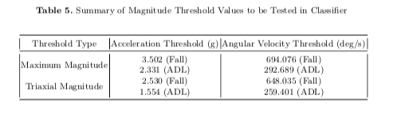
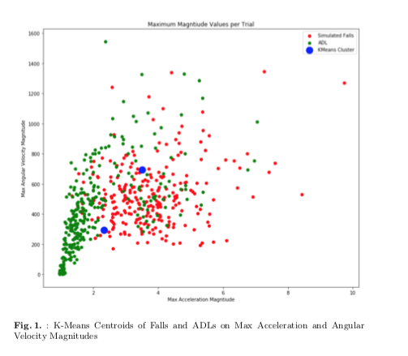
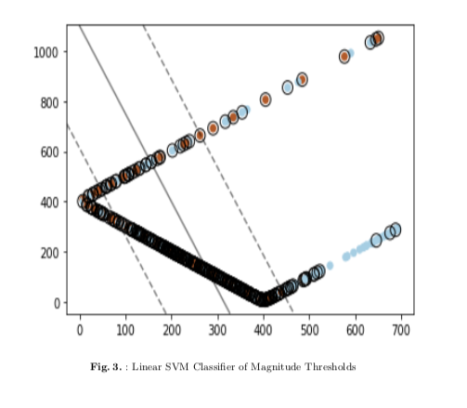
Models: Chosen Approach
Sensor Data
Threshold Analysis:
Max Acceleration Magnitude
K-means Clustering:
Create major/minor classes
Linear SVC
Classify Fall

Slide 14
Next Steps
Add a preprocessing step to separate the signal (such as a low pass or bandpass filter)
In previous research the AVC was used instead of magnitude, but we would apply a filter
Alternatively test PCA on triaxial sensors to extract prior to clustering instead of after
This will help test the weights of each axis
Create update step for threshold analysis

Slide 15
Questions?

