Slide 1
Signal Processing of Geospatial and Biometric Data from Wearable Devices for Fall Detection
Joseph Caguioa, Andy Nguyen, & Michael J. Wolfe
Advisor: Dr. Jackie Cheun

Slide 2
Motivation
In 2016 falls were the leading cause of injury-related deaths in seniors
~30,000 adults 65 years and older experienced fatal falls in 2016 with increasing death rates annually since 2007 in the U.S.
~ 646,000 reported globally
Falls are often associated with (strokes) or can result in life-threatening situations (TBI) that require immediate medical intervention for patient’s survival
Risk factors of advanced age: reduced activity/gait/balance, neurologic disease, other underlying medical conditions
Other risk factors: hazardous working conditions, substance abuse, socioeconomic factors (World Health Organization)

Slide 3
How can we optimize health outcomes by quickly diagnosing fall events?

Slide 4
Research Idea
Use sensor data (accelerometer and gyroscope) from wearable devices to detect falls and immediately dispatch paramedics to device’s GPS location
Algorithm should differentiate between actual falls and false positive events (activities of daily living, intentional falls)
Notes:
Waist and head are located on the axis of the human anatomy’s center of gravity

Slide 5
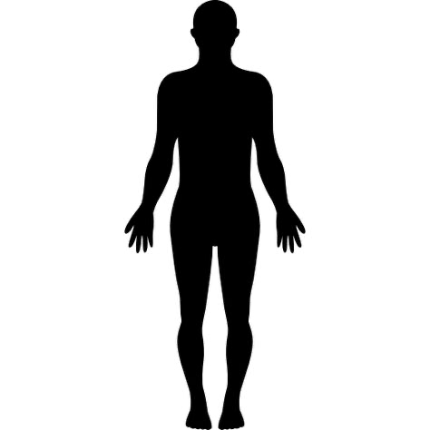
Waist and head are algorithmically preferred
Wrist is more practical for daily wear

Slide 6
Chosen Dataset
UP-Fall Detection dataset
Multiple sensors - we limited to wrist
17 subjects, 11 activities (6 ADLs, 5 falls), 3 trials
A trial is an activity period with a measurement each second for 10-60 seconds, sampling rate of 100 Hz for both sensors
559 trials total (2 trials missing for Subject 8, activity 11)

Slide 7
Past Research
A simple threshold model detects a fall and the results are applied to a Hidden Markov Models to differentiate between an actual fall and an activity of daily living (ADL)
Fall-Detection Algorithm Using 3-Axis Acceleration: Combination with Simple Threshold and Hidden Markov Model (Dongha Lim, Chulho Park, Nam Ho Kim, Sang-Hoon Kim, Yun Seop Yu): 2014
A simple threshold model is combined with a multiphase fall model (free fall, impact, and rest) as a solution to the technical challenges of differentiating a fall from ADL
Novel Hierarchical Fall Detection Algorithm Using a Multiphase Fall Model (Chia-Yeh Hsieh, Kai-Chun Liu, Chih-Ning Huang, Woei-Chyn Chu, Chia-Tai Chan): 2017
A 3-tier model architecture combining simple threshold models with machine learning algorithms to detect falls from smartphone sensors implemented in an Android application called uSurvive. The application runs as a background service to monitor activity and can automatically send notifications to authorities when a fall is detected.
An Energy-Efficient Multi-Tier Architecture for Fall Detection on Smartphones (M. Amac Guvensan, A. Oguz Kansiz, N. Cihan Camgoz, H. Irem Turkmen, A. Gokhan Yavuz, M. Elif Karsligil): 2017

Slide 8
Models
Our Model Approach:
Simple Threshold Model
Multiphase Fall Model
Test Combination of Different Machine-Learning Algorithms
Principal Component Analysis
Linear Discriminant Analysis
Support Vector Machines
Hidden Markov Model
Naïve Bayesian Classifier
Decision Trees
Random Forests
Undifferentiated Range of ADL as majority response

Slide 9
Potential Challenges
Wearable devices are the most common application of past algorithms
Single sensor placement limits the amount of spatial data that can be processed
Multiple sensors are more effective but less practical
Manufacturers of devices are protective of their data and algorithms

Slide 10
Models: Chosen Approach
Our Model Approach:
Simple Threshold Model
Multiphase Fall Model
Test Combination of Different Machine-Learning Algorithms
Principal Component Analysis
Linear Discriminant Analysis
Support Vector Machines
Hidden Markov Model
Naïve Bayesian Classifier
Decision Trees
Random Forests
Undifferentiated Range of ADL as majority response

Slide 11
Results
Tested a variety of kernels (linear, Gaussian, polynomial) in classification, as well as triaxial and magnitude threshold analysis
All classifiers were around 50% accurate except magnitude threshold analysis with linear SVC classification, which was 66% accurate

Slide 12
Models: Chosen Approach
3-phased approach:
Threshold Analysis - Acceleration Magnitude
K-Means Clustering
Linear Kernel SVC

Slide 13
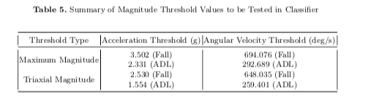
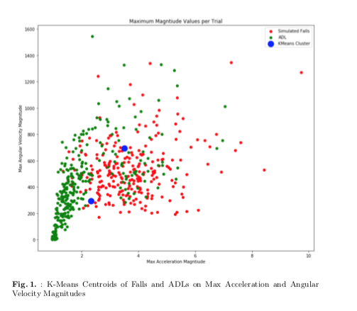
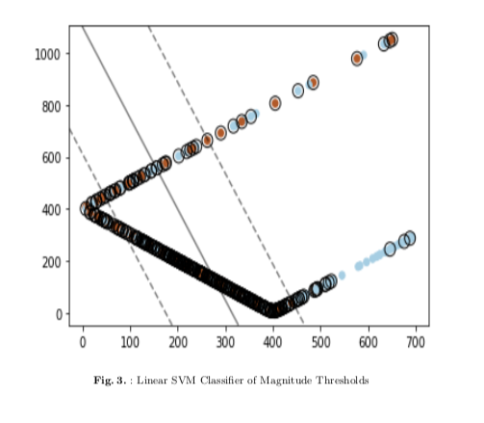
Models: Chosen Approach
Sensor Data
Threshold Analysis:
Max Acceleration Magnitude
K-means Clustering:
Create major/minor classes
Linear SVC
Classify Fall

Slide 14
Next Steps
Add a preprocessing step to separate the signal (such as a low pass or bandpass filter)
In previous research the AVC was used instead of magnitude, but we would apply a filter
Alternatively test PCA on triaxial sensors to extract prior to clustering instead of after
This will help test the weights of each axis
Create update step for threshold analysis

Slide 15
Questions?

