Slide 1
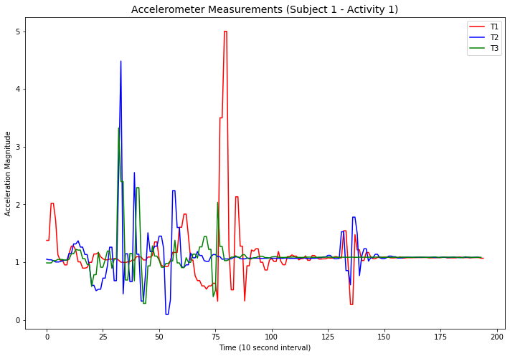
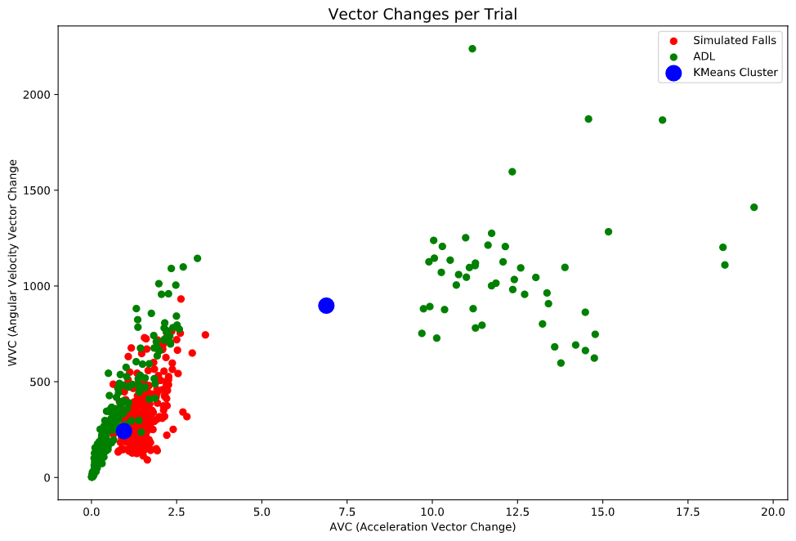
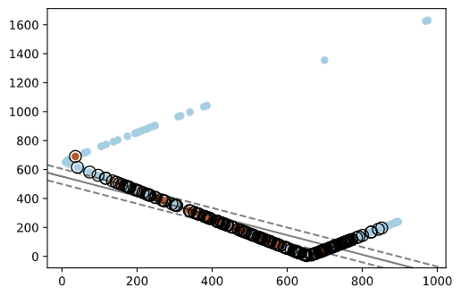


Fall Detection: Threshold Analysis of Motion Sensor Data
Joseph Caguioa, Andy Nguyen, Michael J. Wolfe
Advisor: Dr. Jacquelyn Chen
Master of Science in Data Science
Southern Methodist University, Dallas, TX 75275, USA
Introduction
Vector Change Feature
Falls can be a significant health hazard that may result in tissue damage, broken bones, and even death
The elderly (age≥65) are at greatest risk of falls
Many device manufacturers (i.e. Apple, FitBit, Garmin, etc.) have incorporated fall detection algorithms into wearable devices to address these hazards
Triaxial measurements from wrist accelerometer and gyroscope were used to extract a vector change feature from all activity trials
$$VC=\frac{\sum_{i=1}^{n}{|{ magnitude}_{i}}−{magnitude}_{i−1} |}{T_{n}−T_{0}}$$
$$magnitude= \sqrt{x^{2}+y^{2}+z^{2}}$$
Note: $T_{n}−T_{0}$ is the time interval of the activity’s experimental period
Main Topics
About 30,000 people above the age of 65 died from falls in 2016
This is an increase of nearly 31% over ten years, and could be as high as 45,000 in 2030
An effective and adoptable system of detection is necessary to curb this trend
Clustering
We used k-means to create 2 clusters: a majority class of all ADL’s, and a minority class of all fall types
Using the AVCs and WVCs we defined the clusters seen in the central diagram
There is good separation, but significant overlap with some trials
Problem
The most effective methods of fall detection use multiple body sensors to boost prediction accuracy, but is not a practical solution to be adopted for daily use by consumers
We aim to develop a model based on wrist-worn sensors, so that falls can be effectively detected in a popular device such as a wristwatch
SVC Classification
The centroid distance from the AVC clustering was used for SVC classification
We tested linear, Gaussian, and polynomial kernel
Visually a linear kernel made most sense, and this also generated the most accurate model
Summary
We settled on a threshold analysis approach, using k-means clustering to create class labels, and classify using SVC
We began by testing pre-processing methods discussed in related works, such as Acceleration Vector Changes
We then fed these vectors into the aforementioned pipeline to classify falls
Conclusions
Using k-means clustering to define class label thresholds from AVC and WVC values, our model generated 77.3% classification accuracy
Our algorithm is intended to be further integrated with GPS systems built into smartwatches to autonomously dispatch paramedics if the user is unconscious following a detected fall
Notes:
1

