Slide 1
Fall Detection: Threshold Analysis of Wrist-Worn Motion Sensor Signals
Joseph Caguioa, Andy Nguyen, & Michael J. Wolfe
Advisor: Dr. Jacquelyn Cheun

Slide 2
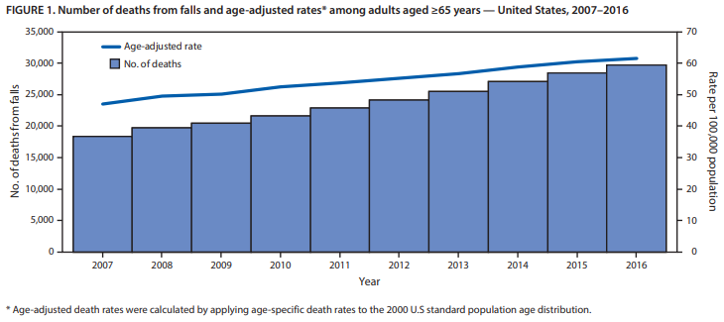
Death Rates from Falls Increasing Annually
Figure 1. Age-adjusted death rates in seniors (2007-2016). Adapted from “Deaths from Falls Among Persons Aged ≥65 Years,” by E. Burns, and R. Kakara, 2018, MMWR Morb Mortal Wkly Rep (67). P. 509-514.
Notes:
In 2016 falls were the leading cause of injury-related deaths in seniors, with an estimated 43,000 deaths due to fatal falls in 2030 if these current rates remain stable
adjusted-age death rates for this senior population have increased by 31% from 2007 to 2016
In 2016 falls were the leading cause of injury-related deaths in seniors
~30,000 adults 65 years and older experienced fatal falls in 2016 with increasing death rates annually since 2007 in the U.S.
The adjusted-age death rates for this senior population have increased by 31% from 2007 to 2016, with an estimated 43,000 deaths due to fatal falls in 2030 if these current rates remain stable
~ 646,000 reported globally
Falls are often associated with (strokes) or can result in life-threatening situations (TBI) that require immediate medical intervention for patient’s survival
Risk factors of advanced age: reduced activity/gait/balance, neurologic disease, other underlying medical conditions
Other risk factors: hazardous working conditions, substance abuse, socioeconomic factors (World Health Organization)
Reference: Burns E, Kakara R. Deaths from Falls Among Persons Aged ≥65 Years — United States, 2007–2016. MMWR Morb Mortal Wkly Rep 2018;67:509–514. DOI: http://dx.doi.org/10.15585/mmwr.mm6718a1

Slide 3
How can we optimize health outcomes by quickly diagnosing fall events?
Notes:
Novel fall detection systems have been developed to address these increasing mortality rates by swiftly identifying falls and providing immediate medical assistance.

Slide 4
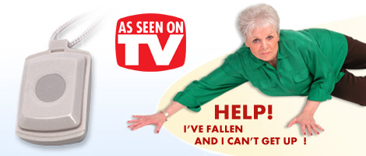
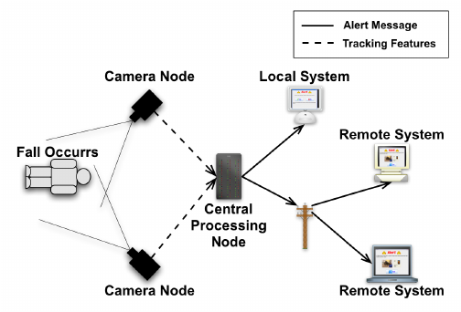
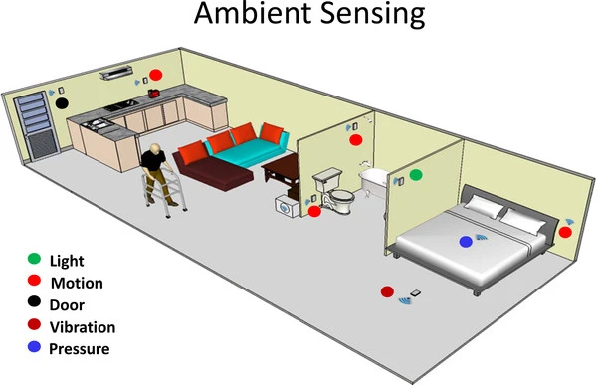
Fall Detection Systems
User-Activated Fall Detection
Autonomous Fall Detection
Notes:
Early fall detection systems such as life alert required a user-activated device such as a wrist-band or necklace to interface with an emergency help desk operator.
However, autonomous fall detection systems that can call for help even if the user is unconscious have since been introduced.
These autonomous systems can be categorized into: camera-based systems, ambient environment sensor-based systems, and wearable sensor-based systems.
Image Source (Life-Alert): https://maxvaluesmag.com/findit/business-directory/life-alert-parma-ohio/
Image Source (Camera-Based): https://www.researchgate.net/figure/The-fall-detection-and-alert-process_fig1_228783799
Citation: Williams, Adam & Xie, Dan & Ou, Shichao & Grupen, Roderic & Hanson, Allen & Riseman, Edward. (2010). Distributed smart cameras for aging in place.
Image Source (Ambient-Sensors): https://link.springer.com/article/10.1186/1743-0003-9-21/figures/5
Citation: Patel, S., Park, H., Bonato, P. et al. A review of wearable sensors and systems with application in rehabilitation. J NeuroEngineering Rehabil 9, 21 (2012). https://doi.org/10.1186/1743-0003-9-21

Slide 5
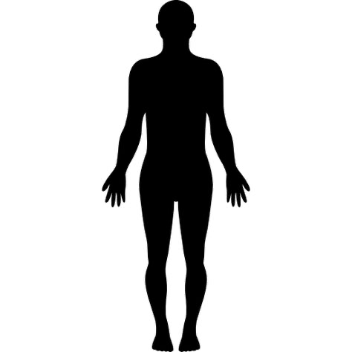
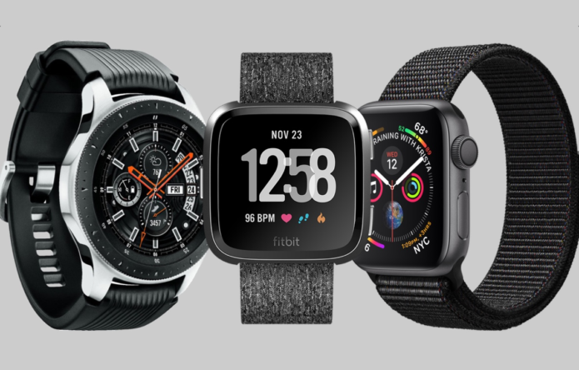
Fall Detection Using Wearable Wrist Sensors
Notes:
Our research focuses on optimizing a fall detection algorithm using wrist-worn sensors.
Previous search supports sensor placement on the axis of the human anatomy’s center of gravity, but is not practical for daily use.
motion sensors have been built into modern smartwatches that are heavily accessorized by the general public.
Prior research supports placing
Waist and head are located on the axis of the human anatomy’s center of gravity (algorithmically preferred)
Wrist is more practical for daily wear
The most effective methods of wearable fall detection systems use multiple body sensors to boost prediction accuracy, but is not a practical solution to be adopted for daily use by consumers
We aim to develop a model based on wrist-worn sensors, so that falls can be effectively detected in a popular device such as a smartwatch (Apple, Garmin, Fitbit)
Image Source (Smartwatches): https://gearopen.com/wearables/best-smartwatch-2019-july-update-on-the-top-tech-watches-124796/

Slide 6
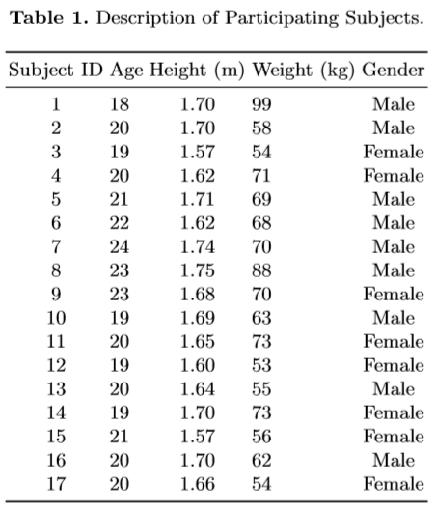
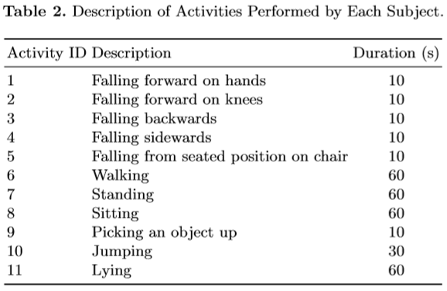
UP-Fall Detection Dataset
17 subjects (8 females, 9 males)
18-24 years old
average height = 1.66m
average weight = 66.8 kg
11 activities
Activity ID #1-5 are stimulated falls
Activity ID #6-11 are activities of daily living (ADL)
Notes:
We used a subset of the UP-Fall Detection dataset that only includes data from a triaxial accelerometer and gyroscope.
11 activities performed 3 times each. 5 of the activities are stimulated falls and 6 of the activities are activities of daily living. The activities were sampled in either 10, 30, or 60 second periods.
Both sensors were set to a sampling rate of 100 Hz.
The data was collected from a subpopulation of 8 females and 9 males ranging from 18-24 years old with average height of 1.66 m and average weight of 66.8 kg.
Multiple sensors - we limited to wrist
17 subjects, 11 activities (6 ADLs, 5 falls), 3 trials each
A trial is an activity period with a measurement each second for 10-60 seconds, sampling rate of 100 Hz for both sensors
559 trials total (2 trials missing for Subject 8, activity 11)

Slide 7
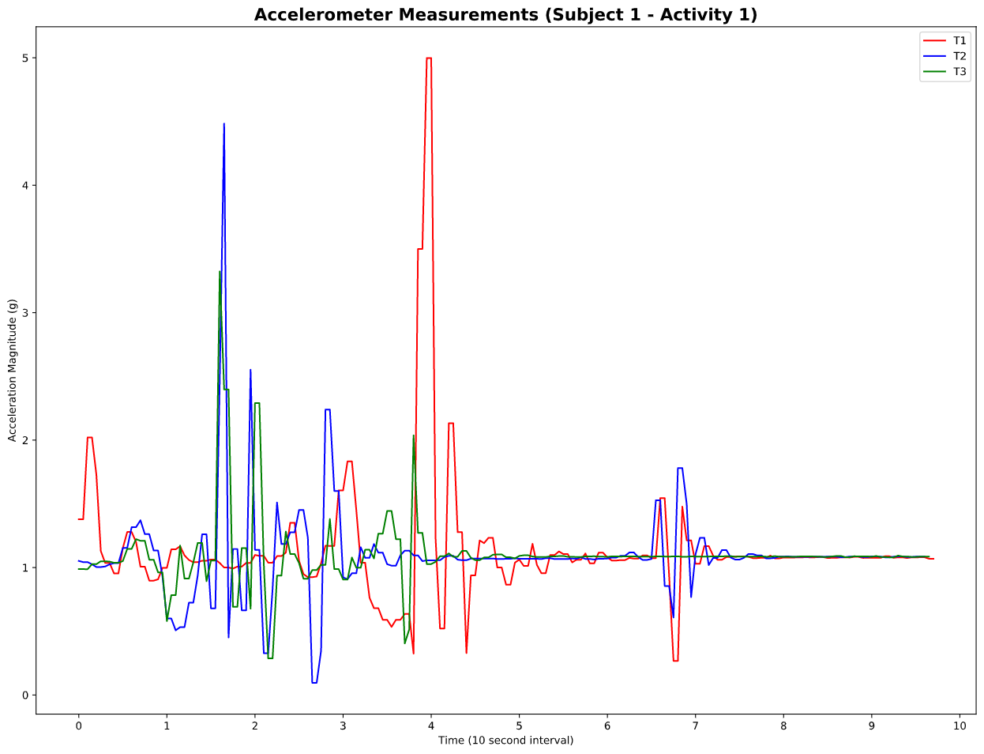
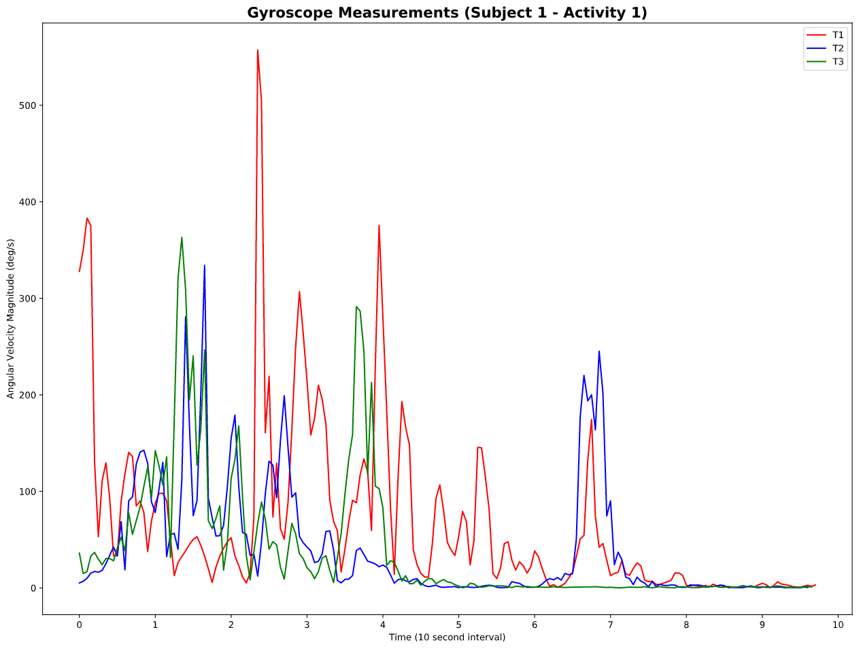

Triaxial Magnitude Vector Signals
$$magnitude =x^{2}+y^{2}+z^{2}$$
How do we best define threshold values to classify a fall?
Notes:
The triaxial signal measurements were processed into one magnitude vector signal for acceleration and another for angular velocity.
These magnitude signals were used to extract features that capture the accelerometer and gyroscope variation between falls and ADLs.
Since measurements for Trials 2 and 3 of Activity 11 for Subject 8 were missing, the final processed dataset consists of 559 instances representing each experimental trial.
Use sensor data (accelerometer and gyroscope) from wearable devices to detect falls and immediately dispatch paramedics to device’s GPS location
Algorithm should differentiate between actual falls and false positive events (activities of daily living, intentional falls)

Slide 8
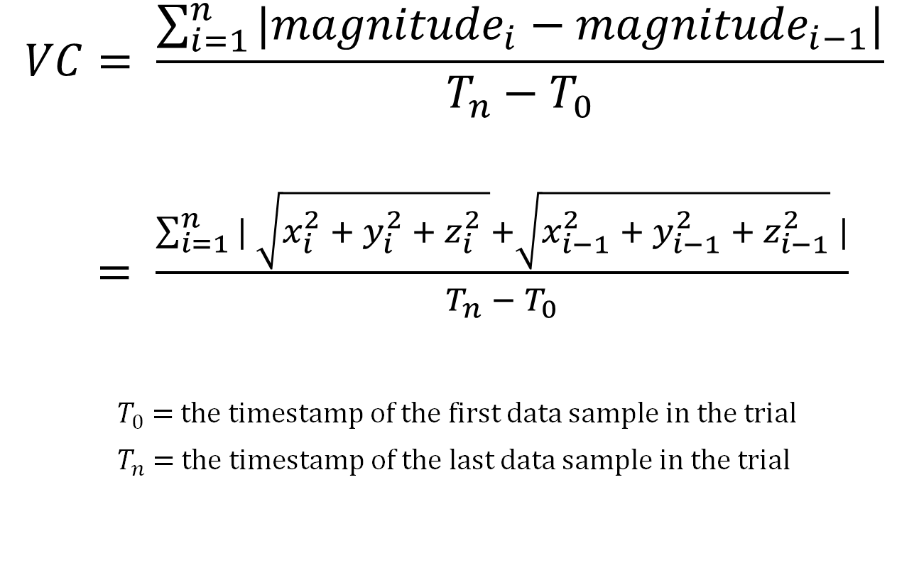
Vector Change Feature Extraction
$$VC= \frac{\sum_{i=1}^{n}{|{magnitude}_{i}−{magnitude}_{i−1}|}}{T_{n}−T_{0}}$$
$= \frac{\sum_{i=1}^{n}{| \sqrt{x_{i}^{2} + y_{i}^{2} + z_{i}^{2} }}+\sqrt{x_{i−1}^{2} + y_{i−1}^{2} + z_{i−1}^{2}} |}{T_{n} −{ T}_{0}}$
$T_{0}$ = the timestamp of the first data sample in the trial
$T_{n}$ = the timestamp of the last data sample in the trial
Notes:
Vector change value is a weighted sum of the signal differences in the time interval.
Our model assumes that falls are more intense motions than ADLs and are characteristic of greater vector changes in magnitude.
We found that the threshold values for distinguishing falls from activities of daily living were best defined by a vector change feature that is calculated d
Triaxial accelerometers and gyroscopes capture vector signals along a calibrated x, y, and z-axis. When the sensors are at rest, consecutive signal measurements will remain constant since no motion is experienced. These signals will change when motion is detected, with larger changes detected for more rigorous motions.

Slide 9
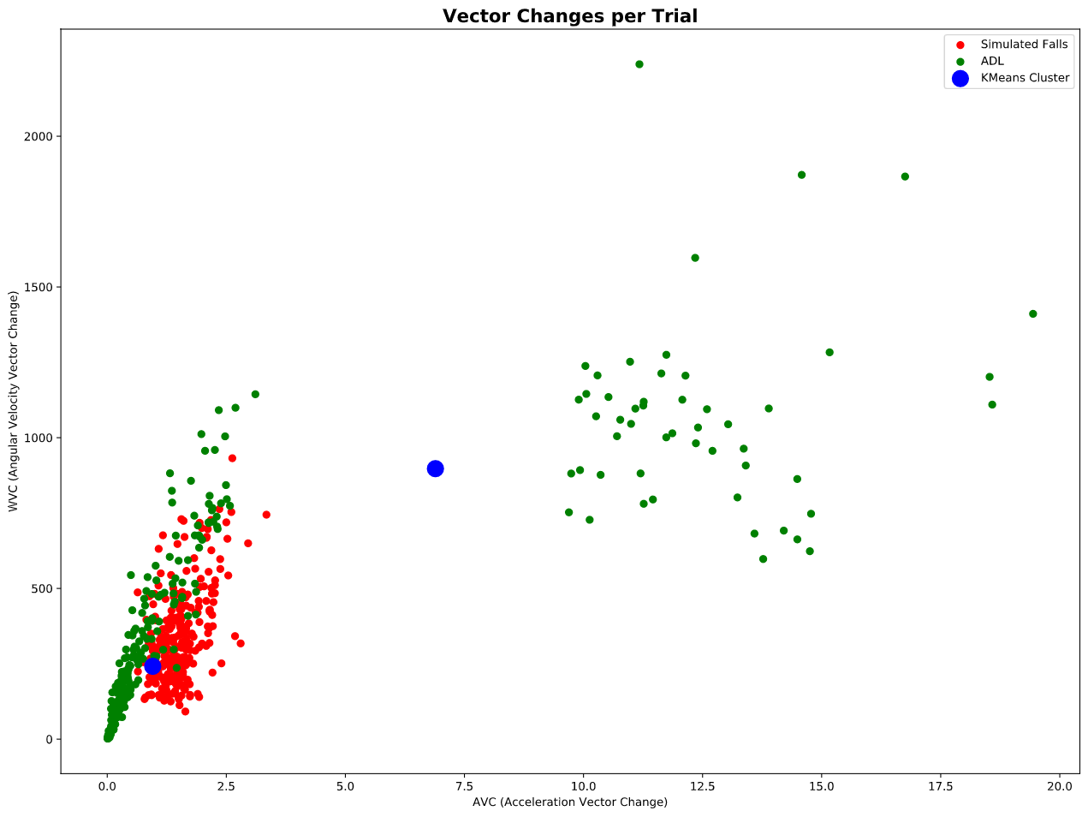
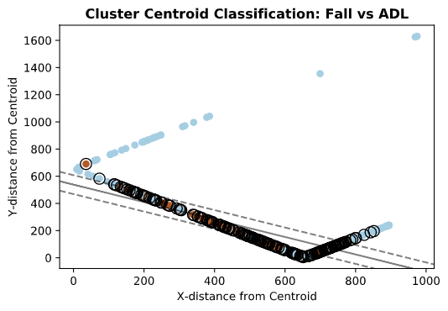
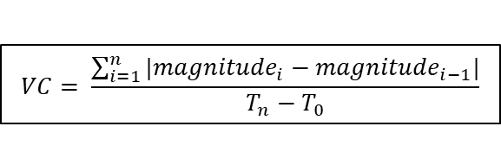
3-Phased Approach
Sensor Data
$$VC= \frac{\sum_{i=1}^{n}{|{magnitude}_{i}−{magnitude}_{i−1}|}}{T_{n}−T_{0}}$$
Threshold Analysis:
Vector Change Feature Extraction
K-means Clustering:
Create major/minor classes
Linear SVC
Classify Fall
Notes:
3-Phased Approach to developing our algorithm

Slide 10
Notes:
AVC = acceleration vector change
WVC = angular velocity vector change
We used k-means to create 2 clusters: a majority class of all ADL’s, and a minority class of all fall types
Using the AVCs and WVCs we defined the clusters seen in the central diagram
There is good separation, but significant overlap with some trials

Slide 11
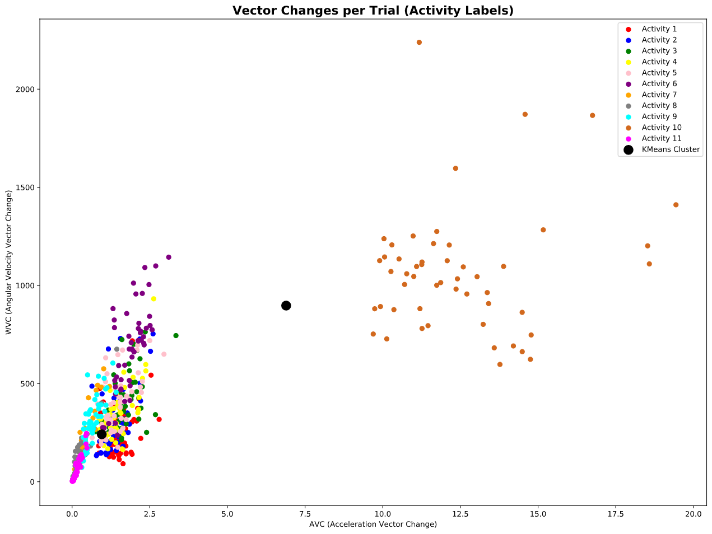
Notes:
Activity 10 skewed cluster centroids. Makes sense since jumping continuously will result in a large vector change value over time.
Highlights importance of selecting an optimal sampling window that can capture sudden, large changes in the motion sensors.

Slide 12
3-Phased Approach
Sensor Data
$$VC= \frac{\sum_{i=1}^{n}{|{magnitude}_{i}−{magnitude}_{i−1}|}}{T_{n}−T_{0}}$$
Threshold Analysis:
Vector Change Feature Extraction
K-means Clustering:
Create major/minor classes
Linear SVC
Classify Fall
Notes:
The centroid distance from the AVC clustering was used for SVC classification

Slide 13
Notes:
Final output of k-means cluster centroids applied to SVM classifier
Grouped around decision boundary but produces correct classification of events
We tested linear, Gaussian, and polynomial kernel
Visually a linear kernel made most sense, and this also generated the most accurate model
Linear SVM clustered around decision boundary
Brown dots: fall event
Blue Dots: ADL event

Slide 14
Results
Preprocessing | Classifier | Accuracy | Precision | Recall | F1-score
AVC/WVC | Linear | 78.4% | 74.2% | 82.8% | 78.3%
Max Magnitude Threshold | Linear | 67.0% | 63.8% | 69.0% | 66.3%
Max Magnitude Threshold | Gaussian | 58.9% | 58.5% | 43.7% | 50.0%
Linear kernel intuitively performs best given dimensions of our processed data
Model using acceleration (AVC) and angular velocity (WVC) vector change features performed best with 78.4% classification accuracy
Notes:
All classifiers were around 50% accurate except magnitude threshold analysis with linear SVC classification, which was 66% accurate

Slide 15
Pitfalls
Sub-optimal sampling window that did not capture sudden, large changes in motion
Falls occur in smaller window frames than experimental sampling periods (i.e. 10s, 30s, 60s)
Sensor sampling calibration
Inconsistent number of samples in different trials of same activity
Subpopulation tested was not representative of elderly population
Experimental population aged 18-24 years old
Notes:
Potential Challenges
Wearable devices are the most common application of past algorithms
Single sensor placement limits the amount of spatial data that can be processed
Multiple sensors are more effective but less practical
Manufacturers of devices are protective of their data and algorithms

Slide 16
Next Steps
Apply filters to improve signal processing when extracting Vector Change Feature
Our algorithm is intended to be further integrated with GPS systems built into smartwatches to autonomously dispatch paramedics
Threshold analysis should be used as a weak learner in an ensemble classification algorithm for fall detection
Notes:
Next steps to improve our current research is apply filters (such as a butterworth band-pass) to improve the magnitude signal processing into features
Our model is intended to be integrated with GPS systems built into smartwatches to dispatch paramedics to a specific location
Our threshold analysis model should be used as a weak learner in an ensemble fall classification algorithm that can better distinguish between specific classes of ADLs and falls

Slide 17
Questions?

Slide 18
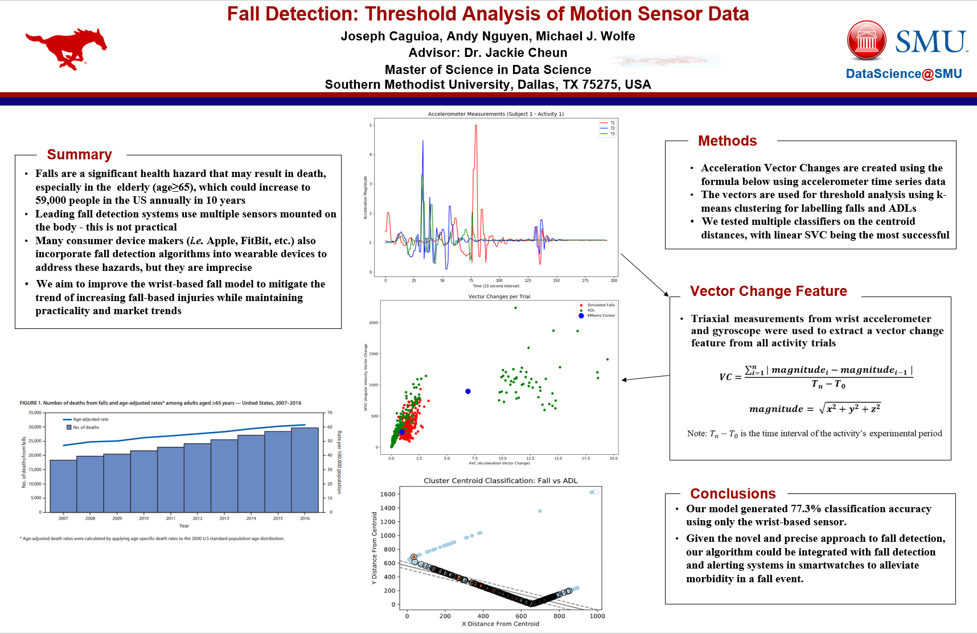

Slide 19
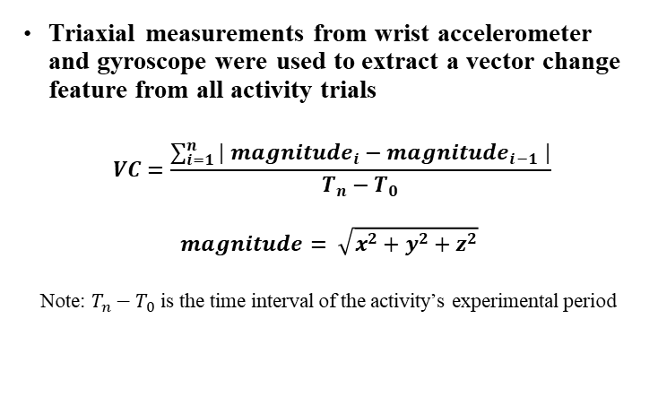
Models: Chosen Approach
3-phased approach:
Threshold Analysis – Vector Change Feature Extraction
K-Means Clustering
Linear Kernel SVC

Slide 20
Models
Our Model Approach:
Simple Threshold Model
Multiphase Fall Model
Test Combination of Different Machine-Learning Algorithms
Principal Component Analysis
Linear Discriminant Analysis
Support Vector Machines
Hidden Markov Model
Naïve Bayesian Classifier
Decision Trees
Random Forests
Undifferentiated Range of ADL as majority response

Slide 21
Models: Chosen Approach
Our Model Approach:
Simple Threshold Model
Multiphase Fall Model
Test Combination of Different Machine-Learning Algorithms
Principal Component Analysis
Linear Discriminant Analysis
Support Vector Machines
Hidden Markov Model
Naïve Bayesian Classifier
Decision Trees
Random Forests
Undifferentiated Range of ADL as majority response

Slide 22
Next Steps
Add a preprocessing step to separate the signal (such as a low pass or bandpass filter)
In previous research the AVC was used instead of magnitude, but we would apply a filter
Alternatively test PCA on triaxial sensors to extract prior to clustering instead of after
This will help test the weights of each axis
Create update step for threshold analysis

