Slide 1
Twitter Sentiment Analysis
DONIA TARJAM, MATTHEW YURICH, ALLISON DORION

Slide 2

Data Source
Kaggle
Twitter Emotion Analysis

Slide 3
Back End Development
Data Cleaning/Storing/Handling
Jupyter Notebook
SciPy, Seaborn
NLTK and SKLearn

Slide 4
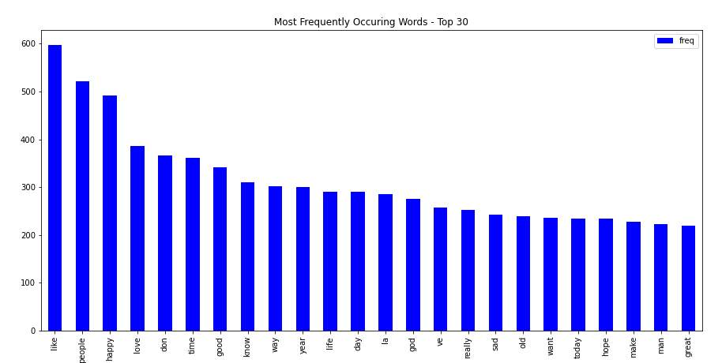
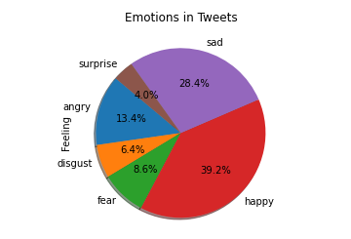
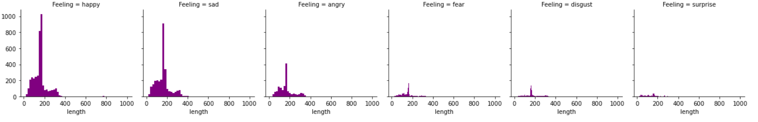
Analysis

Slide 5
Front End Development
GitHub Pages

Slide 6
Questions?

