Slide 1

SENG 696 Agent-based Software Engineering
Session 2a : Methodologies for agent-based analysis and design
Behrouz Far
Schulich School of Engineering, University of Calgary
far@ucalgary.ca
http://people.ucalgary.ca/~far/

Slide 2

Contents
Session 2-3 : Methodologies for agent-based analysis and design
A Methodology for Agent-Oriented Analysis and Design (GAIA)
MaSE
Tropos
Passi
Case studies
Comparison of development techniques

Slide 3
Course Curriculum
Overview of agent-based SE
Principles of
Object Technology
Methodologies for agent-based
analysis and design
Agent communication &
knowledge sharing
Other topics:
Agent Interaction,
Infrastructure, APIs,
Performance metrics,
Learning,
Self-organizing systems
etc.
Agent-based System
Architecture & Organization
FIPA: Foundation for
Intelligent Physical Agents
Agent-based System Implementation
using Jade
Agent-based System Quality
and Reliability

Slide 4
Multi Agent system Development
What do we need to develop an agent-based system?
Agent-based development methodology
How to analysis and design a multi-agent system?
e.g., GAIA, MaSE, Tropos, Prometheus, etc.
Agent-based development platform
How to implement a multi-agent system?
e.g., Jade, Spade, Jason, Jive, Aglets, etc.

Slide 5
Introduction (contd.)
Evolution of software engineering paradigms:
Assembly languages
Procedural and structured programming
Object Oriented programming
Component-ware
Design patterns
Software architectures
…
Software Agents
Languages that have their conceptual basis determined by machine architecture
Increase of
Complexity
time
Languages that have their key abstractions rooted in the problem domain

Slide 6
Why We Need This?
Several researchers have devised methodologies that has been specifically tailored to the analysis and design of agent-based systems. ← Collectively called Agent Oriented Software Engineering (AOSE) methodologies
Why we need this?

Slide 7
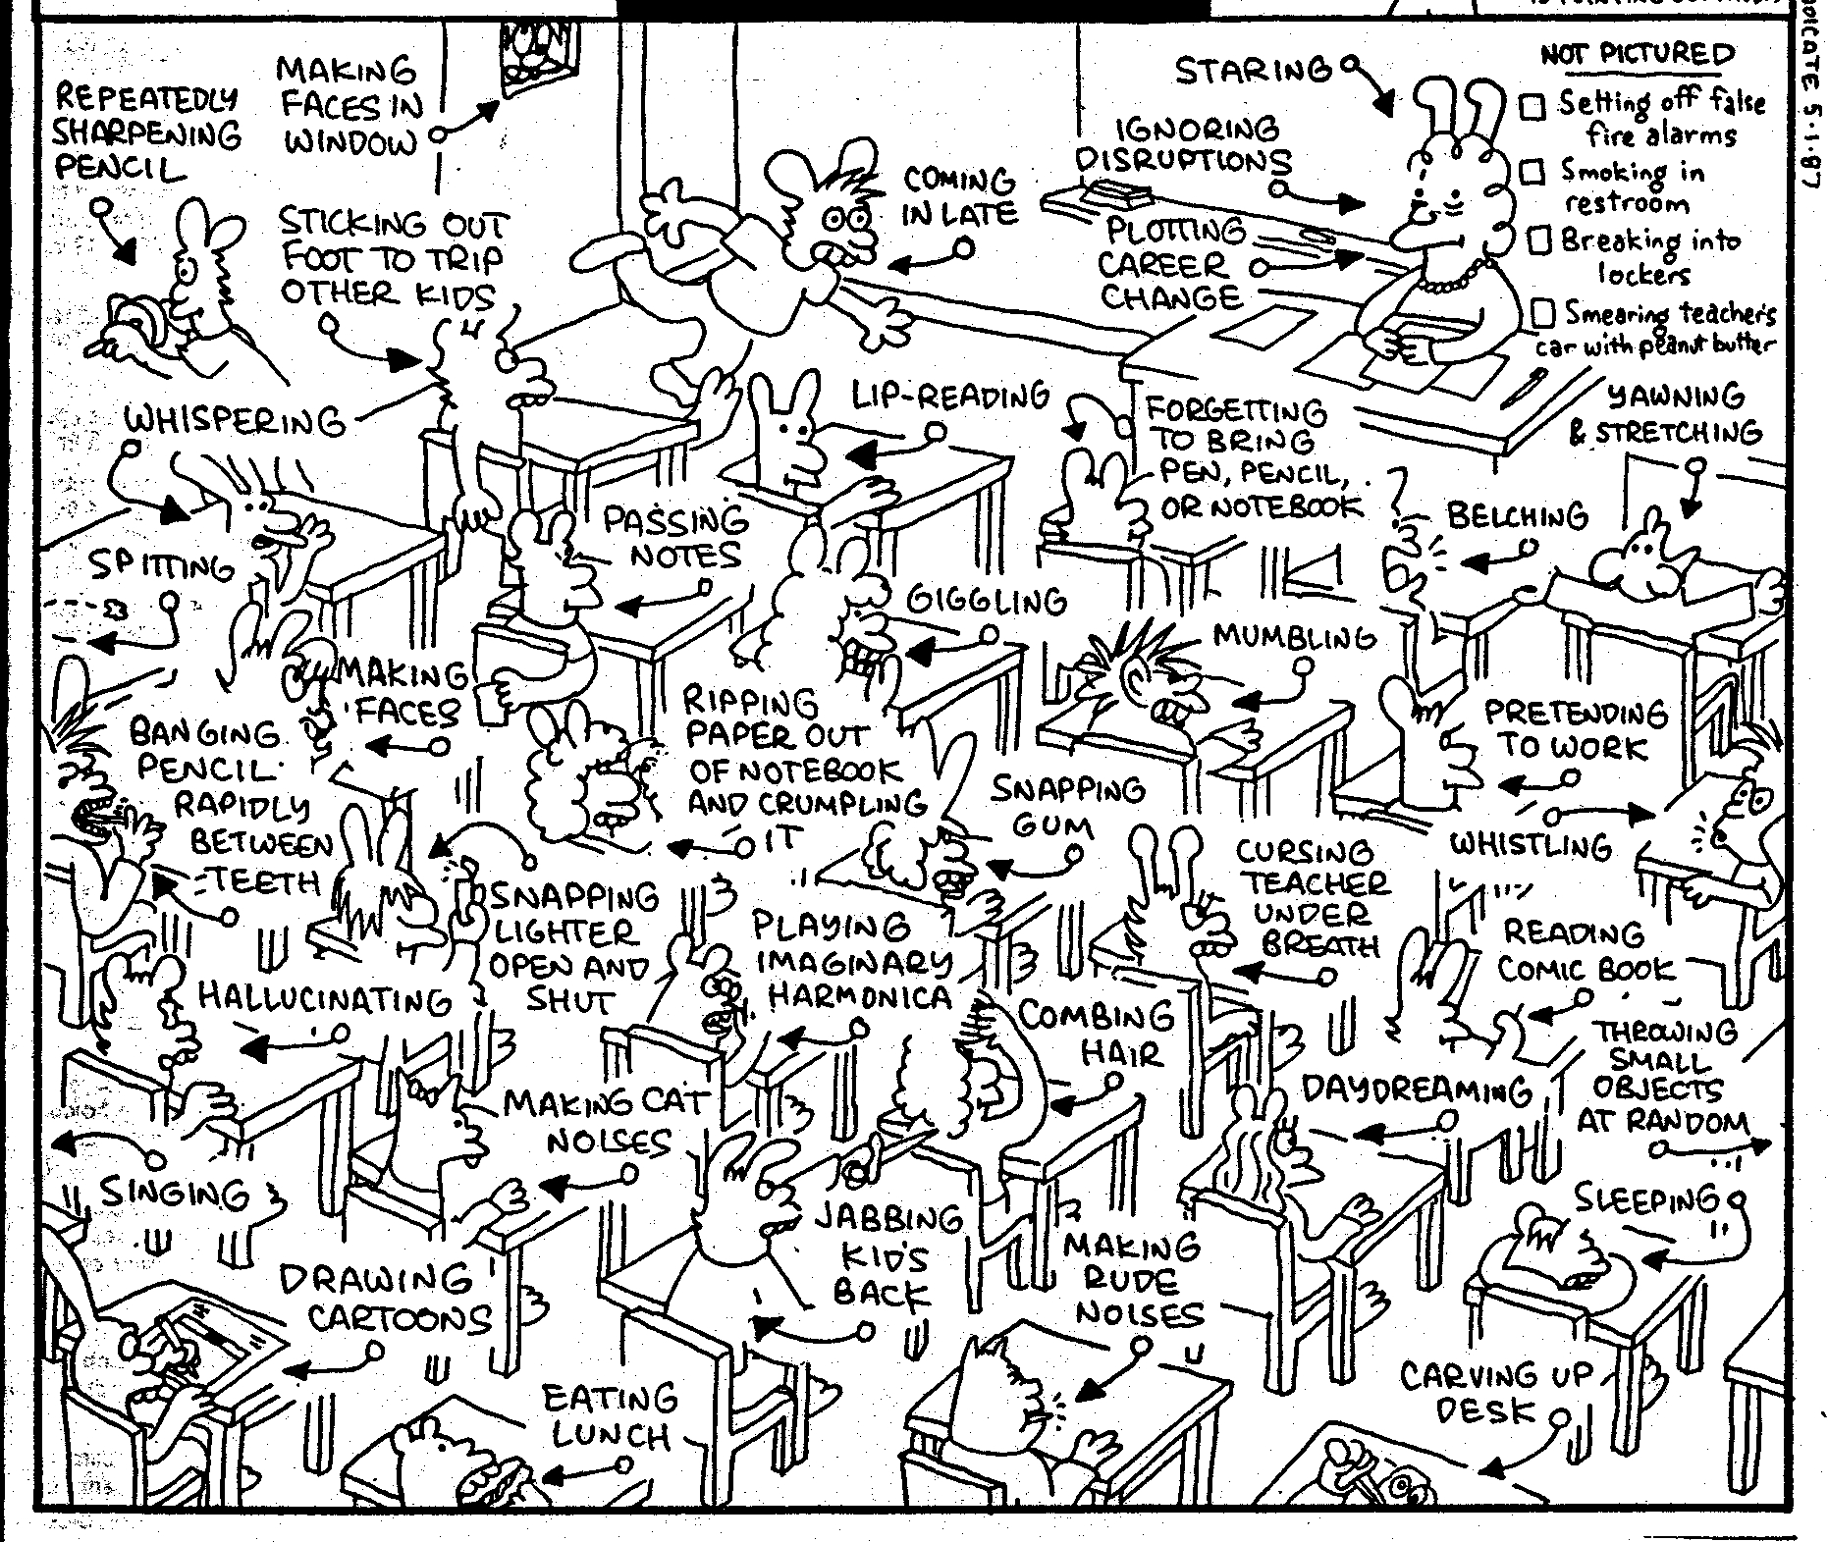
Why We Need This? (contd.)
The way Object Oriented systems are designed
Objects and their “pre-defined” interactions are designed
Behaviour is the result of objects interactions

Slide 8

Why We Need This? (contd.)
The way agent-based systems are designed
Agents, their “roles” in the society, “goals” and “possible” ways of interactions are defined
Behaviour is the result of agents interactions

Slide 9
Why We Need This? (contd.)
Existing software development methodologies are rather unsuitable for agent based software engineering tasks ← how to account for goal orientation and inter-actions?
Fundamental mismatch between the concepts used by object-oriented developers and the agent-oriented view. How to adequately capture
agents’ flexible, autonomous behaviour (problem-solving, goal-oriented)?
richness of agent interactions (higher level complex communication, collaborative problem solving)?
complexity of an agency’s organizational structures?

Slide 10
Simple Agent Model
Agent =
Set of States, S = {s₁, s₂, …, s_{n}}
Set of Events, E = {e₁, e₂, …, e_{m}}
Set of Actions, A = {a₁, a₂, …, a_{k}}
A transfer function, f
For each pair of (s,e) there is an action (a) to transfer to another (s)

Slide 11
Notes
Service oriented architecture (SOA) concepts can be used to design agents (swimlanes; interactions; messages; enterprise service bus ESB, etc.)
Through sensory data analysis (converting sensory info to events) can be used to make agents intelligent
In agent-based systems, data is not important anymore. Messages contain data that is processed locally

Slide 12
A Methodology for Agent-Oriented Analysis and Design: GAIA
Michael Wooldridge
Nicholas R. Jennings
David Kinny

Slide 13
Abstract
GAIA is a methodology for agent-oriented analysis and design. ← actually, just detailed analysis
GAIA methodology is concerned with how a society of agents cooperate to realize the system level goals, and what is required of each individual agent in order to do this.
The methodology is general. It is applicable to a wide range of multi-agent systems. It deals with both the macro-level (societal) and the micro-level (agent) aspects of systems.
The methodology is founded on the view of a system as a computational organization consisting of various interacting roles.

Slide 14
Introduction
Abstraction and autonomy are the key concepts
A common trend in software engineering: Need for powerful and natural abstractions with which to model and develop complex systems.
Examples so far: Procedural abstraction, abstract data types, and objects, are all examples of such abstractions.
Agents represent a similar advance in abstraction: they may be used by software developers to more naturally understand, model, and develop complex distributed systems.

Slide 15
Domain Characteristics
Agents are coarse-grained computational entities, each making use of significant computational resources (think of each agent as having the resources of a computational process)
It is assumed that the goal is to obtain a system that maximizes some global quality measure, but which may be suboptimal from the point of view of the system components
Agents are heterogeneous, in that different agents may be implemented using different programming languages and techniques
Agents can reside on different platforms but able to find and interact with each other

Slide 16
Conceptual Framework
The methodology is intended to allow an analyst to go systematically from a set of requirements to a design that is sufficiently detailed that it can be implemented directly
In applying the methodology, the analyst moves from abstract to increasingly concrete concepts
Each successive move introduces greater implementation bias, and shrinks the space of possible systems that could be implemented to satisfy the original requirements statement
The methodology encourages a developer to think of building software systems as a process of organizational design whose building blocks are software agents

Slide 17
Analysis Concepts
System
Role(s)
By means of?
What?
How?
Permission
Responsibility
Protocol
Liveness property
Safety property
(goal, utility)
(guards)

Slide 18
Abstract & Concrete Concepts
The concepts used by GAIA are split in two categories:
abstract: used in the analysis phase, that don’t necessary have a correspondent in the implementation of the system
concrete: concepts that typically have a correspondent in run-time system.
Abstract Concepts | Concrete Concepts
Roles | Agent Types
Permissions | Services
Responsibilities | Acquaintances
Liveness properties
Safety properties
Protocols
Activities

Slide 19

1. System = Society of Agents
The most abstract entity in the concept hierarchy is the system which is equivalent to society or organization of agents. That is, we think of an agent-based system as an artificial society or organization.
The idea of a system as a society is useful when thinking about the next level in the concept hierarchy: roles.

Slide 20
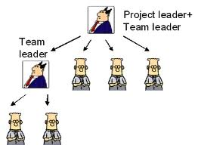
2. Role
Adopting an organizational view of the world: Think of a computer system being defined by a set of roles
Consider a human organization such as a typical company. The company has roles such as president, vice president, etc.
The roles will be instantiated with actual individuals: i.e., individuals take on the role of president, vice president, etc.
The instantiation is not necessarily static. E.g., throughout the company lifetime, many individuals may take on the role of company president.
A role is defined by three attributes:
responsibilities, permissions,
and protocols.

Slide 21
3. Responsibilities (What?)
Responsibilities determine functionality and are the key attribute associated with a role.
Example: a responsibility associated with the role of company president might be calling the shareholders meeting every year.
Responsibilities are divided into two types: liveness properties and safety properties.
Role
Responsibility
Liveness
Safety
Permission
Protocol

Slide 22

4. Liveness (Goal or Utility)
Liveness properties describe what must be achieved by a role under certain environmental conditions.
Example: increase profit for “seller” role. Minimize the price while getting the best quality for “buyer” role.
Responsibility
Liveness
Safety

Slide 23
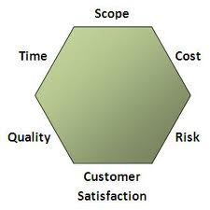
5. Safety (Guards)
Safety properties impose a number of constraints on the behavioural states of a role (i.e., that an acceptable state of affairs is maintained across all states of execution).
Example: Ensure liabilities
of the company are
always less than assets.
Responsibility
Liveness
Safety

Slide 24
6. Permissions = Rights
In order to realise responsibilities, a role is usually associated with a set of permissions.
Permissions are the rights associated with a role. The permissions of a role thus identify the resources that are available to that role in order to realize its responsibilities.
In typical systems, permissions tend to be information resources.
Examples:
Ability to retrieve a particular information; modify or delete another piece of information.
Ability to generate information.
Role
Responsibility
Permission
Protocol

Slide 25
7. Protocols (How?)
A role is also identified with a number of protocols, which define the way that a role can interact with the other roles in the system.
Example:
A seller role might have the protocols Dutch auction and English auction associated with it.
A hiring role of the president of a company is to conform to the hiring protocol (policies?).
Role
Responsibility
Permission
Protocol

Slide 26

Roles: how to find them?
Think of the system as a society
Think of possible scenario of system behavior and identify actors in them
Think of possible must do and must not do actions
Think of what is needed to do a task and what should be avoided
Think of possible interactions

Slide 27
How to Find Roles?
Use-Case Realization
(identified)
Supplementary
Specifications
Glossary
Software Architecture
Document
Use-Case Model
Roles
Actors
Use cases
Views:
Conceptual view
Module view
Code view
Execution view
Notes:
The following is a summary of the analysis activities that occurred during our project.
First of all, project requirements came to the analysis and design team by way of a use-case model for functional requirements and a supplemental specification for nonfunctional requirements. Since analysis is focused on “what” the problem is, the team worked strictly on modelling the functional requirements for the project.
The team used an architecture-centric process. The architect created a high-level view of the architecture focusing on the upper-level layers and identifying key abstractions. Next, the designers identified potential objects from the use-case model and categorized the different objects under class definitions. To aid the team in focusing on responsibilities for the classes, the team concentrated on identifying the classes with one of three analysis stereotypes: boundary, control, or entity. Once a set of candidate classes was identified, the team turned its attention to modelling the interaction of objects to carry out use-case behavior in collaboration diagrams. The collaboration diagrams could then be used to allow the team to identify the static structure of the classes involved in the use-case realization by the creation of a class diagram or View of Participating Classes (VOPC).
Review the activities that have occurred in analysis.

Slide 28
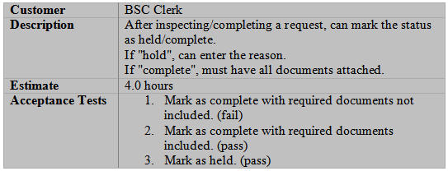
Case of Agile Development /1
Main source: User stories
Example:

Slide 29
Case of Req. Document
Example
Dr. X, a recent graduate from a medical university, is starting her medical practice in a small town. She is planning to hire a receptionist. She approaches software company Y to build a software system to manage the patients’ appointments. The following is her problem description (next two slides).
Suppose that you are the analyst in charge of developing this system.
What are the roles that you can identify?

Slide 30
Example (cont’d)
file
When a patient calls for an appointment, the receptionist will ask the patient’s name or patient’s ID number and will check the calendar and will try to schedule the patient as early as possible to fill in vacancies. If the patient is happy with the proposed appointment, the receptionist will enter the appointment with the patient name and purpose of appointment. The system will verify the patient name and supply supporting details from the patient records, including the patient’s ID number. After each appointment the Dr. X will mark the appointment as completed, add comments, and then schedule the patient for the next visit if appropriate.
input
output
query
Ask: Who is responsible for these?

Slide 31
Example (cont’d)
The system will answer queries by patient name, by patient ID and by date. Supporting details from the patient’s records are displayed along with the appointment information. The receptionist can cancel appointments. The receptionist can print out a notification list for making reminder calls 2 days before appointments. The system includes the patient’s phone numbers from the patient records. The receptionist can also print out daily and weekly work schedules with all the patients.
Actors:
patient? Receptionist? Doctor? DB?

Slide 32
Example (cont’d)
Type | Description | Actor/Role
Inputs | Patient name, Patient ID number, Appointment completed, Appointment purpose, Cancel appointment
Outputs | Comments, Calendar, Supporting details, Appointment Information, Notification List, Daily schedule, Weekly schedule,
Queries | Check calendar, Query by name, Query by ID, Query by date, Verify patient, Available Appointment
Internal files | Patients’ data record
External files | --

Slide 33
Analysis & Design Models
Requirements Statement
Analysis
Roles Model
Interactions Model
Agent
Model
Services Model
Acquaintances Model
Design
aka.
Detailed
analysis

Slide 34
1) Analysis Phase
The objective of the analysis phase is to develop an understanding of the system and its structure as a multi-agent organization. This understanding is captured in the system organization.
Organization is viewed as a collection of roles, that stand in certain relationships to one another, and that take part in systematic, institutionalised patterns of interactions with other roles.
To define an organization, it suffices to define the roles in the organization, how these roles relate to one another, and how a role can interact with other roles.
The analysis phase is comprised of two models:
Role model
Interactions model

Slide 35
Analysis: Roles Model
The roles model identifies the key roles in the system. Here a role can be viewed as an abstract description of an entity’s expected function.
Roles are characterised by two types of attribute:
The permissions/rights associated with the role
A role will have associated with it certain permissions, relating to the type and the amount of resources that can be exploited when carrying out the role. These aspects are captured in an attribute known as the role's permissions.
The responsibilities of the role
A role is created in order to do something. That is, a role has a certain functionality. This functionality is represented by an attribute known as the role's responsibilities.

Slide 36
Analysis: Permissions
The permissions associated with a role have two aspects:
They identify the resources that can legitimately be used to carry out the role, intuitively, they say what can be spent while carrying out the role;
They state the resource limits within which the role executor must operate, intuitively, they say what can be spent while carrying out the role.
In this method, in order to carry out a role, an agent will typically be able to access certain information (or other resources).
Some roles might generate information; others may need to access a piece of information but not modify it, and others may need to modify the information.

Slide 37
Analysis: Responsibilities
The functionality of a role is defined by its responsibilities. These responsibilities can be divided into two categories: liveness responsibilities and safety conditions.
Liveness responsibilities are so called because they tend to say that something will be done and hence that the agent carrying out the role is still alive.
Liveness responsibilities tend to follow certain patterns.
Example: The guaranteed response type of achievement goal has the form “request is always followed by a response”.
Liveness expressions define the potential execution trajectories through the various activities and interactions (i.e., over the protocols) associated with the role.

Slide 38
Analysis: Responsibilities
In many cases, it is insufficient simply to specify the liveness responsibilities of a role. This is because an agent, carrying out a role, will be required to maintain certain invariants while executing.
Example: We might require that a particular agent taking part in an electronic commerce application never spends more money than it has been allocated.
These invariants are called safety conditions, because they usually relate to the absence of some undesirable condition arising.
Safety requirements are specified by means of a list of predicates. These predicates are typically expressed over the variables listed in a role’s permissions attribute.

Slide 39
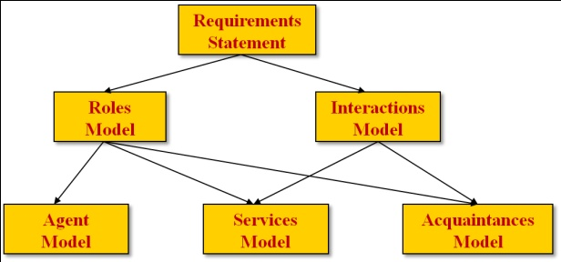
GAIA: Analysis Process
Identify the roles in the system.
Output: A prototypical roles model, a list of the key roles that occur in the system (may be informal, unelaborated at this stage)
For each role, identify and document the associated protocols. Protocols are the patterns of interaction that occur in the system between the roles.
Output: An interaction model, which captures the recurring patterns of inter-role interaction.
Using the interaction model as a basis, elaborate the roles model.
Output: A fully elaborated roles model, which documents the key roles occurring in the system, their permissions and responsibilities, and the protocols in which they take part.
Iterate stages (1)- (3).

Slide 40
Navigation Service System
Navigation
service
System?
Navigation service for tactical missions
Use-case: a user want to go from point A to B
Multi-Agent Dispatch System (MADS) provides various kinds of assistance for a fleet of vehicles
Exercise: Find roles
MADS Java Client
MADS Browser Client
Internet
Dispatch System Database
Dispatch System Agents
Internet
Standard Interfaces
SOAP
XML
WMS
Other
MapPoint Server
Services
Map Rendering
Routing
Geocoding
Other
GIS Data
Files
DBMS

Slide 41
Navigation Service System
Navigation service for tactical missions
Use-case: a user want to go from point A to B
Multi-Agent Dispatch System (MADS) provides various kinds of assistance for a fleet of vehicles
Exercise: Find roles
MADS Java Client
MADS Browser Client
Internet
Dispatch System Database
Dispatch System Agents
Internet
Standard Interfaces
SOAP
XML
WMS
Other
MapPoint Server
Services
Map Rendering
Routing
Geocoding
Other
GIS Data
Files
DBMS

Slide 42
Example: MADS System
Role: Geocode
Description: converts GPS location to a map element; wraps the MapPoint geocoding Web Services and it queries MapPoint for geocodes.
Role: Route
Description: It wraps the MapPoint routing Web Services and it queries MapPoint for routes.
Role: RenderMap
Description: It wraps the MapPoint map rendering Web Services and it queries MapPoint for maps.
Role: PersonalAssistant
Description: It acts on behalf of a system user. It gets the geocode information, maps and routes, and it calculates distances between the current location and available service providers.

Slide 43
Example (cont’d)
Permissions for RenderMap:
reads
MapPointWebServices
newMap // true or false
changes
notifyUser // true or false

Slide 44
Example (cont’d)
Liveness Property:
When the newMap is true, get a new map.
When the new map is ready, notify the user.
RENDERMAP = (RenderMap)
RENDERMAP = RequestMap.QueryMapPoint.RespondMap

Slide 45
Example (cont’d)
Safety Property:
Safety properties are specifies using a list of predicates in relationship with the variables listed in the role’s permissions attribute.
For the RenderMap role, a successful connection with MapPoint Web Services is the safety property.

Slide 46
Role Schema
GAIA roles model is composed of a set of role schemata for each role in the system with the following template
Role Schema |  | name of role
Description |  | short description of the role
Protocols and Activities |  | protocols and activities in which the role plays a part
Permissions |  | rights associated with the role
Responsibilities | Liveness | liveness responsibilities/properties
 | Safety | safety responsibilities/properties

Slide 47
Example: RenderMap
Role Schema |  | RenderMap
Description |  | Wraps the MapPoint map rendering Web Services and queries MapPoint for maps.
Protocols and Activities |  | QueryMapPoint, RequestMap, RespondMap
Permissions |  | reads MapPoint Web Services
Responsibilities | Liveness | RENDERMAP = (RenderMap) RENDERMAP = RequestMap.QueryMapPoint.RespondMap
 | Safety | a successful connection with MapPoint Web Services

Slide 48
Analysis: Interaction Model
There are dependencies and relationships between the various roles in a multi-agent organisation. Interactions need to be captured and represented in the analysis phase.
This model consists of a set of protocol definitions (mechanisms), one for each type of inter-role interaction.
A protocol can be viewed as a pattern of interaction that has been formally defined and abstracted away from any particular sequence of execution steps.
A single protocol definition will give rise to a number of message interchanges in the run time system.
Example: English auction protocol. This involves multiple roles (sellers and bidders) and many potential patterns of interchange (price announcements and corresponding bids). However at the analysis stage, such precise instantiation details are not necessary.

Slide 49
Analysis: Interaction Model
Protocol definitions consist of the following set of attributes:
Purpose: brief description of the nature of the interaction (e.g. Information request, schedule activity and assign task;
Initiator: the role(s) responsible for starting the interaction;
Responder: the role(s) with which the initiator interacts;
Inputs: information used by the
role initiator while enacting the
protocol;
Outputs: information supplied
by/to the protocol responder
during interaction;
Processing: brief description
of any processing the protocol
initiator performs during the
course of the interaction.
Purpose
Initiator role
Responder role
Inputs
Processing
Outputs

Slide 50
Example: Interaction Model
Protocol | RequestGeocode | RequestMap | RequestRoute
Purpose/ parameters | Request to geocode a location. The response includes the Latitude and Longitude of the location | Request a map containing a list of location. The response include the URL to the map that displays the locations | Request a route between two locations. The response includes the driving direction between the locations
Initiator(s) | PersonalAssistant | PersonalAssistant | PersonalAssistant
Receiver(s) | Geocode | RenderMap | Route
Processing | …… | …… | ……

Slide 51
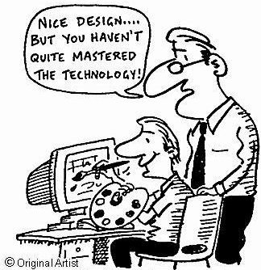
2) Design Phase
The aim of the design phase is to transform the analysis models into a lower level of abstraction that traditional design and coding techniques (e.g. object-oriented techniques) may be applied.
How an agent realizes its services and how it is implemented is beyond the scope of the methodology, and will depend on the particular application domain.

Slide 52
Analysis & Design Models
Requirements Statement
Analysis
Roles Model
Interactions Model
Agent
Model
Services Model
Acquaintances Model
Design
detailed
analysis

Slide 53
Design Models
The design process involves generating three models.
Agent model: identifies the agent types that will make up the system, and the agent instances that will be instantiated from these types.
Service (function or operation) model: identifies the main services that will be associated with each agent type.
Acquaintance (collaboration) model: documents the acquaintances for each agent type.

Slide 54

Design: Agent Model
The purpose of the agent model is to document the various agent types that will be used in the system, and the agent instances that will realise these agent types at run-time.
An agent type is composed of a set of agent roles.
There may in fact be a one-to-one correspondence between roles and agent types. However, this need not be the case. A designer can choose to package a number of closely related roles in the same agent type for the purposes of convenience.
The agent model is defined using a simple tree, in which root nodes correspond to agent types and leaf nodes correspond to roles, (as defined in the roles model).

Slide 55
Agent Model
AgentType1
AgentType2
*
2 . . 4
Role1
Role2
Role3
Qualifier | Meaning
n | there will be exactly n instances
m . . n | there will be between m and n instances
* | there will be 0 or more instances
+ | there will be 1 or more instances

Slide 56
Example: Agent Model
Geocode
RenderMap
Route
1
1
1
Geocode
RenderMap
Route
PersonalAssistant
*
PersonalAssistant
Legend
Agent types
Agent roles

Slide 57
Service Model /1
The aim of the services model is to identify the services associated with each agent role, and to specify the main properties of these services.
Service means a function or an operation of the agent. A service is a single, coherent block of activity that an agent will engage in.
In OO terms, a service would correspond to an operation (a method); however, the services may not be available for other agents in the same way that an object’s methods are available for another object to invoke.

Slide 58
Service Model /2
For each service that may be performed by an agent, it is necessary to document its properties. Specifically, we must identify the inputs, outputs, pre-conditions, and post-conditions of each service.
Inputs and outputs to services will be derived from the protocols model.
Pre-conditions and post-conditions represent constraints on services. These are derived from the safety properties of a role. By definition, each role will be associated with at least one service.
The services that an agent will perform are derived from the list of protocols and responsibilities associated with a role, and in particular, from the liveness definition of a role.

Slide 59
Example: Service Model
Service | Inputs | Outputs | Pre-conditions | Post-conditions
Geocode | Address | Latitude and Longitude of the Address | A personalized assistant agent is created and associated with the user | User enters an address
RenderMap | List of geocodes | URL to the map | A personalized assistant agent is created and associated with the user. The system does the proximity calculation
Route | Breakdown and service provider Location | Driving direction | A personalized assistant agent is created and associated with the user | User selects the service provider

Slide 60
Acquaintance Model
Acquaintance models define the communication links that exist between agent types. They do not define what messages are sent or when messages are sent. They indicate that communication pathways exist.
The purpose of acquaintance model is to identify any potential communication bottlenecks, which may cause problems at run-time. ← helpful when testing the system
An agent acquaintance model is a graph, with nodes in the graph corresponding to agent types and arcs in the graph corresponding to communication pathways.
Agent acquaintance models are directed graphs: A → B indicates that A will send messages to B, but not necessarily that B will send messages to A.

Slide 61
Example: Acquaintance Model
Geocode
RenderMap
Route
PersonalAssistant

Slide 62
Design Process
Create an agent model:
Aggregate roles into agent types, and refine to form an agent type hierarchy;
Document the instances of each agent type using instance annotations.
Develop a services model, by examining protocols and safety and liveness properties of roles.
Develop an acquaintance model from the interaction model and agent model.

Slide 63
Extensions (Future Works)
Dealing with truly open systems, in which agents may not share common goals (← liveness property). This class of systems represents the most important application area for multi-agent systems, and it is therefore essential that the methodology be able to deal with it. ← case of competition
Notion of an organizational structure: at the moment, such structures are only implicitly defined within the methodology via the role, interaction and acquaintance models. However, direct, explicit representations of such structures will be of value. Representing such structures may be the only way of adequately capturing and understanding the organization’s communication and control structures.

Slide 64
Critics
Evaluate the methodology along with the followings:
Roles vs. tasks
Emergent behaviour
Knowledge cycle
Interactions vs. intra-actions
Symbol level communication
Knowledge completeness
Indeterminism: Decision making
yes
n/a
no
yes
no (may be)
no
no

Slide 65
Evaluation /1
Concepts: abstract and concrete concepts are clearly defined. (Good)
Modeling constructs: uses a clear and consistent notation with a clear and defined syntax and semantics. None of the abstracts and concrete concepts or the models are in conflict and they can be interpreted unambiguously. (Good)
Scalability: Roles are not hierarchical. The role model provides strictly one level of abstraction for the developers to conceptualize the system. The methodology does not facilitate iterative refinement of the system through different levels of abstraction. As a result, GAIA does not scale up well to handle complex systems. (Poor)

Slide 66
Evaluation /2
GAIA does not have the ability to track dependencies between different models and the underling code used to implement them.
GAIA does not directly deal with particular modeling techniques or implementation details.
GAIA models do not specify what tasks are done in parallel, so it has a weak support for concurrency.
GAIA offers no mechanisms to model the dynamic reasoning, extension and modification of the social aspects at runtime.
GAIA assumes complete specification of requirements and does not address the requirement gathering phase.

Slide 67
Evaluation /3
Limited process life-cycle coverage: GAIA is intended to allow an analyst to go systematically from a statement of requirements to a design that is sufficiently detailed that it can be implemented directly, but ignoring implementation, testing/debugging, deployment and maintenance details.
Limited process management: GAIA does not address any management and/or cost estimation aspects involved in software development.

Slide 68
Evaluation /4
Formal semantics: GAIA does not have a formal semantics. A successful methodology is one that is not only of pragmatic value, but one that also has a well-defined, unambiguous formal semantics. While the typical developer need never even be aware of the existence of such a semantics, it is nevertheless essential to have a precise understanding of what the concepts and terms in a methodology mean.

Slide 69
Conclusions
GAIA is a “popular” methodology for analysis and design of agent-based systems.
The key concepts in this methodology are roles, which are associated with responsibilities, permissions, and protocols. Roles can interact with one another in certain institutionalised ways, which are defined in the protocols of the respective roles.

Slide 70
Case Study – Using GAIA
Online Examination Assistant System

Slide 71
Online Examination Assistant
Enable students to register with a valid college ID.
Allow the user to choose and schedule exams for the faculty and courses they are registered.
Allow students to appear for the exams on the scheduled date and time by logging with their user credentials.
Permit students to answer the exams in the stipulated time and provide a message 10 minutes prior to end of the exam.
Make results available immediately after the students submit their exam.
Allow the user to access the exam through the internet and support standard web browsers.
Exercise: Design the system using GAIA methodology

Slide 72
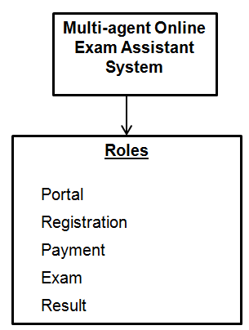
Role Model
Five roles are identified

Slide 73
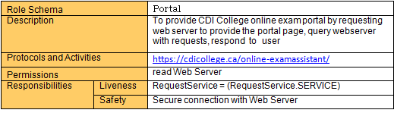
Role Schema
The student will launch the CDI portal from a web browser. The student will then be able to select the services provided by the multi-agent online-exam assistant. The services available will be to register for exams, make payment for the exam selected, appear for the exam on the selected date and time and view result of the exam
Notes:
The above Role Schema is the main schema for providing the CDI college web portal to a student. The student will launch the CDI portal from a web browser. The student will then be able to select the services provided by the multi-agent online-exam assistant. The services available will be to register for exams, make payment for the exam selected, appear for the exam on the selected date and time and view result of the exam..
When the Student selects a particular "SERVICE", the web page will send the RequestService for the "SERVICE" selected. The key "SERVICE" will have the value of either "Registration", "Payment", "Exam" or "Result". This we will refer to as key-value pair and the value in the key will provide the Role Schema to carry out the required tasks on its own using the property of the agent.
\

Slide 74
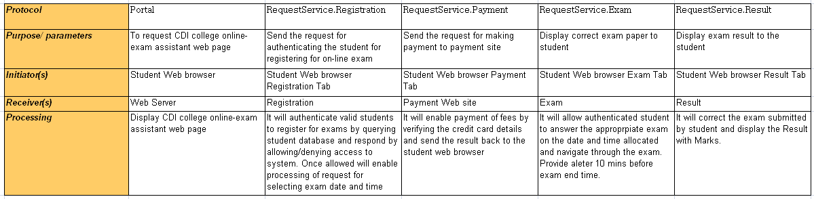
Interaction Model

Slide 75
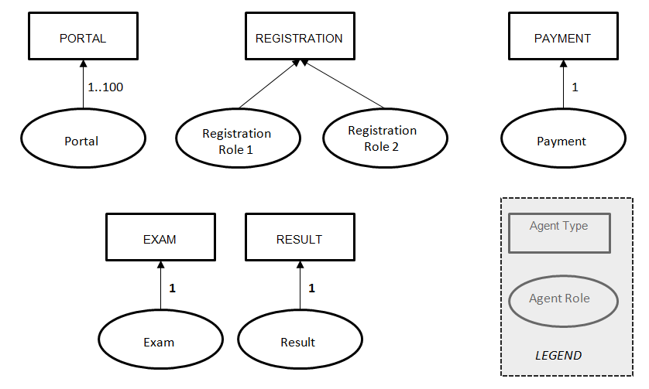
Design: Agent Model

Slide 76
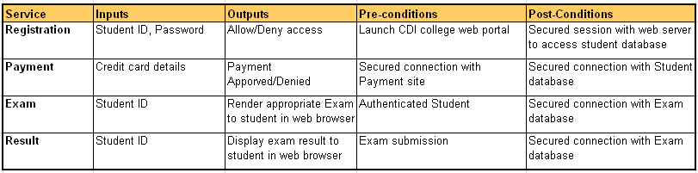
Design: Service Model

Slide 77
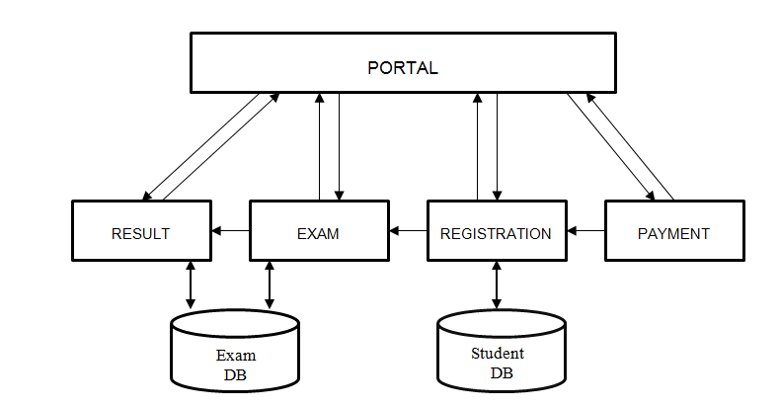
Design: Acquaintance Model

Slide 78
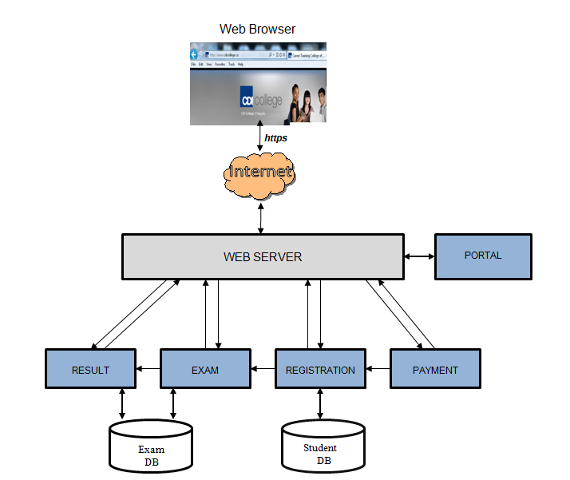
Overall System

Slide 79
Case Study – Using GAIA
Electronic Marketplace System

Slide 80
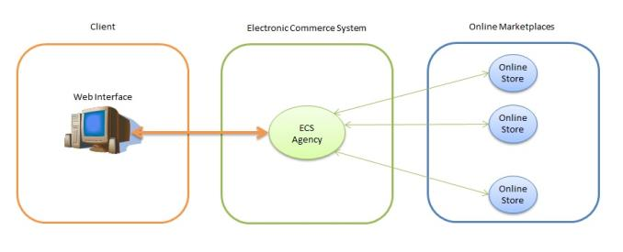
Electronic Marketplace
The Buyer registers, and defines its product requirements through the Web Based GUI.
The Seller defines its offered product specifications and posts it in online marketplace or online store.
The ECS system will be searching, evaluating the possible options as well as providing feedback to the client, and dealing with the negotiable deals if available.

Slide 81
Assumptions
The Buyer specifies:
What products
How many products
What quantity
What is the maximal acceptable price
Purchase Deadline
The Seller specifies:
What products
How many products
What quantity
Sale price
Additional conditions, if willing to negotiate the price

Slide 82
Analysis: Role Model

Slide 83
Analysis: Role Model

Slide 84
Analysis: Role Model

Slide 85
Analysis: Interaction Model

Slide 86
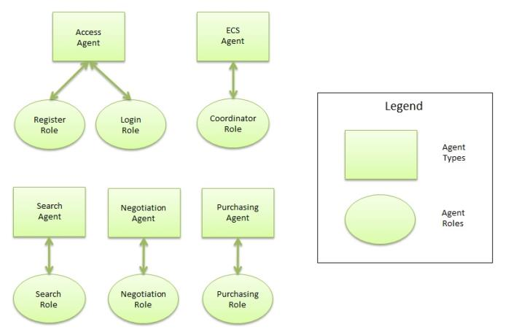
Design: Agent Model

Slide 87
Design: Service Model

Slide 88
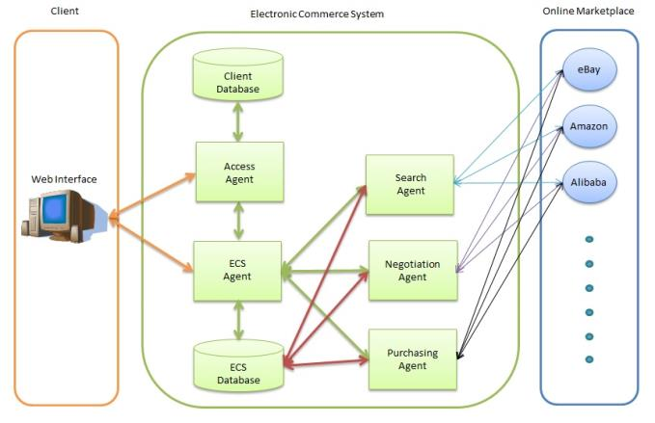
Design: Acquaintance Model

Slide 89
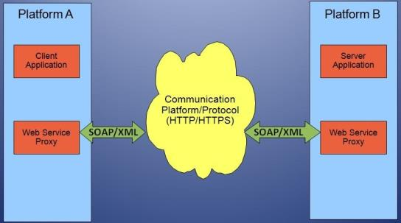
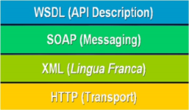
Design: Communication
Communication (external): SOAP - XML

Slide 90
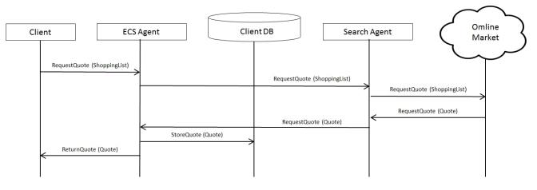
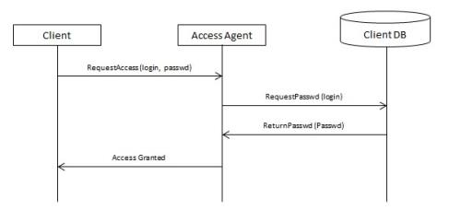
Design: Communication
Communication (internal): Message Sequence Chart

Slide 91
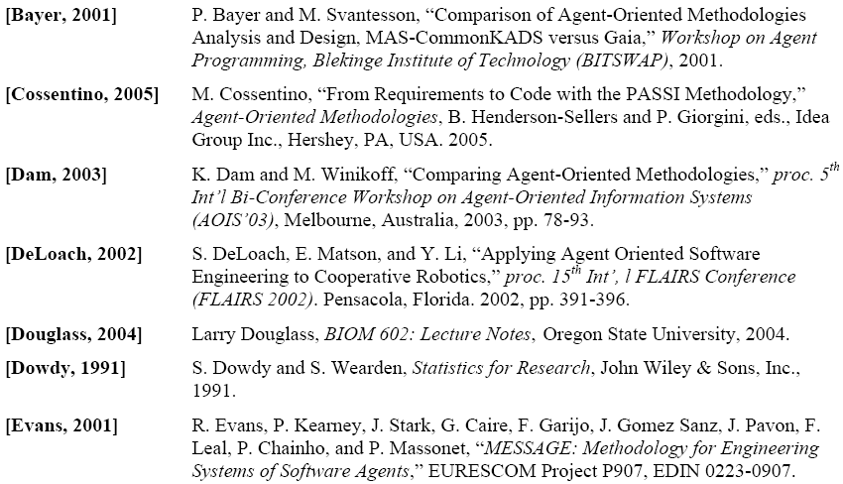
References /1

Slide 92
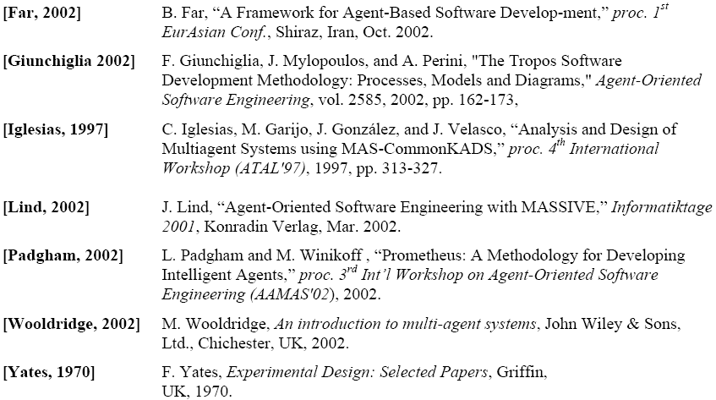
References /2

Slide 93
End of Part 1

