Slide 1
SENG 696 Agent-based Software Engineering
Sample Project :
Travel Agency System (TAS)
Behrouz Far
Schulich School of Engineering, University of Calgary
far@ucalgary.ca

Slide 2
Contents
Sample Project
System Specifications
Design Document
Detailed Design Document
Data Dictionary
Inter-Agents Messages

Slide 3
Travel Agency System (TAS)
System Specifications

Slide 4
1. Business Case
The travel industry is increasingly becoming internationalized. Airlines, accommodators and tour operators control the market, but these retailers face high costs in communication and personnel.
Communication is one of the main problems in the travel industry.
Many travel agents retain a great deal of information about their clients on individual preferences and do not share it with other agencies. Because this information translates into business, it is usually accessible only to individual travel companies, and not the industry as a whole. For example, airlines have their own portal where they offer travel packages to their customers on their fleet.

Slide 5
1. Business Case (cont’d)
The customers adopt the Internet travel sites model as a medium to purchase a travel package. Customers, usually looking for holiday packages, depend on their travel agent to show them what is available according to their taste and budget, or visit specific content providers, such as airlines, accommodators and car rental agencies.
The existing travel reservation systems only show the customer the different travel packages. The customer has to compare the different travel packages on his/her own and make his/her decision.
In this environment, intelligent agents have a great potential in helping the customer get the best ‘deal’ on a travel package and help him/her book the selected travel product.

Slide 6
2. System Description
The proposed Travel Agency System (TAS) is a multi-agent system designed to obtain travel packages for user depending on their preferences.
The travel package is composed of a flight ticket, a hotel accommodation, and a car rental.
The TAS application deals with multiple airline companies, hotels, and car rentals to find the optimum package for its user.
The application has to schedule the travel and proceed with the transactions related to the purchase of the travel package.

Slide 7
2. System Description (Cont’d)
USER
GUI
User Travel
Agency
Database
Travel Agency Agents
INTERNET
Flight Web Services
Hotel Web Services
Car Rental Web Services

Slide 8
3. Assumptions
The system maintains a user profile where each client has his or her own individual preferences, such as:
Hotel preferences (i.e., rating)
Car rental preferences (i.e., car model)
Period when the system shall search for a flight deal (e.g., every Sunday)
Period when the system shall remind the user of a flight departure (e.g., two hours before a flight departure).
The user requests a travel package through a user interface. The user interface captures the flight information. Hotel and car inputs are retrieved from the user profile, accordingly.
The user must book a complete package (flight, hotel and car rental).
There are already predefined web services on the Internet which the Travel Agency makes use of. These web services have the same WSDL description meaning their input and output messages have a standard syntax.

Slide 9
4. Requirements
The TAS shall provide flight, hotel accommodation and car rental enquiries.
The TAS shall deal with different airline, hotel and car rental companies.
The TAS shall verify the user schedule to schedule a travel.
The TAS shall book the flight, the hotel accommodation and the rental car upon the approval by the user.
The TAS shall send a memo to the user about the travel information and alert user before the flight. The period before which the system shall remind the user is specified in the user profile.
The TAS shall automatically enquire for flights depending on the user destination preferences and his/her flight booking history. The period when the system shall initiate an enquiry to get a flight ‘deal’ is specified in the user profile.

Slide 10
5. Wish List (Not Implemented)
The Travel Agency System shall allow a user book a flight, hotel, and a car rental separately.
Facilitates the setting of Insurance, Administration Charges, Confirmation and Cancellation policy, Vacation packages, international taxes or other related supplements.
During any booking any flight, car or accommodation unit is held off from the main inventory the moment it is selected, removing the possibility of overbooking from a multi-user system.
The System shall check the flight Web Service for any delay in flight departure and automatically alert user if any.
The Agents should use lookup services to locate Web services, and their selection of Web services should be based on trusted rating services.
The Travel Agency System shall allow the user choose a specific carrier and the connectivity cities.

Slide 11
Travel Agency System (TAS)
System Design Documents

Slide 12
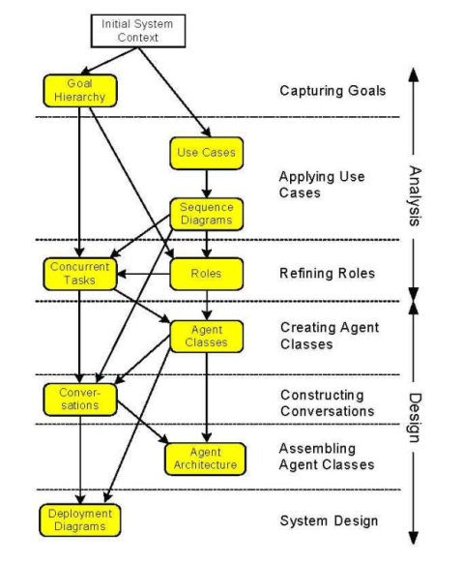
How to Proceed?
Follow the agent-based development methodology and create the analysis and design documents specified by the methodology.
Typical tasks include:
Goal hierarchy
Role identification
Agent system architecture
Agent description
Agent internal architecture
Requirements Statement
Roles Model
Interactions Model
Agent
Model
Services Model
Acquaintances Model

Slide 13
System Architecture
The way this system is envisioned to work is that there is a layer of multi-agent system in between the client (browser) and already existing Web Services.
The Web Services may come from one or more providers and they return the respective quotations of their service area to the agents based on client input and user profile.
The agents then try to sort the results in a way that the client gets the best price for the travel package and matches his/her time constraints.

Slide 14
Role Identification
What roles are required?
Personal assistance role
Scheduling role
Web-services handling roles: hotel, flight, car
Assign roles to agents

Slide 15
System Architecture (cont’d)

Slide 16
System Architecture (cont’d)
In this system we have the client submitting his/her request on an Internet browser interface. The main input screen is focused on the flight and retrieves only flight information from the user. Hotel and Car information are pre-stored in the TAS database as user preferences.
Any user that wants to use the Travel Agency System services has to create his/her own profile before hand.
The multi-agent system has to interact with Web Services to get the user a best ‘deal’ travel package, and with the user’s scheduler tool to schedule a travel and display the booked travel package information.

Slide 17
Agent Description
Travel Agent
The Travel Agent intercepts the request sent by the user through the Internet browser. In our architecture the Travel Agent handles the correspondence with all other agents and in this way we have a central point of delegation.
The Travel Agent requests flight, hotel rooms, and car rentals listings from the adequate agents and displays the different travel packages on the user’s Internet browser. Moreover, the Travel Agent requests from the Flight, Hotel, and Car Rental agents to book the respective travel package selected by the user (i.e. flight, hotel room, and car rental).
The Travel Agent generates a Memo that contains the information on the travel package, and sends it to the Scheduler Agent.
Finally, the Travel Agent has to trigger a search for a an automatic enquiry for a flight ‘deal’ based on the user flight history and period scheduled by the user stored in the TAS database.

Slide 18
Agent Description (cont’d)
Scheduler Agent
The Scheduler Agent communicates with the Travel Agent. Once the user has specified his/her flight date and time preferences the Travel Agent talks to the Scheduler Agent in order to check if the client schedule is free on that date and time. Instead of the customer checking his/her own schedule before making flight decisions the Scheduler Agent does that on behalf of the user.
The Scheduler Agent also handles conflicts in user appointments. Flight booking takes precedence over any low priority events. The user low priority events are rescheduled and the user is notified. If the user selects a flight offered by the TAS and a conflict is caused with a high priority event then the Scheduler Agent prompts the user to reschedule himself/herself his/her appointments.
The Scheduler Agent makes sure that the date and time is blocked in the user’s scheduler once the travel package is booked. Instead of the user blocking his/her calendar and scribbling the details of his/her travel, the Scheduler Agent takes on that responsibility and blocks the time and fills in all the details of travelling (flight, hotel and car).
The Scheduler Agent also triggers a reminder to alert the user about his/her departure date and airport arrival time based on the time the user wants to be notified (i.e. two hours before flight departure).
Finally, the Scheduler Agent displays the Memo sent by the Travel Agent on the user’s scheduler tool browser.

Slide 19
Agent Description (cont’d)
Flight Agent
As the name suggests this agent take the responsibility of making flight arrangements for the user based on the information he/she submitted through the Internet browser interface. It takes the inquiry request from the Travel Agent and then communicates with the predefined Flight Web Services on the Internet. The Flight Web Services offered by various providers return their quotations on the flight. The Flight Agent retrieves these responses, parses them, sorts them, and passes them to the Travel Agent, which then presents it to the user.
The Flight Agent is also responsible of booking the flight selected by the user. This is accomplished by getting all payment information from TAS database and then passes it to the Flight Web Service, which in turn returns the confirmation for the flight. The Flight Agent returns the flight confirmation number to the Travel Agent.

Slide 20
Agent Description (cont’d)
Hotel Agent
The Hotel Agent makes hotel room arrangements for the user based on his/her hotel preferences that are stored in the TAS database. It takes the inquiry request from the Travel Agent and then communicates with the predefined Hotel Web Services on the Internet. The Hotel Web Services offered by various providers return their quotations on hotel rooms. The Hotel Agent retrieves these responses, parses them, sorts them, and passes them to the Travel Agent, which then presents it to the user.
The Hotel Agent is also responsible of booking the hotel room selected by the user. This is accomplished by getting all payment information from TAS database and then passes it to the Hotel Web Service, which in turn returns the confirmation for the booked hotel room. The Hotel Agent returns the hotel room confirmation number to the Travel Agent.

Slide 21
Agent Description (cont’d)
Car Rental Agent
The Car Rental Agent makes car rental arrangements for the user based on his/her car rental preferences that are stored in the TAS database. It takes the inquiry request from the Travel Agent and then communicates with the predefined Car Rental Web Services on the Internet. The Car Rental Web Services offered by various providers return their quotations on car rentals. The Car Rental Agent retrieves these responses, parses them, sorts them, and passes them to the Travel Agent, which then presents it to the user.
The Car Rental Agent is also responsible of booking the car rental selected by the user. This is accomplished by getting all payment information from TAS database and then passes it to the Car Rental Web Service, which in turn returns the confirmation for the booked car rental. The Car Rental Agent returns the car rental confirmation number to the Travel Agent.

Slide 22
Agent Internal Architecture
Travel Agency System user
Interpreter
Listener
Web Services
Processor
Discovery Agent
Web Services
Web Services
Rendering Agent
Agent boundary

Slide 23
Agent Internal Architecture
Listener:
The Listener component listens to a port for any incoming requests from the TAS application.
Interpreter
The Interpreter parses and interprets the XML messages. We assume that all agents have agreed on a Document Type Definition (DTD).
Processor:
The Processor receives an XML document as an input. It uses the Interpreter to parse the document, and calls the appropriate function to run a process.
Discovery Agent:
The Discovery Agent provides the service discovery base-service (a superset of UDDI). May be implemented as an external service.
Rendering Agent:
The Rendering Agent is optional; it can be used by the Processor to render data before sending it back to the calling function. May be implemented as an external service.

Slide 24
Technology Overview
Approaches to Service Discovery
Two categories of information must be discovered before a service is used:
Logical information
Technical information
The logical information provides a description of the nature of the service, such as business information.
The technical information describes the interface parameters of the logic that drives the service. Technical information, such as the exact protocol that the service uses, the inputs and outputs, and the encoding of messages, form a crucial part in machine-to-machine conversation.

Slide 25
Technology Overview
Approaches to Service Discovery
A service must be visible to be discovered. In much the same way businesses list themselves in directories, such as the yellow pages, and mount signs on their entrances describing the nature of their business, Web services must provide short descriptions (on the Web) of themselves.
Roughly, there are three major ways by which Web services can be described and, consequently, discovered:
Universal Description, Discovery, and Integration (UDDI) and Web Service Description Language (WSDL), the yellow pages approach
World Web Wide Consortium’s (W3C) Resource Description Framework (RDF), the sign mounting approach
JINI discovery, the Java code discovery approach

Slide 26

First Assignment Summary
Your First assignment document should include what has been described so far
Your Second Assignment shall include what comes hereafter

Slide 27
Detailed Design
Use cases and use case definition for all the participating agents should be documented.
This includes
Use Case for Travel Agent
Use Case for Scheduler Agent
Use Case for Flight Agent
Use Case for Hotel Agent
Use Case for Booking Car Agent

Slide 28
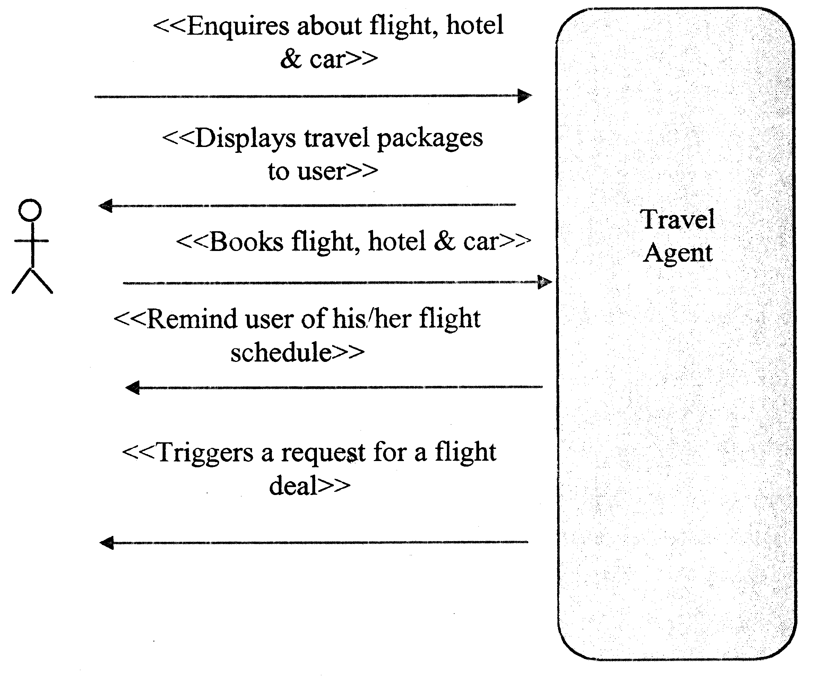
Use Case: Travel Agent

Slide 29
Use Case Def. : Travel Agent
Brief Description: | The Actor uses this use case to request and book a travel package.
Precondition(s): | User Profile is created before providing any service.
Post condition(s): | If all the business rules are successfully met, than actor will be able to avail the facilities provided by the travel agency
Process Steps
1 | Actor makes a request for travelling by providing date for departure, departure location, arrival location, one way or two way, date of return, business class or economy class through a browser interface.
2 | Travel Agent collects the user preferences for Hotel and Car Rental from user profile.
3 | Travel Agent requests from Scheduler Agent to check schedule availability and manage conflicts if any (described in U002)
4 | Travel Agent requests from Flight Agent to get a list of proposed flights from Flight Web Services.
5 | Travel Agent requests from Hotel Agent to get a list of proposed hotels Hotel Web Services.
6 | Travel Agent request from Car Rental Agent to get a list of proposed car rentals from Car Rental Web Services.
7 | Travel Agent displays list of proposed flights, hotels, and car rentals on user’s browser.
8 | Actor selects a flight, hotel, and a car rental from the proposed list on his/her browser.
9 | Travel Agent requests from Flight, Hotel, and Car Rental Agents to respectively book flight, hotel and car rental.
10 | Travel Agent generates a Memo composed of travel package information and confirmation numbers and sends it to Scheduler Agent.

Slide 30
Use Case Def. : Travel Agent
Exceptions
1a | System is not accessible at this point | Error message is generated stating that System is not accessible at this point. Use Case Terminated
4a | System can not find the flight other than waiting list ones | Message is generated, Use Case Terminated. In this phase of design we are only considering the flights that are fully open.
Relationships:
Initiating | Actor
Collaborating | Scheduler Agent, Flight Agent, Hotel Agent, Car Rental Agent
Other Diagrams:
Data Requirements
Data Required: | Data required for Travel Agent: Flight information Hotel and Car rental preferences Memo that contains information and confirmation number of flight, hotel and car rental booked

Slide 31
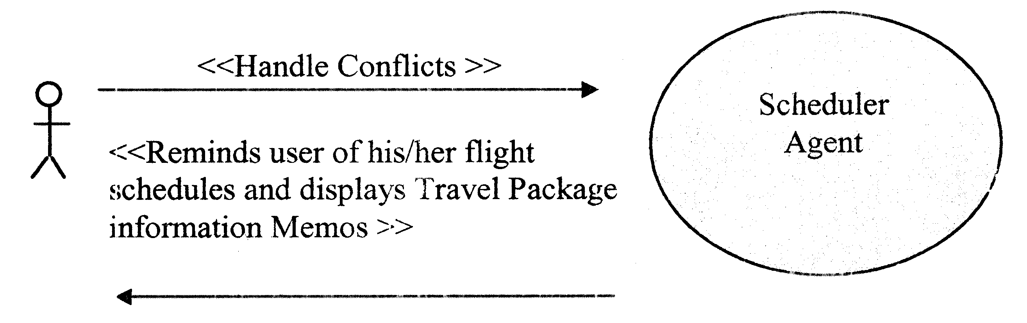
Use Case: Scheduler Agent

Slide 32
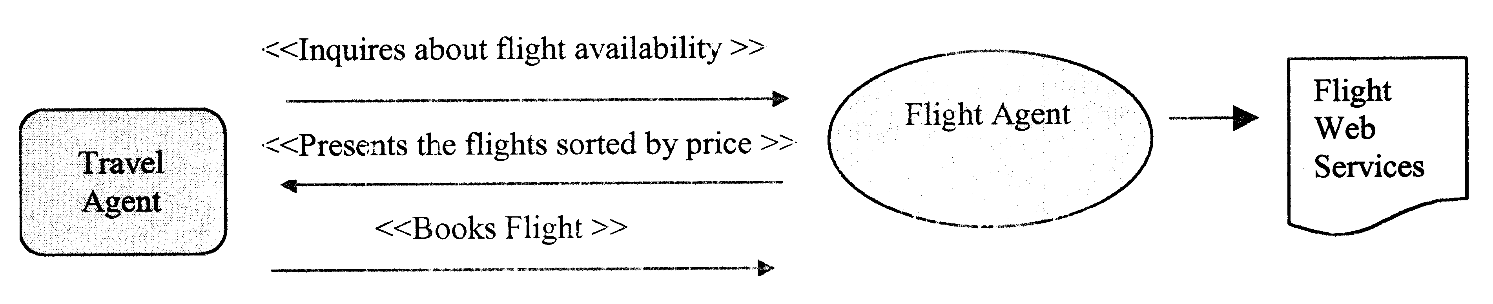
Use Case: Flight Agent

Slide 33
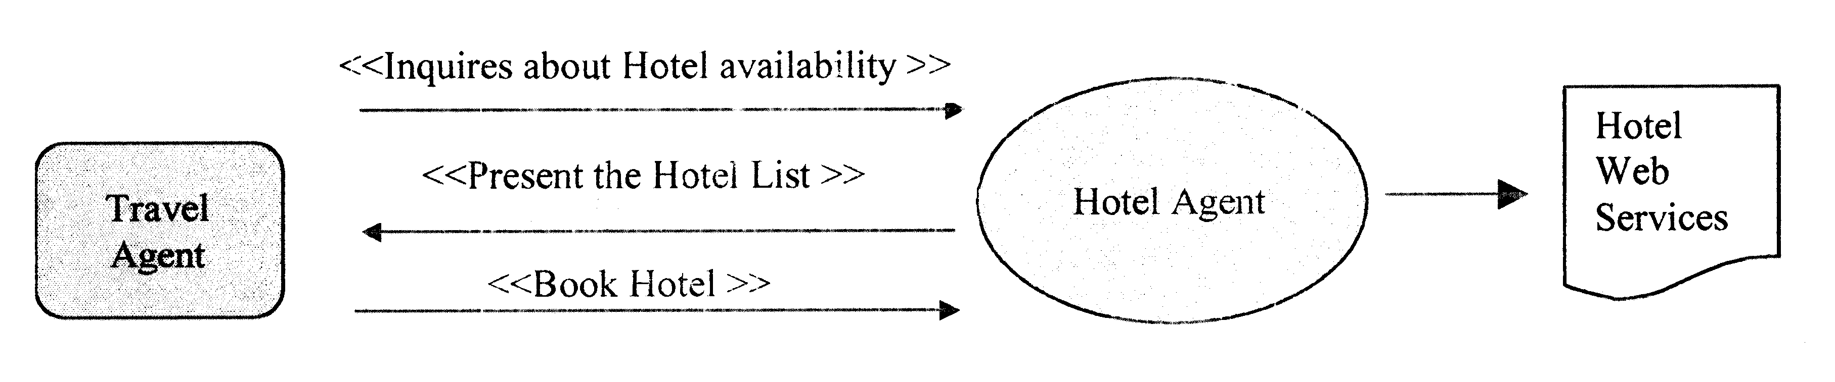
Use Case: Hotel Agent

Slide 34
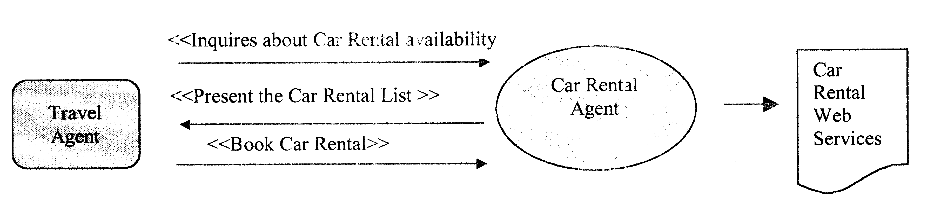
Use Case: Car Booking Agent

Slide 35
Detailed Design
Detail design (class diagram and message sequence chart) for each agent participant should follow.
Modularization of the internal architecture will help and save a lot of time!

Slide 36
Data Specification
TAS: E-R Diagram

Slide 37
Typical Data Definition
Flight:
The information of a flight booked by a user is stored in the Flight table. This table is also accessed by the TAS to get the user’s flight history.
Field | Description | Type
Flight_ID | Unique ID | Long
Flight_No | Flight number | Long
Departure_Calendar_ID | Departure date and time from origin | Calendar
Arrival_Calendar_ID | Arrival date and time to destination | Calendar
Departure_Location | Departure location | Varchar (50)
Arrival_Location | Arrival location | Varchar (50)
Trip_Type | 1=One way / 2= Round trip | Integer
Class_Type | 1=First class / 2=Business/ 3=Economy | Integer
Airline | Airline company name | Varchar (50)
Rate | Flight fee | Float

Slide 38
Inter-Agents Messages
As discussed in the Design document, SOAP will be used as a protocol of communication between agents and between agents and Web services.
The input and output parameters of each function introduced below has an XML format.
These XML documents map the data structure defined in the Data Dictionary document.

Slide 39
Get Flight
Input parameters
Parameter | Description
<flight> <departureLocation> String </departureLocation> <departureDate> String </departureDate> <arrivalLocation>String</arrivalLocation> <arrivalDate>String</arrivalDate> <tripType>String</tripType> <classType>String</classType> </flight> | User’s Flight Related Information

Slide 40
Get Flight
Output parameters
Parameter | Description
<flights> <flight> <flightID>n</flightID> <flightNo>String<FlightNo> <departureLocation> String </departureLocation> <departureDate> Calendar </departureDate> <arrivalLocation>String</arrivalLocation> <arrivalDate>Calendar</arrivalDate> <tripType>String</tripType> <classType>String</classType> <airline>String</airline> <rate>Float</rate> </flight> . n . </flights> | List of all available flights

Slide 41
Inter-Agents Messages
Similar descriptions for
Book Flight ; Get Hotel Room ; Book Hotel Room ; Get Car Rental ; Book Car Rental ; and Send Memo
should be generated.

Slide 42
Code and Demo
Use Jade (or Spade) to implement the designed system
Use Git to share code-base with the TA and course instructor
Virtual demo: Book an appointment and demo the working version of your developed system

Slide 43
Second Assignment Summary
Your Second assignment document should include what has been described so far

Slide 44
Documents Required
Assignment 1:
System overall specification
Design documents for the agency (system architecture, follow AOSE methodology, explain why it is necessary to use each agent in your design)
Assignment 2:
Design documents for each participating agent, their basic functions and/or services
Data and/or knowledge sharing specification
Communication specification (message format, conforming to the communication protocol)
Code-base + Project Demo
Journal of important design decisions (optional)

Slide 45
Design Journal
We need to keep track of the design decisions that the developers make; e.g., why a role was discarded? why several roles were assigned to a single agent? why a use-case was split into two? why a communication protocol was chosen? etc.
Create a separate document and keep the record the followings:
What was the input before refinement?
What was the decision made by the designer?
What was the outcome of refinement (output)?
Why such decision was made?

Slide 46
Questions?

