Slide 1

Welcome to
CSc 620 & CSc 820
Natural Language Technologies
Professor Anagha Kulkarni
ak@sfsu.edu
Department of Computer Science
College of Science & Engineering
San Francisco State University
https://faculty.sfsu.edu/~ak

Slide 2
iLearn and Course Syllabus Review

Slide 3
Human Language is _____
“Computer science inverts the normal. In normal science, you're given a world, and your job is to find out the rules. In computer science, you give the computer the rules, and it creates the world.”
- Alan Kay
“The most damaging phrase in the language is: 'It's always been done that way.”
- Grace Brewster Murray Hopper
“One accurate measurement is worth a thousand expert opinions.”
- Grace Brewster Murray Hopper
“I wonder why. I wonder why.
I wonder why I wonder.
I wonder why I wonder why
I wonder why I wonder!”
- Richard P. Feynman

Slide 4
Instances of NLT in real-life
Email reply suggestions (Language Generation)
Chatbots (Language Generation, Dialogue Systems)
Meeting / chatlog / article summary (Text Summarization)
Google translate (Machine Translation)
Notes:
Autocomplete / Autocorrect / Spell check

Slide 5
NLP ⬄ Different Sectors of our Society
NLP for Healthcare
https://www.foreseemed.com/natural-language-processing-in-healthcare
NLP for Biomedicine (Medical research & drug discovery)
https://www.microsoft.com/en-us/research/group/biomedical-nlp-group/
NLP for Education
https://indatalabs.com/blog/nlp-in-education
NLP for Social Justice
https://www.pnas.org/content/114/25/6521
NLP for Finance / Economics
https://mitsloan.mit.edu/ideas-made-to-matter/why-finance-deploying-natural-language-processing
NLP for Real Estate
https://co-libry.com/blogs/natural-language-processing-nlp-real-estate/
Notes:
Career opportunities in NLP are embedded in these links

Slide 6


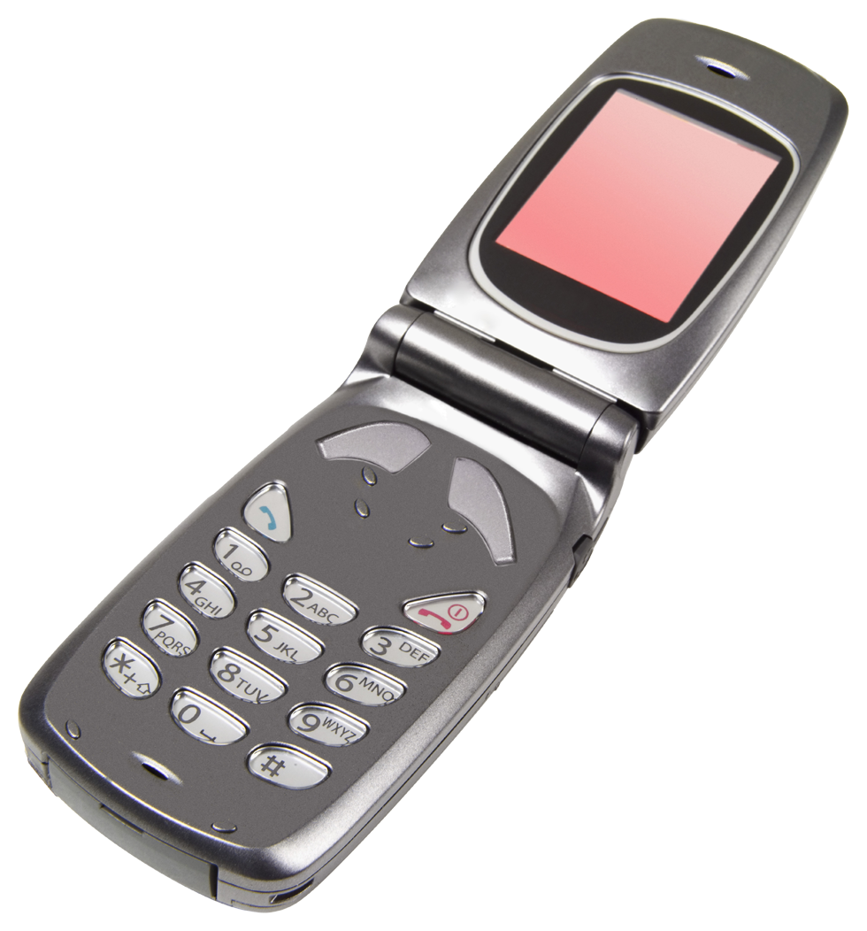

Lay of the land for Language Technologies
NLU: Natural Language Understanding
+
NLP: Natural Language Processing
NLG: Natural Language Generation
making good progress
Sentiment analysis
still really hard
mostly solved
Best roast chicken in San Francisco!
Question answering (QA)
The waiter ignored us for 20 minutes.
Spam detection
Coreference resolution
Q. How effective is ibuprofen in reducing fever in patients with acute febrile illness?
✓
Let’s go to Agra!
Paraphrase
✗
Carter told Mubarak he shouldn’t run again.
Buy V1AGRA …
Word sense disambiguation (WSD)
XYZ acquired ABC yesterday
Part-of-speech (POS) tagging
I need new batteries for my mouse.
ABC has been taken over by XYZ
ADJ ADJ NOUN VERB ADV
Summarization
Colorless green ideas sleep furiously.
Parsing
The Dow Jones is up
Economy is good
I can see Alcatraz from the window!
The S&P500 jumped
Named entity recognition (NER)
Machine translation (MT)
Housing prices rose
PERSON ORG LOC
第13届上海国际电影节开幕…
Dialog
Where is Citizen Kane playing in SF?
Einstein met with UN officials in Princeton
The 13th Shanghai International Film Festival…
Information extraction (IE)
Castro Theatre at 7:30. Do you want a ticket?
You’re invited to our dinner party, Friday May 27 at 8:30
Party May 27 add
(Slide source: Dan Jurafsky)
Notes:
Example of deaf people’s language understanding abilities versus language generation abilities

