Slide 1

CSc 620 & CSc 820
Natural Language Technologies
Professor Anagha Kulkarni
ak@sfsu.edu
Department of Computer Science
College of Science & Engineering
San Francisco State University
https://faculty.sfsu.edu/~ak

Slide 2
Basics of Text Processing
Regular Expressions
Text Normalization
Tokens and Lemmas
Sentence Segmentation
Edit Distance

Slide 3
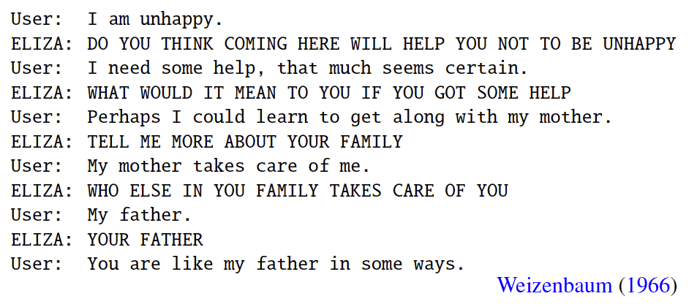
ELIZA
http://psych.fullerton.edu/mbirnbaum/psych101/Eliza.htm
ELIZA: An early NLP system; a simple rule-based chatbot that was designed to mimic Rogerian styled psychotherapist.
Turing Test
"I had not realized ... that extremely short exposures to a relatively simple computer program could induce powerful delusional thinking in quite normal people.” -- Weizenbaum
Pattern matching
“I am X” => “DO YOU THINK COMING HERE WILL HELP YOU NOT TO X”
“I need X” => “WHAT WOULD IT MEAN TO YOU IF YOU GOT X”
No world knowledge needed.
Notes:
Early: 1964- 66
Rule-based
Rogerian: Carl Roger: https://en.wikipedia.org/wiki/Carl_Rogers “Person-centered therapy seeks to facilitate a client's self-actualizing tendency, "an inbuilt proclivity toward growth and fulfillment",[3] via acceptance (unconditional positive regard), therapist congruence (genuineness), and empathic understanding.”
Attempted one of the first Turing tests. Many many people who interacted with ELIZA believed it to be a human being.

Slide 4
Modern Conversational Agents
More sophisticated pattern matching and machine learning
Presence of world knowledge
usually limited to specific domain though, e.g. restaurant booking chatbot

Slide 5
Regular Expressions (RE)
Very powerful tool.
Usage: To search for lexical patterns in a corpus.
E.g. Find all the lines that contain one or more numbers in the below corpus.
Mahoney becomes the 14th president of SFSU
and the first woman appointed to serve in the role in a permanent ​capacity.
She will join the campus in her new capacity on July 15.
Mahoney succeeds Leslie E. Wong who will be retiring in July 2019
after 46 years in higher education including service
as SFSU president for the past seven years.
RE: /[0-9]+/g (Answer: Lines 1, 3, 4, 5)
RE: /\b[0-9]+\b/g (Answer: Lines 3, 4, 5)
What about lines 2 (“first”) and 6 (“seven”)??
Notes:
Examples of applications of RE for NLP:
Information extraction: Should this email trigger a calendar event? Does the email contain any dates? Look for date patterns: 1 or more number, hyphen or forward slash, 1 or more number, hyphen or forward slash, 2 or more numbers.
Identify all the acronyms in the collection (Uppercase character sequences: SFSU, Uppercase with periods: U.S.A)

Slide 6
RE: Basics
RE are case sensitive by default. To make RE case insensitive: use ‘i’ modifier
RE are lazy by default. To fix that: use ‘g’ modifier
e.g. /apple/ig
“I ate an apple at APPLE without any thought about my friend Apple.”

Slide 7
RE: Basics
Notes:
? implies 0 or 1 instance of the previous character

Slide 8
RE: ? Kleene * Kleene +
Pattern | Matches | Examples
/colou?r/ | 0 or 1 instance of previous char | color colour
/oo*h!/ | 0 or more of previous char | oh! ooh! oooh! ooooh!
/oo+h!/ | 1 or more of previous char | ooh! oooh! ooooh!
/baa+/ | 1 or more of previous char | baa baaa baaaa baaaaa
/beg.n/ | any character (1) except line breaks | begin begun beg*n beg3n

