Slide 1

CSc 620 & CSc 820
Natural Language Technologies
Professor Anagha Kulkarni
ak@sfsu.edu
Department of Computer Science
College of Science & Engineering
San Francisco State University
https://faculty.sfsu.edu/~ak/home

Slide 2
Attendance
CSC 820: Term Project Update #1 Meeting (Sept 7th 5:15 to 6:15pm)
Meeting time-slot: I haven’t heard from all graduate students yet.
Peer Discussion of Weekly Summary #2

Slide 3
Basics of Text Processing
Regular Expressions
Text Normalization
Tokens and Lemmas
Sentence Segmentation
Edit Distance

Slide 4
Minimum Edit Distance
Definition of Minimum Edit Distance

Slide 5
How similar are two strings? For:
Spelling correction:
The user typed “graff”
Which is closest?
graft
grail
giraffe
Computational Biology
Align two sequences of nucleotides
Resulting alignment:
AGGCTATCACCTGACCTCCAGGCCGATGCCC
TAGCTATCACGACCGCGGTCGATTTGCCCGAC
-AGGCTATCACCTGACCTCCAGGCCGA--TGCCC---
TAG-CTATCAC--GACCGC--GGTCGATTTGCCCGAC
Given two sequences, align each letter to a letter or a gap.
Notes:
Continuing with one of the central goals in NLP: matching two units of text.

Slide 6
How similar are two strings? For:
Evaluating speech recognition
R Spokesman confirms senior government adviser was shot
H Spokesman said the senior adviser was shot dead
S I D I
Entity Resolution / Entity Linking
Notes:
1st is from a speech recognizer. 2nd from a news article or some other reliable source.

Slide 7
Minimum Edit Distance
Common practice:
Similarity = -Distance
“How similar are two strings?” => “How distant are two strings?”
The minimum edit distance between two strings:
Is the minimum number of editing operations --
Insertion
Deletion
Substitution
that are needed to transform one string into the other string.

Slide 8
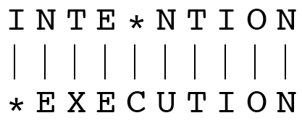
Minimum Edit Distance
Cost of each operation (Ins, Del, Sub): 1
Levenshtein formulation:
Cost of each Ins and Del: 1
Cost of each Sub: 2 (1 Del + 1 Ins)
Two strings and their alignment:
I | N | T | E | N | T | I | O | N
E | X | E | C | U | T | I | O | N
Edit Distance: 2 + 2 + 2 + 2 +2 = 10
Levenshtein Distance: 8
(Minimum Edit Distance)

Slide 9
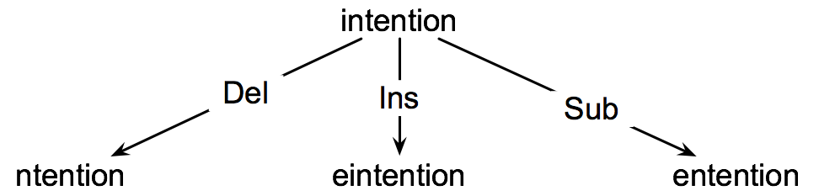
How to find the Min Edit Distance?
Searching for a path (sequence of edits) from the start string to the final string:
Initial state: the word being transformed
Goal state: the word we are trying to get to
Operators: insert, delete, substitute
Path cost: what we want to minimize: the number of edits

Slide 10
Minimum Edit as Search
But the space of all edit sequences is huge!
We can’t afford to navigate naïvely
Lots of distinct paths wind up at the same state.
We don’t have to keep track of all of them
Just the shortest path to each of those revisited states.

Slide 11
Minimum Edit Distance
Computing Minimum Edit Distance

Slide 12
Define function D(n,m)
For two strings
X of length N
Y of length M
We define D(i,j)
as the edit distance between X[1..i] and Y[1..j]
i.e., the first i characters of X and the first j characters of Y (Substrings)
The edit distance between X and Y (the complete strings) is thus D(N,M)
E.g.
X: INTENTION (N: 9)
Y: EXECUTION (M: 9)
E.g. D(2,3):
X[1..2]: IN
Y[1..3]: EXE
D(2,3) = 5

Slide 13
Defining Min Edit Distance (Levenshtein)
Initialization
D(i,0) = i
D(0,j) = j
Recurrence Relation:
For each i = 1…M (Iterator over Source String)
For each j = 1…N (Iterator over Target String)
D(i-1,j) + 1
D(i,j)= min D(i,j-1) + 1
D(i-1,j-1) + 2; if X(i) ≠ Y(j)
0; if X(i) = Y(j)
Termination:
D(N,M) is minimum edit distance
Base cases
However, simplistic implementation of recurrence is almost always computationally inefficient!
Solution: Memoization & Dynamic Programming
Remember previously solved problems &
Take a bottom-up approach.
Dynamic programming: Solve a larger problem by dividing it into smaller problems & combining their solutions.
Notes:
Same computations are repeated multiple times.

Slide 14
Defining Min Edit Distance (Levenshtein)
Initialization
D(i,0) = i
D(0,j) = j
Recurrence Relation:
For each i = 1…M (Iterator over Source String)
For each j = 1…N (Iterator over Target String)
D(i-1,j) + 1
D(i,j)= min D(i,j-1) + 1
D(i-1,j-1) + 2; if X(i) ≠ Y(j)
0; if X(i) = Y(j)
Termination:
D(N,M) is minimum edit distance
Base case 1. Transforming source string of len i to target string of len 0 will take i deletes.
Base case 2. Transforming source string of len 0 to target string of len j will take j inserts.

Slide 15
The Edit Distance Table D
Base case 1
9 | N | 9
8 | O | 8
7 | I | 7
6 | T | 6
5 | N | 5
4 | E | 4
3 | T | 3
2 | N | 2
1 | I | 1
0 | # | 0 | 1 | 2 | 3 | 4 | 5 | 6 | 7 | 8 | 9
Indx i |  | # | E | X | E | C | U | T | I | O | N
D | Indx j | 0 | 1 | 2 | 3 | 4 | 5 | 6 | 7 | 8 | 9
Base case 2
Notes:
How to read/interpret this matrix?
Base case 1: Row:I and Column:# represents the distance between source string “I” and target string “”, which is 1 deletion. Similarly, Row:T and Column:# represents the distance between source string “INT” and target string “”, which is 3 deletions.
Base case 2: Row:# and Column:E represents the distance between source string “” and target string “E”, which is 1 insertion. Similarly Row:# and Column:”X” represents distance between source string “” and target string “EX” which is 2 insertions.
Whiteboard calculations for D(1,1)

