Slide 1

CSc 620 & CSc 820
Natural Language Technologies
Professor Anagha Kulkarni
ak@sfsu.edu
Department of Computer Science
College of Science & Engineering
San Francisco State University
https://faculty.sfsu.edu/~ak/home

Slide 2
Administrative items
HA #4
Attendance

Slide 3
Language Modeling
Introduction to Probabilistic Language Models & N-grams

Slide 4
Compute the probability to a sentence / phrase / unit of text.

Slide 5
Compute probability of phrase W: P(W)
How to compute this joint probability: P(W) = P(w₁,w₂,w₃,w₄,w₅…w_{n})
E.g. P(i would like to schedule another meeting) = ?
Intuition: let’s rely on the Chain Rule of Probability
P(w₁,w₂,w₃,…,w_{n}) = P(w₁)P(w₂|w₁)P(w₃|w₁, w₂)…P(w_{n}|w₁,…, w_{n-1})
P(i would like to schedule another meeting)
= P(i) x P(would|i) x P(like | I would) x P(to| I would like) x….
How do we compute these probabilities?
We estimate them using corpus statistics.
However corpus statistics become non-existential as the context/history becomes longer.
e.g. P(month | i would like to schedule another meeting on the thursday of the next)

Slide 6
Markov Assumption
Reduce the length of history/context.
Chain Rule:
Simplifying assumption:

Slide 7
Simplest case: Unigram model
Chain Rule:
Simplifying assumption:
Simplest case:
Unigram model:

Slide 8
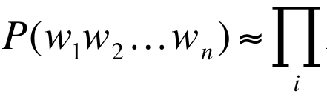
Simpler case: Bigram model
Chain Rule:
Simplifying assumption:
Simpler case:
Bigram model:
P(w_{i} | w_{i-1})

Slide 9
Language Modeling
Estimating N-gram Probabilities

Slide 10
Estimating unigram probabilities
Using Maximum Likelihood Estimate (MLE):
P(w) = count(w) / N
N: Total number of words in the corpus
(Toy) Corpus:
I am Sam
Sam I am
I do not like green eggs and ham
P(Sam) = 2 / 14

Slide 11
Estimating bigram probabilities
P(w_{i} | w_{i-1})
Intuition: How often is w_{i-1} followed by w_{i} ?
Using MLE:

Slide 12

An example
<s> I am Sam </s>
<s> Sam I am </s>
<s> I do not like green eggs and ham </s>

Slide 13
More examples: Corpus: Berkeley Restaurant Project sentences (A dialogue system that answered questions about restaurants in Berkeley)
can you tell me about any good cantonese restaurants close by
mid priced thai food is what i’m looking for
tell me about chez panisse
can you give me a listing of the kinds of food that are available
i’m looking for a good place to eat breakfast
when is caffe venezia open during the day

Slide 14
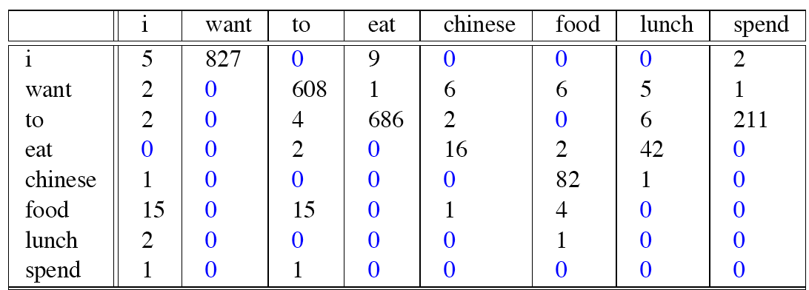
Raw bigram counts
Out of 9222 sentences
w_{i}
w_{i-1}
Notes:
Row w1 and column w2
Thus not a symmetric matrix

Slide 15
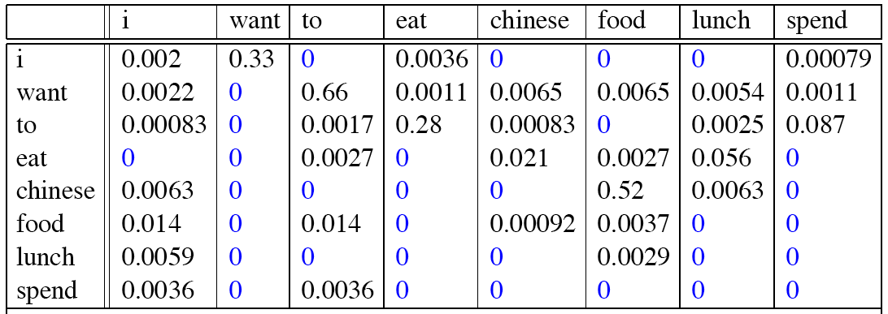
Raw bigram probabilities
Normalize by unigrams:
P(w_{i}|w_{i-1})
w_{i}
w_{i-1}

Slide 16
Bigram estimates of sentence probabilities
P(<s> I want english food </s>) =
P(I|<s>)
× P(want|I)
× P(english|want)
× P(food|english)
× P(</s>|food)
= 0.000031
0.25
0.33
0.0011
0.5
0.68

Slide 17
What kinds of trends can be observed?
P(english|want) = .0011
P(chinese|want) = .0065
P(eat|to) = .28
P(food|to) = 0
P (i | <s>) = .25
Notes:
This corpus is not from China. More demand for chinese food.
Typically a verb comes after “to”.
Information seeking activity for personal use.

Slide 18
Practical Issues
We do everything in log space
Avoid underflow
(also adding is computationally more efficient than multiplying)

