Slide 1

CSc 620 & CSc 820
Natural Language Technologies
Professor Anagha Kulkarni
ak@sfsu.edu
Department of Computer Science
College of Science & Engineering
San Francisco State University
https://faculty.sfsu.edu/~ak/home

Slide 2
Administrative items
Peer Discussion of Summary #4
Attendance

Slide 3
Language Modeling
Introduction to Probabilistic Language Models & N-grams

Slide 4
Compute the probability to a sentence / phrase / unit of text.

Slide 5
Language Modeling
Smoothing: Add-one (Laplace) smoothing
Notes:
Problem of zero frequency n-grams

Slide 6
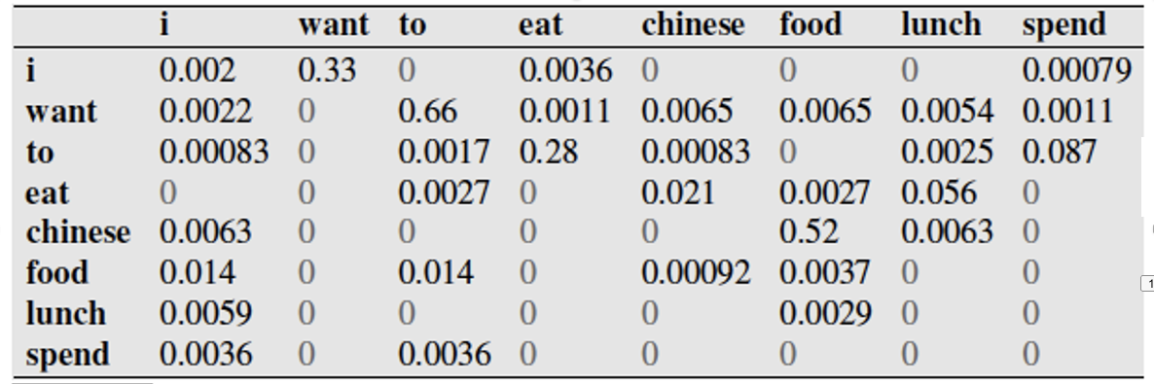
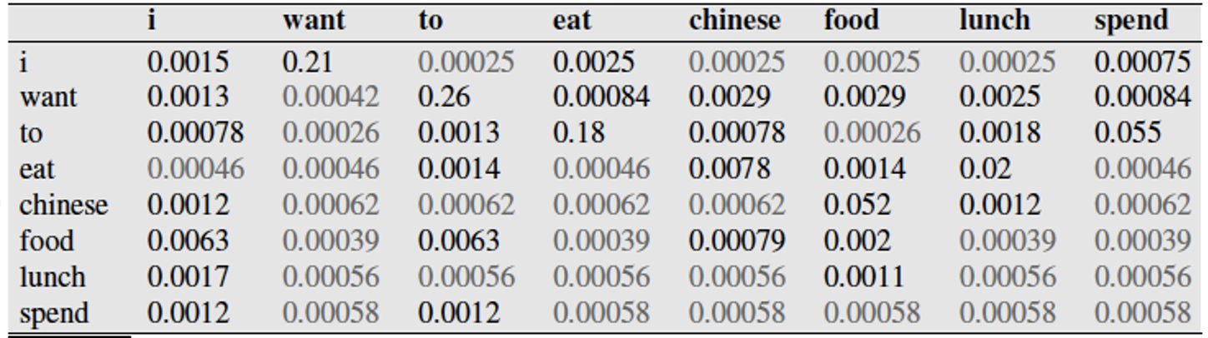
Computing sentence probability using Bigram LM
P(I lunch chinese food)
= P(lunch|I)
× P(chinese|lunch)
× P(food|chinese)
= 0 x 0 x 0.52
= 0
For simplicity, I am ignoring the first term in the product, P(I)
P(I lunch chinese food)
= P(lunch|I)
× P(chinese|lunch)
× P(food|chinese)
= 0.00025 x 0.00056 x 0.052

Slide 7
Language Model: Estimation with Smoothing
Toy corpus:
i am i am i
P(i) = 3/5
P_{Laplace}(i) = (3 + 1) / (5 + 2) = 4/7
Conceptually Laplace smoothing adds one instance of each unique word to the corpus.
So, our toy corpus after Laplace smoothing:
i am i am i i am
Unigram LM: Estimation with MLE
Smoothed Unigram LM: Estimation with MLE + Laplace Smoothing

Slide 8
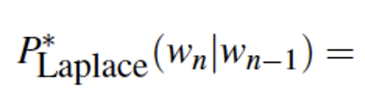
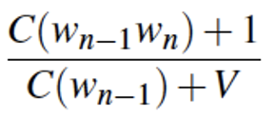
Language Model: Estimation with Smoothing
Bigram LM: Estimation with MLE
Smoothed Bigram LM: Estimation with MLE + Laplace Smoothing
Notes:
Whiteboard: Trigram LM: Estimation with MLE + Laplace Smoothing
P_Laplace(w_n|w_n-2, w_n-1) = ( C(w_n-2 w_n-1 w_n) + 1 ) / Sum_w_. ( C(w_n-2 w_n-1 w_.) + 1 ) = ( C(w_n-2 w_n-1 w_n) + 1 ) / ( C(w_n-2 w_n-1) + V )

Slide 9
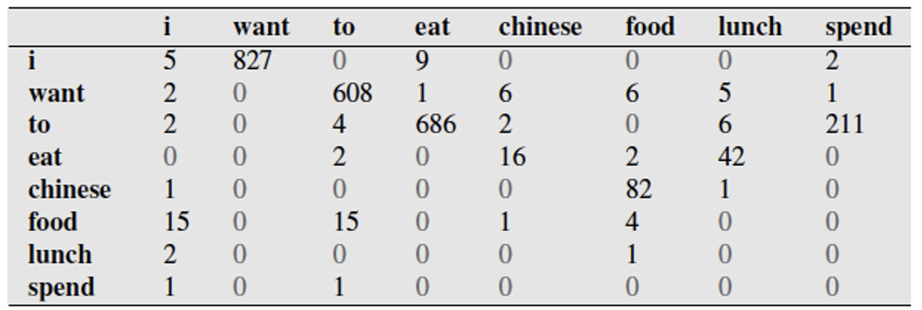
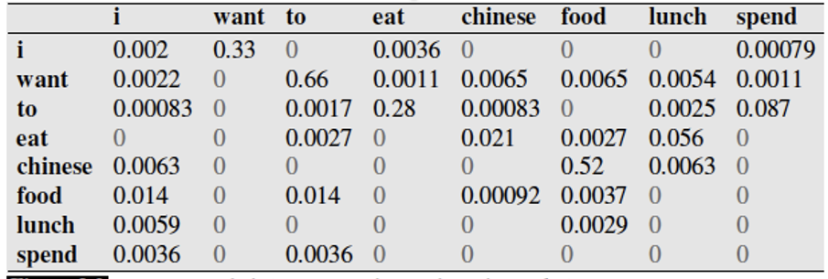

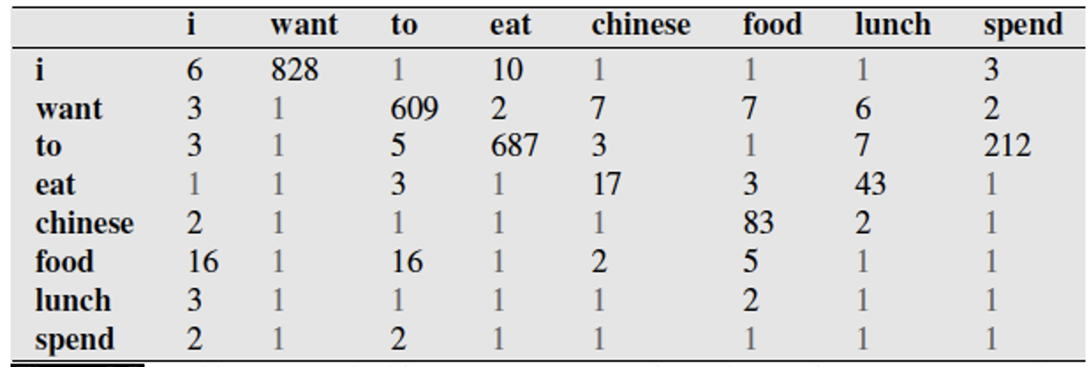

Bigram LM (without smoothing):
In-class exercise:
Compute P(i want lunch) using Bigram LM (top) and Smoothed Bigram LM (bottom table)
Compute P(i lunch want) using Bigram LM (top) and Smoothed Bigram LM (bottom table)
Move small probability mass from seen bigrams to unseen bigrams.
Bigram LM
with Laplace smoothing):
Notes:
P(want | I) x P(lunch | want) = 0.33 x 0.0054
P(want | I) x P(lunch | want) = 0.21 x 0.0025
P(lunch | I) x P( want | lunch)
0 x 0
0.00025 x 0.00056

Slide 10
Add-1 estimation is a blunt instrument
Add-1 is not used for Language Modeling
Takes away too much probability mass from non-zero frequency n-grams
#zero freq n-grams >>> #non-zero freq n-grams
Add-1 is used to smooth other NLP models
For text classification
In domains where the number of zeros isn’t so huge.
Notes:
Problem of zero frequency n-grams

Slide 11
Alternatives
Add-k smoothing
k values are fractional (0.5, 0.05, 0.01, ..)
Simple Linear Interpolation

