Slide 1

CSc 620 & CSc 820
Natural Language Technologies
Professor Anagha Kulkarni
ak@sfsu.edu
Department of Computer Science
College of Science & Engineering
San Francisco State University
https://faculty.sfsu.edu/~ak/home

Slide 2
Language Modeling
Evaluation
Notes:
Problem of zero frequency n-grams

Slide 3
LM: Evaluation
Let’s say you have two bigram language models, how do you evaluate which one is better?
Extrinsic evaluation approach: Uses the language model in an NLP application, such as, Machine Translation, and then check if the performance of the application improves.
Downside: Expensive. Running NLP applications end-to-end over and over again can be expensive.
Intrinsic evaluation approach: Measures the quality of language model independent of any application.
Notes:
Training Set

Slide 4
LM: Evaluation
New (and very important) terminology:
Train set / Training Corpus
The corpus used to compute the n-gram probabilities
Test set
Unseen corpus: A separate corpus that was not part of the training set.
Typical process:
Choose a corpus, say, Berkeley restaurant corpus.
Split it into train set (80%) and test set (20%)
Train/Learn a n-gram model (i.e. compute unigram / bigram / n-gram probabilities) using train set
Use the learnt LM to predict probability of test set.
If we have multiple n-gram models, then the one that estimates higher probabilities for test set is the better model.

Slide 5
LM: Evaluation
Cardinal rule: Never train your model on the test set!
Dev set (Development set)
When splitting the corpus into train, test (and dev):
Avoid systematic bias by selecting datapoints (e.g. sentences, paragraphs) at random for each split
sample without replacement
The largest split is typically the training set, so as to provide as much learning / “reading” as possible.
Test set cannot be too small though, otherwise reliable evaluation is not possible. (representative datapoints)
Notes:
Cross validation will come later

Slide 6
Perplexity (PP)
Instead of probability, perplexity is commonly used as the evaluation metric for LMs.
Why?
In case of probability, length of the test set becomes a factor, incorrectly.
P(larger test set) < P(smaller test set)
Toy example:
Test set 1: “hello world”
Test set 2: “hello world hello world”
Unigram LM (hello: 0.1, world=0.2)
P(Test set 1) = 0.02
P(Test set 2) = 0.0004
Size normalization is needed.

Slide 7
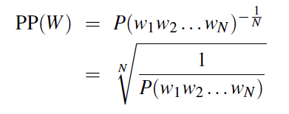
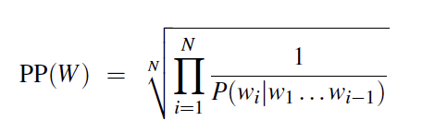
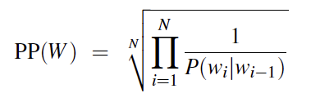

Perplexity (PP)
Perplexity
A variation of probability
Inverse probability of the test set, normalized by the number of words in test set.
Smaller value is better in case of perplexity
As opposed to higher value is better in case of probability
normalize by #words in test set
Inverse
With Chain rule:
With Bigram LM:
Perplexity values for 3 different LMs on test set of 1.5M word corpus from WSJ:
(LMs were trained on 38M word corpus from WSJ)
More informative the LM, lower the perplexity.

Slide 8
LMs and language generation

Slide 9
Language Models: Summary
LMs (n-grams) are the most widely used tool in NLP
LMs provide a way to assign probability to a sentence / phrase / a unit of text
LMs also provide a way to predict the next word given previous word(s)
We saw how to compute / train / learn n-gram models
We saw how to compute smoothed n-gram models
We saw how to evaluate LMs
More sophisticated LMs, Neural Language Models will be introduced later in the course

Slide 10
Administrative items
Attendance
HA #4
HA #5
Code is given to you.
This code demos usage of pandas library
The optional part of the assignment shows how to use several other popular python and ML libraries

Slide 11
Additional pointers on the topic

Slide 12
Language Modeling Toolkits
SRILM
http://www.speech.sri.com/projects/srilm/
KenLM
https://kheafield.com/code/kenlm/

Slide 13
Google N-Gram Release, August 2006

Slide 14
Google N-Gram Release, August 2006

Slide 15
Google N-Gram Release
serve as the incoming 92
serve as the incubator 99
serve as the independent 794
serve as the index 223
serve as the indication 72
serve as the indicator 120
serve as the indicators 45
serve as the indispensable 111
serve as the indispensible 40
serve as the individual 234
http://googleresearch.blogspot.com/2006/08/all-our-n-gram-are-belong-to-you.html

