Slide 1

CSc 620 & CSc 820
Natural Language Technologies
Professor Anagha Kulkarni
ak@sfsu.edu
Department of Computer Science
College of Science & Engineering
San Francisco State University

Slide 2
Text Classification

Slide 3
Text Classification: Definition
Given:
A set of classes: C = {c₁, c₂,…, c_{J}}
E.g. {English, Spanish, Mandarin, Hindi}
A set of labeled documents: D = {d₁, d₂,…, d_{n}},
where for every document, d_{x} , its class label, c^{dx} ∈ C
E.g. d_{x} : “Hola amigo”, c^{dx} : Spanish
Learn classification model:
Using the training data, D, learn a classifier, γ()
Use the classification model:
Predict the class label for a given unlabeled document d
γ(d) = c^{d} ∈ C
Notes:
gamma function

Slide 4
Ç√
Ç√
Ç√
Ç√

Slide 5
Classification Methods: Supervised Machine Learning
Classification algorithms
Naïve Bayes
Logistic regression
Support-vector machines
k-Nearest Neighbors
…

Slide 6
Text Classification and Naïve Bayes
Naïve Bayes (I)

Slide 7
Naïve Bayes Intuition
Based on Bayes rule
Relies on very simple (Naïve) representation of documents

Slide 8
Text Classification and Naïve Bayes
Formalizing the Naïve Bayes Classifier

Slide 9
Naïve Bayes Classifier
MAP is “maximum a posteriori” = most likely class

Slide 10
Bayes’ Rule Applied to Documents and Classes
For a document d and a class c
likelihood
posterior
prior
Notes:
Explain Bayes rule first, and then likelihood, prior probability, and posterior probability.

Slide 11
Naïve Bayes Classifier
MAP is “maximum a posteriori” = most likely class
Bayes Rule
Dropping the denominator
We need to estimate P(d|c) and P(c)

Slide 12
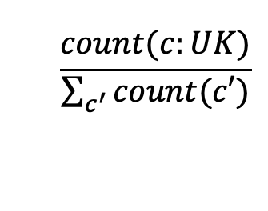
We need to estimate P(d|c) and P(c)
Ç√
Ç√
$$\frac{count(c:UK)}{\sum_{c^{′}}{count(c′)}}$$
Ç√
P(c: UK) =
Ç√
P(d|c) = ?
Notes:
P(c = UK) = 3/6 = 1/2 = P(China)

Slide 13
Naïve Bayes Classifier
More generally, x₁,…x_{n} are features of d.
e.g.
words (single words, pairs, triplets,...)
pos tags
meta-data of d
x₁,…x_{n} can be the words in document d.
x₁..x_{n}: Feature representation of document d.

Slide 14
Naïve Bayes Independence Assumption
Conditional Independence: Assume the feature probabilities P(x_{i}|c_{j}) are independent given the class c.
Notes:
Multinomial distribution

Slide 15
Naïve Bayes Classifier
We need to estimate these probabilities.
This is called learning / training NB classification model.

Slide 16
Text Classification and Naïve Bayes
Naïve Bayes: Learning

Slide 17
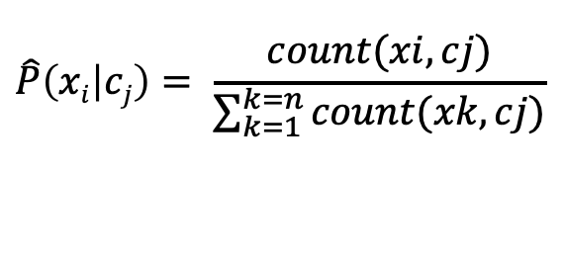
Learning the Multinomial Naïve Bayes Model
Maximum Likelihood Estimates:
Simply use the relative frequencies in the data
$$\hat{P}\left(xi | cj\right)= \frac{count(xi, cj)}{\sum_{k=1}^{k=n}{count(xk, cj)}}$$
Number of times feature x_{i} appears in documents of class c_{j}
relative to all feature counts in class c_{j}
Relative importance of feature x_{i} for class c_{j}
Effectively, for each class we are learning a multinomial distribution over all the features, x₁..x_{n}.
Notes:
V defined over the entire training data. But the denominator count restricted to the specific class cj documents.

Slide 18


Example of TC: Positive or negative movie review?
Training Data:
unbelievably disappointing
Full of zany characters and richly applied satire, and some great plot twists
this is the greatest screwball comedy ever filmed
It was pathetic. The worst part about it was the boxing scenes.
OOV term!
Unlabeled data / review: “fantastic plot full of comedy”
Class: Positive / Negative ?

Slide 19
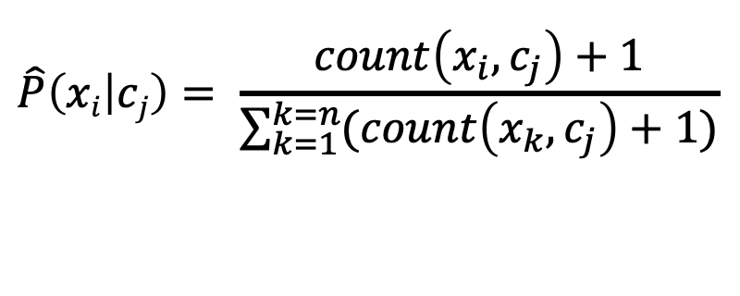
Laplace (add 1) smoothing for Naïve Bayes
$$\hat{P}\left(xi | cj\right)= \frac{count\left(x_{i},c_{j}\right)+1}{\sum_{k=1}^{k=n}{(count\left(x_{k},c_{j}\right)+1)}}$$

Slide 20
Text Classification and Naïve Bayes
Naïve Bayes: A Worked Example
(Only unigram features)
(With Laplace Smoothing)

Slide 21
Priors: (Using MLE)
Data | Doc | Words | Class
Training | 1 | Chinese Beijing Chinese | c
 | 2 | Chinese Chinese Shanghai | c
 | 3 | Chinese Macao | c
 | 4 | Tokyo Japan Chinese | j
Test | 5 | Chinese Chinese Chinese Tokyo Japan | ?
Likelihood:
(Using MLE with Laplace Smoothing)
Priors:
P(c)=
P(j)=
Testing Phase
Training Phase
3
4
1
4
Assigning a class label to Test doc d5:
P(c|d5)
P(j|d5)
C_{NB}(d5) = c (i.e. china)
Likelihood: Conditional Probabilities:
P(Chinese|c) =
P(Tokyo|c) =
P(Japan|c) =
P(Chinese|j) =
P(Tokyo|j) =
P(Japan|j) =
3/4 * (3/7)³ * 1/14 * 1/14
≈ 0.0003
(5+1) / (8+6) = 6/14 = 3/7
(0+1) / (8+6) = 1/14
1/4 * (2/9)³ * 2/9 * 2/9
≈ 0.0001
(0+1) / (8+6) = 1/14
(1+1) / (3+6) = 2/9
(1+1) / (3+6) = 2/9
(1+1) / (3+6) = 2/9
Notes:
|V|: Size of the vocabulary defined over the *entire* training set.

