Slide 1

CSc 620 & CSc 820
Natural Language Technologies
Professor Anagha Kulkarni
ak@sfsu.edu
Department of Computer Science
College of Science & Engineering
San Francisco State University

Slide 2
Text Classification: Logistic Regression
Notes:
NB, LR: Instance of Probabilistic ML algorithms
as opposed to Rule-based ML
And other non-probabilistic supervised ML algorithms: k-NN, SVM, RF

Slide 3
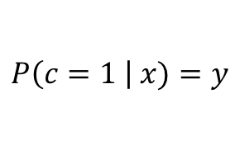
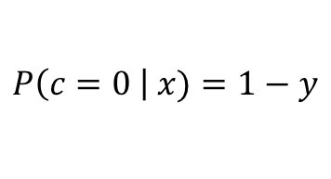
Logistic Regression
Regression Equation.
Dot product between weight vector and input vector.
b: a real number.
(bias / intercept)
Logistic function (Sigmoid)
$$P\left(c=1 \right| x)=y$$
$$P\left(c=0 \right| x)=1−y$$
c
Decision boundary
c_{LR}
Notes:
b: scalar. Tensor of rank 0.
w and x are vectors. Tensor of rank 1.
Simplest classification scenario: Binary classification

Slide 4
Logistic Regression:
Feature Vector & Weight Vector
Feature ID | Feature Definition | Feature Vector for Doc1 | Weight Vector | Product
x₁ | Count of positive lexicon words | 3 | 2.5
x₂ | Count of negative lexicon words | 2 | -5.0
x₃ | Does no appear? (binary feature) | 1 | -1.2
x₄ | Num 1st and 2nd person pronouns | 3 | 0.5
x₅ | Does ! appear? (binary feature) | 0 | 2.0
x₆ | Log of the word count for the doc | 4.15 | 0.7
b | bias | 1 | 0.1

Slide 5
Logistic Regression: Computing Z
Feature ID | Feature Definition | Feature Vector for Doc1 | Weight Vector | Product
x₁ | Count of positive lexicon words | 3 | 2.5 | 7.5
x₂ | Count of negative lexicon words | 2 | -5.0 | -10
x₃ | Does no appear? (binary feature) | 1 | -1.2 | -1.2
x₄ | Num 1st and 2nd person pronouns | 3 | 0.5 | 1.5
x₅ | Does ! appear? (binary feature) | 0 | 2.0 | 0
x₆ | Log of the word count for the doc | 4.15 | 0.7 | 2.905
b | bias | 1 | 0.1 | .1
Z=0.805

Slide 6
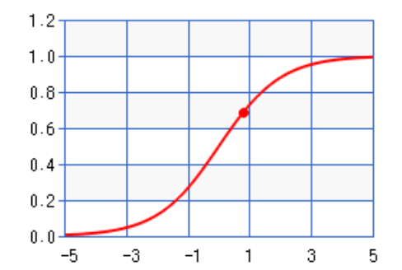
Logistic Regression: Sigmoid(Z): σ(Z)
Feature ID | Feature Definition | Feature Vector for Doc1 | Weight Vector | Product
x₁ | Count of positive lexicon words | 3 | 2.5 | 7.5
x₂ | Count of negative lexicon words | 2 | -5.0 | -10
x₃ | Does no appear? (binary feature) | 1 | -1.2 | -1.2
x₄ | Num 1st and 2nd person pronouns | 3 | 0.5 | 1.5
x₅ | Does ! appear? (binary feature) | 0 | 2.0 | 0
x₆ | Log of the |  | 7 | 2.905
b | bias |  | 1 | .1
word count for the doc 4.15 0.
1 0.
Z = 0.805
σ(0.805)
= 0.69

Slide 7
Text Classification:
Logistic Regression: Learning

Slide 8



Logistic Regression
Regression Equation.
Dot product between weight vector and input vector.
b: a real number.
(bias / intercept)
$$\hat{y}$$
Logistic function (Sigmoid)
$$P\left(c=1 \right| x)=\hat{y}$$
$$P\left(c=0 \right| x)=1−\hat{y}$$
c
Decision boundary
c_{LR}
Notes:
b: scalar. Tensor of rank 0.
w and x are vectors. Tensor of rank 1.
what combination of wi values gives the best performance on the training set

Slide 9
How to estimate weight vector w & bias b?
Define:
What is the goal?
Objective function / Loss Function:
Cross-entropy loss function
An algorithm for optimizing the objective function:
Stochastic Gradient Descent to minimize cross-entropy loss function
Define:
How will we achieve the goal?

Slide 10
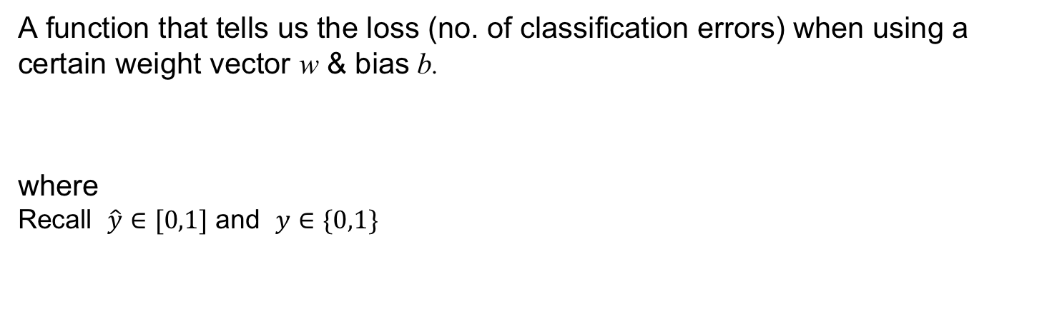
Cross-entropy Loss Function
A function that tells us the loss (no. of classification errors) when using a certain weight vector w & bias b.
where
Recall $\hat{y}∈[0,1]$ and $y∈\{0,1\}$
Z
Notes:
Best case: $L\left(\hat{y},y\right)=0$, when $\hat{y}==y$
e.g. 1.0 == 1, 0.0 == 0
Worse case: $L\left(\hat{y},y\right)=1$, when $\hat{y} !=y$
e.g. 1.0 != 0, 0.0 != 1

Slide 11
Cross-entropy Loss Function: One data point
Let’s derive this loss function for one training data point: {x, y}
Since y ∊ {0,1}, we will use Bernoulli distribution where:
pmf
Log Probability function that should be maximized.
Why?
The range of the log probability function: log p(y|x) is [-inf, 0]
How?
= 1 * log (1.0) + (1 - 1) * log (1 - 1.0)
= 0 + 0 = 0
= 0 * log (0.0) + (1- 0) * log(1 - 0.0)
= 0 + 0 = 0
= 1 * log (0.0) + (1 - 1) * log (1 - 0.0)
= -inf + 0 = -inf
= 0 * log (1.0) + (1- 0) * log (1 - 1.0)
= 0 + -inf = -inf
Perfect classifier
Incorrect classifier
Notes:
Bernoulli distribution: Coin toss.
y^ is the probability of class 1, i.e. y=1, and (1-y^) is probability of class 0, i.e. y=0

Slide 12

Cross-entropy (CE) Loss Function: One data point
Let’s derive this loss function for one training data point: {x, y}
Since y ∊ {0,1}, we will use Bernoulli distribution where:
pmf
Log Probability function that should be maximized, [-inf, 0]
Cross-Entropy Loss function that should be minimized, [0,inf]
Replace:
$$L_{CE}(\hat{y},y)$$
Find w and b that minimize this function.
Before that let’s extend the above loss function to all data points from the training set.
Notes:
The negative log of this probability is a convenient loss metric since it goes from 0 (negative
log of 1, no loss) to infinity (negative log of 0, infinite loss).
It’s called the cross-entropy loss it is also the formula for the cross- entropy
between the true probability distribution y and our estimated distribution
ˆ y .

Slide 13
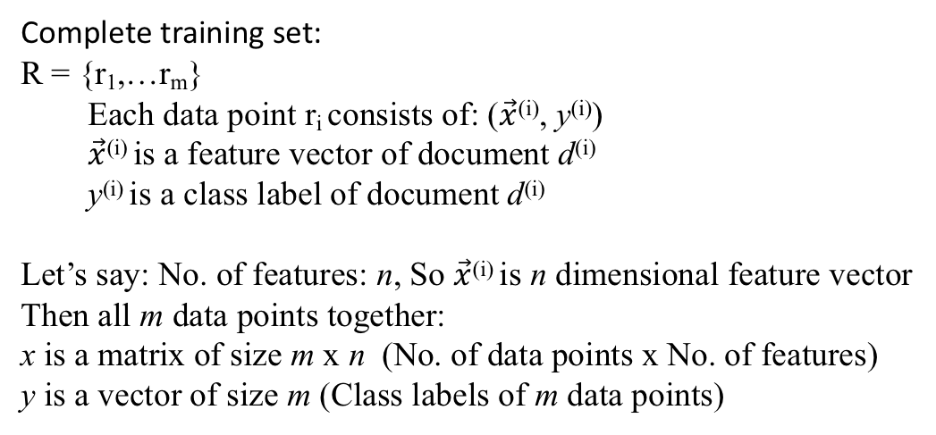
Cross-entropy Loss Function: Complete training set
Complete training set:
R = {r₁,…r_{m}}
Each data point r_{i} consists of: ($\vec{x}$^{(i)}, y^{(i)})
$\vec{x}$^{(i)} is a feature vector of document d^{(i)}
y^{(i)} is a class label of document d^{(i)}
Let’s say: No. of features: n, So $\vec{x}$^{(i)} is n dimensional feature vector
Then all m data points together:
x is a matrix of size m x n (No. of data points x No. of features)
y is a vector of size m (Class labels of m data points)
Notes:
Note:
x is a matrix of size, m x n
m : #data points
n : #features
y is a vector of size m

Slide 14

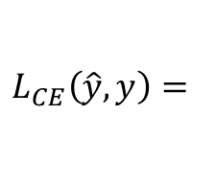
Cross-entropy (CE) Loss Function: Complete training set
CE Loss function for single data point from training set:
$$L_{CE}\left(\hat{y},y\right)=$$
$$L_{CE}\left(\hat{y},y\right)$$
Average loss over all training data points
aka Objective function / Cost function:
Notes:
Note:
x is a matrix of size, m x n
m : #data points
n : #features
y is a vector of size m

Slide 15
How to estimate weight vector w & bias b?
Objective function / Loss Function:
Cross-entropy loss function
An algorithm for optimizing the objective function:
Stochastic Gradient Descent to minimize cross-entropy loss function
✓

