Slide 1

CSc 620 & CSc 820
Natural Language Technologies
Professor Anagha Kulkarni
ak@sfsu.edu
Department of Computer Science
College of Science & Engineering
San Francisco State University

Slide 2
Text Classification:
Logistic Regression: Learning

Slide 3
How to estimate weight vector w & bias b?
1. Objective function / Loss Function:
Cross-entropy loss function
2. An algorithm for optimizing the objective function:
Stochastic Gradient Descent to minimize cross-entropy loss function

Slide 4

Stochastic Gradient Descent
$$L\left({\hat{y}}^{(i)},y^{(i)}\right)=−[y^{\left(i\right)}log {\hat{y}}^{\left(i\right)}+\left(1 −y^{\left(i\right)}\right)log(1−{\hat{y}}^{\left(i\right)})]$$
$$f\left(\vec{x},θ\right)= \hat{y}=σ\left(Z\right)=\frac{1}{1+e^{−Z}}=\frac{1}{1+e^{−(\vec{w}∙\vec{x} +b)}}$$
Stochastic: One random training data point at a time.
Minibatch Gradient Descent: For each iteration use a small batch of training data points: k, where 1 <= k <= m
k = 1, It is SGD
k = m, Batch GD
Notes:
Updating the weights so as to improve performance on that single example. very choppy weight updates
Minibatch: Distributed loss computation for all data points in a mini-batch in parallel is often feasible
T restarts

Slide 5
Text Classification:
Logistic Regression for multi-class problems

Slide 6
Multinomial Logistic Regression (aka softmax regression, maxent classifier)
For classification problems with more than two classes:
y ∊ {1,2,3,…k}
Uses generalization of sigmoid function: Softmax function

Slide 7
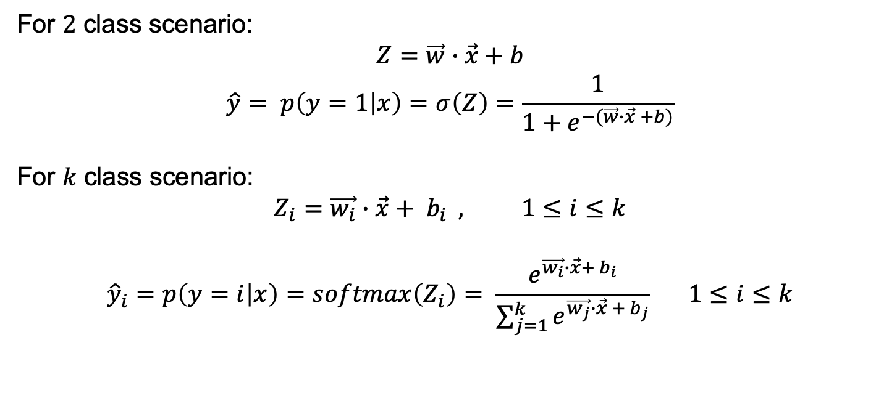
Multinomial Logistic Regression (aka softmax regression, maxent classifier)
For $2$ class scenario:
$$Z=\vec{w}∙\vec{x}+b$$
$$\hat{y}= p\left(y=1 | x\right)=σ\left(Z\right)=\frac{1}{1+e^{−(\vec{w}∙\vec{x} +b)}}$$
For $k$ class scenario:
$$Z_{i}=\vec{w_{i}}∙\vec{x}+ b_{i} , 1≤i≤k$$
$${\hat{y}}_{i}=p\left(y=i | x\right)=softmax\left(Z_{i}\right)= \frac{e^{\vec{w_{i}}∙\vec{x}+ b_{i}}}{\sum_{j=1}^{k}{e^{\vec{w_{j}}∙\vec{x} + b_{j}}}} 1≤i≤k$$

Slide 8
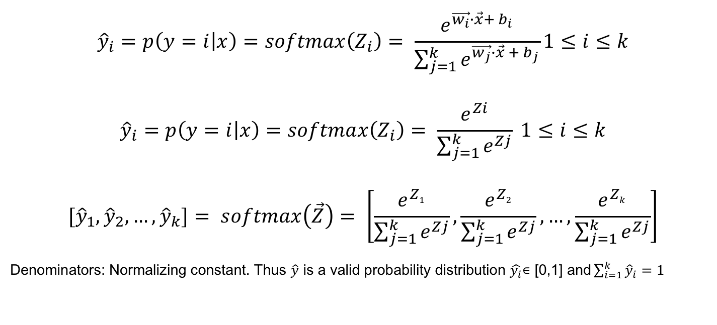
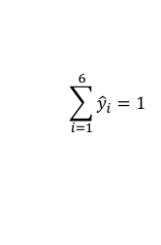

Multinomial Logistic Regression (aka softmax regression, maxent classifier)
$${\hat{y}}_{i}=p\left(y=i | x\right)=softmax\left(Z_{i}\right)= \frac{e^{\vec{w_{i}}∙\vec{x}+ b_{i}}}{\sum_{j=1}^{k}{e^{\vec{w_{j}}∙\vec{x} + b_{j}}}}1≤i≤k$$
$${\hat{y}}_{i}=p\left(y=i | x\right)=softmax\left(Z_{i}\right)= \frac{e^{Zi}}{\sum_{j=1}^{k}{e^{Zj}}} 1≤i≤k$$
$$[{\hat{y}}_{1},{\hat{y}}_{2},…,{\hat{y}}_{k}]= softmax\left(\vec{Z}\right)= \left[\frac{e^{Z1}}{\sum_{j=1}^{k}{e^{Zj}}},\frac{e^{Z2}}{\sum_{j=1}^{k}{e^{Zj}}}, …,\frac{e^{Zk}}{\sum_{j=1}^{k}{e^{Zj}}}\right]$$
Denominators: Normalizing constant. Thus $\hat{y}$ is a valid probability distribution $\hat{y_{i}}\text{∊}\text{ [0,1] }\text{and}\sum_{i=1}^{k}{{\hat{y}}_{i}=1}$
Let’s say input to the softmax function is:
$$[{\hat{y}}_{1},{\hat{y}}_{2},…,{\hat{y}}_{6}]=$$
$$\sum_{i=1}^{6}{{\hat{y}}_{i}=1}$$
Predicted Class: 5

Slide 9
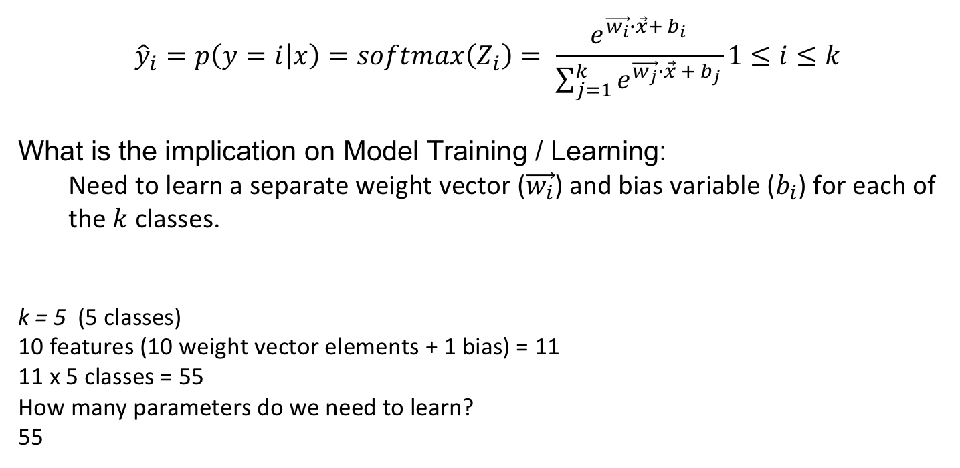
Multinomial Logistic Regression (aka softmax regression, maxent classifier)
$${\hat{y}}_{i}=p\left(y=i | x\right)=softmax\left(Z_{i}\right)= \frac{e^{\vec{w_{i}}∙\vec{x}+ b_{i}}}{\sum_{j=1}^{k}{e^{\vec{w_{j}}∙\vec{x} + b_{j}}}}1≤i≤k$$
What is the implication on Model Training / Learning:
Need to learn a separate weight vector ($\vec{w_{i}}$) and bias variable ($b_{i}$) for each of the $k$ classes.
k = 5 (5 classes)
10 features (10 weight vector elements + 1 bias) = 11
11 x 5 classes = 55
How many parameters do we need to learn?
55

Slide 10

Multinomial Logistic Regression: Learning
2 class scenario:
$$L_{CE}\left(\hat{y},y\right)$$
Loss function for single data point is the negative sum of the log probabilities of k classes:
1{.} function evaluates to 1 if {.} is true, and 0 if {.} is false.
Gradient of the loss function:
Notes:
(Best) Scenario 1: D1, y=2, y^ = [0.01, 0.97, 0.01, 0.01]
(Worst) Scenario 2: D1, y=2, y^ = [0.99, 0.01, 0.01, 0.01]

Slide 11
Stochastic Gradient Descent
Notes:
Updating the weights so as to improve performance on that single example. very choppy weight updates
Minibatch: Distributed loss computation for all data points in a mini-batch in parallel is often feasible

Slide 13
Regularization
Technique used to avoid overfitting.
Don’t have few features dominate the classification outcome
Learn a model that generalizes well
Don’t let any feature weight get too big
where R(w) is the regularization term
Notes:
Example: Spooky Author classification problem. For one of the authors Edgar Allan Poe, the excerpt from their books is always of length 15 words, while for other authors the excerpt length varies. This is happened due to some random idiosyncrasy in the data creation process. If you have defined a feature: word_count then the learning process is going to assign a HIGH weight for this feature since it is perfectly correlated with EAP class.

Slide 14
L2 Regularization
Square of L2 norm (Euclidean norm. Euclidean distance between origin and the point.)
L2 Regularization
L2 Regularized Objective function:

Slide 15
L1 Regularization
L1 norm (Manhattan distance between origin and the point.)
Sum of absolute values of the weights
L1 Regularization
L1 Regularized Objective function:
Notes:
Manhattan distance for point P(x,y) from origin = x + y

Slide 17
Logistic Regression: Summary
One of the most widely used supervised machine learning algorithm for text classification
Feature engineering is an important step
Feature weights provide convenient mechanism to interpret the learnt classification model

Slide 18
Reminders
Next Tuesday, Oct 25
Online class
Guest session by folks from Health Promotion and Wellness
Topic: “Self-Care for Resilience: Managing Stress”
Next Thursday, Oct 27
Back to NLP
Online class
Attendance

