Slide 1

CSc 620 & CSc 820
Natural Language Technologies
Professor Anagha Kulkarni
ak@sfsu.edu
Department of Computer Science
College of Science & Engineering
San Francisco State University

Slide 2
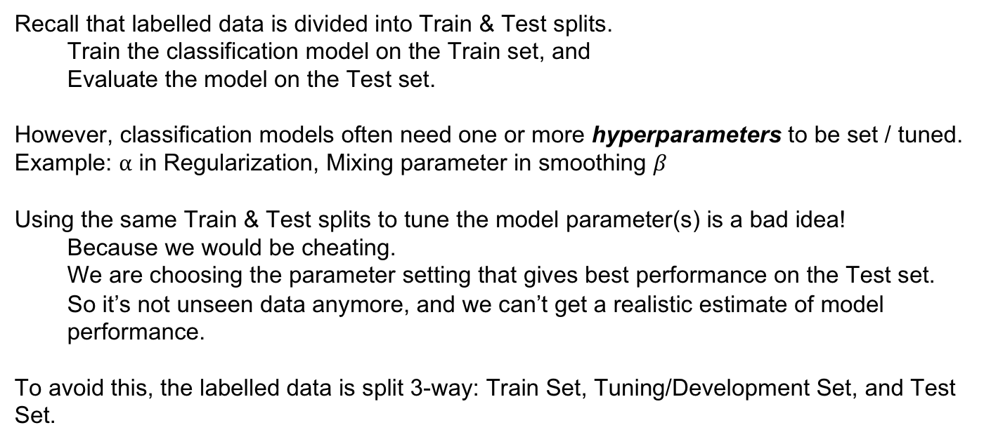
Text Classification: Development Set
Recall that labelled data is divided into Train & Test splits.
Train the classification model on the Train set, and
Evaluate the model on the Test set.
However, classification models often need one or more hyperparameters to be set / tuned.
Example: ⍺ in Regularization, Mixing parameter in smoothing $β$
Using the same Train & Test splits to tune the model parameter(s) is a bad idea!
Because we would be cheating.
We are choosing the parameter setting that gives best performance on the Test set.
So it’s not unseen data anymore, and we can’t get a realistic estimate of model performance.
To avoid this, the labelled data is split 3-way: Train Set, Tuning/Development Set, and Test Set.

Slide 3
Text Classification: Cross-validation
Labelled data is precious
Almost always, there is less of it than you would like.
1) The more data we have for training the better the model.
2) Train, Dev and Test sets HAVE to be separate sets.
To meet both 1 & 2, let’s keep 80% of the labeled data as Train set, 10% for Dev, and 10% for Test.
However, with this setup the selected hyperparameters may be well-suited only for that small Dev set.
Can we set things up differently such that we can tune the hyperparameters on more data while also meeting (1) & (2)

Slide 4
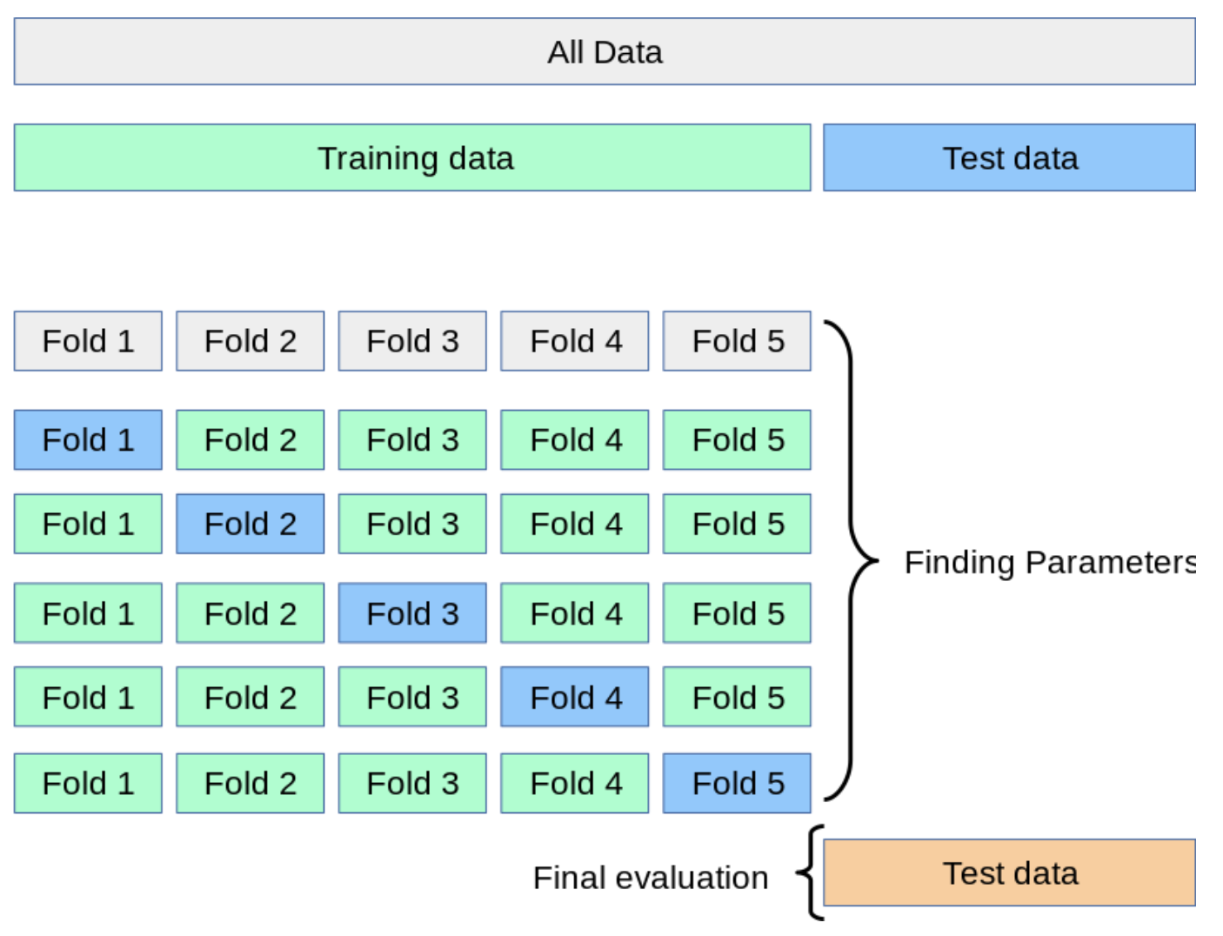
5-fold Cross-validation (5-fold CV)
80%
20%
16%
16%
16%
16%
16%
16%
64%
Tuning hyperparameters
Image source: https://scikit-learn.org/stable/modules/cross_validation.html
Notes:
80 - 20 split

Slide 5
Statistical Significance Testing

Slide 6
Statistical Hypothesis Testing
How do we assess if one classification model is better than another?
Given:
Classification models A and B
Evaluation Metric M (E.g. F1, Prec, Recall)
M(A,x) is the performance of A on test set x
𝛿(x): the performance difference between A, B on x as quantified by M() metric:
𝛿(x) = M(A,x) – M(B,x)
𝛿(x) is called the effect size
We want to know if 𝛿(x)>0, then does it mean A is better than B
If effect size is positive. Are we done?
No! This might be just an accidental effect size on this one test set.

Slide 7
Statistical Hypothesis Testing
How do we assess if one classification model is better than another?
Let’s make this concrete:
Text classification task: Spam vs Ham Email Classification
A: Classification model learnt with Logistic Regression
B: Classification model learnt with Naïve Bayes
x: Test set
M(A,x) = F1(A,x) = 0.98
M(B,x) = F1(B,x) = 0.97
𝛿(x) = M(A,x) - M(B,x) = 0.01
Right here, the delta we are getting on Test set is counter to our H₀: 𝛿(x) ≤ 0.
But statistically this evidence isn’t sufficient to reject H₀ since it is just 1 observation.
So, we proceed to create multiple observations (test sets) and then ask the question:
If H₀ is true, what is: P(𝛿(X) ≥ 0.01 | H₀ is true) just by chance
Consider two hypotheses:
Null hypothesis: A isn't better than B
A is better than B
We want to rule out H₀
How?
We create a random variable X ranging over test sets.
And ask, if H₀ is true, then among these test sets how likely is it that we would see the effect size we observed or bigger, just by chance?
Formalized as the p-value:
This is the probability that we will see similarly big differences in A & B by chance when H₀ is true.
When p-value is high, it means that the observed effect size, 𝛿(x), is by chance.
When p-value is low, it means that the observed effect size, 𝛿(x), is not by chance, it is a real trend (A is better than B).

Slide 8
Statistical Hypothesis Testing
How do we compute this probability, p-value?
In NLP, we don't tend to use parametric tests (like t-tests) because the underlying assumptions are often not true in our scenarios (e.g. normal distribution)
Instead, we use non-parametric tests based on sampling: artificially creating many versions of the setup.

Slide 9
Non-parametric Statistical Significance Test: Paired Bootstrap Test
Paired tests:
Comparing two sets of observations in which each data-point in one set can be paired with an data-point in another.
For example, when looking at systems A and B on the same test set, we can compare the performance of system A and B on the same data-point x_{i} (Each Email, in our running example.)
Bootstrap test:
Bootstrap means to repeatedly draw large numbers of smaller samples with replacement (called bootstrap samples) from an original larger sample.
Can be applied to any metric (accuracy, precision, recall, F1, etc).
(From Efron and Tibshirani, 1993)

Slide 10
Paired Bootstrap example
Consider a toy text classification example with a test set x of 10 documents, using accuracy as metric.
Suppose these are the results of systems A and B on x, with 4 possible outcomes:
A & B both right,
A & B both wrong,
A right & B wrong,
A wrong & B right

Slide 11

Paired Bootstrap example
Now we create, many, say, b=10,000 virtual test sets x^{(i)}, where each |x^{(i)}| = 10 and i: 1 to b.
To create each x^{(i)}, we randomly select a cell from row x with replacement 10 times:
Now we have a distribution over 𝛿()!
We can use it to check how often A has an accidental advantage over B (not true advantage).
To do that we can check if the original 𝛿(x) we saw was very common among virtual test sets x^{(i)}.
That is, count for how many x^{(i)} the 𝛿(x^{(i)}) was equal or greater than 𝛿(x):
If the count is high (it is common) then the original 𝛿(x) was an accident
But if the count is low (it is not common) then the original 𝛿(x) was real, not just an accidental advantage.
Notes:
Distribution of effect size

Slide 12
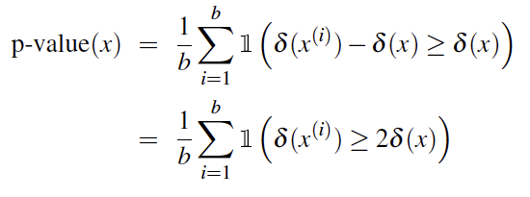
Paired Bootstrap Test
Alas, it's slightly more complicated.
We didn’t draw these samples from a distribution with 0 mean; we created them from the original test set x, which happens to be biased (by .20) in favor of A.
So to measure how surprising is our observed 𝛿(x), we actually compute the p-value by counting how often 𝛿(x^{(i)}) exceeds the expected value of 𝛿(x) (not 0) by 𝛿(x) or more:

Slide 13
Paired Bootstrap example
We have 10,000 test sets x(i)
And in only 47 of the test sets we find that 𝛿(x^{(i)}) ≥ 2𝛿(x)
The resulting p-value is: 47/10000 = 0.0047
This is smaller than .01, indicating that original 𝛿(x) is indeed not a common occurrence.
Thus the original 𝛿(x) must not have happened just by chance.
Model A outperforming Model B on x was not an accident.
And thus we reject the null hypothesis and conclude A is better than B.

Slide 14
Paired bootstrap example
From Berg-Kirkpatrick et al (2012)

Slide 15
That is a wrap for Text Classification!

Slide 16
Reminders
Attendance
HW #10

Slide 17
HW #10
1. a. CV: Experiment with 3 cross-validation (CV) settings: 2-fold, 10-fold, and 20-fold.
2. a. CV: Compare and contrast model performance across the three CV settings.
Step 1. Find out which hyperparameters can be tuned
Step 2. Choose 1 or 2 hyperparameters (hp) to tune. E.g. ‘penalty’ (Regularization type)
Step 3. Use grid search to try a few different values for the chosen hp. Repeat this step with the 3 different CV settings.
Step 4. Print the best hp settings found by grid search for each of the 3 CV settings.
Step 5. Refit the model with the best setting on the complete train set, and then use this model to predict on test set. Do this for each of the 3 CV settings. Compare and contrast the model performance on test set for the 3 CV settings. Which CV setting gives the highest Accuracy? How about efficiency -- does 10-fold CV take longer than 2-fold? If so, does the gain in Accuracy justify the higher computational cost?
Notes:
https://www.kaggle.com/code/baghern/a-deep-dive-into-sklearn-pipelines/notebook#Cross-Validation-To-Find-The-Best-Pipeline
pipeline.get_params().keys()
…

Slide 18
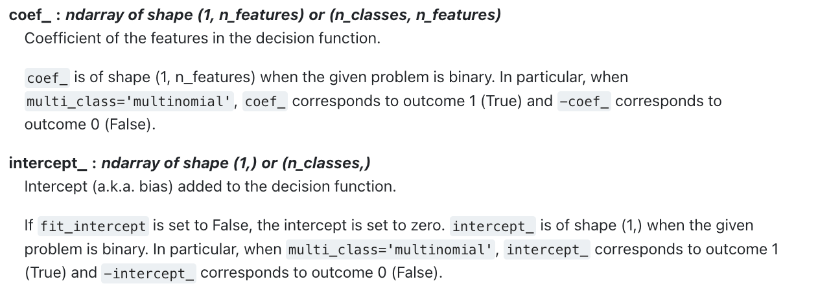
HW #10
1. b. Feature importance analysis / Model interpretation: For each class, print the 10 most important features, and the 10 least important features. Also, print the weights learnt for the three features you added in HW#9.
2. b. Feature importance analysis / Model interpretation: Specifies 3 most important features and 3 least important features for each class. For each feature, describe your conjecture for why that weights was learnt for that feature.
Feature weight == Feature coefficient
(Source: https://scikit-learn.org/stable/modules/generated/sklearn.linear_model.LogisticRegression.html)
Spooky Author classification is a multi_class problem.
For each class take absolute values of its feature coefficients, and then sort them to do 1.b.
Notes:
https://scikit-learn.org/stable/modules/generated/sklearn.linear_model.LogisticRegression.html

