Slide 1

CSc 620 & CSc 820
Natural Language Technologies
Professor Anagha Kulkarni
ak@sfsu.edu
Department of Computer Science
College of Science & Engineering
San Francisco State University

Slide 2
Reminders
Attendance
Peer discussion of a previous homework solution

Slide 3
CSC 620/820: Natural Language Technologies Vector Semantics

Slide 4
What does a word convey? And how do we represent it?
Notes:
Heavy on philosophical discussions.
“the meaning of a word is its use in the language”
-- (Wittgenstein, 1953)
When a word in used in a sentence I imagine meaning-tendrils reaching out from other words in the sentence to that word and vice versa. It is a symbiotic relationship between words -- one cannot exist without others.

Slide 5
Vector Semantics
Two key ideas:
Distributionalist intuition: Represent a word using the other words that occur around it.
Vector representation: A word as a point in space.
The word is “embedded” in a multidimensional semantic space so as to capture the many attributes of a word.

Slide 6
Simple approach: Term-Term Matrix / Word-Word Matrix
|V| x |V| dimensional matrix.
Each cell records the frequency of co-occurrence of row word (target) and column word in some context in a training corpus.
training corpus: no labels. Just textual language data.
context: a window of X words to the left and right of the target word
Notes:
Rows are word vectors, columns are word vectors
For each target word:
Identify all its occurrences in the training corpus and its surrounding contexts
Count how many times a given column word occurs in all the identified contexts

Slide 7
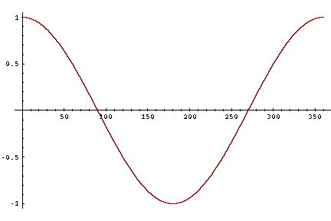
Similarity between two target words: v and w

Slide 8
Word Vectors from Word-Word Matrix
Typical Properties:
Long
Sparse
Unwieldy
 | aardvark | … | computer | data | pinch | result | sugar | … |V| = in millions
aardvark | 0 | … | 0 | 0 | 0 | 0 | 0 | …
…
computer | 0 | … | 0 | 79 | 0 | 83 | 0 | …
data | 0 | … | 79 | 0 | 0 | 123 | 0 | …
pinch | 0 | … | 0 | 0 | 0 | 0 | 65 | …
…
Notes:
Unwieldy why?
Efficiency: We can’t have millions of features in a classification model, for example. We would have to learn millions of feature weights. Computationally very very expensive. Imagine doing gradient descent in a million dimensional space.
Effectiveness: Having so many parameters is sure to overfit the model.
Do not capture word relationships very well. For example, these long sparse vectors for ‘car’ and ‘automobile’ are very different. They shouldn’t be given that they are synonyms / hyper - hyponyms
Reuters RCV1 Dataset Size Statistics:
symbol statistic value
N documents 800,000
V types 400,000
T tokens 100,000,000

Slide 9
Word2Vec
Word-Word Matrix representation produces long and sparse word vectors.
Can we generate word vectors that are short (50-500 dims) and dense (most values are non-zero)?
Yes.
Word2vec Approaches (Mikolov et al., 2013 -- Google)
SGNS (Skip-Gram Negative Sampling)
CBOW (Continuous Bag Of Words)
GloVe Approach (Pennington et al., 2014 -- Stanford)
Notes:
Multiple trained models available for both: Glove trained on Wikipedia, Web data, Twitter.

Slide 10
The Magic that word2vec can do:
Closest word vectors (as per cosine similarity) to frog word vector in GloVe:
frogs, toad, litoria, leptodactylidae, rana, lizard, eleutherodactylus
vector(“Paris”) - vector(“France”) + vector(“Italy”)
Resulting vector is very close to vector(“Rome”)
vector(“brother”) - vector(“man”) + vector(“women”)
Resulting vector is very close to vector(“sister”)
Notes:
Multiple trained models available for both: Glove trained on Wikipedia, Web data, Twitter.

Slide 11
Word2Vec
Word-Word matrix approach counts how often each word w occurs near target word t
Instead train a classifier on a binary prediction task:
Is word w likely to show up near word t ?
Classes: YES or NO
We don’t actually care about the learnt classification model
But we'll take the learned classifier weights as the word vectors (aka word embeddings)

Slide 12
Brilliant insight:
In order to learn the binary classification we need…
Training data (Labelled data for both classes)
Simply use language corpora from real world to extract “labeled” data:
Instances of target word t and co-occurring words around it
No need for hand-labeled data
The idea comes from neural language modeling
Bengio et al. (2003)
Collobert et al. (2011)
Notes:
Use running text as labeled training data
A neural language model: a neural network that is learned to predict the next word from prior words.
word2vec is a much simpler model than the neural network language model, in two ways.
First, word2vec simplifies the task (making it binary classification instead of word prediction).
Second, word2vec simplifies the architecture (training a logistic regression classifier instead of a multi-layer neural network with hidden layers that demand more sophisticated training algorithms)

Slide 13
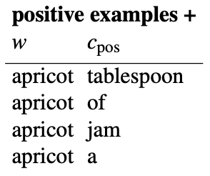
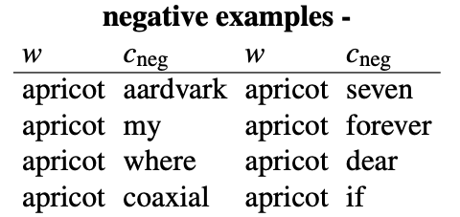
Word2Vec: Skip-Gram with Negative Sampling (SGNS)
Build the training data.
(Assumes context words are those in +/- 2 word window)
For each positive example, create k negative examples.
Using noise words (any random word that isn't t)
Labelled datapoints for Class Yes/Positive
Labelled datapoints for Class No/Negative

Slide 14
Word2vec: Skip-Gram with Negative Sampling (SGNS)
Initialization: Represent each unique word as a vector of some length (d). Initialize these word vectors to zero (or random values).
 | 1 | 2 | 3 | … | d = 300
aardvark | 0 | 0 | 0 | … | 0
… | 0 | 0 | 0 | … | 0
computer | 0 | 0 | 0 | … | 0
data | 0 | 0 | 0 | … | 0
pinch | 0 | 0 | 0 | … | 0
… | 0 | 0 | 0 | … | 0

Slide 15
Word2vec: Skip-Gram with Negative Sampling (SGNS)
Learning: Iteratively update these word vectors such that:
Word vectors for w and c_{pos} are similar
e.g. apricot & tablespoon
Word vectors w and c_{neg} are not similar
e.g. apricot & aardvark
How?
Using Logistic Regression, and
Stochastic Gradient Descent
Notes:
Need an objective function for this!

Slide 16
Task Formulation: Binary Classification Problem
Given a target word (w) and context word (c)
Predict if c is a real context word for w:
P(pos|w,c)
P(neg|w,c) = 1 − P(pos|w,c)
Example:
Given (w,c): (apricot, preserve) P(pos|w,c) is higher than P(neg|w,c), so predict pos class
Given (w,c): (apricot, aardvark) P(neg|w,c) is higher than P(pos|w,c), so predict neg class
How do we estimate P(pos|w,c) and P(neg|w,c) ?

Slide 17
How to formulate P(pos|w,c)
Intuition: words that appear near each other are similar (related) to each other.
(Distributionalist Approach)
When c is a true context word for w, similarity(w,c)
>
When c is not a context word for w, similarity(w,c)
Use simplified version of cosine similarity function (just the numerator)
similarity(w,c) ∝ w.c
But we need a probability, P(pos|w,c), not similarity score. So…

Slide 18
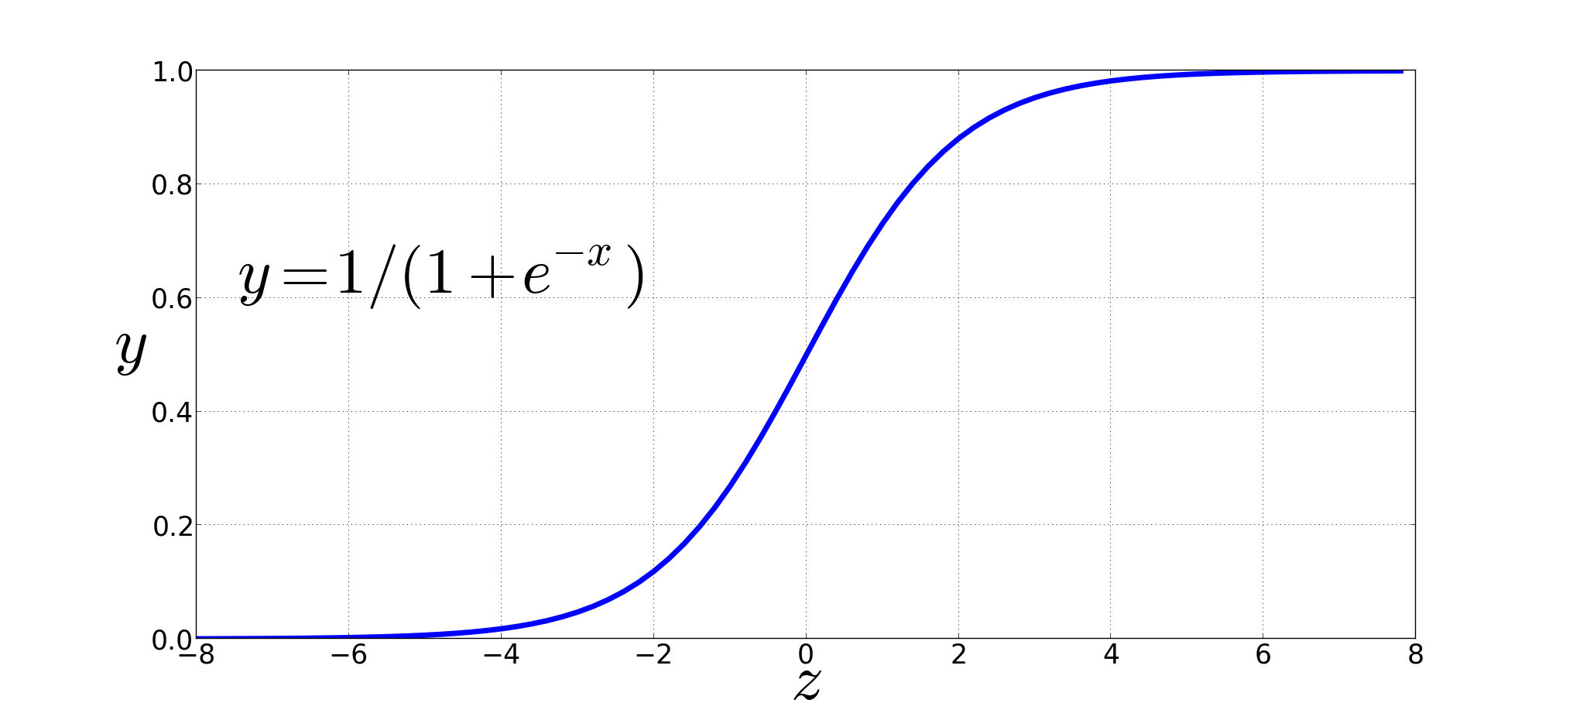
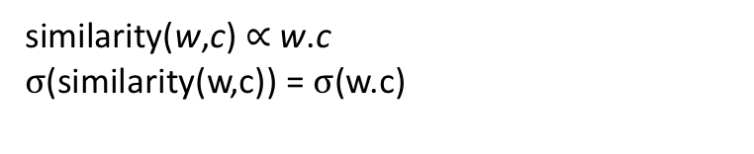
Turn similarity score into a probability using sigmoid function
The sigmoid lies between 0 and 1:
similarity(w,c) ∝ w.c
$σ$(similarity(w,c)) = $σ$(w.c)

Slide 19
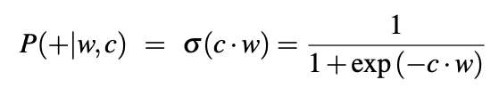
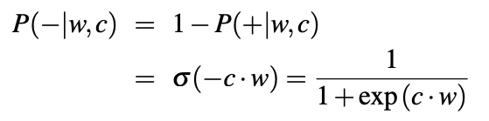
Turn similarity score into a probability
P(pos|w,c)
P(neg|w,c)
P(pos|w,c)
$P\left(− | w,c \right)=1 −\frac{1}{1+e^{−c.w }}=\frac{1+e^{−c.w } −1}{1+e^{−c.w }}=\frac{e^{−c.w}}{1+e^{−c.w }}$ = $\frac{1}{e^{c.w }} ×\frac{e^{c.w}}{1+e^{c.w }}$ = $\frac{1}{1+e^{c.w }}=σ\left(−c.w\right)$
P(neg|w,c)
In order to compute these probabilities we need w and c vectors.

Slide 20
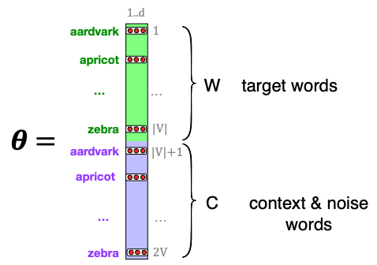
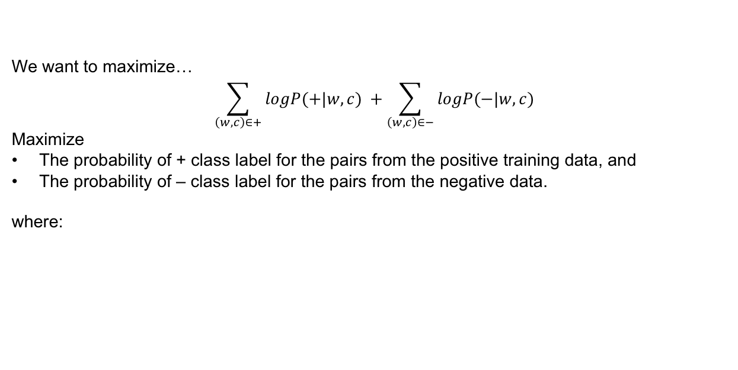


Objective Function
We want to maximize…
$$\sum_{\left(w,c\right)∈+}{logP(+|w,c)} +\sum_{\left(w,c\right)∈−}{logP(−|w,c)}$$
Maximize
The probability of + class label for the pairs from the positive training data, and
The probability of – class label for the pairs from the negative data.
where:
Keep in mind, w and c are vectors of length d
$P\left(+ | w,c \right)= \frac{1}{1+e^{−w.c }}$
$P\left(− | w,c \right)= \frac{1}{1+e^{w.c }}$
What are the underlying parameters for this objective function?
θ : Two matrices, w and c, both of dimensions: |V| x d

Slide 21
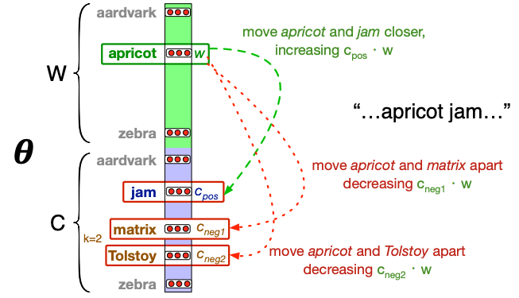
Learning the Parameters: W and C matrices

Slide 22
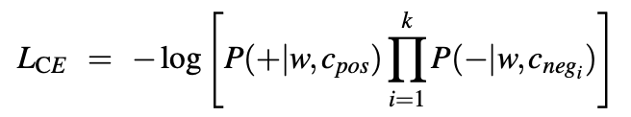
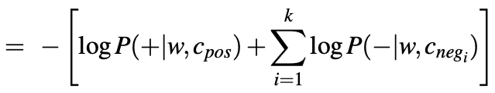
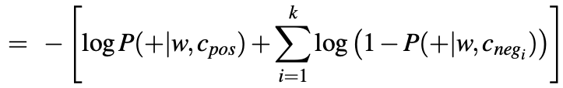
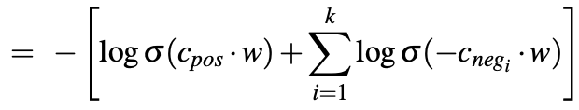

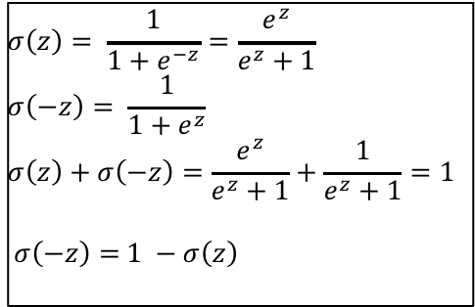
Learning the Parameters: Objective function
Optimize (minimize) the objective function (loss function)
Keep in mind, w and c_{x} are vectors of length d
$$σ\left(z\right)= \frac{1}{1+e^{−z}}=\frac{e^{z}}{e^{z}+1}$$
$$σ\left(−z\right)= \frac{1}{1+e^{z}}$$
$$σ\left(z\right)+σ\left(−z\right)=\frac{e^{z}}{e^{z}+1}+\frac{1}{e^{z}+1}=1$$
$σ\left(−z\right)=$ $1 −σ\left(z\right)$
$$=− \left[\log{σ(c_{pos} . w)+ \sum_{i=1}^{k}{log⁡(1−σ(c_{neg}.w))}}\right]$$

Slide 23
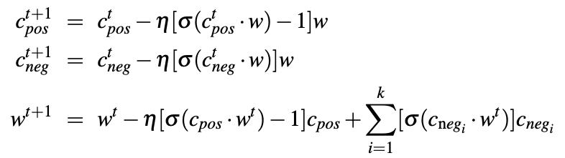
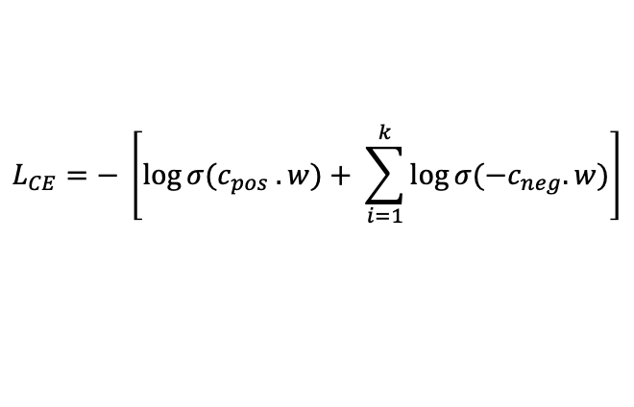
Learning the Parameters: W and C matrices
Optimize (minimize) the objective function (loss function):
$$L_{CE}=− \left[\log{σ(c_{pos} . w)+ \sum_{i=1}^{k}{log⁡σ(−c_{neg}.w)}}\right]$$
Using gradient descent: (For single parameter, w)
Random initialization of w at w¹ (w^{t}, in general)
Compute gradient (in this case, slope) of the loss function at w^{t}
Take a step in the opposite direction of the increasing slope to reach new w^{t} (Parameter update rule / equations)
Repeat steps 2 & 3 until stopping criteria is met.
For the above Loss function, the parameter update rule comes to (after computing partial derivatives of the loss function):
Notes:
One can use W and throw away C, or
Merge them: add or concatenate

Slide 24

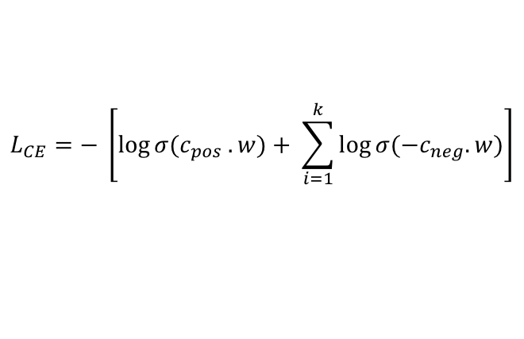
Learning the Parameters: W and C matrices
Optimize (minimize) the objective function (loss function):
$$L_{CE}=− \left[\log{σ(c_{pos} . w)+ \sum_{i=1}^{k}{log⁡σ(−c_{neg}.w)}}\right]$$
Using gradient descent: (For single parameter, w)
Random initialization of w at w¹ (w^{t}, in general)
Compute gradient (in this case, slope) of the loss function at w^{t}
Take a step in the opposite direction of the increasing slope to reach new w^{t} (Parameter update rule / equations)
Repeat steps 2 & 3 until stopping criteria is met.
For the above Loss function, the parameter update rule comes to (after computing partial derivatives of the loss function):
Notes:
One can use W and throw away C, or
Merge them: add or concatenate

Slide 25
Word2Vec: SGNS
Optimize (Minimize) the Objective function using gradient descent
Once the binary classifier is learnt, that is, matrix W and C, are learnt the word embeddings are ready!
In fact, two versions of embeddings are ready for each word, one in each of the matrix.
One can use W and throw away C, or
Aggregate them: add or concatenate

Slide 26
Word2vec SGNS: Summary
Generate labeled data for binary classification task: Is word c a true context word for target word w?
Represent words as vectors of some length (d), randomly initialized.
Target word matrix W: d x |V| dimensions
Context word matrix C: |V| x d dimensions
Over the entire training set, adjust the word vectors so as to:
Maximize the similarity of w vectors and c vectors drawn from the positive data
Minimize the similarity of w vectors and c vectors drawn from the negative data.
One can use W and throw away C, or
Merge them: add or concatenate

