Slide 1

CSc 620 & CSc 820
Natural Language Technologies
Professor Anagha Kulkarni
ak@sfsu.edu
Department of Computer Science
College of Science & Engineering
San Francisco State University

Slide 2
CSC 620/820: Natural Language Technologies Vector Semantics

Slide 3
Vector Semantics
What all does a word convey? And how do we represent it?
Can we represent all of that as short, dense vectors?
Word2Vec: SGNS Algorithm
Notes:
Heavy on philosophical discussions.
“the meaning of a word is its use in the language”
-- (Wittgenstein, 1953)
When a word in used in a sentence I imagine meaning-tendrils reaching out from other words in the sentence to that word and vice versa. It is a symbiotic relationship between words -- one cannot exist without others.

Slide 4
Word2vec SGNS: Summary
Generate labeled data for binary classification task: Is word c a true context word for target word w?
Represent words as vectors of some length (d), randomly initialized.
Target word matrix W: d x |V| dimensions
Context word matrix C: |V| x d dimensions
Over the entire training set, adjust the word vectors so as to:
Maximize the similarity of w vectors and c vectors drawn from the positive data
Minimize the similarity of w vectors and c vectors drawn from the negative data.
One can use W and throw away C, or
Merge them: add or concatenate

Slide 5
Choosing noise words
Could pick noise word w according to their unigram frequency P(w)
But more common to choose them according to P_{α}(w)
α= ¾ works well because it gives rare noise words slightly higher probability
Toy example:
Just two unique words (|V| = 2): a and b
count(a) = 99, count(b) = 1
Using unweighted unigram freq:
P(a) = 99 / (99 + 1) = 0.99
P(b) = 1 / (99 + 1) = 0.01
Using weighted unigram freq:
P_{α}(a) = 99^0.75 / (99^0.75 + 1^0.75) = 0.97
P_{α}(b) = 1^0.75 / (99^0.75 + 1^0.75) = 0.03

Slide 6
Properties of embeddings
Similarity depends on window size of the context C
Example:
Target word: Hogwarts
C = ±2
Sunnydale
Evernight
C = ±5
Dumbledore
Malfoy
halfblood
Semantically similar words with the same parts of speech.
Topically related but not similar.

Slide 7
The Magic that word2vec can do:
Closest word vectors (as per cosine similarity) to frog word vector in GloVe:
frogs, toad, litoria, leptodactylidae, rana, lizard, eleutherodactylus
vector(“Paris”) - vector(“France”) + vector(“Italy”)
Resulting vector is very close to vector(“Rome”)
vector(“brother”) - vector(“man”) + vector(“women”)
Resulting vector is very close to vector(“sister”)
biological/zoological relationships
geopolitical relationships
familial relationships
Notes:
Multiple trained models available for both: Glove trained on Wikipedia, Web data, Twitter.

Slide 8
Embeddings Can Capture Analogical Word Relations
Notes:
high-dimensional vectors have been projected onto 2 dimensions.

Slide 9
Embeddings Can Capture Comparative & Superlative Morphology

Slide 10
Embeddings Can Capture Historical Semantics
Notes:
How word meaning has changed over time?

Slide 11
Hierarchical Clustering of Word Embeddings
Notes:
High-level: Body parts, Pet animals, Cities, Countries

Slide 12
Embeddings reflect cultural bias
Bolukbasi, Tolga, Kai-Wei Chang, James Y. Zou, Venkatesh Saligrama, and Adam T. Kalai. "Man is to computer programmer as woman is to homemaker? debiasing word embeddings." In Advances in Neural Information Processing Systems, pp. 4349-4357. 2016.
Ask “Paris : France :: Tokyo : x”
x = Japan
Ask “father : doctor :: mother : x”
x = nurse
Ask “man : computer programmer :: woman : x”
x = homemaker

Slide 13
Embeddings reflect cultural bias
Caliskan, Aylin, Joanna J. Bruson and Arvind Narayanan. 2017. Semantics derived automatically from language corpora contain human-like biases. Science 356:6334, 183-186.
Psychological findings on US participants:
Certain racial/ethnic names are associated with unpleasant words more.
Male names associated more with math, female names with arts.
Old people's names with unpleasant words, young people with pleasant words.
Caliskan et al. replicated these results with embeddings in their work
Embeddings reflect and replicate all sorts of harmful biases.

Slide 14
Future Directions for Vector Semantics
Debiasing algorithms for embeddings
Bolukbasi, Tolga, Chang, Kai-Wei, Zou, James Y., Saligrama, Venkatesh, and Kalai, Adam T. (2016). Man is to computer programmer as woman is to homemaker? debiasing word embeddings. In Advances in Neural Information Processing Systems, pp. 4349–4357.
Use embeddings as a historical tool to study bias

Slide 15
History of biased framings of women
Garg, Nikhil, Schiebinger, Londa, Jurafsky, Dan, and Zou, James (2018). Word embeddings quantify 100 years of gender and ethnic stereotypes. Proceedings of the National Academy of Sciences, 115(16), E3635–E3644
Embeddings for competence adjectives are biased toward men
Smart, wise, brilliant, intelligent, resourceful, thoughtful, logical, etc.
This bias is slowly decreasing

Slide 16
Conclusion
Words
Complex concepts that can convey many different meanings / concepts
Have a complex many-to-many association with other words
Synonymy, Antonymy, Superordinate
But are hard to define formally
Embeddings = vector models of words
More fine-grained than just a string or index
Especially good at modeling similarity/analogy
Just download them and use cosines!!
Can use sparse models (tf-idf) or dense models (word2vec, GLoVE)
Useful in practice but know they encode cultural stereotypes

Slide 18
CSC 620/820: Natural Language Technologies Neural Networks (NNs)

Slide 19
Neural Networks
Biological inspiration: Human neurons
Modern Neural Networks / Artificial Neural Networks
Are loosely based on the biological neural networks
Large networks consisting of layers of simple units with high degree of connectivity
A very active and evolving sub-field of machine learning
The core underlying idea predates modern IC-based computers (McCulloch and Pitts, 1943)
Last decade has seen tremendous progress in this field due to multiple developments
Data: Availability of large amounts of digital data (e.g. language data, images, videos)
Hardware: Increased computing power (Specialized hardware: GPUs & TPUs, and Distributed computing)
Algorithm: Multiple advancements in learning approaches and network architectures
© by Anagha Kulkarni, 2021

Slide 20
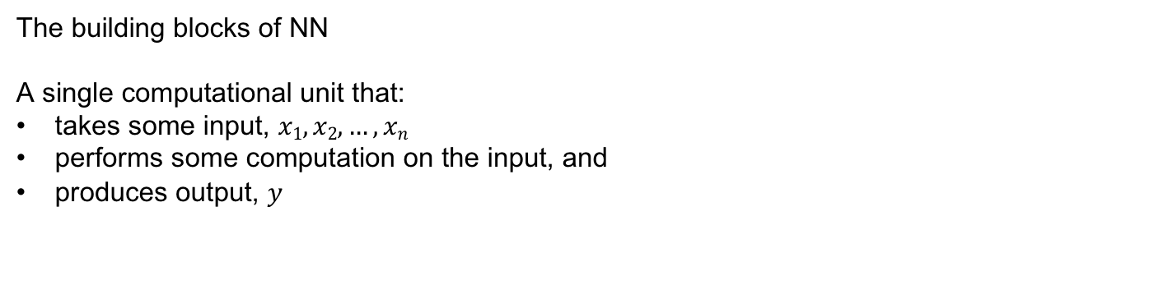
NN: Units
The building blocks of NN
A single computational unit that:
takes some input, $x1, x2,…,xn$
performs some computation on the input, and
produces output, $y$
© by Anagha Kulkarni, 2021

Slide 21
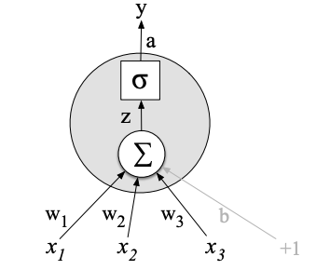


NN: Units
More specifically…
A single computational unit that:
takes weighted sum of the input
adds bias term
apply a non-linear function to z (activation function)
$f()$: non-linear function. Commonly, sigmoid, tanh, ReLU
Activation value of the unit/node.
Also the final output, y, in this single node network.
© by Anagha Kulkarni, 2021

Slide 22
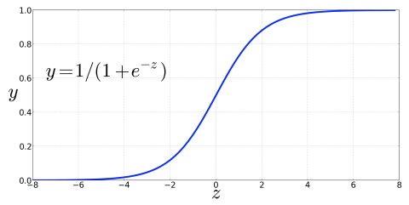
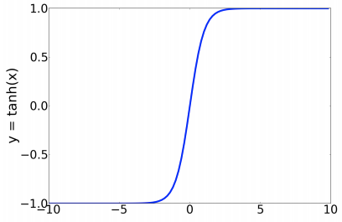


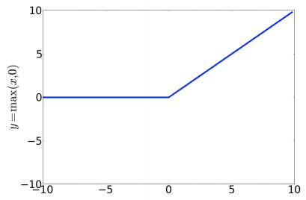
Activation Functions: Non-linear
Sigmoid function
Range: [0,1]
Differentiable
Squashes outliers to 0 or 1
Tanh function
Very similar to Sigmoid but works better for most applications
Range: [-1, +1]
Differentiable
Rectified Linear Unit (ReLU)
Simplest activation function
Most commonly used
Range: [0, ∞)
Close to a linear function
Does not suffer from the vanishing gradient problem
© by Anagha Kulkarni, 2021
Notes:
For Sigmoid and tanh functions: high values of z lead to saturation: value of 1. This implies that the function doesn’t change thus derivative very close to 0 for high values of z. Zero derivatives lead to problems during learning / model training.
ReLU doesn’t have that problem because derivatives for high z values are close to 1 rather than 0.
Without activation functions, NN units will simply perform a linear transformation on the input. “A neural network without an activation function is essentially just a linear regression model.”

Slide 23

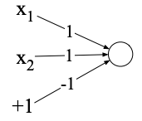
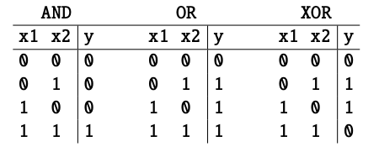
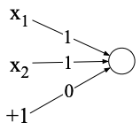
Power of Neural Networks
Ability to combine the simple NN units into larger networks
A clever demonstration of this from 1969! (Minsky and Papert, 1969)
XOR function
Perceptron: A simple neural unit with binary output and no non-linear activation function.
Perceptron for logical AND function:
Perceptron for logical OR function:
Weights w
© by Anagha Kulkarni, 2021
Notes:
Perceptron function: Binary Step function.

Slide 24
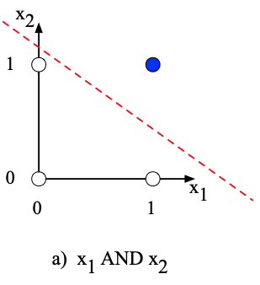
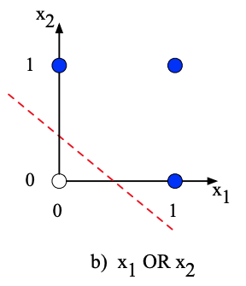
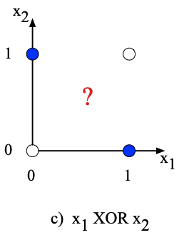
Power of Neural Networks
Impossible to build an XOR function with perceptron.
Why?
Perceptron is a linear classifier.
For a two-dimensional input space the perceptron’s decision boundary is a line.
For multi-dimensional input the decision boundary would be a hyperplane.
White dots
Blue dots
© by Anagha Kulkarni, 2021

Slide 25
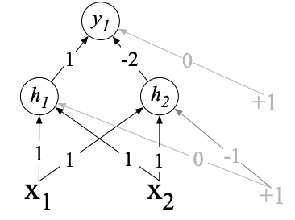
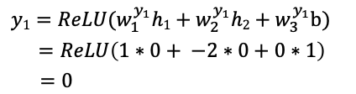
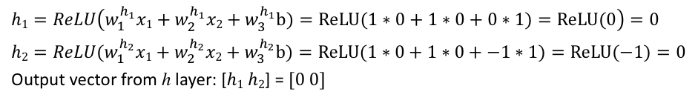
Power of Neural Networks
XOR function is not a linearly separable function.
Solution: Neural Networks
2 layers of ReLU-based units (Goodfellow et al., 2016)
Case 1: 0 XOR 0 is 0
ReLU function:
$$h1=ReLU\left(w_{1}^{h_{1}}x1+w_{2}^{h_{1}}x2+w_{3}^{h_{1}}b)=ReLU(1∗0+1∗0+0∗1)=ReLU(0\right)=0$$
$$h2={ReLU(w}_{1}^{h_{2}}x1+w_{2}^{h_{2}}x2+w_{3}^{h_{2}}b)=ReLU(1∗0+1∗0+−1∗1)=ReLU(−1)=0$$
Output vector from h layer: [$h1$ $h2$] = [0 0]
Layer 2: y
Layer 1: h
$$y1={ReLU(w}_{1}^{y_{1}}h1+w_{2}^{y_{1}}h2+w_{3}^{y_{1}}b)$$
$$=ReLU\left(1∗0+ −2∗0+0∗1\right)$$
$=0$
[0 0]
© by Anagha Kulkarni, 2021

Slide 26
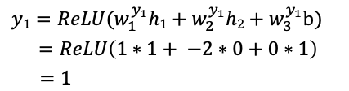
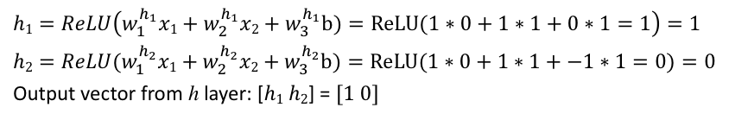
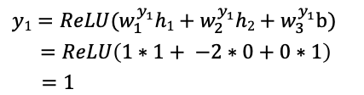
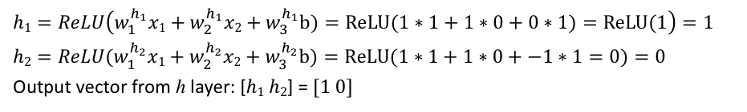
Power of Neural Networks
ReLU function:
Layer 2: y
Case 2: 1 XOR 0 is 1
$$h1=ReLU\left(w_{1}^{h_{1}}x1+w_{2}^{h_{1}}x2+w_{3}^{h_{1}}b)=ReLU(1∗1+1∗0+0∗1)=ReLU(1\right)=1$$
$$h2={ReLU(w}_{1}^{h_{2}}x1+w_{2}^{h_{2}}x2+w_{3}^{h_{2}}b)=ReLU(1∗1+1∗0+−1∗1=0)=0$$
Output vector from h layer: [$h1$ $h2$] = [1 0]
Layer 1: h
$$y1={ReLU(w}_{1}^{y_{1}}h1+w_{2}^{y_{1}}h2+w_{3}^{y_{1}}b)$$
$$=ReLU\left(1∗1+ −2∗0+0∗1\right)$$
$=1$
[1 0]
[0 1]
Case 3: 0 XOR 1 is 1
$$h1=ReLU\left(w_{1}^{h_{1}}x1+w_{2}^{h_{1}}x2+w_{3}^{h_{1}}b)=ReLU(1∗0+1∗1+0∗1=1\right)=1$$
$$h2={ReLU(w}_{1}^{h_{2}}x1+w_{2}^{h_{2}}x2+w_{3}^{h_{2}}b)=ReLU(1∗0+1∗1+−1∗1=0)=0$$
Output vector from h layer: [$h1$ $h2$] = [1 0]
$$y1={ReLU(w}_{1}^{y_{1}}h1+w_{2}^{y_{1}}h2+w_{3}^{y_{1}}b)$$
$$=ReLU\left(1∗1+ −2∗0+0∗1\right)$$
$=1$
© by Anagha Kulkarni, 2021

Slide 27
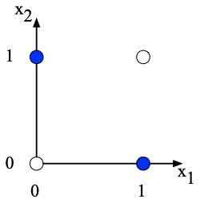
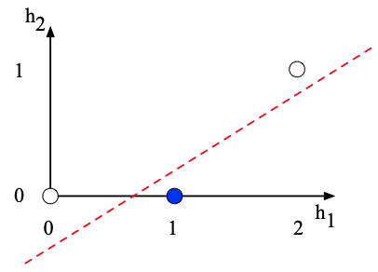
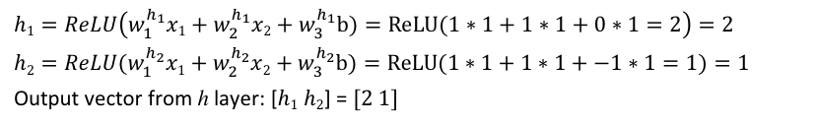
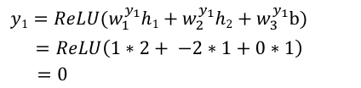
Power of Neural Networks
Layer 2: y
This hidden representation of the input collapses two input cases ([1 0] and [0 1]) to a single point in the h space [1 0].
Enabling linear separation of the blue and white datapoints!
Case 4: 1 XOR 1 is 0
Layer 1: h
$$h1=ReLU\left(w_{1}^{h_{1}}x1+w_{2}^{h_{1}}x2+w_{3}^{h_{1}}b)=ReLU(1∗1+1∗1+0∗1=2\right)=2$$
$$h2={ReLU(w}_{1}^{h_{2}}x1+w_{2}^{h_{2}}x2+w_{3}^{h_{2}}b)=ReLU(1∗1+1∗1+−1∗1=1)=1$$
Output vector from h layer: [$h1$ $h2$] = [2 1]
[1 1]
$$y1={ReLU(w}_{1}^{y_{1}}h1+w_{2}^{y_{1}}h2+w_{3}^{y_{1}}b)$$
$$=ReLU\left(1∗2+ −2∗1+0∗1\right)$$
$=0$
In original x space:
Case 1: [0 0] is 0
Case 2: [1 0] is 1
Case 3: [0 1] is 1
Case 4: [1 1] is 0
In the new h space (linearly separable):
Case 1: [0 0] is 0
Case 2: [1 0] is 1
Case 3: [1 0] is 1
Case 4: [2 1] is 0
© by Anagha Kulkarni, 2021

Slide 28
Reminders
Attendance

