Slide 1

CSc 620 & CSc 820
Natural Language Technologies
Professor Anagha Kulkarni
ak@sfsu.edu
Department of Computer Science
College of Science & Engineering
San Francisco State University

Slide 2
CSC 620/820: Natural Language Technologies Neural Networks (NNs)
© by Anagha Kulkarni, 2021

Slide 3
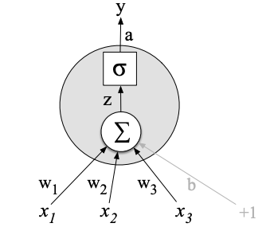


NN: Units
A single computational unit that:
takes weighted sum of the input
adds bias term
apply a non-linear function to z (activation function)
$f()$: non-linear function. Commonly, sigmoid, tanh, ReLU
Activation value of the unit/node.
Also the final output, y, in this single node network.
© by Anagha Kulkarni, 2021

Slide 4

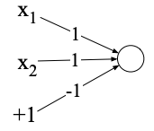
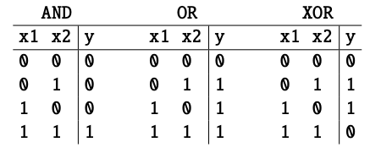
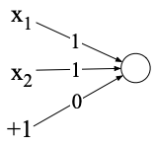
Power of Neural Networks
Ability to combine the simple NN units into larger networks
A clever demonstration of this from 1969! (Minsky and Papert, 1969)
XOR function
Perceptron: A simple neural unit with binary output and no non-linear activation function.
Perceptron for logical AND function:
Perceptron for logical OR function:
Weights w
© by Anagha Kulkarni, 2021
Notes:
Perceptron function: Binary Step function.

Slide 5
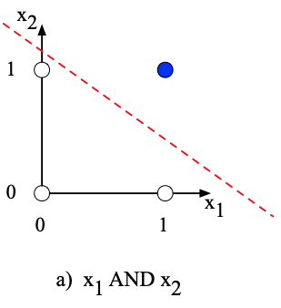
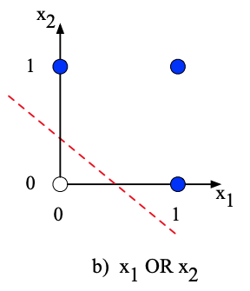
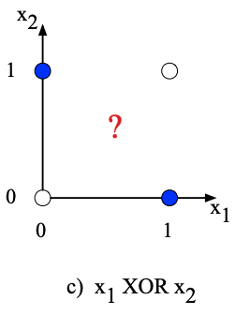
Power of Neural Networks
Impossible to build an XOR function with perceptron.
Why?
Perceptron is a linear classifier.
For a two-dimensional input space the perceptron’s decision boundary is a line.
For multi-dimensional input the decision boundary would be a hyperplane.
White dots
Blue dots
© by Anagha Kulkarni, 2021

Slide 6
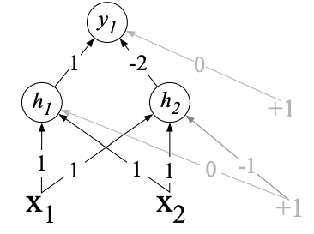
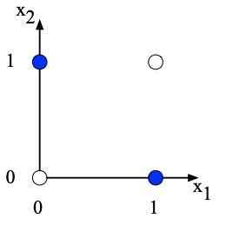
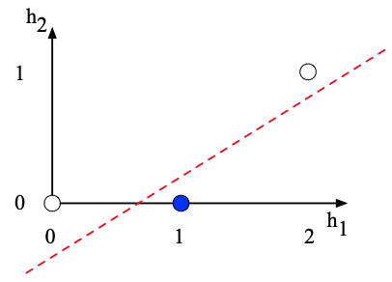
Power of Neural Networks
Layer 2: y
This hidden representation of the input collapses two input cases ([1 0] and [0 1]) to a single point in the h space [1 0].
Enabling linear separation of the blue and white datapoints!
Layer 1: h
[1 1]
In original x space:
Case 1: [0 0] is 0
Case 2: [1 0] is 1
Case 3: [0 1] is 1
Case 4: [1 1] is 0
In the new h space (linearly separable):
Case 1: [0 0] is 0
Case 2: [1 0] is 1
Case 3: [1 0] is 1
Case 4: [2 1] is 0
© by Anagha Kulkarni, 2021

Slide 8
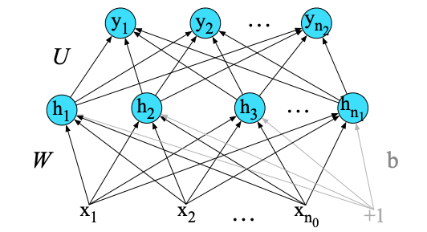
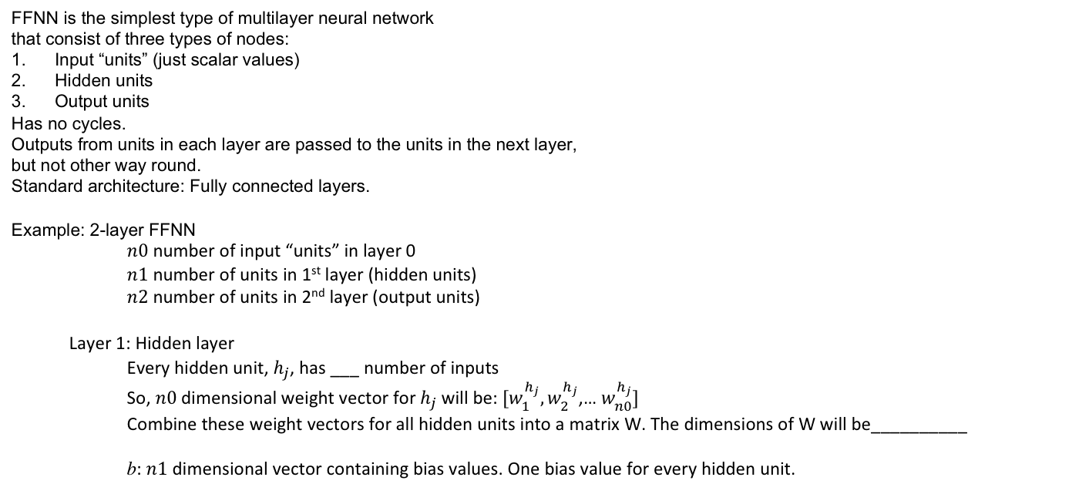


Feed-Forward Neural Network FFNN
Recall, every unit has as many w parameters as the no. of inputs (+ 1 bias parameter).
E.g., This unit has 3 w parameters (+ 1 bias parameter).
FFNN is the simplest type of multilayer neural network
that consist of three types of nodes:
Input “units” (just scalar values)
Hidden units
Output units
Has no cycles.
Outputs from units in each layer are passed to the units in the next layer,
but not other way round.
Standard architecture: Fully connected layers.
Example: 2-layer FFNN
$n0$ number of input “units” in layer 0
$n1$ number of units in 1st layer (hidden units)
$n2$ number of units in 2nd layer (output units)
Layer 1: Hidden layer
Every hidden unit, $h_{j}$, has ___ number of inputs
So, $n0$dimensional weight vector for $h_{j}$will be: ${[w}_{1}^{h_{j}},w_{2}^{h_{j}}$,… $w_{n0}^{h_{j}}]$
Combine these weight vectors for all hidden units into a matrix W. The dimensions of W will be__________
b: $n1$ dimensional vector containing bias values. One bias value for every hidden unit.
$$n0$$
$$[n1,n0]$$
© by Anagha Kulkarni, 2021
Notes:
(one weight $w_{i}^{h_{j}}$ for every incoming edge from input $x_{i}∈[x_{1},x_{2},…,x_{n0}]$)

Slide 9
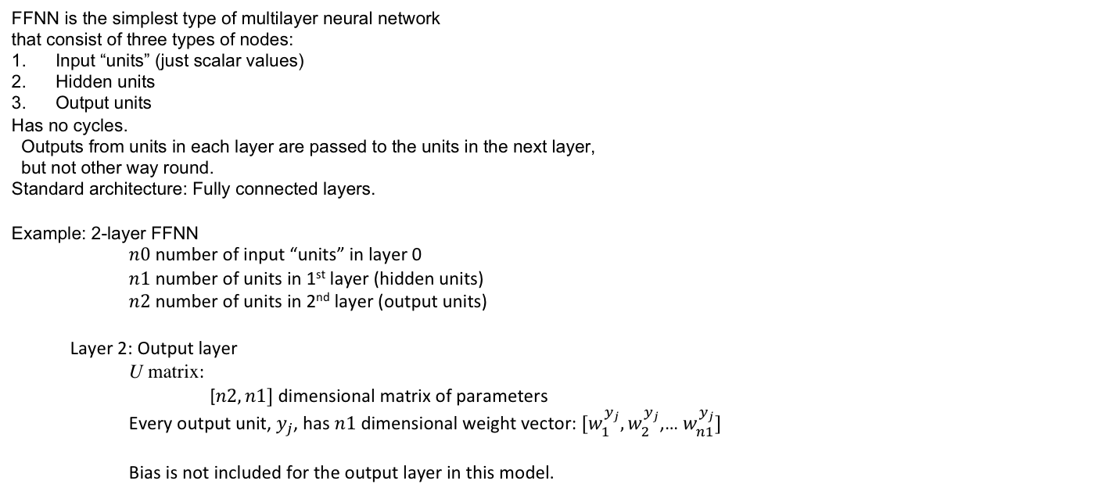
Feed-Forward Neural Network FFNN
FFNN is the simplest type of multilayer neural network
that consist of three types of nodes:
Input “units” (just scalar values)
Hidden units
Output units
Has no cycles.
Outputs from units in each layer are passed to the units in the next layer,
but not other way round.
Standard architecture: Fully connected layers.
Example: 2-layer FFNN
$n0$ number of input “units” in layer 0
$n1$ number of units in 1st layer (hidden units)
$n2$ number of units in 2nd layer (output units)
Layer 2: Output layer
U matrix:
[$n2, n1]$ dimensional matrix of parameters
Every output unit, $y_{j}$, has $n1$dimensional weight vector: ${[w}_{1}^{y_{j}},w_{2}^{y_{j}}$,… $w_{n1}^{y_{j}}]$
Bias is not included for the output layer in this model.
© by Anagha Kulkarni, 2021
Notes:
(one weight $w_{i}^{y_{j}}$ for every incoming edge from hidden unit $h_{i}∈[h_{1},h_{2},…,h_{n1}]$)

Slide 10



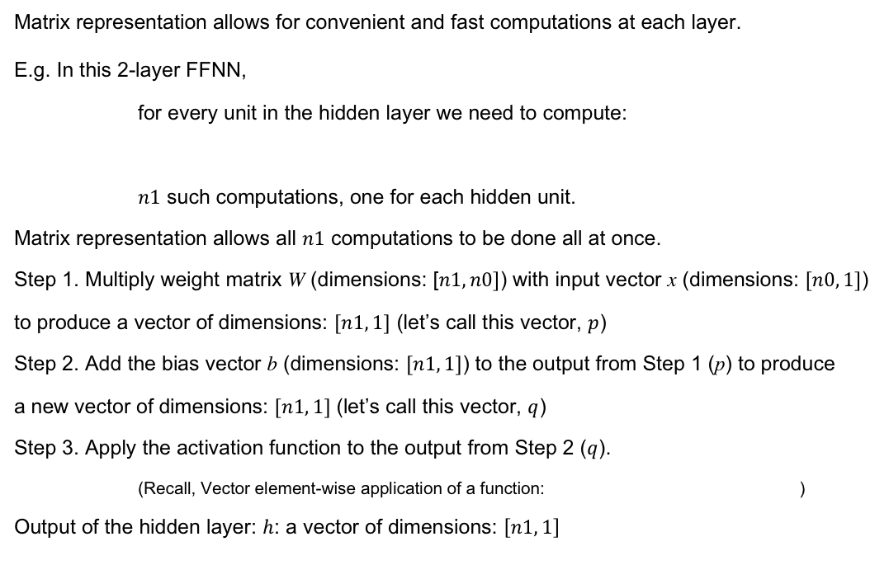




Feed-Forward Neural Networks
Matrix representation allows for convenient and fast computations at each layer.
E.g. In this 2-layer FFNN,
for every unit in the hidden layer we need to compute:
$n1$ such computations, one for each hidden unit.
Matrix representation allows all $n1$ computations to be done all at once.
Step 1. Multiply weight matrix W (dimensions: [$n1, n0]$) with input vector x (dimensions: $[n0, 1]$)
to produce a vector of dimensions: $[n1, 1]$ (let’s call this vector, $p$)
Step 2. Add the bias vector b (dimensions: $[n1, 1]$) to the output from Step 1 (p) to produce
a new vector of dimensions: $[n1, 1]$ (let’s call this vector, $q$)
Step 3. Apply the activation function to the output from Step 2 ($q$).
(Recall, Vector element-wise application of a function: )
Output of the hidden layer: $h$: a vector of dimensions: $\left[n1, 1\right]$
$$h_{j}=$$
$$p=Wx$$
$$q=p+b$$
$$σ(q)$$
© by Anagha Kulkarni, 2021
Notes:
Linear Algebra!

Slide 11

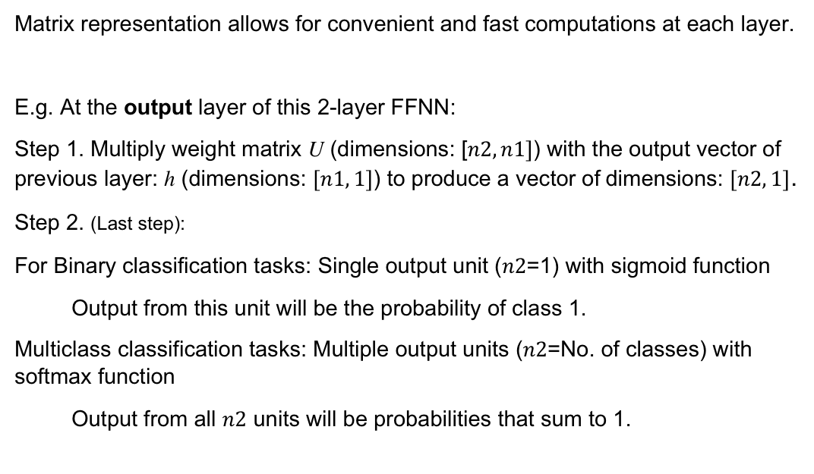
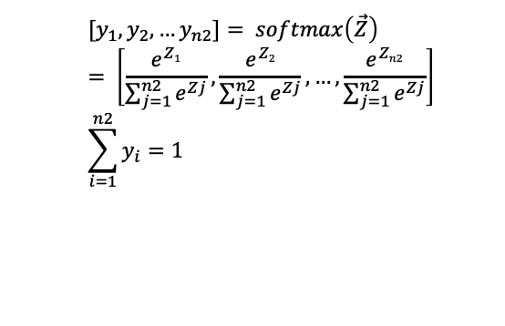

Feed-Forward Neural Networks
Matrix representation allows for convenient and fast computations at each layer.
E.g. At the output layer of this 2-layer FFNN:
Step 1. Multiply weight matrix U (dimensions: [$n2, n1]$) with the output vector of previous layer: h (dimensions: $[n1, 1]$) to produce a vector of dimensions: $[n2, 1]$.
Step 2. (Last step):
For Binary classification tasks: Single output unit ($n2$=1) with sigmoid function
Output from this unit will be the probability of class 1.
Multiclass classification tasks: Multiple output units ($n2$=No. of classes) with softmax function
Output from all $n2$ units will be probabilities that sum to 1.
$$P\left(c=1 \right| x)=y_{1}= \frac{1}{1+e^{−z}}$$
$$[y_{1},y_{2},…y_{n2}]= softmax\left(\vec{Z}\right)= \left[\frac{e^{Z1}}{\sum_{j=1}^{n2}{e^{Zj}}},\frac{e^{Z2}}{\sum_{j=1}^{n2}{e^{Zj}}}, …,\frac{e^{Zn2}}{\sum_{j=1}^{n2}{e^{Zj}}}\right]$$
$$\sum_{i=1}^{n2}{y_{i}=1}$$
© by Anagha Kulkarni, 2021

Slide 12
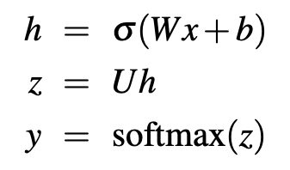
Feed-Forward Neural Networks
In Summary:
This 2-layer FFNN:
Takes as input vector x
Outputs probability distribution y, and
Is parameterized by weight matrices W and U, and bias vector b,
The final equations are:
Need to be learned / trained
© by Anagha Kulkarni, 2021

Slide 13
Feed-Forward Neural Networks
The parallels between 2-layer FFNN classifier and traditional classification approach:
Step 1. Input Transformation: Input to Hidden layer vector ≈ Input to Feature vector (network features instead of engineered features)
Step 2. Learn classification model: Learn network weights ≈ Learn feature weights
© by Anagha Kulkarni, 2021

