Slide 1

CSc 620 & CSc 820
Natural Language Technologies
Professor Anagha Kulkarni
ak@sfsu.edu
Department of Computer Science
College of Science & Engineering
San Francisco State University

Slide 2
CSC 620/820: Natural Language Technologies Neural Networks (NNs)
© by Anagha Kulkarni, 2021

Slide 3
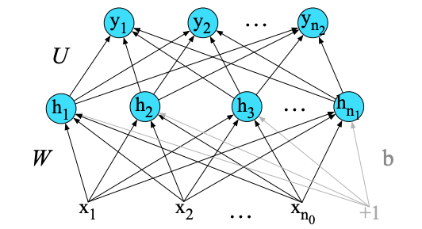
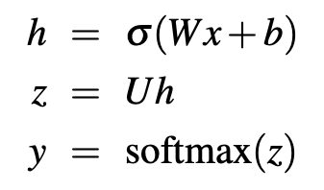
Feed-Forward Neural Networks
In Summary:
This 2-layer FFNN:
Takes as input vector x
Outputs probability distribution y, and
Is parameterized by weight matrices W and U, and bias vector b,
The final equations are:
Need to be learned / trained
© by Anagha Kulkarni, 2021

Slide 4
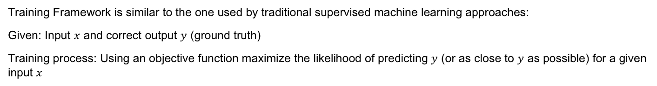
Training Neural Networks
Training Framework is similar to the one used by traditional supervised machine learning approaches:
Given: Input $x$ and correct output $y$ (ground truth)
Training process: Using an objective function maximize the likelihood of predicting $y$ (or as close to $y$ as possible) for a given input $x$
© by Anagha Kulkarni, 2021

Slide 5
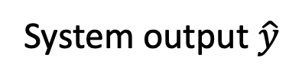
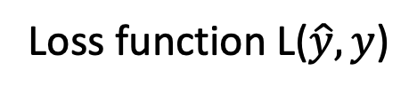

Intuition: Training a 2-layer Network
Actual answer $y$
Loss function L($\hat{y},y$)
System output $\hat{y}$
U
(Backward computation of the weight updates)
Backward pass
Forward pass
W
(Forward computation of the loss)
x₁
x_{n}
Training instance
How did we update the weights?
We computed the loss function
We computed its derivative
Notes:
The intuition of neural net training is the forward computation of the loss and the backward computation of the weight updates. Given an input x,
CLICK
we run a forward pass through the network, computing the system output y-hat. CLICK
Then we compare y-hat to the true answer y, CLICK to get a loss for this example. CLICK Then CLICK we do a backward pass through the network, computing the gradients we need to update the weights.
Notice: Where in the network are we able to compute the loss? Keep this in mind over the next few slides.

Slide 6
Step 1 (Reminder: Loss Function for binary logistic regression)
A measure for how far off the current answer is from the right answer
Cross entropy loss for logistic regression:
Notes:
Let's next get an intuition from what we did for logistic regression. Remember our loss function for binary logistic regression. We’d like to learn weights that maximize the log probability of the correct label p(y|x). To turn this into loss function (something that we need to minimize), we flipped the sign, and then we can plug in our estimate of the probability from the sigmoid of the weights

Slide 7

Step 2 (Reminder: gradient descent for weight updates)
Use the derivative of the loss function with respect to weights $\frac{d}{dw}L(f\left(x;w\right),y)$
To tell us how (which direction) to adjust weights for each training item
Move them in the opposite direction of the gradient
For logistic regression:
Notes:
And let's recall from the lecture on logistic regression how gradient descent works for weight updates. The magnitude of the amount to move in gradient descent is the value of the graident of the loss function (with respect to w) weighted by a learning rate η . A higher (faster) learning rate means that we should move w more on each step. The change we make in our parameter is the learning rate times the gradient.
For logistic regression, we saw that the derivative of the loss function with respect to one weight w_j coming from input x_j is

Slide 8
Training Neural Networks
However, applying optimization algorithms (e.g. GD) to NNs is complicated because
there are many more parameters and they are spread over multiple layers
the loss information at the output layer has to inform adjustment of the parameters on layers not directly connected to the output layer
Computing partial derivatives of the loss function (like we did before) to iteratively update the parameters will only update the weights on the last layer. What about the weights on the previous layers?
How does one compute partial derivatives of the loss function over intermediate layers?
Error backpropagation. Reverse differentiation.
© by Anagha Kulkarni, 2021

Slide 9
Short detour

Slide 10
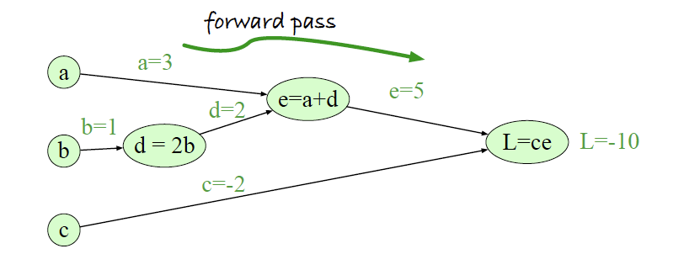

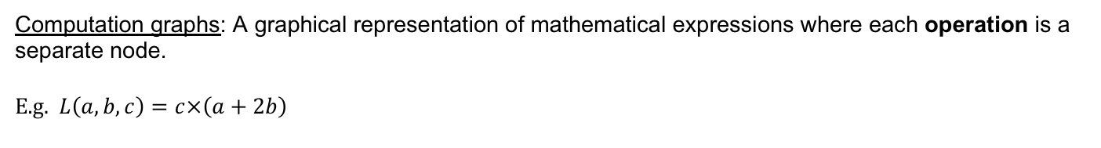
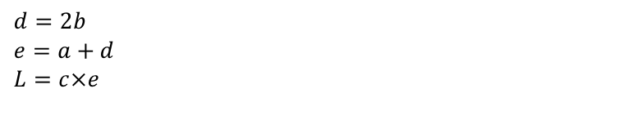
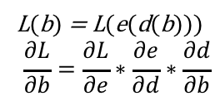
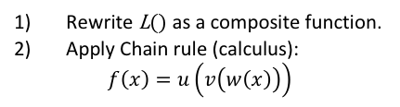
Computation graphs: A graphical representation of mathematical expressions where each operation is a separate node.
E.g. $L\left(a,b,c\right)=c×\left(a+2b\right)$
$$d=2b$$
$$e=a+d$$
$$L=c×e$$
Computation graph of function L().
E.g. How does one compute partial derivate of L() wrt b?
Two nodes in between, d & e. The gradient has to pass backward through the intermediate nodes.
Using computation graphs…
L(b) = L(e(d(b)))
$$\frac{∂L}{∂b}=\frac{∂L}{∂e}∗\frac{∂e}{∂d}∗\frac{∂d}{∂b}$$
Rewrite L() as a composite function.
Apply Chain rule (calculus):
$$f\left(x\right)=u\left(v\left(w\left(x\right)\right)\right)$$
Notes:
The intuition of backward differentiation is to pass gradients back from the final node to all the nodes in the graph.
L/b = L/e * e/d * d/b

Slide 11
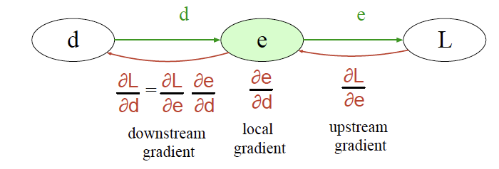
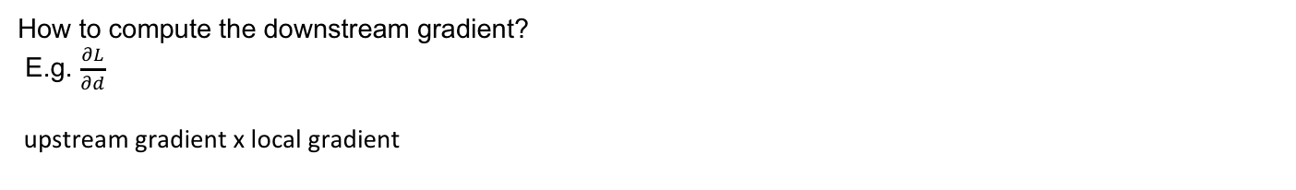
How to compute the downstream gradient?
E.g. $\frac{∂L}{∂d}$
upstream gradient x local gradient
Notes:
The intuition of backward differentiation is to pass gradients back from the final node to all the nodes in the graph.
L/b = L/e * e/d * d/b

Slide 12
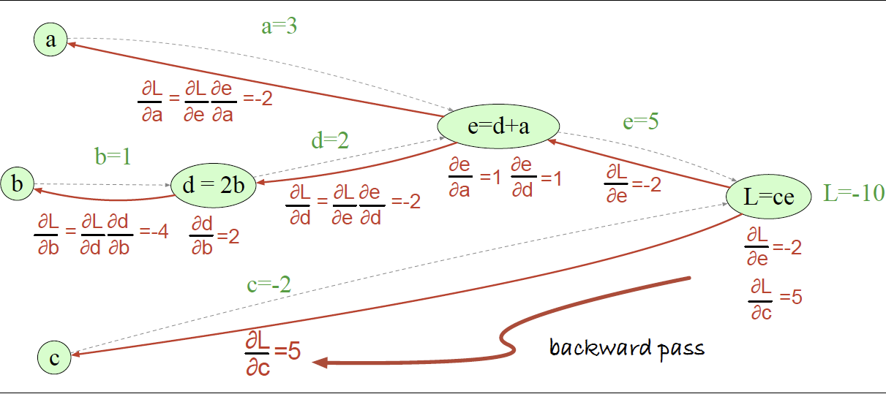
Now we can compute partial derivate of L() wrt a, d, and b !
downstream gradient
local gradient
upstream gradient
Notes:
The intuition of backward differentiation is to pass gradients back from the final node to all the nodes in the graph.
L/b = L/e * e/d * d/b

Slide 13
Training Neural Networks
Error Backpropagation at scale!
This process of backward differentiation on much larger computation graphs has to be done
NN Toolkits are designed to do this at large-scale efficiently by utilizing matrix operations and parallelization
Using customized hardware & software
GPUs, TPUs, PyTorch, TensorFlow

Slide 15
Two use cases for feedforward neural networks in NLP
Text classification
Language modeling
Notes:
State of the art systems use more powerful neural architectures, but first understanding simpler models is a foundational step.

Slide 16
Text Classification using traditional classification algorithms
σ()
Sentiment Classification:
{f₁,…,f_{n}} = {x₁,…,x_{n}} = Engineered Features to capture Sentiment signals in documents
Logistic
Regression
W
x₁
x_{n}
f₁
f₂
f_{n}
Input layer consists of engineered features, and
Output layer is single node that uses thresholded sigmoid to produce: 0 or 1 (Class prediction)

Slide 17
Text Classification using FFNN
σ()
U
σ()
2-layer
feedforward
network
Logistic
Regression
W
W
x₁
x_{n}
f₁
f_{n}
x₁
x_{n}
f₂
f₁
f₂
f_{n}
17
For the input layer, we could do exactly what we did with logistic regression:
Engineered features as input to the network.
Notes:
Adding a hidden layer to logistic regression allows the network to use non-linear interactions between features which may (or may not) improve performance.

Slide 18
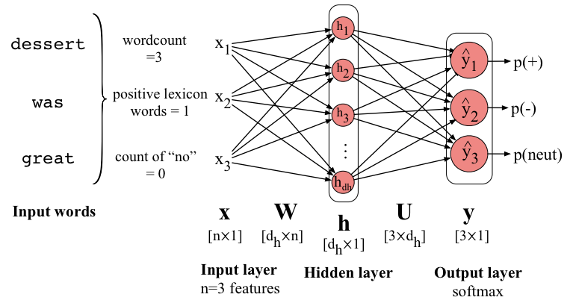
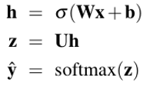
Sentiment Classification using FFNN & Engineered features as input representation

Slide 19
Better choice: Input representation learning
σ()
U
The real power of deep learning comes from the ability to learn features from the data.
Instead of using hand-built human-engineered features for classification
Use learned representations like embeddings!
W
x₁
x_{n}
e₁
e₂
e_{n}

