Slide 1

CSc 620 & CSc 820
Natural Language Technologies
Professor Anagha Kulkarni
ak@sfsu.edu
Department of Computer Science
College of Science & Engineering
San Francisco State University

Slide 2
CSC 620/820: Natural Language Technologies Neural Networks (NNs)
© by Anagha Kulkarni, 2021

Slide 3
Reminders
Quick 10-minute homework #12 share with a peer
Record lectures this week

Slide 4
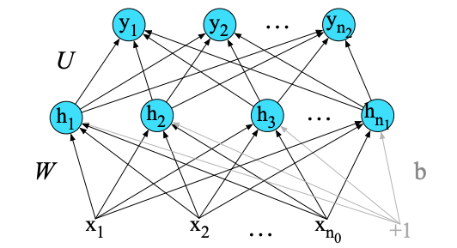
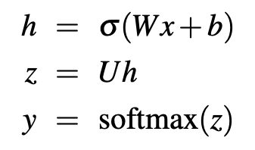
Feed-Forward Neural Networks
In Summary:
This 2-layer FFNN:
Takes as input vector x
Outputs probability distribution y, and
Is parameterized by weight matrices W and U, and bias vector b,
The final equations are:
© by Anagha Kulkarni, 2021
Notes:
W, U, b Need to be learned / trained
Forward Pass equations

Slide 5
Two use cases for feedforward neural networks in NLP
Text classification
Language modeling
Notes:
State of the art systems use more powerful neural architectures, but first understanding simpler models is a foundational step.

Slide 6
Text Classification using FFNN
σ()
U
σ()
2-layer
feedforward
network
Logistic
Regression
W
W
x₁
x_{n}
f₁
f_{n}
x₁
x_{n}
f₂
Sentiment Classification:
{f₁,…,f_{n}} = {x₁,…,x_{n}} = Engineered Features to capture Sentiment signals in documents
f₁
f₂
f_{n}
6
For the input layer, we could do exactly what we did with logistic regression:
Engineered features as input to the network.
Notes:
Adding a hidden layer to logistic regression allows the network to use non-linear interactions between features which may (or may not) improve performance.

Slide 7
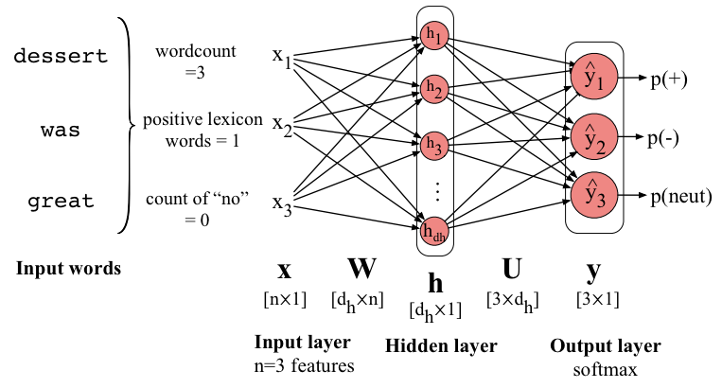
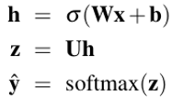
Sentiment Classification using FFNN & Engineered features as input representation

Slide 8
Better choice: Input representation learning
σ()
U
The real power of deep learning comes from the ability to learn features from the data.
Instead of using hand-built human-engineered features for classification
Use learned representations like embeddings!
W
x₁
x_{n}
e₁
e₂
e_{n}

Slide 9

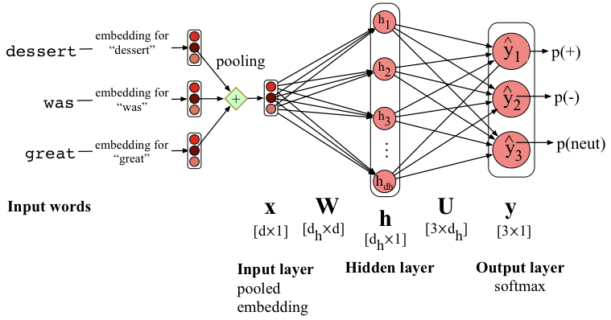
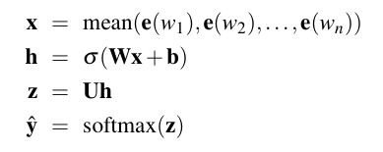
Sentiment Classification using FFNN & Pooled embeddings of the input words
Final set of equations for this feedforward sentiment classifier with mean pooling:

Slide 10
Two use cases for feedforward neural networks in NLP
Text classification
Language modeling
Notes:
State of the art systems use more powerful neural architectures, but first understanding simpler models is a foundational step.

Slide 11
Neural Language Models (LMs)
Language Modeling: Calculating the probability of the next word in a sequence of words.
We've seen N-gram based LMs
But neural network LMs far outperform n-gram language models
State-of-the-art neural LMs are based on more sophisticated neural networks
But simple feedforward LMs can do almost as well!
Notes:
technology like Transformers

Slide 12
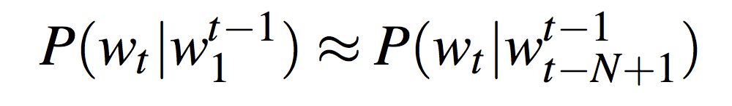
Simple feedforward Neural Language Models (NLM)
Task: predict next word w_{t}
given prior words w_{t-1}, w_{t-2}, w_{t-3}, …
Challenge: Now we’re dealing with sequences of arbitrary length.
Solution: Sliding windows (of fixed length)

Slide 13
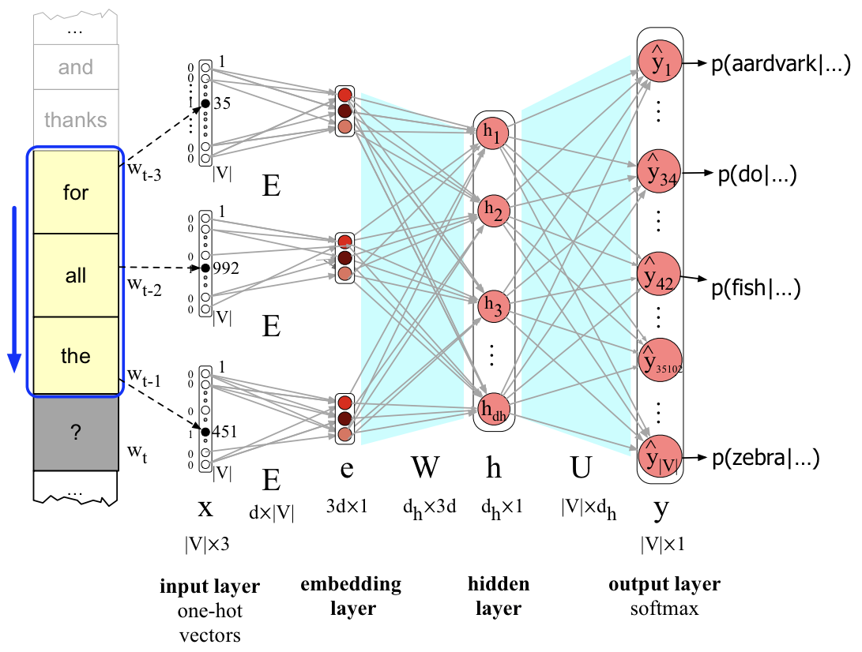
Neural LM: Forward Inference
In the context of LM,
Forward Inference in the task of running a forward pass on the network for the given input word sequence (e.g. “for all the”)
to produce a probability distribution over all the words in the vocabulary.
P(“aardvark”|“for all the”) = 0.0003
P(“do”|“for all the”) = 0.00000000001
P(“fish”|“for all the”) = 0.0005
P(“trouble”|“for all the”) = 0.003
This probability distribution quantifies the likelihood of each word being the next word in the input sequence.
Sliding window size: 3

Slide 14
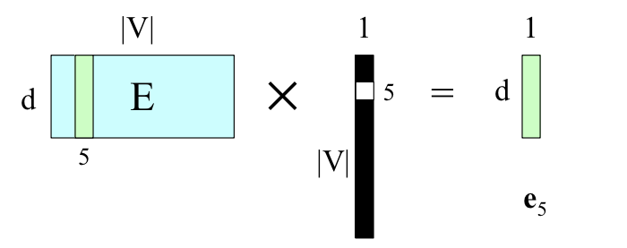
Neural Language Model
Let’s start by understanding the network architecture, layer by layer.
Starting with layer 0, input layer.
Part 1. one-hot vectors & embeddings
Why do we need 1-hot vectors?
To be able to use linear algebra (vector/matrix multiplication).
Sliding window size: 3

Slide 15

Neural Language Model
Still layer 0, input layer, but
Part 2. Concatenated input word embeddings
for all the
Sliding window size: 3
Notes:
The input word embeddings are concatenated for this problem, as opposed to, mean pooling in the text classification problem.

Slide 16

Neural Language Model
Now, layer 1, hidden layer.
Sliding window size: 3

Slide 17
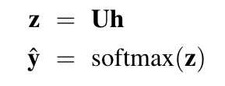
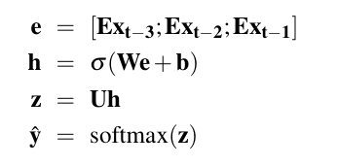
Neural Language Model
Last, layer 2, output layer.
Final set of equations for this feedforward neural language model:
Sliding window size: 3

Slide 18
Why Neural LMs work better than N-gram LMs
Training data:
We've seen: I have to make sure that the cat gets fed.
Never seen: dog gets fed
Test data:
I forgot to make sure that the dog gets ___
N-gram LM can't predict "fed"!
Neural LM can use similarity of "cat" and "dog" embeddings to generalize and predict “fed” after dog
Notes:
Pretrained embeddings: embedding representation for words already learnt using another algorithm (e.g. Word2Vec, GloVe)

Slide 19
Neural Language Models: An Application of Neural Networks
Several advantages over n-gram language models:
No smoothing needed
Better ability to generalize over unseen data
Can handle much longer context histories
Can generalize over contexts of similar words
Higher accuracy at the task of predicting next word
NLMs provide a solid basis for NLP tasks: Machine Translation, Dialog, … (most important benefit)
No free lunch
Neural LM are substantially more complex than n-gram LM
Thus need lot of time & computations to train
© by Anagha Kulkarni, 2021

Slide 20
Neural Networks: Summary
Neural networks are built out of neural units, originally inspired by human neurons but now simply an abstract computational device.
Each neural unit multiplies input values by a weight vector, adds a bias, and then applies a non-linear activation function like sigmoid, tanh, or rectified linear.
In a fully-connected, feedforward network, each unit in layer i is connected to each unit in layer i+1, and there are no cycles.
The power of neural networks comes from the ability of early layers to learn representations that can be utilized by later layers in the network.
Neural networks are trained by optimization algorithms like gradient descent.
Error backpropagation, backward differentiation on a computation graph, is used to compute the gradients of the loss function for a network.
Neural Networks can be used for various NLP tasks, such as Text Classification & Language Modelling
Pretrained embeddings can be used to represent the input.

Slide 21
Administrative items
HA #14 & 15
Attendance

