Slide 1

CSc 620 & CSc 820
Natural Language Technologies
Professor Anagha Kulkarni
ak@sfsu.edu
Department of Computer Science
College of Science & Engineering
San Francisco State University

Slide 2
Reminders
Record the lecture
Attendance
HA #14 & 15

Slide 3
CSC 620/820: Natural Language Technologies Deep Learning Architectures for Sequence Processing
© by Anagha Kulkarni, 2021

Slide 4
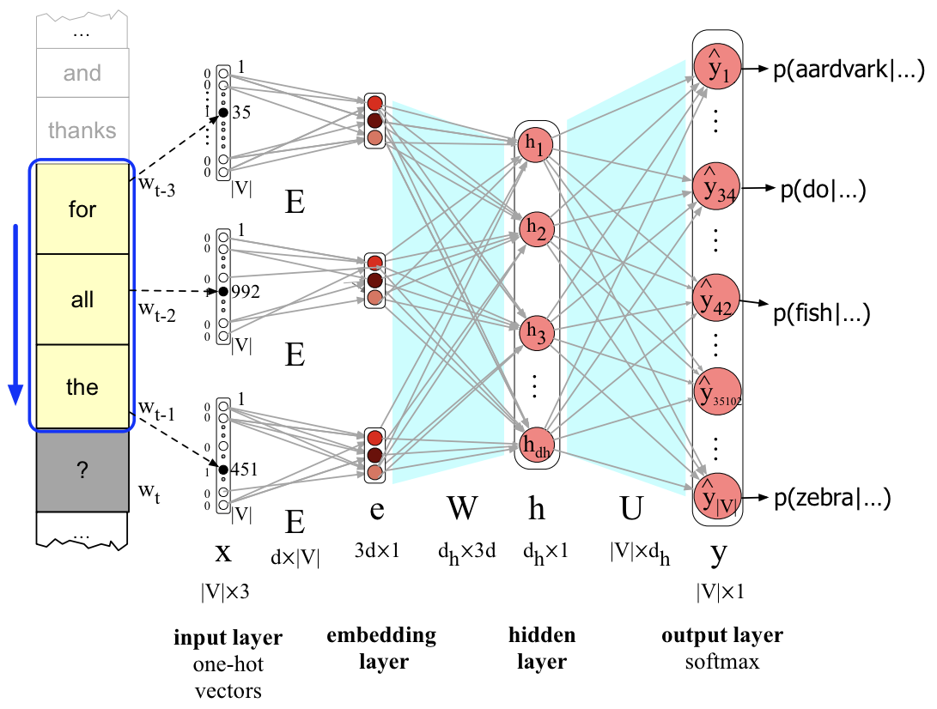
Sequential
Every human language is inherently sequential. A temporal phenomenon.
Current word that one says or writes (or thinks) is dependent on the words before it.
Simple FFNN models the temporal aspect of language using the sliding window setup
© by Anagha Kulkarni, 2021
Notes:
Verb bark is valid only for one of the subjects, dog.

Slide 5
Fixed-length prior context (sliding window approach)
Language is sequential and comes in all sizes.
We have completely valid 1-word sentences, like, “Stop!” “Me?” “Never.”
And also (painfully) long sentences that are entirely valid, like, “In the event that the Purchaser defaults in the payment of any instalment of purchase price, taxes, insurance, interest, or the annual charge described elsewhere herein, or shall default in the performance of any other obligations set forth in this Contract, the Seller may: at his option: (a) Declare immediately due and payable the entire unpaid balance of purchase price, with accrued interest, taxes, and annual charge, and demand full payment thereof, and enforce conveyance of the land by termination of the contract or according to the terms hereof, in which case the Purchaser shall also be liable to the Seller for…” (516 words long sentence!)
Our solution thus far to tackle this characteristic of language, variable-length sequence is: use fixed-length window-size and keep shifting the window in the direction of the progression of the input data.
Like we did in Neural LM and in n-gram LM before that.

Slide 6
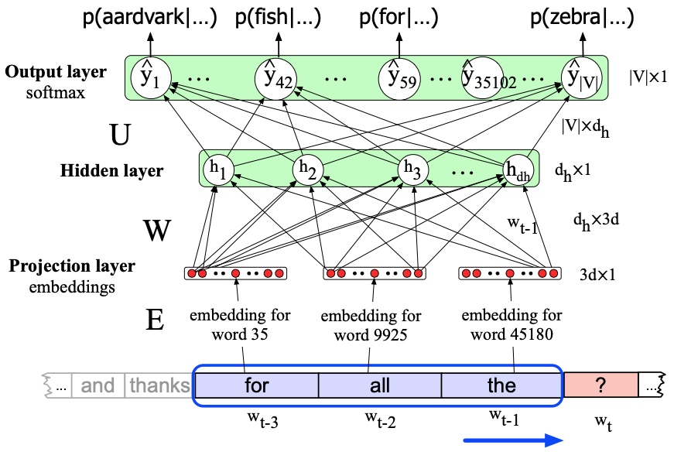
Fixed-length prior context (sliding window approach)
Neural LM
Problems with this approach:
Limited visibility into past and future.
Any information outside of the current window cannot inform the current decision.
Decisions made in one window have no direct impact on subsequent decisions in farther windows
What is a good size for the window??
There is no right answer.
4 words in between
“The dog that the cat chased barked at us.”
“The music was so very loud that we couldn't enjoy it one bit.”
8 words in between
In summary,
The sliding window size is limited (even with Neural LM)
The sliding window size is fixed (always previous x words)
Notes:
Every <window, and prediction> are treated like independent data-points. Whereas in reality all/many data-points are intrinsically dependent on each other due to the sequential nature of language.

Slide 7
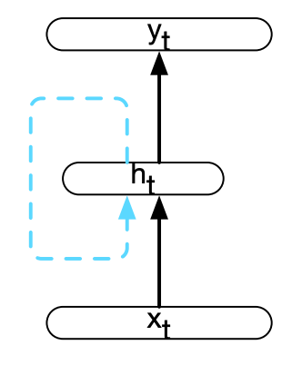
Recurrent Neural Networks (RNN)
A network architecture that:
presents one input item at a time to the network, and
contains one or more cycles within its network connections.
Cycle: A network where the value of a unit is directly, or indirectly, dependent on its own earlier outputs as an input.

Slide 8
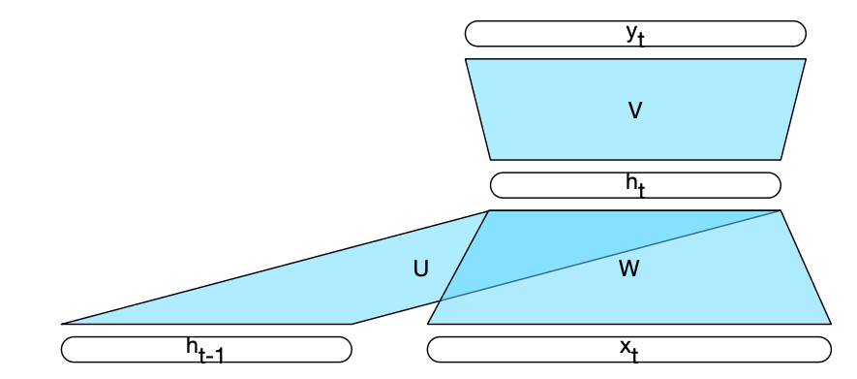
Recurrent Neural Networks (RNN)
An easier to understand representation of RNN

Slide 9
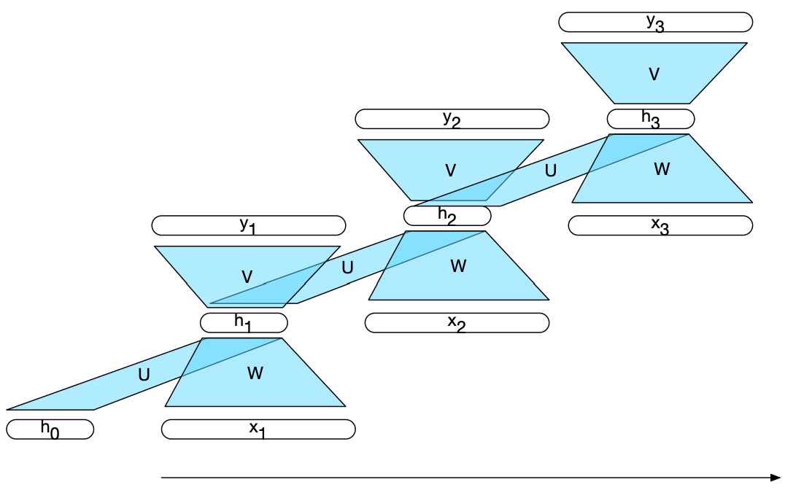


Recurrent Neural Networks (RNN)
Such network architecture is well suited for variable-length sequential data because:
The hidden layer from previous time step:
Provides past memory / context for the decision to be made at the current time step.
Lifts the restriction of fixed-length prior context (window size)
How?
Hidden layer at every time step captures information from:
the start of the sequence, and
from the current item of the sequence.
Serves as cumulative source of information about the input sequence.
Processing one input item at a time allows for
variable-length history.

Slide 10
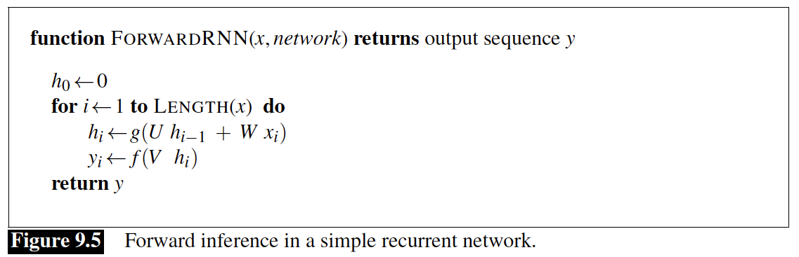
RNNs
Units will have different values over different timesteps
Weights, however, are shared across the timesteps
Computations at timestep t, require
The computation at time t requires the value of the hidden layer from time t,
This mandates an incremental inference algorithm that proceeds from the start of the sequence to the end

Slide 11
RNNs for NLP Tasks

Slide 12
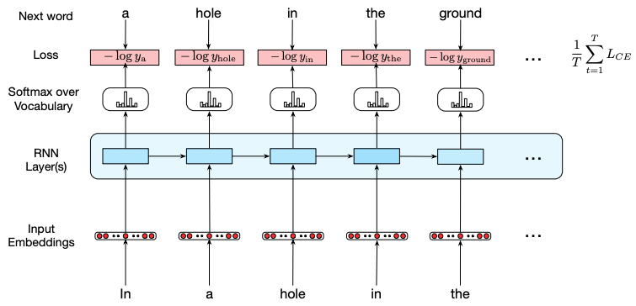
Language Modeling using RNNs
True
Blue box (RNN) represents hidden layers with cycles.

Slide 13
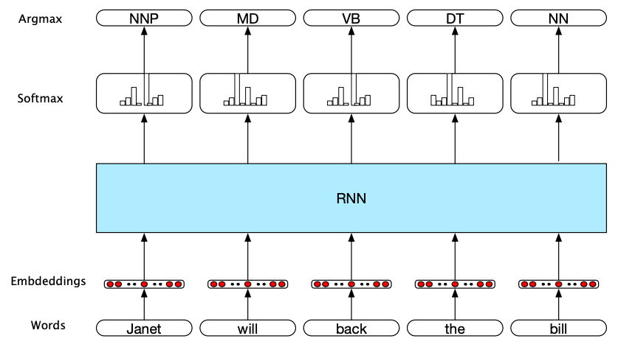
Sequence Labeling with RNNs
The task is to assign a label (from a small fixed set of labels) to each element of a sequence.
E.g. POS tagging, NER tagging
Input: Word embeddings
Output: Probability distribution over a tagset.
Recurrent network (cycles) is needed because of ambiguity -- the same word can invoke different labels depending upon the context.
E.g. POS tagging
“How/ADV time|NOUN flies|VERB”
“They|NOUN gathered|VERB like|ADP flies|NOUN on|ADP sweets|NOUN”

Slide 14
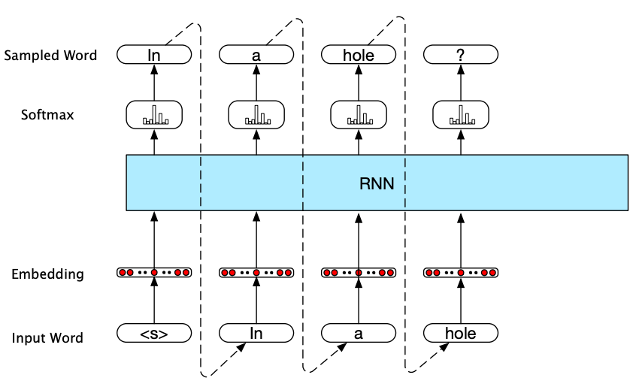
Language Generation with RNNs
Autoregressive generation: word generated at each time step is conditioned on the word selected by the network in the previous step.
(From statistics: “An autoregressive model specifies that the output variable depends linearly on its own previous values and on a stochastic term.”)

Slide 15
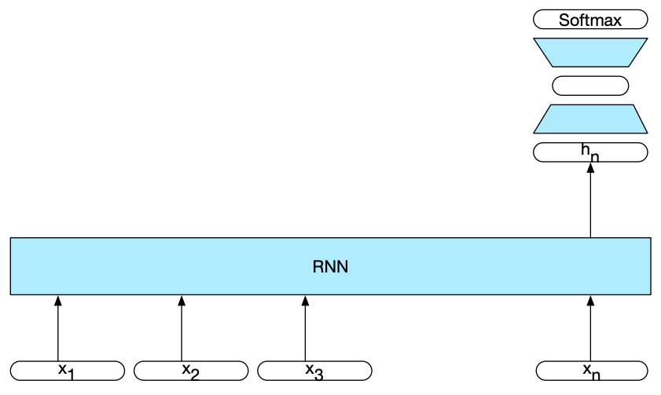
Sequence Classification with RNNs
Use RNNs to classify entire sequences rather than individual tokens in the sequence.
E.g. Sentiment classification for product reviews; Ham vs spam classification of emails
Simple approach: RNN + FFNN
1. Input text is passed through RNN one word at a time and generating a new hidden layer at each time step.
No output layer on the RNN component of the network.
The final hidden layer is a cumulative representation of the input text
2. Final hidden layer is input to the FFNN
Uses softmax function to estimate prob. distribution on classes
RNN component: provides an equivalent of feature engineering
FFNN component: provides classification

Slide 16
Sequence Classification with RNNs
No output on the RNN part of the network, thus no loss function associated with it either.
Loss function is all the way at the end of the output layer of the FFNN.
Thus error at the output layer has to be backpropagated through two weight matrices (W & U) of the FFNN and then through the three weight matrices (W, U & V) of RNN.
This type of training regimen that uses the loss from a downstream application (text classification, in this example) to adjust the weights all the way through the network is referred to as end-to-end training.
This simple network, a combination of RNN and FFNN, is an example of deep neural network.
Also, an illustration of the modular nature of the network architectures.
Notes:
This allows us to combine different networks to create complex architectures that are better at capturing various aspects of the underlying data. Two examples of such popular combined architectures are Stacked RNNs and Bidirectional RNNs.

Slide 18
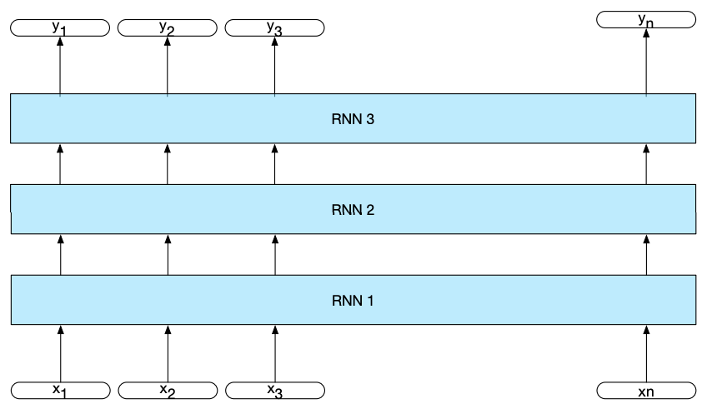
Stacked RNNs
Output of one RRN is an input sequence to next RNN and so on.
Multiple hidden layers with cycles (output of one is input to the one above it and so on).
Original input sequence is seen only by the bottom-most RNN.
The final output is provided only by the top-most RNN.
The input and output for intermediate RNNs is the abstract representation provided by hidden layers.
Notes:
Outline of the face, then specific features -- shape of the forehead, eyes, etc., and then finer details of these features -- color of the eyes, shape of the eyebrows, and so on….

Slide 19
Stacked RNNs
Such architecture has performed well for many tasks where multiple “layers” of information of different granularities can be gleaned from the input.
Easiest to see this with Computer Vision tasks such as face recognition.
A single RNN cannot capture all the complexity of the data.
The optimal number of stacks is dependent on the (1) application, and (2) available computational resources.
Training cost increases substantially with every additional stack of RNN (parameter matrices: W, U, V).
Notes:
Outline of the face, then specific features -- shape of the forehead, eyes, etc., and then finer details of these features -- color of the eyes, shape of the eyebrows, and so on….

Slide 20



Bidirectional RNNs
In regular RNNs the hidden layer at time step t has accumulated information from the start of the sequence through this time step.
However, in many application we do have access to the entire input sequence -- sequence until this time point and beyond.
E.g. POS tagging, NER tagging, Machine Translation, Coreference Resolution
Often that future sequence is needed to do inference at the current time step.
Coreference resolution example: “In spite of her situation, Geeta understood Hailey’s point of view.”
Having access to the context on the right (in addition to left) could be useful for the decision in time step t.
Combine the two contexts into single representation using concatenation, or element-wise addition, or multiplication, or averaging:

Slide 21
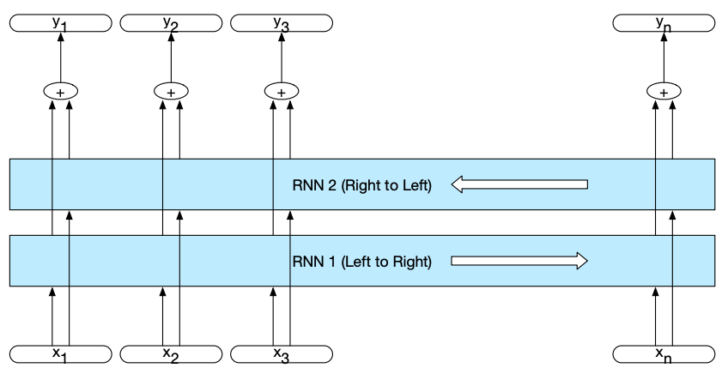
Bidirectional RNNs

Slide 22
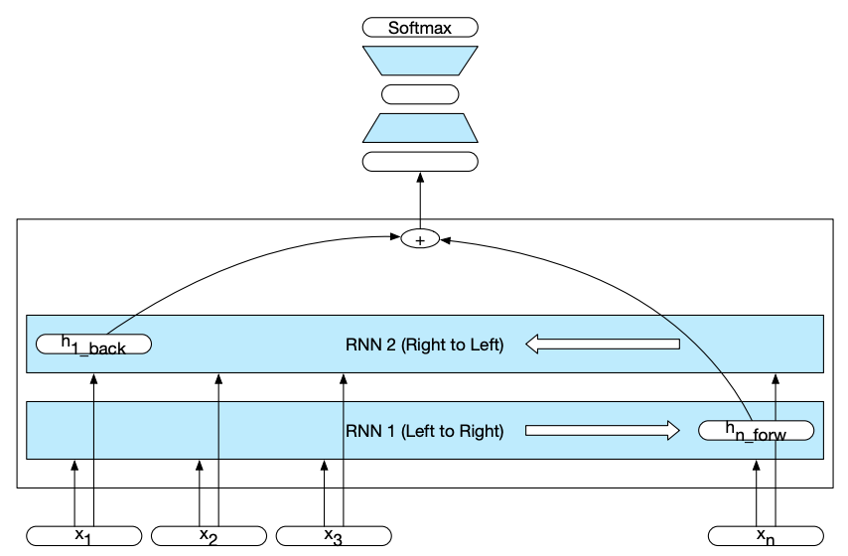
Bidirectional RNNs for Sequence Classification
Problem with regular RNN for Sequence Classification: The h_{n} representation of the input sequence tends to reflect more information about the end of the sequence than about the start.
Solution: Bidirectional RNN
Regular RNN based Sequence Classification

Slide 23
Bidirectional RNNs for Sequence Classification
Learn two separate RNNs:
One from the start to the end of the input sequence
Other from the end to the start of the input sequence
Combine the final hidden layer outputs from the two RNNs
This combined representation becomes the input to the FF classifier

