Slide 1

CSc 620 & CSc 820
Natural Language Technologies
Professor Anagha Kulkarni
ak@sfsu.edu
Department of Computer Science
College of Science & Engineering
San Francisco State University

Slide 2
CSC 620/820: Natural Language Technologies Deep Learning Architectures for Sequence Processing
© by Anagha Kulkarni, 2021

Slide 3
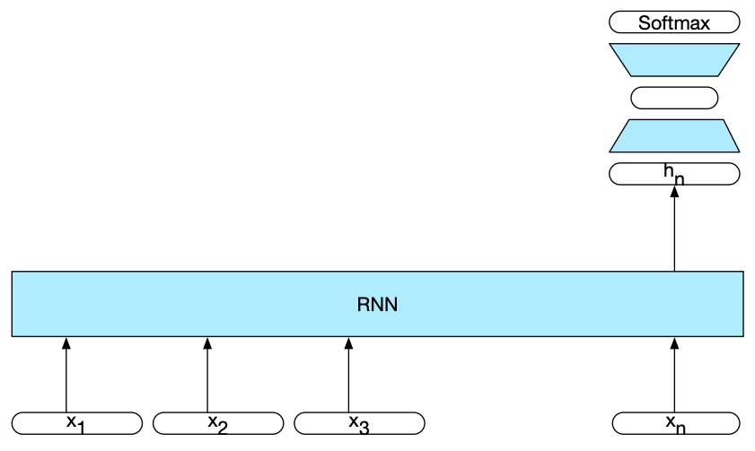
Text Classification using RNNs
Notes:
This allows us to combine different networks to create complex architectures that are better at capturing various aspects of the underlying data. Two examples of such popular combined architectures are Stacked RNNs and Bidirectional RNNs.

Slide 4
Self-Attention Networks: Transformers
Two problems with RNNs:
Vanishing gradient
During training, the error has to be backpropogated through time. Often this drives the resulting gradient to zero thus rendering it useless for making parameter adjustments.
Distributed parallel computations are hard
The inherently sequential nature of recurrent networks makes it hard to do computations in parallel
Led to the development of Transformers:
Cycles were eliminated
Went back to using architecture similar to FFNN
Introduced Self-Attention layers
#1 & #2 allows distributed parallel computations (training efficiency; can train on humongous amounts of data in reasonable amount of time)
#3 allows the model to use distant information from the input (long distance dependencies in language) without the use of recurrent connections (cycles)

Slide 5
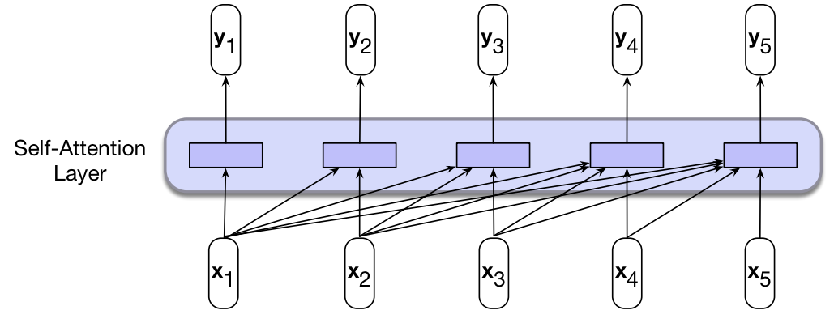
Self-Attention Layer
Input length & Output length are the same.
Input vectors (x₁…x₅)
Output vectors (y₁…y₅)
When processing input item x_{i} the SA layer has access to all the input items until that point (x_{j} where j<i) and including the current item (x_{i}).
No access to information about inputs beyond the current item.
Computation performed for each item is independent of all the other computations.
Note: Boldface font indicates vector.
(Instead on the arrow on the head.)
#1 & #2 ensures that we can use this approach to create effective language models that can handle long-distance dependencies, and we can use them for autoregressive generation (more on this later).
#3 & #4 ensures that we can easily parallelize both forward inference and training of such models.

Slide 6
SA Layer: Main Intuition
Give the model the ability to choose which previous words to pay attention to when processing the current word.
“The 49-year-old truck driver had come to Paris from Lons, in southwestern France, to march with the yellow vest movement, a spontaneous social revolt that had started a month earlier in opposition to French President Emmanuel Macron’s policies, which protesters say favor only the rich.”
More precisely: Give the model the ability to assign different levels of attention to all the previous words.
Each word’s attention level reflects it’s relatedness / relevance to the current word.
This is done by comparing the two words, that is taking the dot-product of the two word vectors.

Slide 7



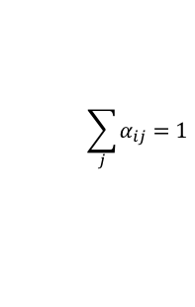
SA Layer: Main Intuition
Let’s say we are processing input embedding x₃
Then we will do the following comparisons:
x₃ . x₃
x₃ . x₂
x₃ . x₁
The result of a dot product of two embeddings is a scalar value ranging from −∞ to ∞
The larger the value the more similar the previous word is to the current word.
However, the scalar value needs to be constrained to a finite range.
And we want the values to form a probability distribution.
So, normalize the values using softmax function.
Resulting normalized values are in range [0, 1], and they all sum to 1.
In the above example: the 3 values after normalization, sum to 1.
“…Macron’s policies, which protesters say favor”
Higher values (more attention) for the red words than non-red words.
Attention levels
$$\sum_{j}{α_{ij}}=1$$
$$α_{33}+α_{23}+α_{13} =1$$

Slide 8


SA Layer: Main Intuition
Now use these attention levels to weight the respective input vectors:
Aggregate these weighted vectors to generate the output vector:
In summary, when computing output y_{n} , the SA layer provides a mechanism to take into consideration previous context and do so selectively.

Slide 9

Multiple Roles & Representations of Input Words
Each input embedding, x_{i} , plays three different roles during the course of the attention process:
As the current focus of attention when being compared to all of the other preceding inputs. We’ll refer to this role as a query.
In its role as a preceding input being compared to the current focus of attention. We’ll refer to this role as a key.
And finally, as a value used to compute the output for the current focus of attention.
A separate parameter matrix is associated with each of the three roles.
Each parameter matrix transforms the original input embedding into a new embedding that captures role-specific information.

Slide 10


Multiple Roles & Representations of Input Words
Now the revised SA layer equations are:
query embedding for the current focus of attention &
key embedding for the preceding input
(Normalization calculation is the same as before)
value embedding to compute the output embedding
Notes:
x & y are 1xd
All W matrix are dxd dimensional

Slide 11
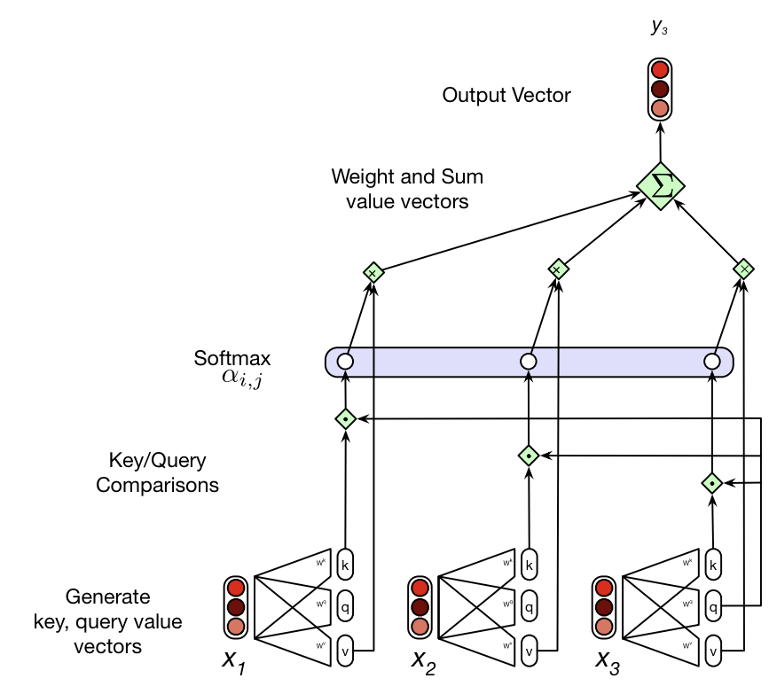
Calculating y₃ (that is, processing x₃ and x₂ x₁)

