Slide 1

Welcome to
Natural Language Technologies
Professor Anagha Kulkarni
ak@sfsu.edu
Department of Computer Science
College of Science & Engineering
San Francisco State University
https://faculty.sfsu.edu/~ak

Slide 2
Instances of NLT in real-life
Email reply suggestions (Language Generation)
Chatbots (Language Generation, Dialogue Systems)
Meeting / chatlog / article summary (Text Summarization)
Google translate (Machine Translation)
Notes:
Autocomplete / Autocorrect / Spell check

Slide 3
NLP ⬄ Different Sectors of our Society
NLP for Healthcare
https://www.foreseemed.com/natural-language-processing-in-healthcare
NLP for Biomedicine (Medical research & drug discovery)
https://www.microsoft.com/en-us/research/group/biomedical-nlp-group/
NLP for Education
https://indatalabs.com/blog/nlp-in-education
NLP for Social Justice
https://www.pnas.org/content/114/25/6521
NLP for Finance / Economics
https://mitsloan.mit.edu/ideas-made-to-matter/why-finance-deploying-natural-language-processing
NLP for Real Estate
https://co-libry.com/blogs/natural-language-processing-nlp-real-estate/
Notes:
Career opportunities in NLP are embedded in these links

Slide 4


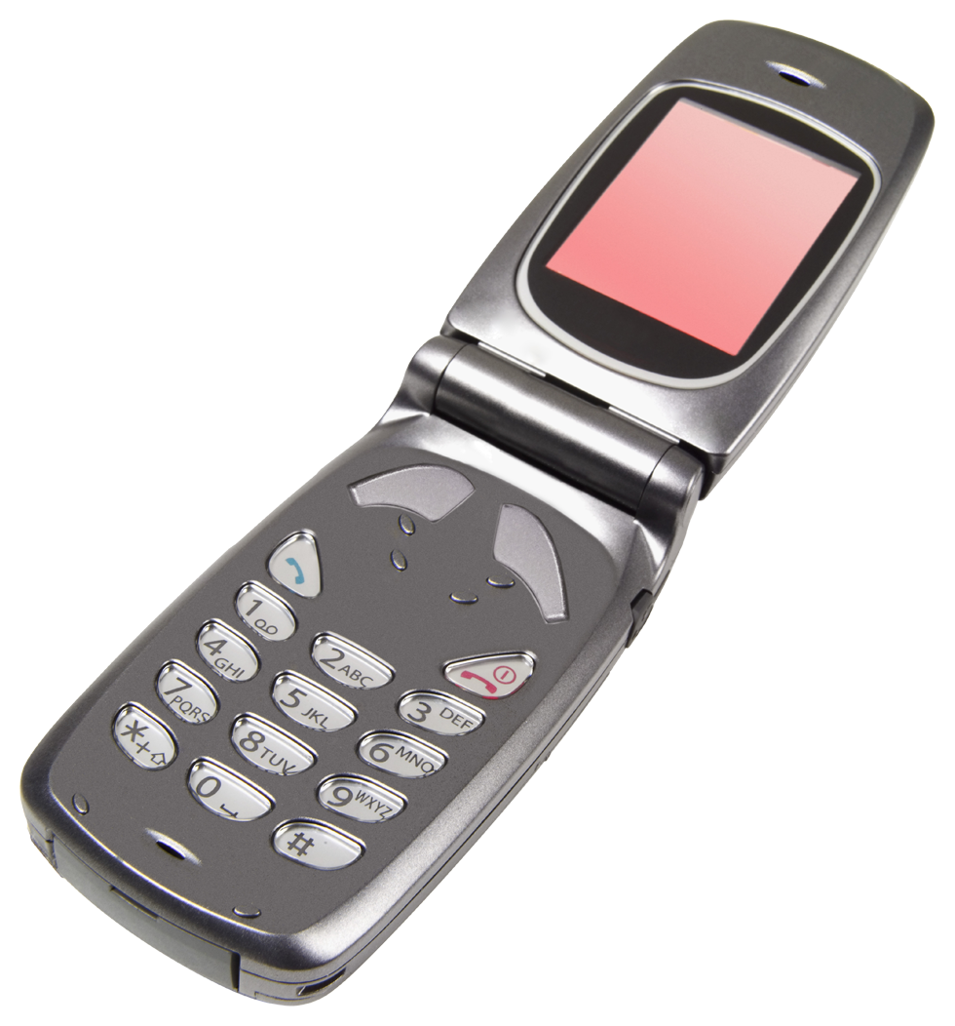

Lay of the land for Language Technologies
NLU: Natural Language Understanding
+
NLP: Natural Language Processing
NLG: Natural Language Generation
making good progress
Sentiment analysis
still really hard
mostly solved
Best roast chicken in San Francisco!
Question answering (QA)
The waiter ignored us for 20 minutes.
Spam detection
Coreference resolution
Q. How effective is ibuprofen in reducing fever in patients with acute febrile illness?
✓
Let’s go to Agra!
Paraphrase
✗
Carter told Mubarak he shouldn’t run again.
Buy V1AGRA …
Word sense disambiguation (WSD)
XYZ acquired ABC yesterday
Part-of-speech (POS) tagging
I need new batteries for my mouse.
ABC has been taken over by XYZ
ADJ ADJ NOUN VERB ADV
Summarization
Colorless green ideas sleep furiously.
Parsing
The Dow Jones is up
Economy is good
I can see Alcatraz from the window!
The S&P500 jumped
Named entity recognition (NER)
Machine translation (MT)
Housing prices rose
PERSON ORG LOC
第13届上海国际电影节开幕…
Dialog
Where is Citizen Kane playing in SF?
Einstein met with UN officials in Princeton
The 13th Shanghai International Film Festival…
Information extraction (IE)
Castro Theatre at 7:30. Do you want a ticket?
You’re invited to our dinner party, Friday May 27 at 8:30
Party May 27 add
(Slide source: Dan Jurafsky)
Notes:
Example of deaf people’s language understanding abilities versus language generation abilities

Slide 5
Basics of Text Processing
Regular Expressions
Text Normalization
Tokens and Lemmas
Sentence Segmentation
Edit Distance

Slide 6
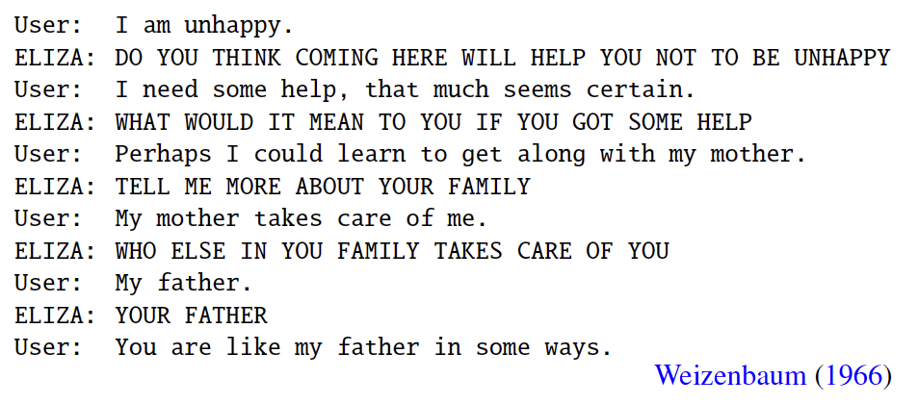
ELIZA
http://psych.fullerton.edu/mbirnbaum/psych101/Eliza.htm
ELIZA: An early NLP system; a simple rule-based chatbot that was designed to mimic Rogerian styled psychotherapist.
Turing Test
"I had not realized ... that extremely short exposures to a relatively simple computer program could induce powerful delusional thinking in quite normal people.” -- Weizenbaum
Pattern matching
“I am X” => “DO YOU THINK COMING HERE WILL HELP YOU NOT TO X”
“I need X” => “WHAT WOULD IT MEAN TO YOU IF YOU GOT X”
No world knowledge needed.
Notes:
Early: 1964- 66
Rule-based
Rogerian: Carl Roger: https://en.wikipedia.org/wiki/Carl_Rogers “Person-centered therapy seeks to facilitate a client's self-actualizing tendency, "an inbuilt proclivity toward growth and fulfillment",[3] via acceptance (unconditional positive regard), therapist congruence (genuineness), and empathic understanding.”
Attempted one of the first Turing tests. Many many people who interacted with ELIZA believed it to be a human being.

Slide 7
Modern Conversational Agents
More sophisticated pattern matching and machine learning
Presence of world knowledge
usually limited to specific domain though, e.g. restaurant booking chatbot

Slide 8
Regular Expressions (RE)
Very powerful tool.
Usage: To search for lexical patterns in a corpus.
E.g. Find all the lines that contain one or more numbers in the below corpus.
Mahoney becomes the 14th president of SFSU
and the first woman appointed to serve in the role in a permanent ​capacity.
She will join the campus in her new capacity on July 15.
Mahoney succeeds Leslie E. Wong who will be retiring in July 2019
after 46 years in higher education including service
as SFSU president for the past seven years.
RE: /[0-9]+/g (Answer: Lines 1, 3, 4, 5)
RE: /\b[0-9]+\b/g (Answer: Lines 3, 4, 5)
What about lines 2 (“first”) and 6 (“seven”)??
Notes:
Examples of applications of RE for NLP:
Information extraction: Should this email trigger a calendar event? Does the email contain any dates? Look for date patterns: 1 or more number, hyphen or forward slash, 1 or more number, hyphen or forward slash, 2 or more numbers.
Identify all the acronyms in the collection (Uppercase character sequences: SFSU, Uppercase with periods: U.S.A)

Slide 9
RE: Basics
RE are case sensitive by default. To make RE case insensitive: use ‘i’ modifier
RE are lazy by default. To fix that: use ‘g’ modifier
e.g. /apple/ig
“I ate an apple at APPLE without any thought about my friend Apple.”

Slide 10
RE: Basics
Notes:
? implies 0 or 1 instance of the previous character

Slide 11
RE: ? Kleene * Kleene +
Pattern | Matches | Examples
/colou?r/ | 0 or 1 instance of previous char | color colour
/oo*h!/ | 0 or more of previous char | oh! ooh! oooh! ooooh!
/oo+h!/ | 1 or more of previous char | ooh! oooh! ooooh!
/baa+/ | 1 or more of previous char | baa baaa baaaa baaaaa
/beg.n/ | any character (1) except line breaks | begin begun beg*n beg3n

Slide 12
Regular Expressions: Anchors ^ $
Pattern | Examples of Matches | Examples of Does not match
/^[A-Z]/ | Palo | pAlo
/^[^A-Za-z]/ | “Hello” | Hello
/^[^A-Za-z]\^/ | 9^y | H^ 9#
/^[^A-Za-z][A-Za-z]+\^[A-Za-z]+[^A-Za-z]/ | “Hello^Kitty” OR ‘x^y’ “x^y” OR 9x^y3 | “Hello Kitty” x^y ‘2^3’
/\.$/ | The end. | End? End. Start!
/\?$/ | The end? | The end!
Notes:
Negation of . (Negation of any single character) -- is not a valid ask. [^.] is NOT interpreted as negation of any single character, rather it is interpreted as negation of the character . literally.
/^apple/g will only match “apple” at the start of the string even though global modifier is present. Even if “apple” is present at the start of a new line in the string, only the instance at the very start start of the string will match.
Input: “apple is yummy\napple is healthy\n” Only the first apple in the string will match.

Slide 14
Example
Find all instances of the word “the” in a text.
/the/g
Misses capitalized examples
/[tT]he/g
Incorrectly returns other or theology
/[^a-zA-Z][tT]he[^a-zA-Z]/g
Incorrectly returns 9the5 or #the.
Also, does not match the/The when that is at the start of the line or at the end.
/\b[tT]he\b/g
The other common word is ‘the’.
\b: Word boundary operator. “Matches” ^\w or \W
Any character other than letters, numbers, and underscore is considered as word boundary.
Finer point: \b is a zero-length match operator.
Notes:
/(^|[^a-zA-Z])[tT]he([^a-zA-Z]|$)/g
Non-capturing Group: ()
Disjunction operator: |
\b: Zero length match. Regex engine doesn’t “consume” that is advance any character on \b match.

Slide 15
Errors
The process we just went through was based on fixing two kinds of errors
Matching strings that we should not have matched (there, then, other)
False positives (Type I)
Not matching things that we should have matched (The)
False negatives (Type II)

Slide 16
Errors cont.
In NLP we are always dealing with these kinds of errors.
Reducing the error rate for an application often involves two antagonistic efforts:
Increasing accuracy or precision (minimizing false positives)
Increasing coverage or recall (minimizing false negatives).

Slide 17
Substitution
s/colour/color/
s/\bfirst\b/1st/
s/ green / blue /

Slide 18
Capture Groups
Task: Enclose all numeric strings with <>
Input: This is a number 13 and 567 example.
Desired Output: This is a number <13> and <567> example.
RE: s/([0-9]+)/<\1>/g

Slide 19
Substitution, Capture Groups
Task: In a pair of numeric strings, enclose first with <> and second with ##
RE: s/([0-9]+)\s+([0-9]+)/<\1> #\2#/g
Input: This is a number 13 45 and 34.
Output: This is a number <13> #45# and 34.
Task: Replace Colour with Color and colour with color
RE: s/([Cc])olour/\1olor/

Slide 20
RE Summary
Regular expressions play a surprisingly large role
Sophisticated sequences of regular expressions are often the first model for any text processing system
For many hard tasks, we use machine learning classifiers
But regular expressions are used as features in the classifiers
Can be very useful in capturing generalizations
Online RE tester: https://regex101.com (Have fun!)
RE Chapter of a Python course: https://developers.google.com/edu/python/regular-expressions

Slide 21
Exercises
Basics: code through the examples and stop at “Emails Example”
In the repetition examples, how would you get the 3rd group to find multiple digits possibly separated by whitespace? Try to code this.
Emails: code this example and stop before ”Square Brackets”.
We’ve looked at these square brackets. How would you fix the RE search so that it includes the entire email address? Try to code this.
Baby Names Python Exercise…

Slide 22
ELIZA exercise
1. Install NLTK: https://www.nltk.org/
2. Read and understand an existing chatbot, ELIZA, that is implemented using using NLTK: https://www.nltk.org/_modules/nltk/chat/eliza.html
3. Develop a chatbot of your own that provides simple emotional support for college students by being a good "listener". For example, when the user says "The finals week has been tough", the chatbot could respond "I hear you. Finals week is tough for many. Do you want to tell me more?"
Use the "nltk.chat.eliza" module for your chatbot.
Information on regex in
NLTK: https://www.nltk.org/_modules/nltk/tokenize/regexp.html

Slide 23
Slightly improved ELIZA
Implement two improvements to your ELIZA chatbot.
1. Use word normalizations to make your chatbot less brittle. Specifically, use NLTK's stemmer to accept word variations in the user's response. For example, your chatbot should be able to understand (using normalization/stemming) that 'Can I (*)' and 'Could I (*)' map to the same response pair. Print to the chatlog the original and the stemmed versions of the user input.
2. Compute and print the total count of types and the total count of tokens in the stemmed version of user's input from the chatlog (Ignore the chatbot responses for this part.) Use 10-15 dialogues for this part. Don't use NLTK's tokenizer. Implement a simple tokenizer of your own.
Notes: * You choose the NLTK stemmer you would like to use in your program.

