Slide 1

AI-STAARS
Natural Language Technologies
Professor Anagha Kulkarni
ak@sfsu.edu
Department of Computer Science
College of Science & Engineering
San Francisco State University
https://faculty.sfsu.edu/~ak/home

Slide 2
Language Modeling
Introduction to Probabilistic Language Models & N-grams

Slide 3
Assign a probability to a sentence / phrase

Slide 4
Assign a probability to a sentence / phrase
Machine Translation:
P(high winds tonight) > P(large winds tonight)
Spell Correction:
The office is about fifteen minuets from my house
P(about fifteen minutes from) > P(about fifteen minuets from)
Speech Recognition:
P(I saw a van) >> P(eyes awe of an)
+ Summarization, Question-Answering, etc., etc.!!
Why?
Notes:
Probability in non-technical language ‘likelihood’
minuet: a kind of ballroom dance

Slide 5
How to compute P(W)
How to compute this joint probability: P(W) = P(w₁,w₂,w₃,w₄,w₅…w_{n})
E.g. P(i would like to schedule another meeting) = ?
Intuition: let’s rely on the Chain Rule of Probability
P(x₁,x₂,x₃,…,x_{n}) = P(x₁)P(x₂|x₁)P(x₃|x₁,x₂)…P(x_{n}|x₁,…,x_{n-1})
P(i would like to schedule another meeting)
= P(i) x P(would|i) x P(like | I would) x P(to| I would like) x….
But how do we compute these probabilities ?
We estimate them using corpus statistics.

Slide 6
How to compute P(w1) ?
(Toy) Corpus:
I am Sam
Sam I am
I do not like green eggs and ham
P(I) = ?
= 3 / 14
P(Sam) = ?
= 2 / 14
P(am | I) = How often does ‘am’ follow ‘I’?
P(have | I) = ?
P(eggs|I am Sam and I like milk bread and) = ?
In order to estimate this probability our corpus has to contain instances of “I am Sam and I like milk bread and eggs”.
Even a large corpus is unlikely to contain the exact string we need.
As the string gets longer it become harder to find it in a corpus.
Relative frequency of a word in a corpus.
Likelihood of this word in this corpus.
Probability of this word in this corpus.
What about P(bread) = ? Or P(milk) = ?
No corpus statistics.
Use larger corpus.
= 2/3
= 0/3 = 0

Slide 7
Markov Assumption
Simplifying assumption:
P(eggs|I am Sam and I like milk bread and) ≈ P(eggs|I am Sam and I like milk bread and)
Or
P(eggs|I am Sam and I like milk bread and) ≈ P(eggs|I am Sam and I like milk bread and)
Or…
P(eggs|I am Sam and I like milk bread and) ≈ P(eggs|I am Sam and I like milk bread and)
Or…
P(eggs|I am Sam and I like milk bread and) ≈ P(eggs|I am Sam and I like milk bread and)

Slide 8
Markov Assumption
Chain Rule:
Simplifying assumption:

Slide 9
Simplest case: Unigram model

Slide 10
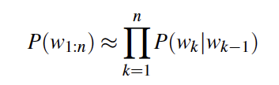
Bigram model
Condition on the previous word only:

Slide 11
N-gram models
We can extend to trigrams, 4-grams, 5-grams,…, n-grams
In general these are insufficient models of language
because language has long-distance dependencies:
“The computers which I had just put into the machine room on the fifth floor are crashing.”
But we can often get far with N-gram models learned with lots of data!

Slide 12
Language Modeling
Estimating N-gram Probabilities

Slide 13
Estimating unigram probabilities
Using Maximum Likelihood Estimate (MLE):
P(w) = count(w) / N
N: Total number of words in the corpus
(Toy) Corpus:
I am Sam
Sam I am
I do not like green eggs and ham
P(Sam) = 2 / 14

Slide 14
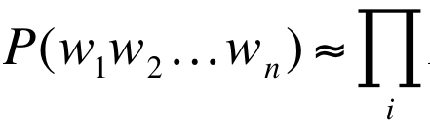
Estimating bigram probabilities
P(w_{i} | w_{i-1})
Intuition: How often is w_{i-1} followed by w_{i} ?
Using MLE:

Slide 15

An example
<s> I am Sam </s>
<s> Sam I am </s>
<s> I do not like green eggs and ham </s>

Slide 16
More examples: Corpus: Berkeley Restaurant Project sentences (A dialogue system that answered questions about restaurants in Berkeley)
can you tell me about any good cantonese restaurants close by
mid priced thai food is what i’m looking for
tell me about chez panisse
can you give me a listing of the kinds of food that are available
i’m looking for a good place to eat breakfast
when is caffe venezia open during the day

Slide 17
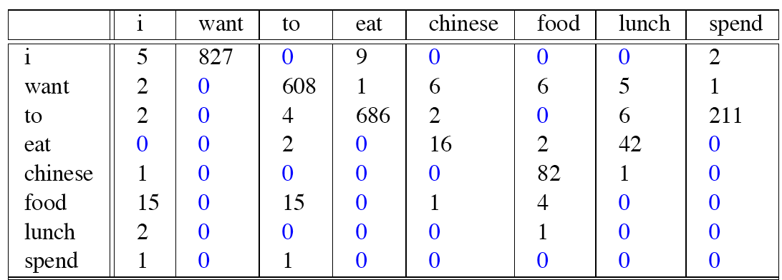
Raw bigram counts
Out of 9222 sentences
w_{i}
w_{i-1}
Notes:
Row w1 and column w2
Thus not a symmetric matrix

Slide 18
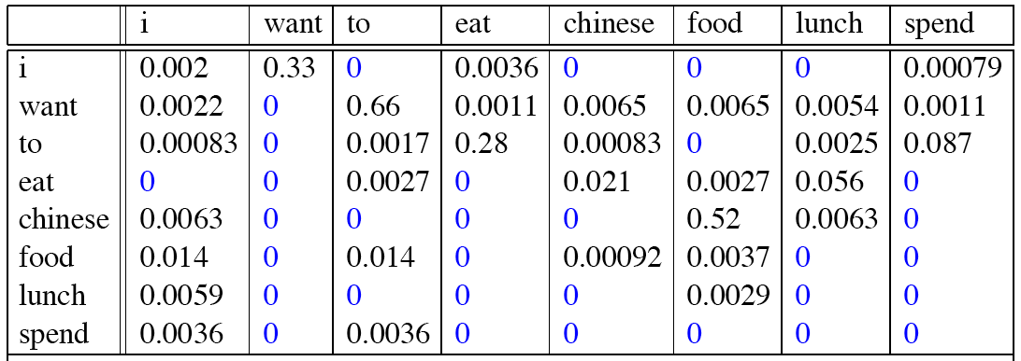
Raw bigram probabilities
Normalize by unigrams:
P(w_{i}|w_{i-1})
w_{i}
w_{i-1}

Slide 19
Bigram estimates of sentence probabilities
P(<s> I want english food </s>) =
P(I|<s>)
× P(want|I)
× P(english|want)
× P(food|english)
× P(</s>|food)
= 0.000031
0.25
0.33
0.0011
0.5
0.68

Slide 20
What kinds of trends can be observed?
P(english|want) = .0011
P(chinese|want) = .0065
P(eat|to) = .28
P(food|to) = 0
P (i | <s>) = .25
Notes:
This corpus is not from China. More demand for chinese food.
Typically a verb comes after “to”.
Information seeking activity for personal use.

Slide 21
Practical Issues
We do everything in log space
Avoid underflow
(also adding is computationally more efficient than multiplying)

Slide 22
Language Modeling
Smoothing: Add-one (Laplace) smoothing
Notes:
Problem of zero frequency n-grams

Slide 23
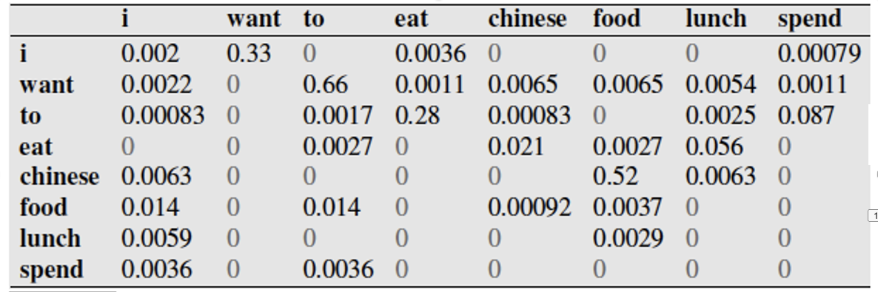
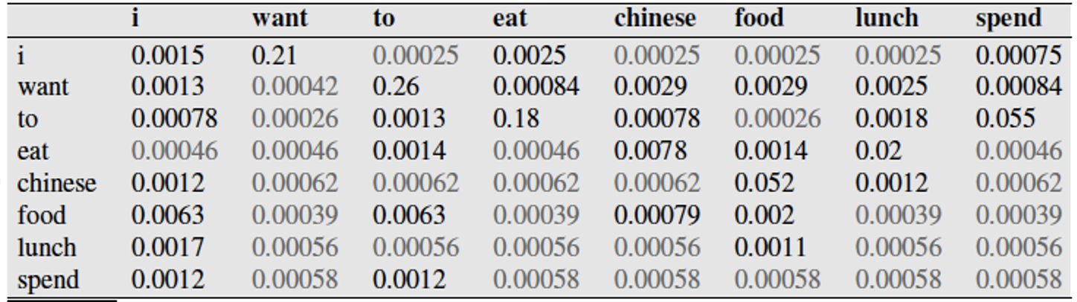
Computing sentence probability using Bigram LM
P(I lunch chinese food)
= P(lunch|I)
× P(chinese|lunch)
× P(food|chinese)
= 0 x 0 x 0.52
= 0
For simplicity, I am ignoring the first term in the product, P(I)
P(I lunch chinese food)
= P(lunch|I)
× P(chinese|lunch)
× P(food|chinese)
= 0.00025 x 0.00056 x 0.052

Slide 24
Language Model: Estimation with Smoothing
Toy corpus:
i am i am i
P(i) = 3/5
P_{Laplace}(i) = (3 + 1) / (5 + 2) = 4/7
Conceptually Laplace smoothing adds one instance of each unique word to the corpus.
So, our toy corpus after Laplace smoothing:
i am i am i i am
Unigram LM: Estimation with MLE
Smoothed Unigram LM: Estimation with MLE + Laplace Smoothing

Slide 25
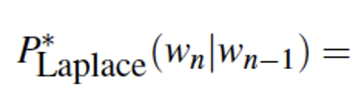
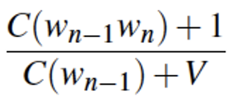
Language Model: Estimation with Smoothing
Bigram LM: Estimation with MLE
Smoothed Bigram LM: Estimation with MLE + Laplace Smoothing
Notes:
Whiteboard: Trigram LM: Estimation with MLE + Laplace Smoothing
P_Laplace(w_n|w_n-2, w_n-1) = ( C(w_n-2 w_n-1 w_n) + 1 ) / Sum_w_. ( C(w_n-2 w_n-1 w_.) + 1 ) = ( C(w_n-2 w_n-1 w_n) + 1 ) / ( C(w_n-2 w_n-1) + V )

Slide 26
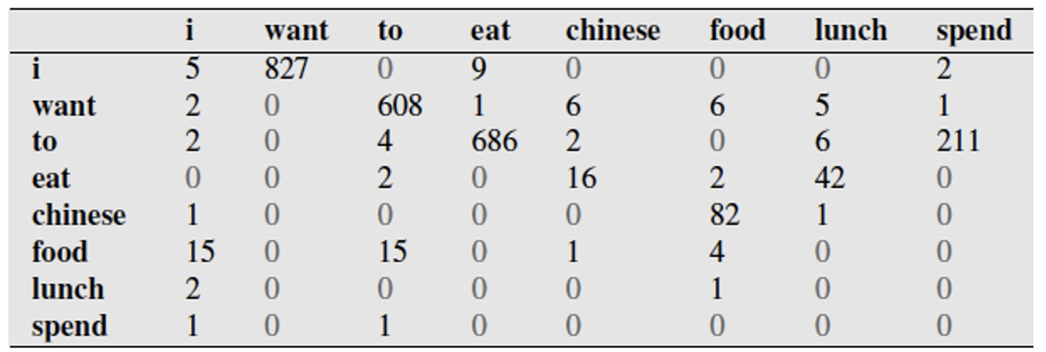
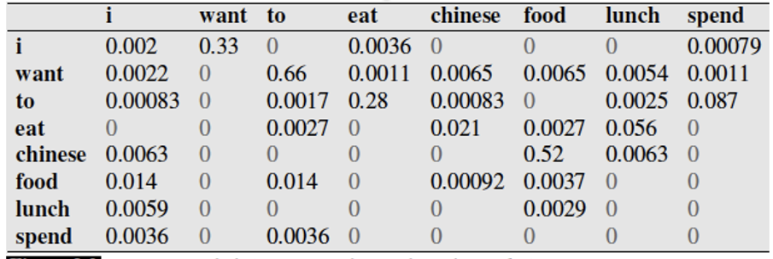

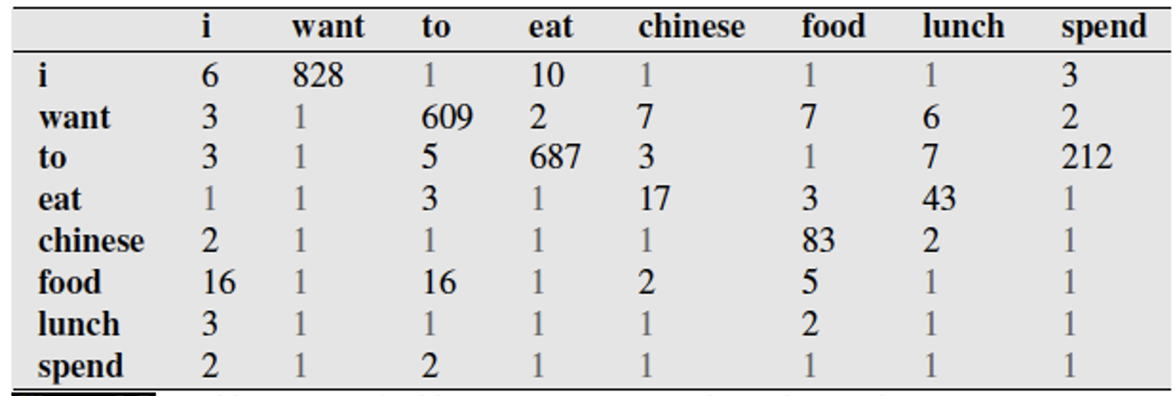

Bigram LM (without smoothing):
In-class exercise:
Compute P(i want lunch) using Bigram LM (top) and Smoothed Bigram LM (bottom table)
Compute P(i lunch want) using Bigram LM (top) and Smoothed Bigram LM (bottom table)
Move small probability mass from seen bigrams to unseen bigrams.
Bigram LM
with Laplace smoothing):
Notes:
P(want | I) x P(lunch | want) = 0.33 x 0.0054
P(want | I) x P(lunch | want) = 0.21 x 0.0025
P(lunch | I) x P( want | lunch)
0 x 0
0.00025 x 0.00056

Slide 27
Add-1 estimation is a blunt instrument
Add-1 is not used for Language Modeling
Takes away too much probability mass from non-zero frequency n-grams
#zero freq n-grams >>> #non-zero freq n-grams
Add-1 is used to smooth other NLP models
For text classification
In domains where the number of zeros isn’t so huge.
Notes:
Problem of zero frequency n-grams

Slide 28
Alternatives
Add-k smoothing
k values are fractional (0.5, 0.05, 0.01, ..)
Simple Linear Interpolation

Slide 29
Language Modeling
Evaluation
Notes:
Problem of zero frequency n-grams

Slide 30
LM: Evaluation
Let’s say you have two bigram language models, how do you evaluate which one is better?
Extrinsic evaluation approach: Uses the language model in an NLP application, such as, Machine Translation, and then check if the performance of the application improves.
Downside: Expensive. Running NLP applications end-to-end over and over again can be expensive.
Intrinsic evaluation approach: Measures the quality of language model independent of any application.
Notes:
Training Set

Slide 31
LM: Evaluation
New (and very important) terminology:
Train set / Training Corpus
The corpus used to compute the n-gram probabilities
Test set
Unseen corpus: A separate corpus that was not part of the training set.
Typical process:
Choose a corpus, say, Berkeley restaurant corpus.
Split it into train set (80%) and test set (20%)
Train/Learn a n-gram model (i.e. compute unigram / bigram / n-gram probabilities) using train set
Use the learnt LM to predict probability of test set.
If we have multiple n-gram models, then the one that estimates higher probabilities for test set is the better model.

Slide 32
LM: Evaluation
Cardinal rule: Never train your model on the test set!
Dev set (Development set)
When splitting the corpus into train, test (and dev):
Avoid systematic bias by selecting datapoints (e.g. sentences, paragraphs) at random for each split
sample without replacement
The largest split is typically the training set, so as to provide as much learning / “reading” as possible.
Test set cannot be too small though, otherwise reliable evaluation is not possible. (representative datapoints)
Notes:
Cross validation will come later

Slide 33
Perplexity (PP)
Instead of probability, perplexity is commonly used as the evaluation metric for LMs.
Why?
In case of probability, length of the test set becomes a factor, incorrectly.
P(larger test set) < P(smaller test set)
Toy example:
Test set 1: “hello world”
Test set 2: “hello world hello world”
Unigram LM (hello: 0.1, world=0.2)
P(Test set 1) = 0.02
P(Test set 2) = 0.0004
Size normalization is needed.

Slide 34
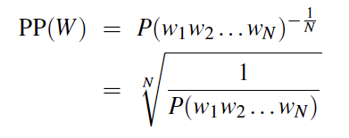
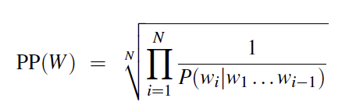
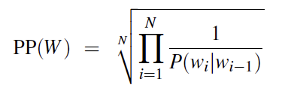

Perplexity (PP)
Perplexity
A variation of probability
Inverse probability of the test set, normalized by the number of words in test set.
Smaller value is better in case of perplexity
As opposed to higher value is better in case of probability
normalize by #words in test set
Inverse
With Chain rule:
With Bigram LM:
Perplexity values for 3 different LMs on test set of 1.5M word corpus from WSJ:
(LMs were trained on 38M word corpus from WSJ)
More informative the LM, lower the perplexity.

Slide 35
Language Models: Summary
LMs (n-grams) are the most widely used tool in NLP
LMs provide a way to assign probability to a sentence / phrase / a unit of text
LMs also provide a way to predict the next word given previous word(s)
We saw how to compute / train / learn n-gram models
We saw how to compute smoothed n-gram models
We saw how to evaluate LMs
More sophisticated LMs: Neural Language Models.

Slide 36
Language Modeling Toolkits
SRILM
http://www.speech.sri.com/projects/srilm/
KenLM
https://kheafield.com/code/kenlm/

Slide 37
Text Classification

Slide 38
Example of TC: Spam Filtering
From: "" <takworlld@hotmail.com>
Subject: real estate is the only way... gem oalvgkay
Anyone can buy real estate with no money down
Stop paying rent TODAY !
There is no need to spend hundreds or even thousands for similar courses
I am 22 years old and I have already purchased 6 properties using the methods outlined in this truly INCREDIBLE ebook.
Change your life NOW !
=================================================
Click Below to order:
http://www.wholesaledaily.com/sales/nmd.htm
=================================================
Notes:
Also used for identifying Spam Pages, so that these pages are excluded from the inverted index.

Slide 39


Example of TC: Positive or negative movie review?
unbelievably disappointing
Full of zany characters and richly applied satire, and some great plot twists
this is the greatest screwball comedy ever filmed
It was pathetic. The worst part about it was the boxing scenes.

Slide 40
Example of TC: What is the subject of this article?
MEDLINE Article
MeSH Subject Category Hierarchy
Antogonists and Inhibitors
Blood Supply
Chemistry
Drug Therapy
Embryology
Epidemiology
…
?

Slide 41
Text Classification Examples
Assigning subject categories, topics, or genres
Spam detection
Authorship identification
Language Identification
Sentiment analysis
…

Slide 42
Text Classification: Definition
Given:
A set of classes: C = {c₁, c₂,…, c_{J}}
E.g. {English, Spanish, Mandarin, Hindi}
A set of labeled documents: D = {d₁, d₂,…, d_{n}},
where for every document, d_{x} , its class label, c^{dx} ∈ C
E.g. d_{x} : “Hola amigo”, c^{dx} : Spanish
Learn classification model:
Using the training data, D, learn a classifier, γ()
Use the classification model:
Predict the class label for a given unlabeled document d
γ(d) = c^{d} ∈ C
Notes:
gamma function

Slide 43
Ç√
Ç√
Ç√
Ç√

Slide 44
Classification Methods: Supervised Machine Learning
Classification algorithms
Naïve Bayes
Logistic regression
Support-vector machines
k-Nearest Neighbors
…

Slide 45
Text Classification and Naïve Bayes
Naïve Bayes (I)

Slide 46
Naïve Bayes Intuition
Based on Bayes rule
Relies on very simple (Naïve) representation of documents

Slide 47
Text Classification and Naïve Bayes
Formalizing the Naïve Bayes Classifier

Slide 48
Bayes’ Rule Applied to Documents and Classes
For a document d and a class c
likelihood
posterior
prior
Notes:
Explain Bayes rule first, and then likelihood, prior probability, and posterior probability.

Slide 49
Naïve Bayes Classifier
MAP is “maximum a posteriori” = most likely class
Bayes Rule
Dropping the denominator
We need to estimate P(d|c) and P(c)

Slide 50
We need to estimate P(d|c) and P(c)
Ç√
Ç√
$$\frac{count(c:UK)}{\sum_{c^{′}}{count(c′)}}$$
Ç√
P(c: UK) =
Ç√
P(d|c) = ?
Notes:
P(c = UK) = 3/6 = 1/2 = P(China)

Slide 51
Naïve Bayes Classifier
More generally, x₁,…x_{n} are features of d.
e.g.
words (single words, pairs, triplets,...)
pos tags
meta-data of d
x₁,…x_{n} can be the words in document d.
x₁..x_{n}: Feature representation of document d.

Slide 52
Naïve Bayes Independence Assumption
Conditional Independence: Assume the feature probabilities P(x_{i}|c_{j}) are independent given the class c.
Notes:
Multinomial distribution

Slide 53
Naïve Bayes Classifier
We need to estimate these probabilities.
This is called learning / training NB classification model.

Slide 54
Text Classification and Naïve Bayes
Naïve Bayes: Learning

Slide 55
Learning the Multinomial Naïve Bayes Model
Maximum Likelihood Estimates:
Simply use the relative frequencies in the data
$$\hat{P}\left(xi | cj\right)= \frac{count(xi, cj)}{\sum_{k=1}^{k=n}{count(xk, cj)}}$$
Number of times feature x_{i} appears in documents of class c_{j}
relative to all feature counts in class c_{j}
Relative importance of feature x_{i} for class c_{j}
Effectively, for each class we are learning a multinomial distribution over all the features, x₁..x_{n}.
Notes:
V defined over the entire training data. But the denominator count restricted to the specific class cj documents.

Slide 56
Example of TC: Positive or negative movie review?
Training Data:
unbelievably disappointing
Full of zany characters and richly applied satire, and some great plot twists
this is the greatest screwball comedy ever filmed
It was pathetic. The worst part about it was the boxing scenes.
OOV term!
Unlabeled data / review: “fantastic plot full of comedy”
Class: Positive / Negative ?

Slide 57
Laplace (add 1) smoothing for Naïve Bayes
$$\hat{P}\left(xi | cj\right)= \frac{count\left(x_{i},c_{j}\right)+1}{\sum_{k=1}^{k=n}{(count\left(x_{k},c_{j}\right)+1)}}$$

Slide 58
Text Classification and Naïve Bayes
Naïve Bayes: A Worked Example
(Only unigram features)
(With Laplace Smoothing)

Slide 59
Priors: (Using MLE)
Data | Doc | Words | Class
Training | 1 | Chinese Beijing Chinese | c
 | 2 | Chinese Chinese Shanghai | c
 | 3 | Chinese Macao | c
 | 4 | Tokyo Japan Chinese | j
Test | 5 | Chinese Chinese Chinese Tokyo Japan | ?
Likelihood:
(Using MLE with Laplace Smoothing)
Priors:
P(c)=
P(j)=
Testing Phase
Training Phase
3
4
1
4
Assigning a class label to Test doc d5:
P(c|d5)
P(j|d5)
C_{NB}(d5) = c (i.e. china)
Likelihood: Conditional Probabilities:
P(Chinese|c) =
P(Tokyo|c) =
P(Japan|c) =
P(Chinese|j) =
P(Tokyo|j) =
P(Japan|j) =
3/4 * (3/7)³ * 1/14 * 1/14
≈ 0.0003
(5+1) / (8+6) = 6/14 = 3/7
(0+1) / (8+6) = 1/14
1/4 * (2/9)³ * 2/9 * 2/9
≈ 0.0001
(0+1) / (8+6) = 1/14
(1+1) / (3+6) = 2/9
(1+1) / (3+6) = 2/9
(1+1) / (3+6) = 2/9
Notes:
|V|: Size of the vocabulary defined over the *entire* training set.

