Slide 1

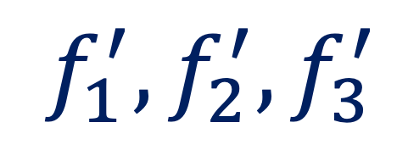

Cluster And Aggregate
Queue
Two Stage Paradigm
Cluster
Aggregate
$$f$$
$$f_{1}^{′},f_{2}^{′},f_{3}^{′}$$
Summarized into 3 features
Long Sequence of features to fuse
Notes:
We divide the queues into smaller batches.
The first four samples are clustered into 3 intermediates.

Slide 2


Cluster And Aggregate
Queue
Two Stage Paradigm
$$T_{1}$$
Cluster
$$f_{1},f_{2},f_{3}{,f}_{4}$$
Aggregate
$$f$$
$$f_{1}^{′},f_{2}^{′},f_{3}^{′}$$
Summarized into 3 features
Split into batches for grouping into few clusters
Notes:
We divide the queues into smaller batches.
The first four samples are clustered into 3 intermediates.

Slide 3


Cluster And Aggregate
Queue
Two Stage Paradigm
$$T_{2}$$
Cluster
Aggregate
$$f$$
$$f_{5},f_{6},f_{7}{,f}_{8}$$
$$f_{1}^{′},f_{2}^{′},f_{3}^{′}$$
Summarized into 3 features
Sequentially update the history
Notes:
Then the first four could be discarded and let the next four be fed in and update the intermediate.

Slide 4

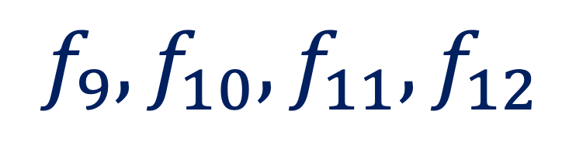
Cluster And Aggregate
Queue
Two Stage Paradigm
Aggregate
$$f$$
$$T_{3}$$
Cluster
$$f_{1}^{′},f_{2}^{′},f_{3}^{′}$$
$$f_{9},f_{10},f_{11}{,f}_{12}$$
Summarized into 3 features
Update procedure is order invariant.
Notes:
Then we could do the same for the last one. Then the summary intermediate could be used to produce a good fused output.

