Slide 1


Team Details
a. Team name: PixelTrendAnalytics
b. Team leader name: Muthukumar Arunachalam
c. Problem Statement: Trace quality evidence into
a reviewed inspection plan.
Notes:
Team PixelTrendAnalytics. Team leader: Muthukumar Arunachalam. BatchLens is a manufacturing quality investigation prototype. The Northstar case is synthetic. The first and last slides retain the organizer template. Interior crew portraits are original app artwork; screenshots and motion capture come from the working prototype.

Slide 2
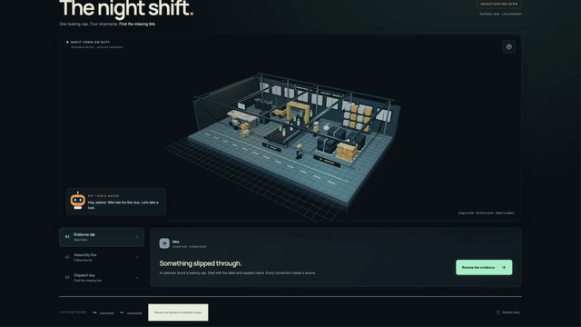
Brief about the idea
One leaking cap.
Possible causes.
One next check.
Pip investigates.
Operators test and review.
Gemini reassesses.
Synthetic case. Real Gemini. Human-reviewed decisions.
Notes:
Source: https://github.com/mk-tdev/BatchLens/tree/main/research/BatchLens . Screenshots show the implemented prototype. Mira, Sol and Pip are authored guides. Gemini performs image extraction; a human confirms relationships.

Slide 3
Opportunities
DIFFERENCE: Gemini revises hypotheses after operator results.
SOLUTION: Evidence, inspection missions and reviewed actions.
USP: A playable factory with an auditable agent journal.
An investigation
that learns from results.
Pip proposes missions and revises evidence-backed hypotheses.
Operators approve checks, facts and the final handover.
Notes:
Source: https://github.com/mk-tdev/BatchLens/tree/main/research/BatchLens . Screenshots show the implemented prototype. Mira, Sol and Pip are authored guides. Gemini performs image extraction; a human confirms relationships.

Slide 4



List of features offered by the solution
Mira’s evidence lab
Sol’s assembly line
Pip’s investigation
Read evidence. Compare causes. Approve a demo inspection mission and record its result.
Review assembly records. Compare inspection scopes with explicit workload assumptions.
Reassess results with Gemini. Ask operational questions. Review corrective-action drafts.
Notes:
Source: https://github.com/mk-tdev/BatchLens/tree/main/research/BatchLens . Screenshots show the implemented prototype. Mira, Sol and Pip are authored guides. Gemini performs image extraction; a human confirms relationships.

Slide 5
Process flow diagram or Use-case diagram
01 INVESTIGATE
Compare causes
02 INSPECT
Operator checkpoint
03 HAND OVER
Review next steps
Read evidence and procedures
Find gaps and contradictions
Propose inspection missions
Approve a demo mission
Record a synthetic result
Gemini revises its findings
Compare inspection scopes
Approve action drafts
Export a reviewed snapshot
Operational chat clarifies the case using cited evidence.
Humans approve decisions. Demo results are explicitly synthetic.
Notes:
Source: https://github.com/mk-tdev/BatchLens/tree/main/research/BatchLens . Screenshots show the implemented prototype. Mira, Sol and Pip are authored guides. Gemini performs image extraction; a human confirms relationships.

Slide 6
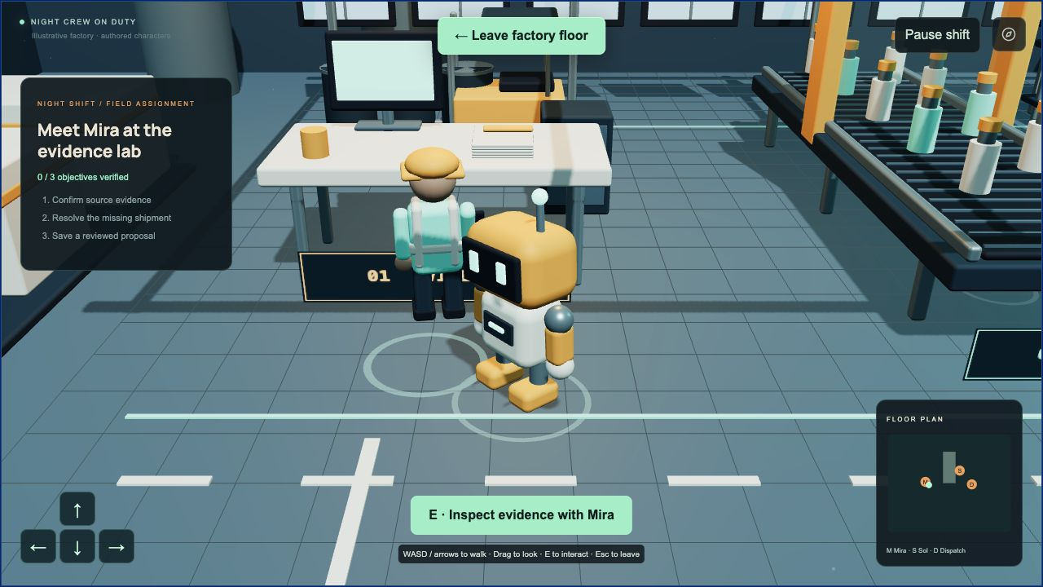
Wireframes/Mock diagrams of the proposed solution (optional)
Walk as Pip. Approach a station. Press E to enter the real evidence-review workflow.
Notes:
Source: https://github.com/mk-tdev/BatchLens/tree/main/research/BatchLens . Screenshots show the implemented prototype. Mira, Sol and Pip are authored guides. Gemini performs image extraction; a human confirms relationships.

Slide 7
Architecture diagram of the proposed solution
Playable factory + adaptive mission journal
Bounded Gemini tool loop
GEMINI / VERTEX AI
Compare causes
Reassess operator results
VALIDATED TOOLS
Procedures, missions, scope
Human approval gates
FIRESTORE
Evidence + result records
Frozen handovers
Operations-only Gemini chat uses a separate scope gate and has no mutation tools.
Notes:
Source: https://github.com/mk-tdev/BatchLens/tree/main/research/BatchLens . Screenshots show the implemented prototype. Mira, Sol and Pip are authored guides. Gemini performs image extraction; a human confirms relationships.

Slide 8
Technologies to be used in the solution
Gemini 3.5 Flash-Lite via Vertex AI
Tool calling, cause comparison and grounded operational chat.
Cloud Run + Firestore
Bounded execution, mission results and persistent case journals.
React, TypeScript, Three.js + FastAPI
Playable factory, human approvals and deterministic scope.
Notes:
Source: https://github.com/mk-tdev/BatchLens/tree/main/research/BatchLens . Screenshots show the implemented prototype. Mira, Sol and Pip are authored guides. Gemini performs image extraction; a human confirms relationships.

Slide 9
Estimated implementation cost (optional)
ONE MEASURED CASE
AI COST PER CASE
 | TOKENS | RATE / 1M | COST
Input | 66,308 | $0.30 | $0.0199
Output | 3,087 | $2.50 | $0.0077
Total (19 calls) | 69,395 |  | $0.0276
≈ $0.03
AI inference per complete
investigation
Gemini 3.5 Flash-Lite on Vertex AI
Investigation, scans, reassessment and 3 chat questions
MONTHLY COST: GEMINI AND TOTAL CLOUD BUDGET
$2.76
$27.61
$6
$40
100 cases
Gemini only
1,000 cases
Gemini only
100 cases
Total cloud budget
1,000 cases
Total cloud budget
Measured synthetic case, 18 Oct 2026. USD before credits and taxes. Total cloud budgets include headroom.
Infrastructure is estimated. 1,000 cases/month requires a higher daily model-call limit.
Notes:
Pilot estimate updated 18 October 2026. This is an engineering budget, not a measured customer pilot or billing invoice.
Measured fresh synthetic demo case bf90a81d-a7bd-4750-ad41-d747f8f1d310: Pip investigated, human approved mission, operator entered labelled synthetic R1, Gemini reassessed, and answered three operational chat questions. Baseline/S4 approvals, handover save and reload followed. No physical inspection was performed. Vertex AI Cloud Monitoring showed 66,308 input tokens, 3,087 output tokens, 19 HTTP-200 model invocations. Case counters: 4 image scans, 9 investigator calls, 6 chat calls. Quiet window and matching daily count support attribution. AI activity 18 Oct 2026 14:00:47–14:02:21 SGT.
Model gemini-3.5-flash-lite, standard global Vertex AI. Rates US$0.30/million input and US$2.50/million output. Calculation: 66,308 * 0.30/1,000,000 + 3,087 * 2.50/1,000,000 = US$0.0276099 per case. 19 calls already included.
Monthly planning allowances at 100 / 1,000 cases:
Gemini: $2.76 / $27.61
Cloud Run: $0.50 / $5.00
Firestore operations and case storage: $0.10 / $1.00
Artifact Registry and build-source storage: $0.60 / $0.60
Cloud Build: $1.00 / $1.00
Internet transfer: $0.25 / $2.50
Subtotal: $5.21 / $37.71
Recommended budget including headroom: $6 / $40.
Assumptions: Cloud Run in Singapore with request-based billing, minimum zero instances, 1 vCPU/512 MiB, about 180 billable instance-seconds and 200 requests per case. Approximately 500 Firestore reads and 200 writes per case, 24-hour case expiry. Named Firestore database has no standard free quota. Around 5 GiB retained container images and 1 GiB build-source files. Twenty five-minute builds/month, about 10 MiB internet traffic/case. Light logs/monitoring assumed within normal free allowance; budget headroom covers small variation. Infrastructure figures are estimates and rounded allowances, not observed billing. No promotional credits or available free-tier discounts subtracted. USD before taxes. More public visits, retained images, longer investigations or builds increase cost. Budget is not a spending cap.
At 19 calls/case, the current 100-attempt/day safeguard allows roughly five full cases/day. The 1,000-case monthly scenario requires an explicitly approved increase to that limit. No deployed limit was changed.
Official price sources checked 18 Oct 2026:
https://cloud.google.com/gemini-enterprise-agent-platform/generative-ai/pricing
https://cloud.google.com/run/pricing
https://cloud.google.com/firestore/pricing
https://cloud.google.com/artifact-registry/pricing
https://cloud.google.com/storage/pricing
https://cloud.google.com/build/pricing
Local measured evidence: research/BatchLens/cost-estimate/vertex-usage-2026-10-18.json

Slide 10
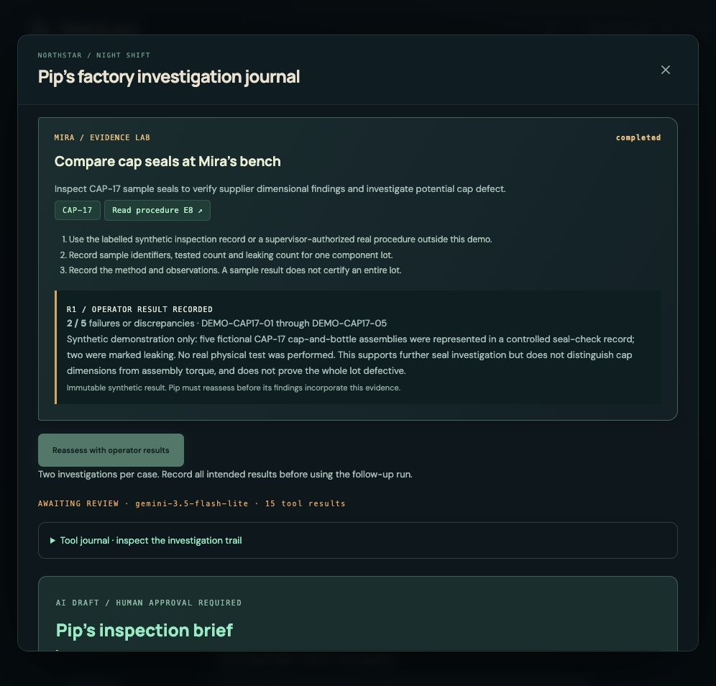
Snapshots of the prototype
Pip proposes.
Operators inspect.
Gemini reassesses.
Humans decide.
Cause comparisons, inspection missions and operational chat with real Gemini.
Notes:
Source: https://github.com/mk-tdev/BatchLens/tree/main/research/BatchLens . Screenshots show the implemented prototype. Mira, Sol and Pip are authored guides. Gemini performs image extraction; a human confirms relationships.

Slide 11
Prototype Performance report/Benchmarking
1,500
ADAPTIVE QUALITY INVESTIGATION
Cause comparison and missions
22 backend tests passed
Human approval gates verified
units proposed for inspection
Zero unresolved after review
Synthetic case and operator-entered demo results. No production accuracy claim.
Gemini recommendations cannot approve scope, release stock or operate equipment.
Notes:
Evidence: https://github.com/mk-tdev/BatchLens/blob/main/docs/live-cloud-verification.json and research/BatchLens/05_Deployment_and_Verification.md. These are observations from one synthetic case. No production accuracy or measured savings are claimed.

Slide 12
Additional Details/Future Development (if any)
Next shift: a real-team pilot
Can a quality team reach a defensible decision with less searching and fewer missed connections?
Measure evidence coverage, review time and decision errors.
Next: approved real procedures, controlled uploads and ERP integration.
Notes:
Source: https://github.com/mk-tdev/BatchLens/tree/main/research/BatchLens . Screenshots show the implemented prototype. Mira, Sol and Pip are authored guides. Gemini performs image extraction; a human confirms relationships.

Slide 13
Try BatchLens and inspect the source
GitHub: https://github.com/mk-tdev/BatchLens
Demo video: recording link pending
Live: https://batchlens-hk3hxwi5na-as.a.run.app/
Walk the factory.
Complete a mission.
Challenge Pip.
Notes:
Source: https://github.com/mk-tdev/BatchLens/tree/main/research/BatchLens . Screenshots show the implemented prototype. Mira, Sol and Pip are authored guides. Gemini performs image extraction; a human confirms relationships.

Slide 14


