Slide 1

ECG AMPLIFIER
S2 B.Tech - Artificial Intelligence and Data Science​
23ECE113 - Introduction to Electronics​
Project – Evaluation 1​
​
Group-5
P. Manikanta (AM.SC.U4AID24035)
O. Mounish Kumar (AM.SC.U4AID24033)
Kasi Viswanadham (AM.SC.U4AID24039)
Uthkarsh Sai (AM.SC.U4AID24031)

Slide 2
Introduction
ECG (ElectroCardiogram) measures the electrical activity of the heart.
Heartbeat monitor is essensital for detecting arrhythmias(irregular heartbeat) and other cardiac issues.
Here we are introducing a prototype for an ECG, which collects the data from the heartbeats and show in the form of a graph(waves).

Slide 3
Literature Survey
1.Portable ECG monitor using AD8232 Module:
(Authors: S. Kumar, A. Patel Year: 2020)
By using AD8232 Module we can make a cost-efficient ECG.
Real time data was displayed on an LCD and transmitted via bluetooth.
Accuracy is suitable for home-based cardiac monitoring.
2. Wearable ECG Systems for Remote Cardiac Monitoring
(Authors: L. Chen, M. Zhang Year: 2021)
It is a review of wearable ECG devices integrated with smartphones.
It has emphasis on power efficiency, signal quality and patient comfort.

Slide 4
Literature Survey
3. Design of ECG acquisition System Using Instrumentation amplifier
(Authors: P. Roy, D. Saha Year: 2020)
Focused on removing noise through notch and low-pass filters.
Improved signal-to-noise ratio for clinical applications.
4. Low-cost ECG Monitoring for Rural Healthcare
(Authors: R. Sharma, V. Joshi Year: 2021)
It contains the details about ECG that works on battery for Rural usage and made using basic op-amp circuit(LM741).
It is proven effective in areas with no hospitals.

Slide 5
Literature Survey
5. Real-time heartbeat Detection Algorithm from ECG signals
(Authors: J. Singh, A. Gupta Year: 2022)
It contains the development of algorithm to detect R-peaks and calculate BPM.
It has shown more than 95% accuracy.
Integration with microcontroller is possible.

Slide 6
COMPONENTS :
Component | Quantity
AD8232 Module | 1
Arduino Nano | 1
Electrode Wires | 3
LM741 Op-Amp | 2
Resistors | 5
capacitors | 5
Breadboard | 1
Voltage Source | 1

Slide 7
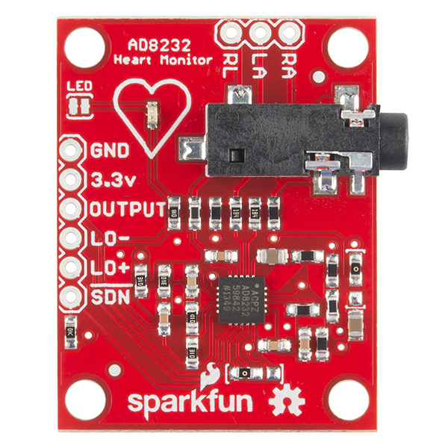
AD8232-Microcontroller:
Integrated circuit (IC) designed to condition signals for Electrocardiogram (ECG) applications.
It's essentially a signal conditioning block that extracts, amplifies the small electrical signals generated by the heart, making them easier to record and analyze.

Slide 8
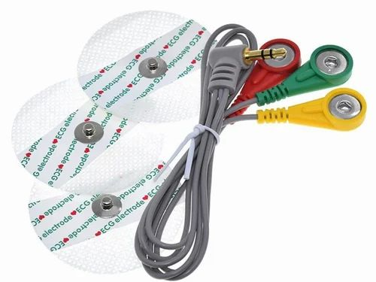
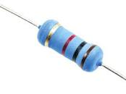
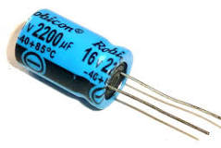
Electrode Wires:
Used to take input signals
from the heart.
Resistors:
A resistor is a passive two-terminal
electronic component that implements
electrical resistance as a circuit element.
Capacitor:
A capacitor is an electronic component
that stores electrical energy by
accumulating electric charges on
two conductive plates separated by
an insulating material called a dielectric

Slide 9
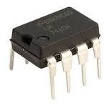
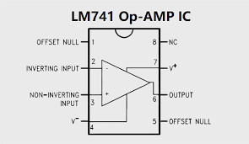
LM741:
The LM741 is a popular and versatile operational amplifier (op-amp) that's known for its high gain and ability to operate with either single or dual power supplies.
It's often used as a DC-coupled amplifier and can be used in various circuits, including comparators and mathematical operations.
The LM741 is also a direct, plug-in replacement for older op-amp models in many applications.

Slide 10
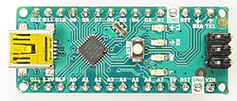
Arduino Nano:
Compact Size:
The Nano is small (45mm x 18mm), making it ideal for space-constrained projects and wearable devices.
Breadboard-Friendly:
It features pin headers that connect easily to breadboards, simplifying prototyping.
ATmega328P Microcontroller:
It utilizes the ATmega328P, offering a balance of performance and affordability.
USB Powered:
The Nano can be powered via a Mini-B USB cable, making it easy to connect to a computer for programming and powering.
Versatile I/O:
It provides 14 digital and 8 analog input/output pins and 6 PWM outputs, allowing for a wide range of applications.

Slide 11
Implementation of Components
Component | Role
Arduino Nano | Reads analog ECG signal via its ADC (Analog-to-Digital Converter) and processes/transmits data to a PC or display.
Instrumentation Amplifier (e.g., AD620) or Op-Amps (e.g., LM741) | Amplifies the tiny ECG signals (~1 mV) from the body electrodes.
Electrodes | Placed on the body to pick up electrical signals from the heart.
Notch Filter (e.g., using RC circuit or op-amp) | Removes 50/60 Hz power line interference.
Low-Pass Filter | Removes high-frequency noise above ECG bandwidth (~100 Hz).
AD8232 Micro controller | The AD8232 captures ECG signals by amplifying and filtering inputs from electrodes.
Resistors & Capacitors | For building filters and gain stages.
Power Supply | ±5V or ±9V dual supply (for op-amps) and 5V for Arduino.

Slide 12
Block Diagram Overview
Arduino Nano : Reads analog ECG signal via its ADC (Analog-to-Digital Converter) and processes/transmits data to a PC or display.
Notch Filter: Removes 50/60Hz power line interference.
Low-Pass Filter: Removes high-frequency noise.
Output: Viewed on display.
AD8232:
AD8232
ECG MODULE
NOTCH FILTER
LOW PASS FILTER
ARDUINO NANO
DISPLAY

Slide 13
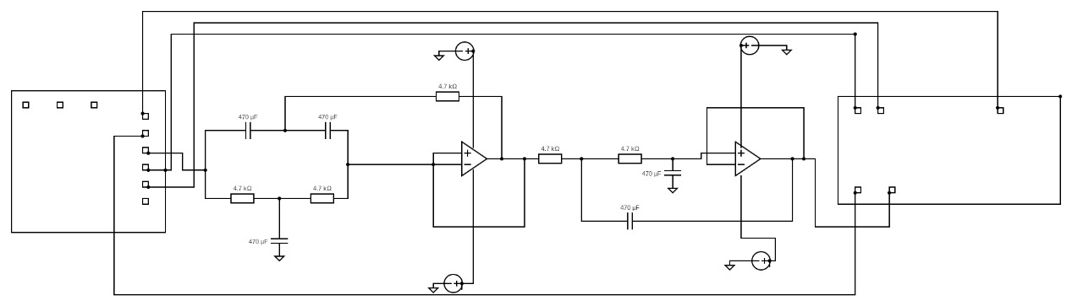
Circuit Diagram
Arduino Nano
AD8232

Slide 14
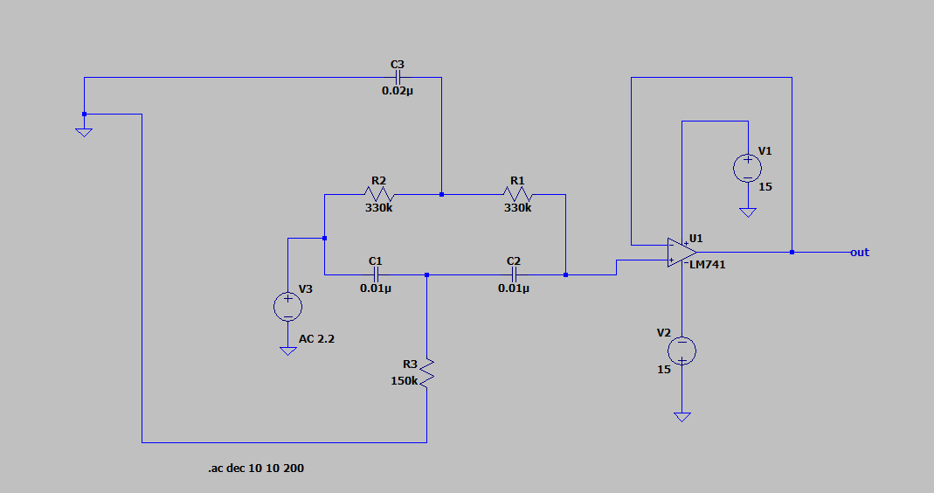
Notch Filter
Components: LM741 (U4), Capacitors (C1–C3), Resistors (R8–R10)
Removes 50/60Hz power line interference
Improves ECG signal quality by eliminating noise

Slide 15
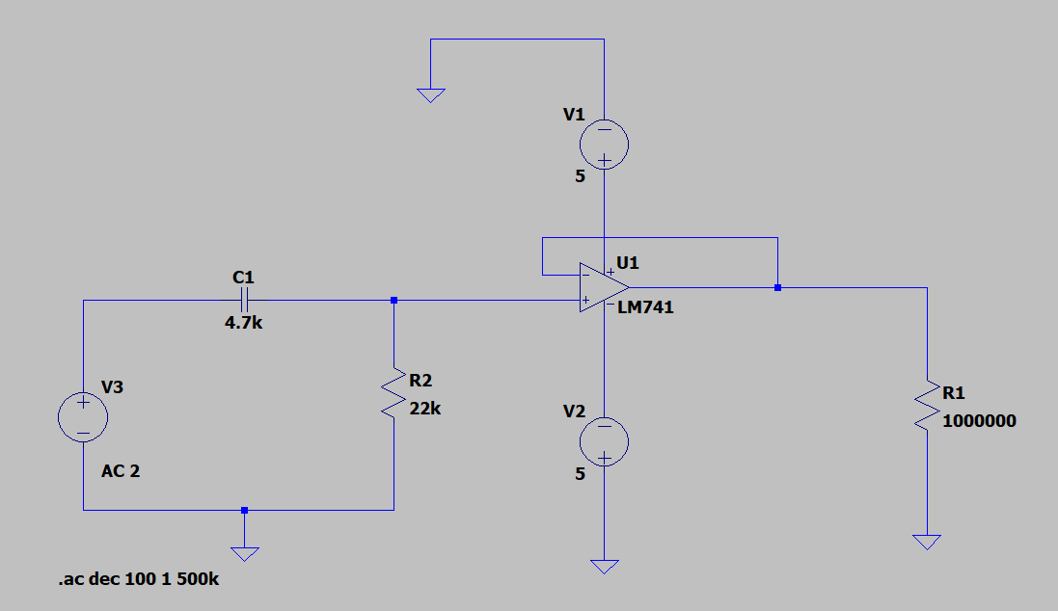
Low-Pass Filter
Components: LM741 (U5), Capacitors (C4, C5), Resistors (R11, R12)
Passes ECG signal frequencies (~0.05Hz–100Hz)
Filters out high-frequency interference

Slide 16
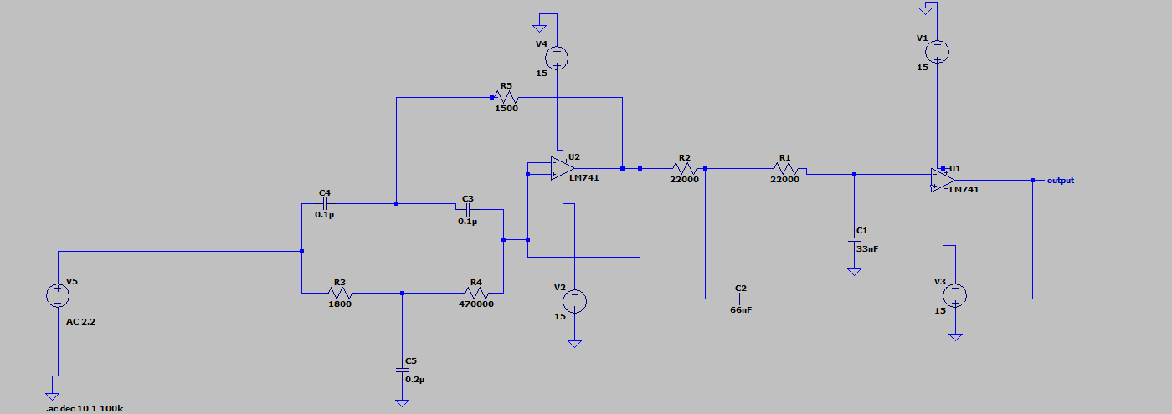
Simulation
Simulation in LTspice

Slide 17
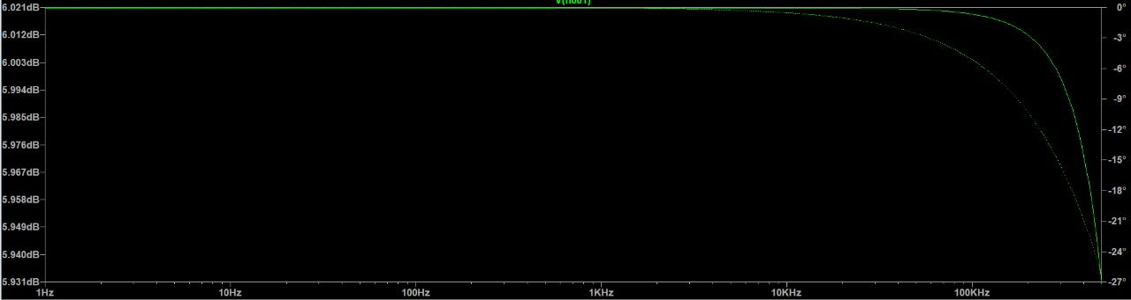
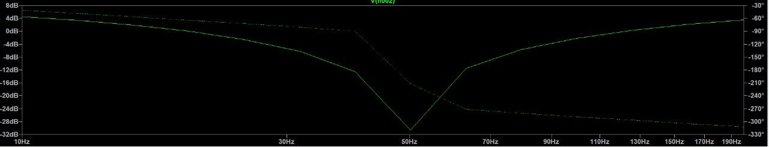
Results

Slide 18
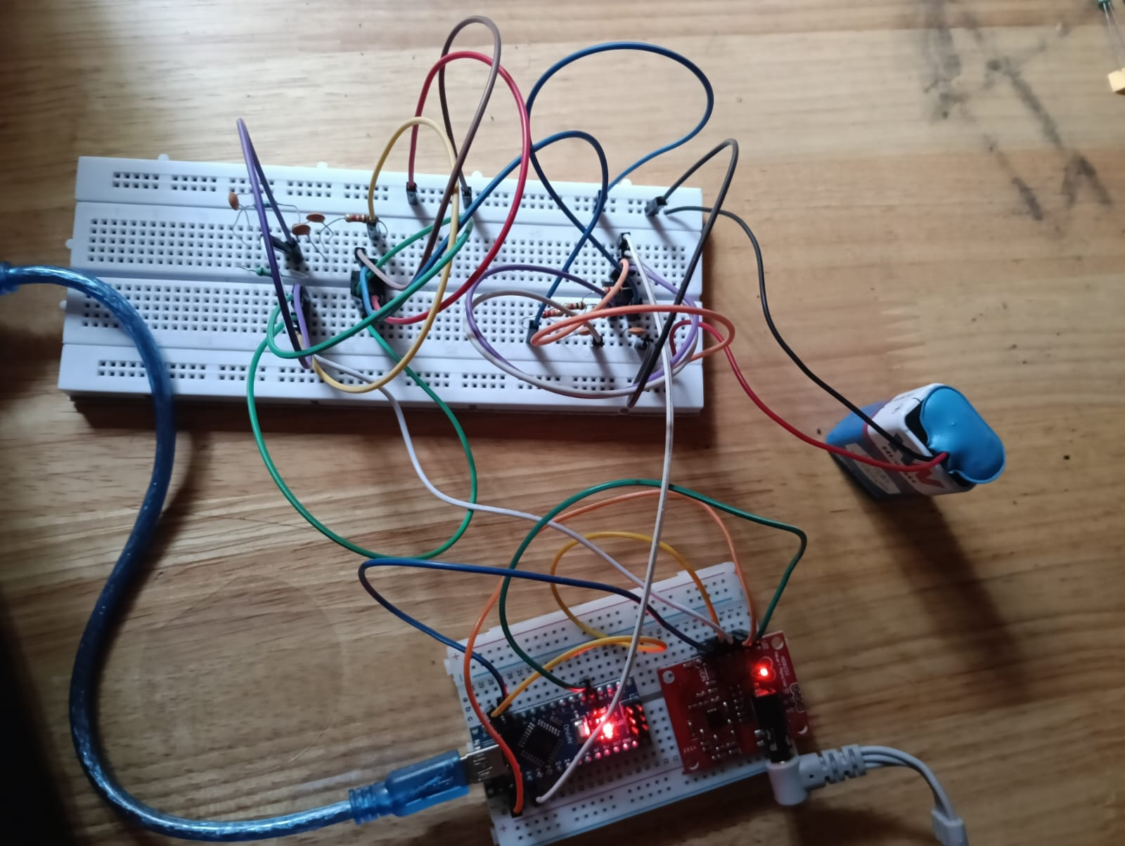
Hardware Implementation:

Slide 19
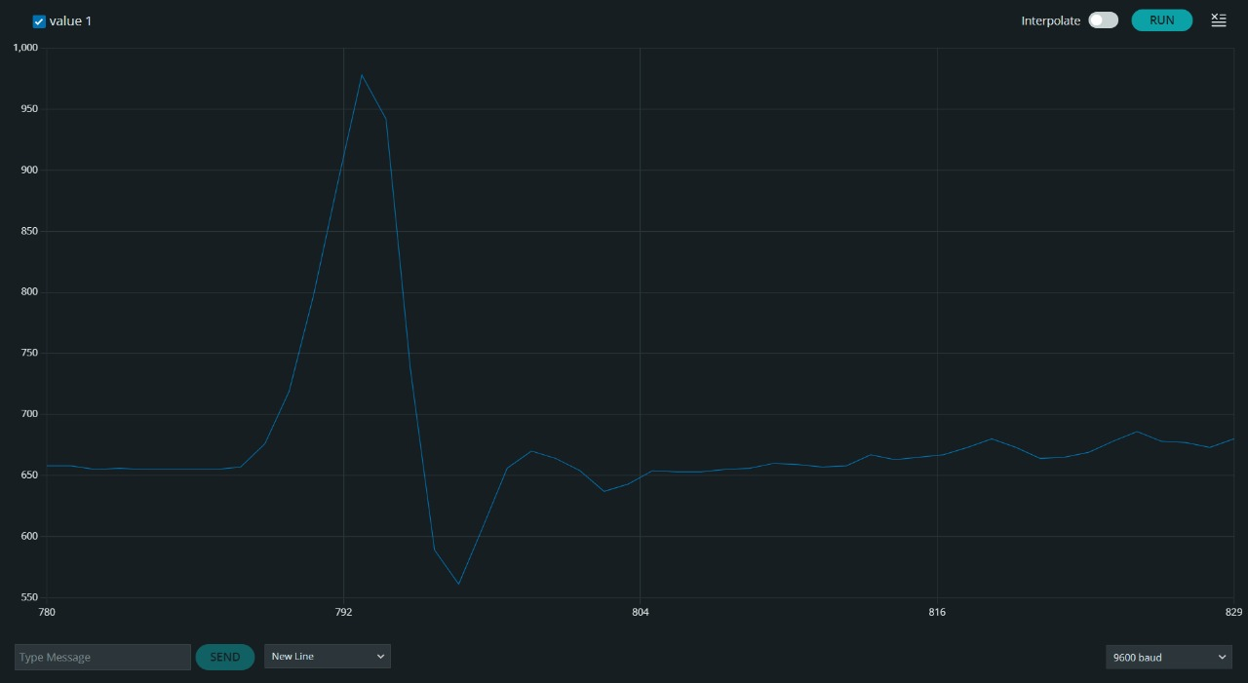
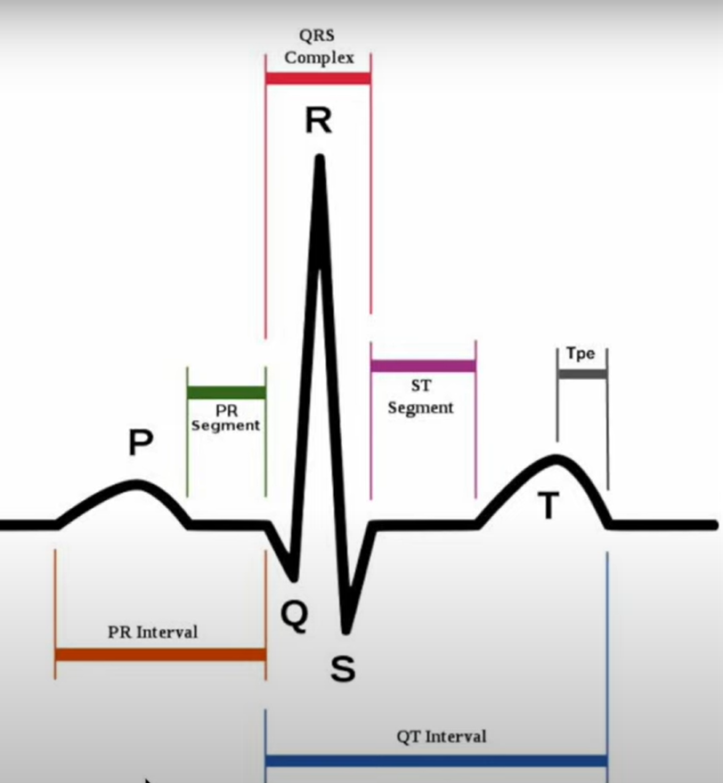
HARDWARE RESULTS:

Slide 20
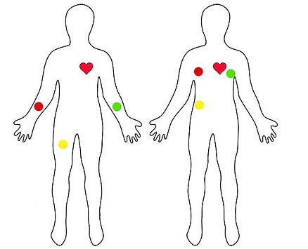
Hardware validation:
P Wave: Atrial depolarization (atria contract).
PR Segment: Delay at AV node, allows ventricular filling.
PR Interval: Time from atrial to ventricular activation.
QRS Complex: Ventricular depolarization (ventricles contract).
T Wave: Ventricular repolarization (ventricles relax).
ST Segment: Time between ventricular contraction and relaxation.
QT Interval: Total time for ventricular activity (depolarization + repolarization)

Slide 21
ADVANTAGES: ​
​
High Signal Amplification: Effectively boosts low-amplitude ECG signals (0.1–5 mV) for accurate measurement and analysis. ​
Noise Suppression: Filters out interference, such as power line noise and muscle artifacts, ensuring a clean ECG signal. ​
High Input Impedance: Minimizes signal loss by matching the high impedance of skin-electrode interfaces. ​
Signal Fidelity: Preserves the frequency range (0.05–100 Hz) and waveform features (P, QRS, T waves) for precise diagnostics. ​
Patient Safety: Incorporates isolation and protection mechanisms to prevent electrical hazards during use. ​
Reliability: Delivers consistent performance across varying physiological and environmental conditions. ​
Versatility: Supports clinical diagnostics, long-term monitoring, and cardiovascular research applications. ​

Slide 22
Conclusion:
Successfully designed and implemented a low-cost ECG amplifier system.
Effectively amplified low-amplitude ECG signals (0.1–5 mV).
Notch and low-pass filters efficiently removed power line and high-frequency noise.
Achieved clear waveform output (P, QRS, T waves) for accurate heart signal analysis.
Ensured patient safety with high input impedance and isolation mechanisms.
Portable and suitable for wearable and rural healthcare applications.
Offers potential for educational use and future integration with IoT and mobile devices

Slide 23
References:
[1] S. Maji, J. Dookhy, and M. J. Burke, “Electrical characterization of conductive textile based ECG recording electrodes,” Meas., Sensors, vol. 15, Jun. 2021, Art. no. 100044, doi: 10.1016/j.measen.2021.100044.
[2] S. Maji, “Design of a high performance low-power ecg amplifier for textile based un-gelled electrodes,” Ph.D. dissertation, Dept. Electron. Elect. Eng., Trinity College Dublin, Dublin, Ireland, 2021.
[3] O. Casas, E. M. Spinelli, and R. Pallas-Areny, “Fully differential AC coupling networks: A comparative study,” IEEE Trans. Instrum. Meas., vol. 58, no. 1, pp. 94–98, Jan. 2009, doi: 10.1109/TIM.2008.927200.
[4] R. Pallas-Areny and J. G. Webster, “Common mode rejection ratio in differential amplifiers,” IEEE Trans. Instrum. Meas., vol. 40, no. 4, pp. 669–676, Aug. 1991, doi: 10.1109/19.85332.
[5] N. Tadic, D. Petric, M. Erceg, and A. Dervic, “CMRR enhance ment in instrumentation amplifiers using an algorithmic approach with dynamic analog signal processing,” IEEE Trans. Instrum. Meas., vol. 70, pp. 1–17, 2021, doi: 10.1109/TIM.2021.3097859.

Slide 24
THANK YOU

