Slide 1
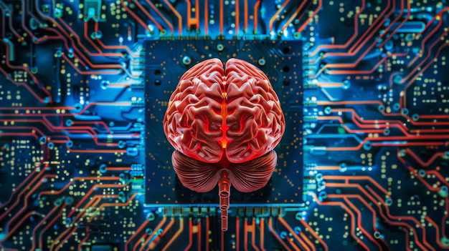
AI: Is it Making Human Brains Useless?
Exploring the relationship between humans and AI.
1

Slide 2
What is Artificial Intelligence (AI)?
Definition of AI
Learning and Improvement
Everyday AI Examples
AI as a Tool, Not a Replacement
2

Slide 3
Why Do We Worry About AI?
AI's Superior Processing Speed
Potential Job Automation
Concerns about AI Superintelligence
3

Slide 4
AI: A Tool, Not a Threat
AI as a Human-Supporting Tool
Unique Human Qualities
Comparative Strengths
Augmenting Human Capabilities
4

Slide 5

Conclusion
AI is a powerful tool, but it's not going to make our human brains obsolete. Instead, it will change the way we work, learn, and interact with the world around us. We need to embrace AI and develop the skills needed to work alongside it, focusing on the uniquely human qualities like creativity, critical thinking, and empathy.
5

Slide 6
Questions and Discussion
6

