Slide 1
The Advection Dispersion Equation
Contaminant Transport

Slide 2
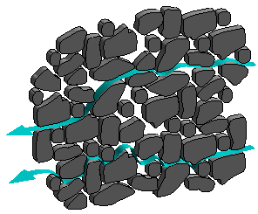
Modelling Contaminant Transport in Porous Media

Slide 3
Advection
Advection causes translation of the solute field by moving the solute with the flow velocity
In 1-d all is does is shift the plume in time by a distance vΔt. It does not change the shape at all
Advection term
n_{e} – effective porosity

Slide 4
Dispersion
Dispersion causes ‘spreading’ of the solute plume
It is composed of both molecular and mechanical dispersion (that can not be distinguished on the Darcy scale)
Dispersion term

Slide 5
Diffusion
Diffusion describes the spread of particles through random motion from regions of higher concentration to regions of lower concentration.
Fick’s Law - diffusive flux
The diffusion coefficient depends on the materials, temperature, electrical fields, etc.
Measured in the Lab
Typically not as large as mechanical dispersion (but this is context specific)

Slide 6
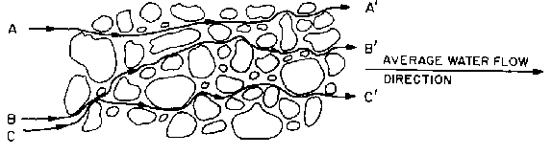
Mechanical Dispersion
Mechanical dispersion reflects the fact that not everything in the porous medium travels at the average water flow speed. Some patha are faster, some slower, some longer, some shorter. This results in a net spreading of the solute plume that looks very much like a diffusive behavior.

Slide 7
Mechanical Dispersion
Since mechanical dispersion depends on the flow, it is expected to increase with increasing flow speed. The most common expression for mechanical dispersion is give by
α is the dynamic dispersivity
v is the average linear velocity

Slide 8
Retardation
When solutes flow through a porous medium they can interact with the solid phase. In particular they can sorb and desorb. The net result is a process called retardation that effective slows the transport of a solute through a porous medium
R depends on the solute, water chemistry and geochemical make up of the porous medium
From a mathematical perspective it can be thought of as a rescaling in time
Retardation term

Slide 9
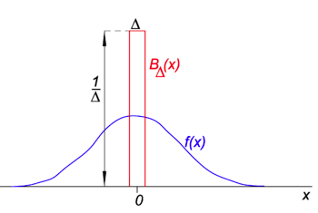
The delta function/pulse initial condition
In order to understand the role of each of these processes we will study how they affect a delta pulse initial condition
The delta function is like an infinitely thin
infinitely peaked pulse. It can be though of
as an approximation to a very narrow
exponential or Gaussian. An important property
is
This allows us to put in a desired mass

Slide 10
Contaminant Evolution
How would you solve this equation?

Slide 11
Contaminant Evolution
Mass of solute injected
Solution
Calculate

Slide 12
What does this concentration distribution look like?
Let the Matlab begin…..
Note here we set R=1
since it just rescales
time

Slide 13
Relevant Questions
How would we quantify the maximum concentration and how it evolves in time?
How do we quantify the position of plume?
How would we quantify the extent of the plume?
How do we extend to multiple dimensions?

Slide 14
Sample Problem
A spill of a contaminant into an aquifer has occurred. The spill was short and over a small area. The total mass of the spill is 1000kg.
After performing a pumping test you infer that the hydraulic conductivity of the aquifer is 500m/d and you know the effective porosity is 0.3. You know flow is from east to west. You have a depth to water measurement 100m east of the of 1m and at 200 m west of the spill it is 2m. The surface elevation is flat.
There are two drinking wells, one 2 m east of the spill and another is 500 m west of the spill. Calculate the concentrations that will arrive at these wells.
The molecular diffusion is 1e-9 m^2/s. The dispersivity is 0.01 m

Slide 15
Spatial Moments
Moment
Zeroth Moment
First Moment
Second Moment
Second Centered Moment (κ₁₁=m₂-m₁²)

Slide 16
Moments
Zeroth Moment – 1 (normalized total mass)
First Moment – vt (center of mass)
Second Moment – 2Dt+v²t² (measure of weight of plume relative to a reference point)
Second Centered Moment - 2Dt (a measure of the width of the plume that increases due to dispersion)

Slide 17
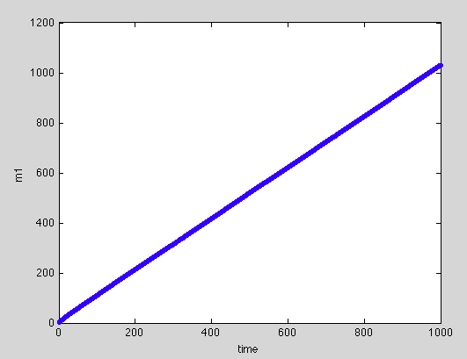
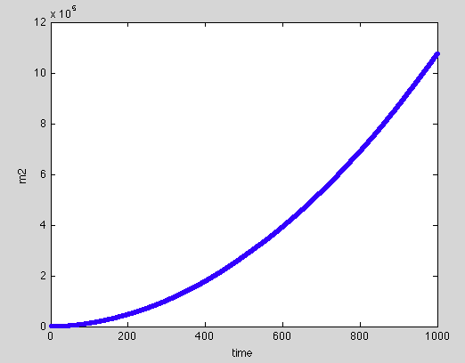
Sample Question
A geophysicist has provided you with the following plots of the first and second moment of a plume. Can you infer the advection speed and the dispersion coefficient?

Slide 18
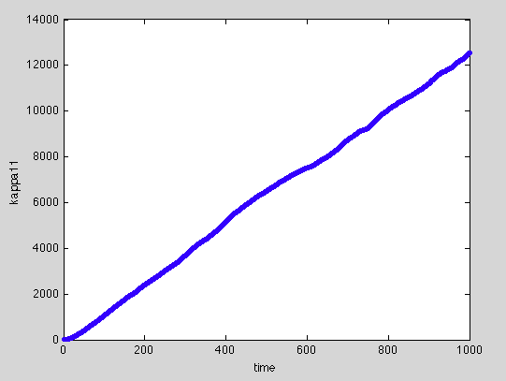
Show random walk model??

Slide 19
Degradation
Many chemicals degrade over time.
Typically in the lab you have a well mixed container and measure how concentration degrades
A variety of models and degradation types exist (linear, nonlinear, 0th , 1st , 2nd…..order)
We will consider the simple case of first order degradation
How do we incorporate this into our governing transport equation?

Slide 20
A correct way of writing it
Consider steady state
The rate of decay is linearly proportional to the concentration
Perfectly consistent with the lab observation
Note γ and λ not always
the same

Slide 21
A few Simple Cases
Consider steady state
For now let’s also neglect dispersion

Slide 22
Imagine you have a continuous source at x=0 and you are only interested in x greater than zero (semi-infinite domain)
How would you solve this equation. Note it is a differential equation in space.

Slide 23
Imagine you have a continuous source at x=0 and you are only interested in x greater than zero (semi-infinite domain)
Solution

Slide 24
Neglect advection
Imagine you have a continuous source at x=0 and you are only interested in x greater than zero (semi-infinite domain)

Slide 25
Neglect advection
Imagine you have a continuous source at x=0 and you are only interested in x greater than zero (semi-infinite domain)
Solution (Inferred)

Slide 26
By the way
When can you neglect dispersion? Or advection? How would you quantify this?

Slide 27
By the way
When can you neglect dispersion? Or advection? How would you quantify this?
Peclet Number Pe=UL/D=L/α
When the Peclet number is large we say advective processes dominate and we often neglect the dispersive term
Similarly when Pe is small we neglect advection

Slide 28
If we include both advection and dispersion
Imagine you have a continuous source at x=0 and you are only interested in x greater than zero (semi-infinite domain)

Slide 29
If we include both advection and dispersion
Imagine you have a continuous source at x=0 and you are only interested in x greater than zero (semi-infinite domain)
The general solution to this ODE is

Slide 30



Health Risk – for chronic exposure to carcinogens
How does the EPA determine if a concentration is too high or that it poses a health risk to the general population
CPF – cancer potency factor
IU/BW is the intake rate per unit body weight
ED – Exposure Duration; EF – Exposure Frequency;
AT – Averaging Time

Slide 31
Health Risk
How does the EPA determine if a concentration is too high or that it poses a health risk to the general population
Risk, as defined here, is a probability of how many people in the population will develop cancer.
The EPA mandates R<10⁻⁶ (less than one in a million gets sick)
Although R>10⁻⁴ is when the trouble begins

Slide 32
Sample Problem
You have a continuous source of a contaminant at x=0 of concentration 100 mg/l. The contaminant degrades with first order coefficient γ=0.1 day^-1
The system has a flow velocity of 1m/day and a dispersivity of 0.001m.
The contaminant has no health risk by dermal or inhalation exposure. For ingestion you can take the cancer potency factor as 2 x10⁻³ kg d/mg. People who are exposed will typically be exposed for eleven months of every year and we consider them exposed over a liftetime of 70 years with a typical residence time in a certain area of 30 years. Assume the average person weighs 65 kg and that they take in 3 litres of water per day
At least how far from the source should you locate a well to ensure acceptable health risk?

Slide 33
Greens Function
In general for an arbitrary initial condition and possibly source of contamination, how to do we solve the ADE on an infinite domain
To solve this we can exploit the linear nature of the equation and use what is called the Greens function
Source
Initial
Condition

Slide 34
Greens Function
The solution to this problem is
Where G is the Greens function defined as

Slide 35
Some Examples
Large initial spill over a length 2L (represent with Heaviside H(x))
Continuous Source at x=0 with zero initial condition, zero flow

