Slide 1
CREDIT SUISSE
SPRING 2012 ITP
Mikyung Kim, Jianxing Chen, Chao Gu, Aye Moe

Slide 2
OVERVIEW
Visualization tool for client engagement
Users:
  Senior Management
    Employee performance
    Employee relationship to clients
  Sales Rep
    Evaluate clients
    Improve relationship
    Resource management

Slide 3
METRICS
Revenue
Trade Volume/Execution
Meetings
Expense (Travel & Entertainment)

Slide 4
THINGS CONSIDERED
Simplicity
One uniform view

Slide 5
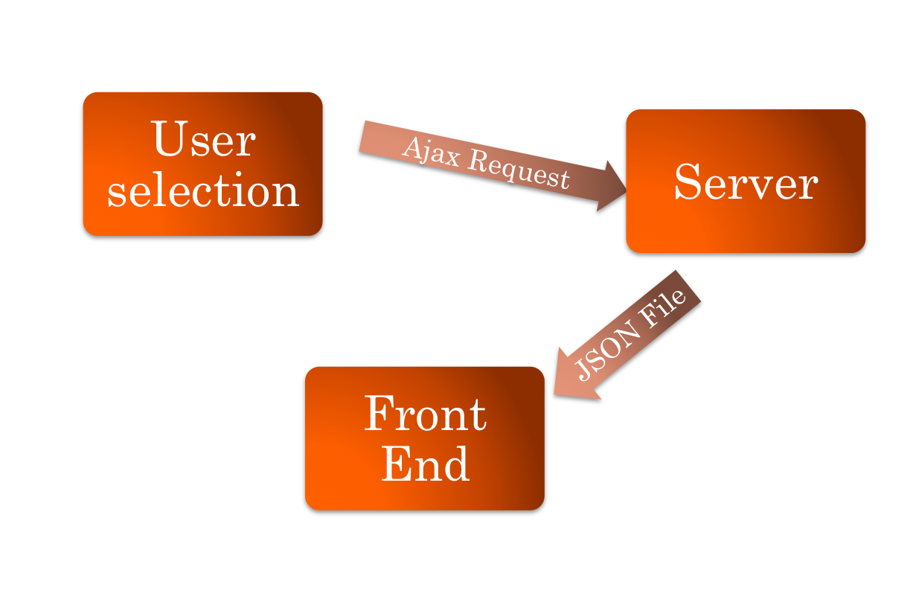
PROCESS

Slide 6
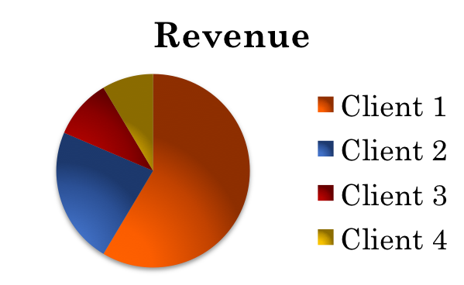
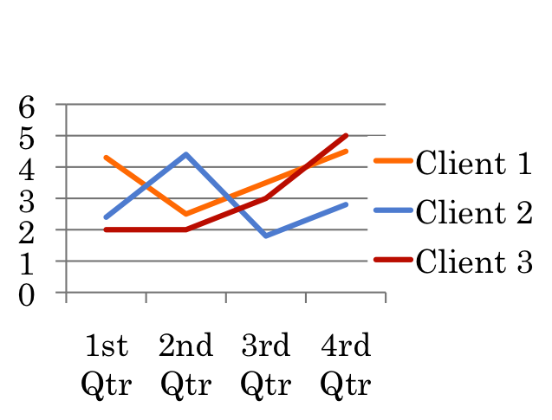
SALES REP
A pie chart
  Revenue by clients
  Total hours that the sale rep spent clients
Detailed client view
  Line chart client’s account growth value against time

Slide 7
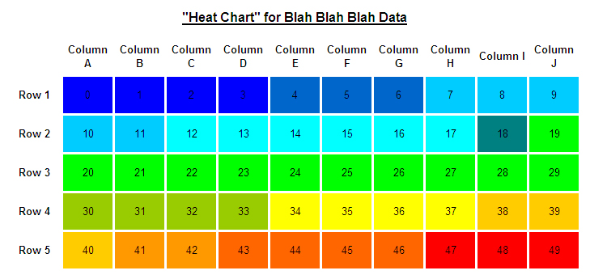
SALES REP
Heat Chart
  Expense/Revenue
  Meeting hours/Revenue
  Phone calls/Revenue

Slide 8
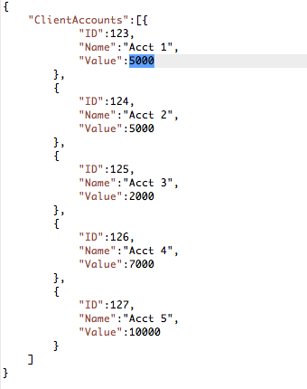
JSON
Light-weight Data Exchange Format
Object – { name : value }
Array – [ {name : value}, {name : value}]

Slide 9
DEMO
Demo

