Slide 2
Graph
Graph is similar to the mathematical graph structure.
It comprise of a set of vertices connected with each other through edges.
Graph is collection of nodes and edges.
Operation performed on a graph data structure include finding possible paths between 2 nodes and finding the shortest possible path.

Slide 3
Basic Concept
A graph G consists of the following elements:
A set V of vertices or nodes where
V={v1,v2,v3……,vn}
A set E of edges also called arcs where
E={e1,e2,e3…….en}
Here G=(V,E)
V2
e2
V3
e5
V5
e1
e3
V1
V4
e4
GRAPH G=(V,E)

Slide 4
Undirected Graph
e1 is an edge between V1 & V2 vertices.
e2 is an edge between V2 & V3 vertices.
Representation of edge e as
e=(u,v)
Where e connects both u and v vertices.
Now e=(u,v) means the same thing as e (v,u).
This means that the ordering of the vertices has no significance here. Thus we can call the graph G as undirected graph.

Slide 5
Directed Graph
If we replace each edge of the graph G with arrows., then it will become a directed graph or diagraph.
V(G)={V1,V2,V3,V4,V5}
E(G)={(V1,V2),(V2,V3),
(V1,V4),(V4,V3),(V3,V5)}
V2
e2
V3
e5
V5
e1
e3
V1
V4
e4

Slide 6
Graph Terminology
Adjacent Node: If e(u,v) represents and edge between u and v vertices then both u and v are called adjacent to each other.
U is predecessor node and v is successor node.
Degree: degree of a vertex is the number of edges connected to a vertex. V3=degree 3.
Indegree: the no. of edges ending at vertex
Outdegree: the no. of edges beginning at vertex.
Path: A path is a sequence of vertices each adjacent to the next.
Path between v1 to v5 is v1->v2->v3->v5.

Slide 7
Cycle: It is a path that starts and ends at the same vertex.
Loop: it is an edge whose endpoints are same that is e(u,u).
Weight: anon-negative number assign to an edge. Also called length.
Order: no. of vertices contained in the graph.

Slide 8
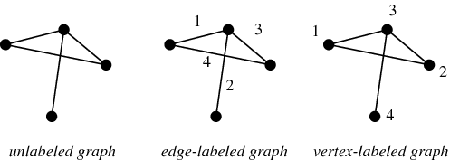
Labeled Graph
It is a graph that has labeled edges or labeled vertices.

Slide 9
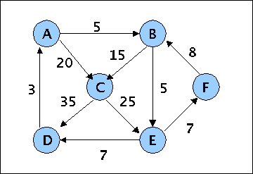
Weighted Graph
It is a graph that has weight assigned to each of its edges.

Slide 10
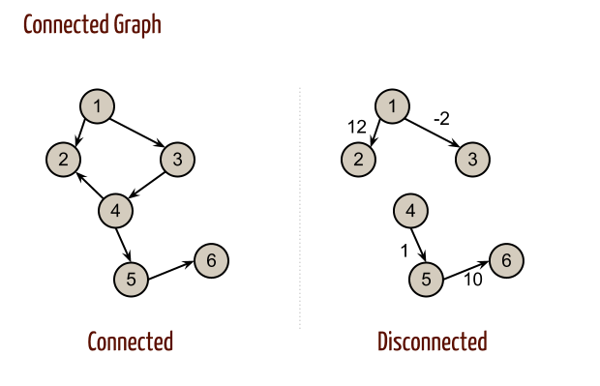
Connected Graph
It is an undirected graph, in which there is a path between each pair of nodes.

Slide 11
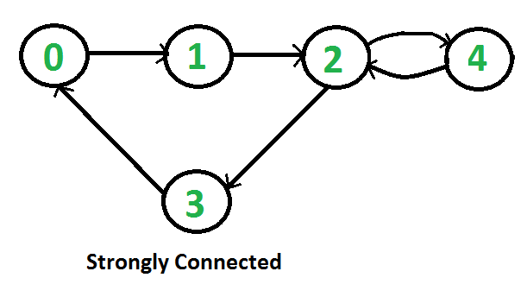
Strongly Connected Graph
It is a directed graph in which there is a route between each pair of nodes.

Slide 12
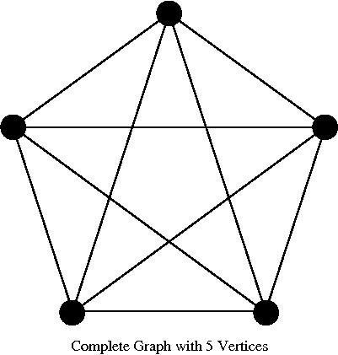
Complete Graph
It is an undirected graph in which there is direct edge between each pair of nodes.

Slide 13
Graph Representation
Graphs can be implemented using following method.
1.Adjacency matrix
2. Path matrix
3. Adjacency list

Slide 14
Adjacency Matrix
A graph G=(V,E) having N nodes.
The adjacency matrix of graph G is defined as NXN matrix A, where
1. Aij=1,if there is an edge from vertex vi to vj
2. Aij=0.if there is no edge from vertex vi to vj
0s represent that there is no direct edge between the corresponding vertices while 1s represent the presence of a direct edge.

Slide 15
Aij | 1 | 2 | 3 | 4 | 5
1 | 1 | 1 | 0 | 1 | 0
2 | 0 | 0 | 1 | 0 | 0
3 | 0 | 0 | 0 | 0 | 1
4 | 0 | 0 | 1 | 0 | 0
5 | 0 | 0 | 0 | 0 | 0
2
e2
3
e5
5
e1
e3
1
4
e4

Slide 16
Path Matrix
A Directed Graph G=(V,E) having N nodes.
The path matrix of graph G is defined as NXN matrix P, where
1.Pi,j=1, if there is a path from vertex vi to vj.
2. Pi,j =0,if there is no path from vertex vi to vj
The path matrix P can be deduced using the adjacency matrix of G.
Pn=A+A2+A3+….+An

Slide 17
Warshall Algorithm
Warshall has suggested a more simplified method of deriving the path matrix from the adjacency matrix .
Warshall method determines the presence of a path between vi and vj by performing logical opeartion.
1. identifying a direct path from vi to vj.
2. identifying the indirect path from vi and vj that is a path from vi to vk. And vk to vj
That is Pi,j=Pi,j OR(pi,k and Pk,j)

Slide 18
Adjacency List
Adjacency list is a linked list representation of a graph.
.It consists of a list of graph nodes with each node itself consisting of a linked list of its neighboring nodes.

Slide 19
1
1
2
4
n
2
e2
3
e5
2
3
n
5
3
5
n
e3
4
3
n
e1
5
Nu
1
4
e4

Slide 20
Shortest Path Algorithm
One of the most common problem associated with graphs is to find the shortest path from one node to the other.
Wij | 1 | 2 | 3 | 4 | 5
1 | 8 | 3 | 0 | 4 | 0
2 | 0 | 0 | 7 | 0 | 0
3 | 4 | 0 | 0 | 0 | 5
4 | 0 | 0 | 2 | 0 | 0
5 | 0 | 0 | 0 | 1 | 0
2
7
3
5
5
4
3
2
1
8
1
4
4

Slide 21
Here Wi,j represents the weight of the edge from node vi to vj.
The value 0 significance that there is no direct edge between the corresponding nodes.
Shortest path represent the weight of the shortest possible path between any two nodes of a graph.

Slide 22
It begins with replacing all the 0s in the weight matrix with
Wij | 1 | 2 | 3 | 4 | 5
1 | 8 | 3 | 0 | 4 | 0
2 | 0 | 0 | 7 | 0 | 0
3 | 4 | 0 | 0 | 0 | 5
4 | 0 | 0 | 2 | 0 | 0
5 | 0 | 0 | 0 | 1 | 0
Spij | 1 | 2 | 3 | 4 | 5
1 | 8 | 3 | 8 | 4 | 0
2 | 8 | 8 | 7 | 8 | 8
3 | 4 | 8 | 8 | 8 | 5
4 | 8 | 8 | 2 | 8 | 8
5 | 8 | 8 | 8 | 1 | 8

Slide 23
Now the following relation is applied to arrive at the shortest path matrix.
Spij=minimum of(SPij, SPjk + SPkj)
The shortest path matrix obtained after applying the above relation for each graph node is.

Slide 24
SPij | 1 | 2 | 3 | 4 | 5
1 | 8 | 3 | 6 | 4 | 11
2 | 11 | 14 | 7 | 13 | 12
3 | 4 | 7 | 8 | 6 | 5
4 | 6 | 9 | 2 | 8 | 7
5 | 7 | 10 | 3 | 1 | 8
2
7
3
5
5
4
3
2
1
8
1
4
4

Slide 25
Graph Traversal
One of the most common task with graph is to traverse or visit the graph nodes and edges in a systematic manner.
1. Breadth First Search(BFS)
2. Depth First Search(DFS)

Slide 26
Both these methods consider the graph nodes to be in one of the following state:
1. Ready State
2. Waiting State
3. Processed State
The state of a node keeps on changing as the graph traversal progresses.
Once the state of a node becomes processed, it is considered as traversed or visited.

Slide 27
Breadth First Search(BFS)
It visits the graph nodes level by level.
It begins with analyzing the starting node and then progresses by analyzing its adjacent or neighboring nodes.
Once all the neighboring nodes of the starting node are analyzed, the algorithm starts analyzing the neighboring nodes of each of the analyzed neighboring nodes.
This method of graph traversal requires frequent backtracking to the already analyzed nodes.
The BFS methods uses the queue data structure for storing the nodes data.

Slide 28
V4
V2
V8
V1
V5
V7
V3
V6
The BFS Traversal sequence for the above graph will be V1,V2,V3,V4,V5,V6,V7,V8
Another BFS traversal sequence can be: V1,V3,V2,V6,V5,V4,V7,V8

Slide 29
Depth First Search(DFS)
The DFS method visits the graph node along the different paths.
It begins the analyzing the nodes from the start to the end node then proceeds along the next path from the start node.
This process is repeated until all the graph nodes are visited.
The DFS method also requires frequently backtracking to the already analyzed nodes.
It uses stack data structure for storing information related to the previous node.

Slide 30
V4
V2
V8
V1
V5
V7
V3
V6
The DFS Traversal sequence for the above graph will be V1,V2,V4,V8,V5,V7,V3,V6
Another DFS traversal sequence can be: V1,V3,V6,V7,V8,V2,V5,V4

Slide 31
Spanning tree
A spanning tree is a subset of Graph G, which has all the vertices covered with minimum possible number of edges. Hence, a spanning tree does not have cycles and it can not be disconnected.

Slide 32
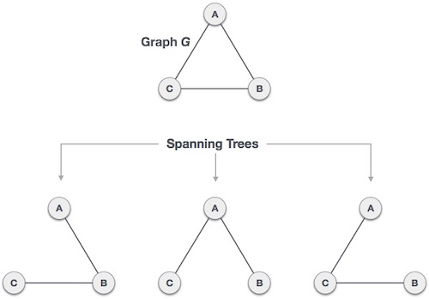

Slide 33
Minimum Spanning Tree(MST)

