Slide 2
Tree
A tree is non-linear data structure. Which stores the data elements in hierarchical manner.
A tree is defined as a finite set of elements or nodes.
It grows downwards from top to bottom.

Slide 3
Tree Terminology
Node: data element of tree. Also specifies links to the other node.
Root: top node in a tree.
Parent node: it has one or more child nodes.
Child node: all nodes except root.
Leaf: terminal node does not have any child.
Degree: no. of subtree.
Level: root level is 0, child level is 1 and so on.
Depth : maximum level of a node in the tree.

Slide 4
A
B
D
E
C
F
G
H
I
J
Root
NODE
0 level
Parent Node
1 level
Child node
2 level
Degree of node A=2
3 level
Depth=3
Leaf

Slide 5
Array representation
1D array is used for storing the node elements.
Following rules are applied while storing the node elements in array.
1. the root node is stored at the first position in the array while its left and right child nodes are stored at the successive position.

Slide 6
In binary tree the root, left child and right child can be easily identified by the formula:
If n=0, then its is the root node .
else
Left child =2n+1
Right child-2n+2

Slide 7
Linked list representation
Tree node is repented with the help of the linked list node comprising of the following field.
1.INFO stores the value of the tree node
2LEFT stores a pointer to the left child.
3. RIGHT stores a pointer to the right child.
There is a special pointer that points at the root node.

Slide 8
Struct tree
{
Int info;
Tree *right;
Tree *left;
}
Struct tree *root;

Slide 9
Binary Tree
A binary tree is finite set of data elemets, which is either empty or consists of a single item called the root and two disjoint binary tree called left-subtree and right subtree.
Its node can have a maximum of degree of 2.

Slide 10
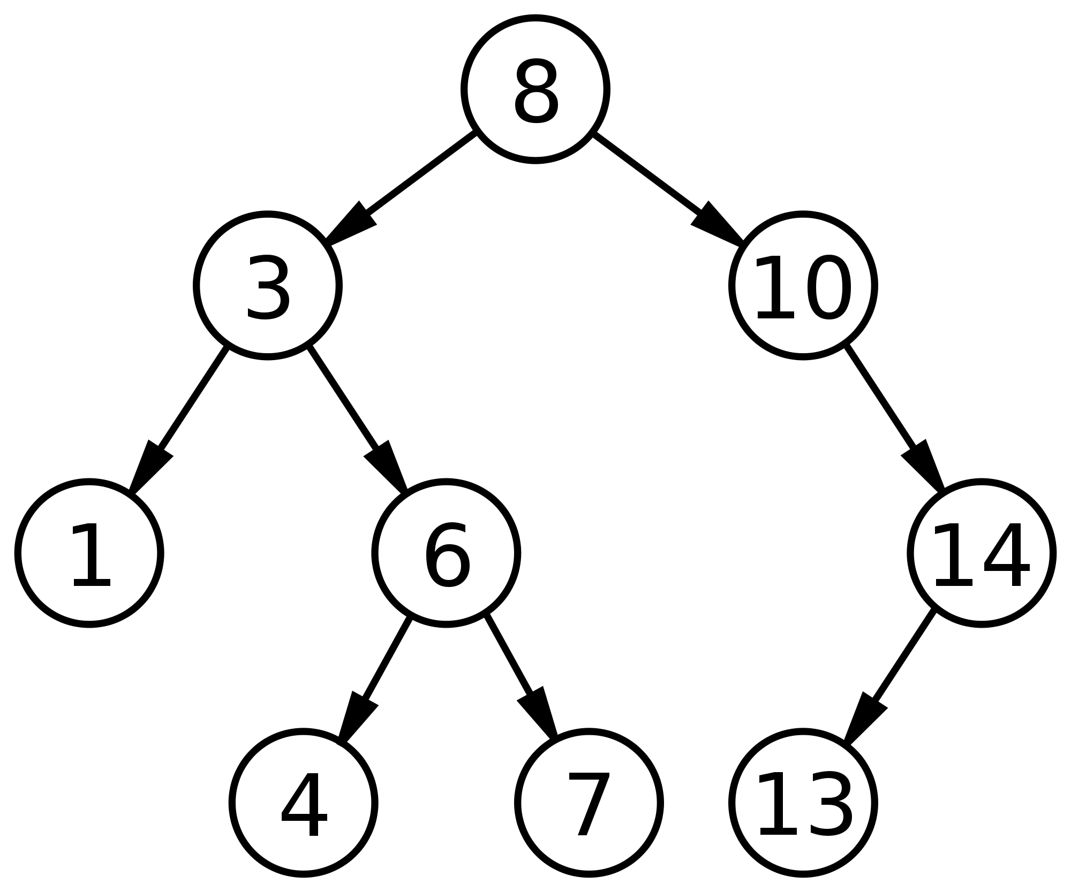

Slide 11
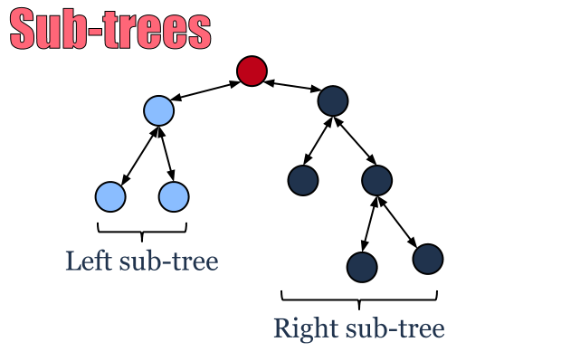

Slide 12
Strictly Binary Tree
A binary tree is called strictly binary if its all nodes barring the leaf nodes contains two childs.

Slide 13
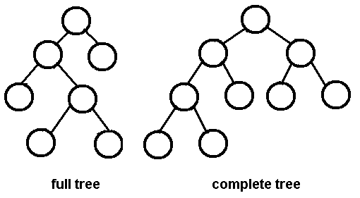

Slide 14
Complete Binary Tree
A binary tree of depth d is called complete binary tree if all its levels from 0 to d-1 contain maximum possible number of nodes.
In a complete binary tree ,there is exactly one nodes at level 0,two nodes at level 1 ,4 nodes at level 2 and so on.
Level n so node=2 n

Slide 15
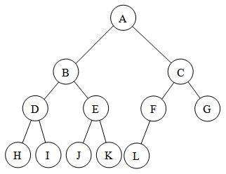

Slide 16
Balanced Binary Tree
A binary tree is called balanced binary tree if the depths of the subtree of all node do not differ by more than 1.

Slide 17
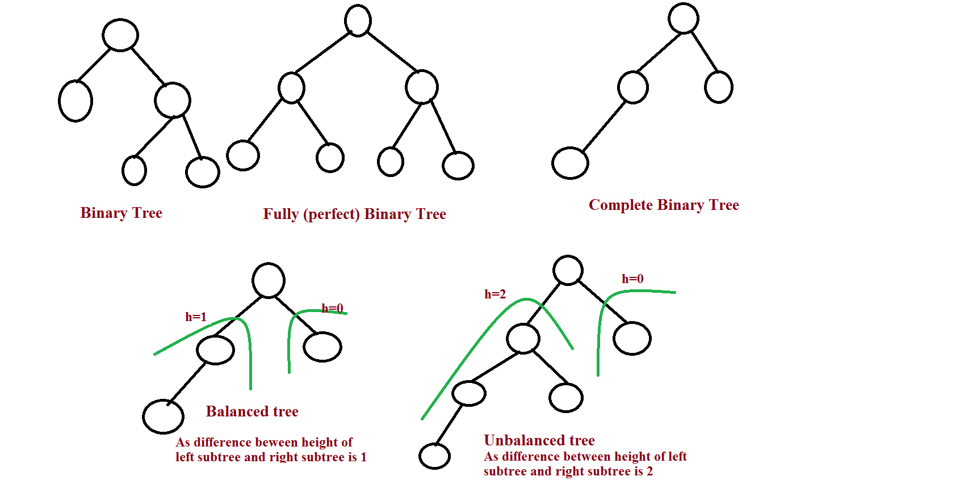

Slide 18
Binary tree representation
Array representation
Linked representation

Slide 19
Binary Tree Traversal
Traversal is the process of visiting the various elemets of a data structure.
Binary tree traversal can be performed using three methods.
1.preorder
2.inorder
3.postorder

Slide 20
Preorder traversal
It perform following operation.
1.process the root node(N)
2.traverse the left subtree of N(L)
3. Traverse the right subtree of N (R)
The sequence of process is-
1.Root-A
2. Left in preorder-BDHIE
3.Right in preorder-CFG
So the
Preorder Traversal is
ABDHIECFG
A
B
E
C
F
G
I
H
D

Slide 21
Inorder Traversal
It perform following operations:
1.traverse the left subtree of N(L)
2. Process the root(N)
3. Traverse the right subtree of N(R)
The sequence of process is-
Left in inorder-HDIBE
Root- A
Right in inorder-FCG
So the
Inorder Traversal is
HDIBEFCG
A
B
E
C
F
G
I
H
D

Slide 22
Post Traversal
It perform following operations:
1.traverse the left subtree of N(L)
2. Traverse the right subtree of N(R)
3. Process the root(N)
The sequence of process is-
Left in postorder-HIDEB
Right in postorder-FGC
Root- A
So the
Post order Traversal is
HIDEBFGCA
A
B
E
C
F
G
I
H
D

Slide 23
Binary Search Tree
A binary search tree is a binary tree which is either empty or satisfy the following rule:
1.the value of the key in the left child or left subtree is less than the value of the root.
2.the value of the key in the right child or right subtree is more than or equal to the value of the root.
3.all the subtree of the left and right child

Slide 24
Binary search tree arranges its node element in a sorted manner.
Most important application of binary search tree is searching.

Slide 25
12,34,5,1,15,6,7,0,13,4,53
12
12
12
12
5
34
5
34
34
1
12
12
34
34
5
5
12
34
1
15
1
6
15
5
1
6
15
12

Slide 26
Tree variants
Expression tree
Threaded binary tree
Height balanced tree
M-way tree
B tree
B+ tree

Slide 27
Expression Tree
A binary tree containing mathematical expression.
The internal node of the tree are used to store the operator and terminal nodes are used to store operands.
Expression‘
(a+b)*(a-b/c)

Slide 28
(a+b)*(a-b/c)
*
-
+
a
b
a
/
b
c

Slide 29
Threaded Binary tree
In linked list representation of a binary tree ,the number of null pointer are actually more than non-null pointer.
Threaded binary trees offer an innovative alternate to avoid the memory wastage.

Slide 30
A
C
B
D
E
F
NULL
NULL
NULL
NULL
NULL
NULL
NULL

Slide 31
Effective use of null pointers.
Replace all the null pointers by the appropriate pointers value called thread.

Slide 32
head
A
B
C
D
E
F

Slide 33
Height Balanced tree(AVL)
A binary tree which height is completely balanced .
If all leaves occur at nodes of level h or h-1 and if all node at levels lower than h-1 have 2 child.
The idea of balancing tree is proposed by Adelson, Velski and EM Lendis.(AVL)

Slide 34
Height Balanced Tree
Each node in AVL tree has the property that the heaight of the left subtree is either equal or one less than the height of the right subtree.
We may define a balance factor
[BF=Height of left subtree –height of right subtree]
The value of BF will be either 0,1 or -1.

Slide 35
If 2 subtree of same height BF=0
If right subtree is higher BF=1
If left subtree is higher BF=-1
0
1
-1
0
1
-1
0
0
0
0
1
0
0
0
-1
0
1
-1
0
0
0

Slide 36
Red-Black Tree
A red black tree is a binary search tree which maintain the following properties.
Color Property
Every node is either red or black.
Root node is always black
If a node is red both child are black.
If a black node has a child that child must be red.
Every node which to be inserted is marked red color.

Slide 37
Order Property
Same as binary search tree.
Keys to the left node are smaller.
Keys to the right node are larger.
Balanced property
We rotate the tree to maintain the balance
Black Height property
The number of black nodes on every path from the root to each leaf is the same.

Slide 38
Example

Slide 39
M-way tree
It is extension of binary search tree.
Instead of 1 key and 2 pointers in each node on m-way tree can have m pointers and m-1 key.

Slide 40
Properties of m-way tree:-
Each node of the tree stores 1 to m-1 number of keys.
The keys are stored in a sorted manner inside the node.k1<k2<k3<k4<km
A node containing k values can have a maximum of k+1 subtress.
For any node ,all key values in the subtree pointed by pointer Pi will be less than ki+1 and all key values in the subtree ponited by pi+1 will be greater than ki+1.

Slide 41
Insert 12,6,9,1
x
1
x
6
x
9
x
12
x
Insert 7,14,50,78
x
1
x
6
9
x
12
x
7
x
x
14
x
50
x
78
x
Insert 2,95,99,93
1
x
6
9
x
12
7
x
14
x
50
x
78
x
x
2
x
93
95
99

Slide 42
B tree
It is a type of m-way tree , which is balanced and the tree is called balanced as all leaves are at the same level.
Due to this the height of this tree is small.
B tree is result of that fact that we wanted to keep the height of m-way tree as small as possible so that searching would be faster.

Slide 43
Properties of B-tree:-
Al the leaves in the tree at the same level.
The root will have minimum 2 child and maximum m child.
In case if tree contains just root node than it will have no child at all.
it can have minimum (m/2) child and maximum m child.
No. of keys in each internal node will be 1 less than the no of pointers it have.
All key partition the keys in the subtree in the manner of search tree.

Slide 44
6
10
1
2
6
7
E: 5,19,9,18
A: 1,7,6,2
11
13
6
B: 11
1
2
4
5
7
11
7
8
9
1
2
C: 4,8,13
6
7
8
11
13
1
2
4
D:10
6
10
7
8
11
13
1
2
4

Slide 45
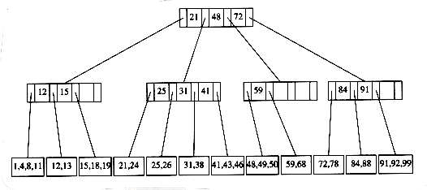

Slide 46
B+ Tree
It is variant of B tree. That is mainly used for implementing index sequential access of records.
B+ tree data records are only stored in the leafs node.
Internal nodes of B+ tree are only used for storing the key value.
If the target element is less than a key value then the search proceeds towards its left pointer.
If the target element is less than a key value then the search proceeds towards its right pointer.

Slide 47
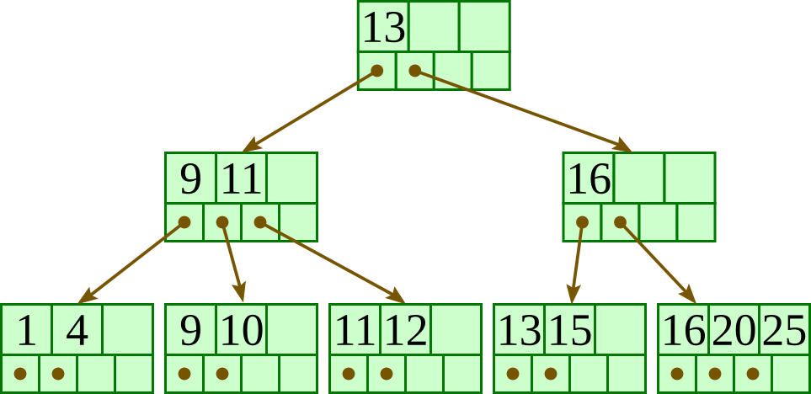

Slide 48
B* Tree
B * Tree is self balancing tree are data structure that most commonly used in database and file system for indexing purpose.
It is 2/3 full to fill two child nodes , then splitting into three nodes.
B* tree Properties:
Multiple data points in a single node.
Each node has a sorted list and points to the next node.
B+ tree is ½ of its maximum capacity while b* tree 2/3 of its max capacity. (atleast 2/3 full)

Slide 49
example

