Slide 1
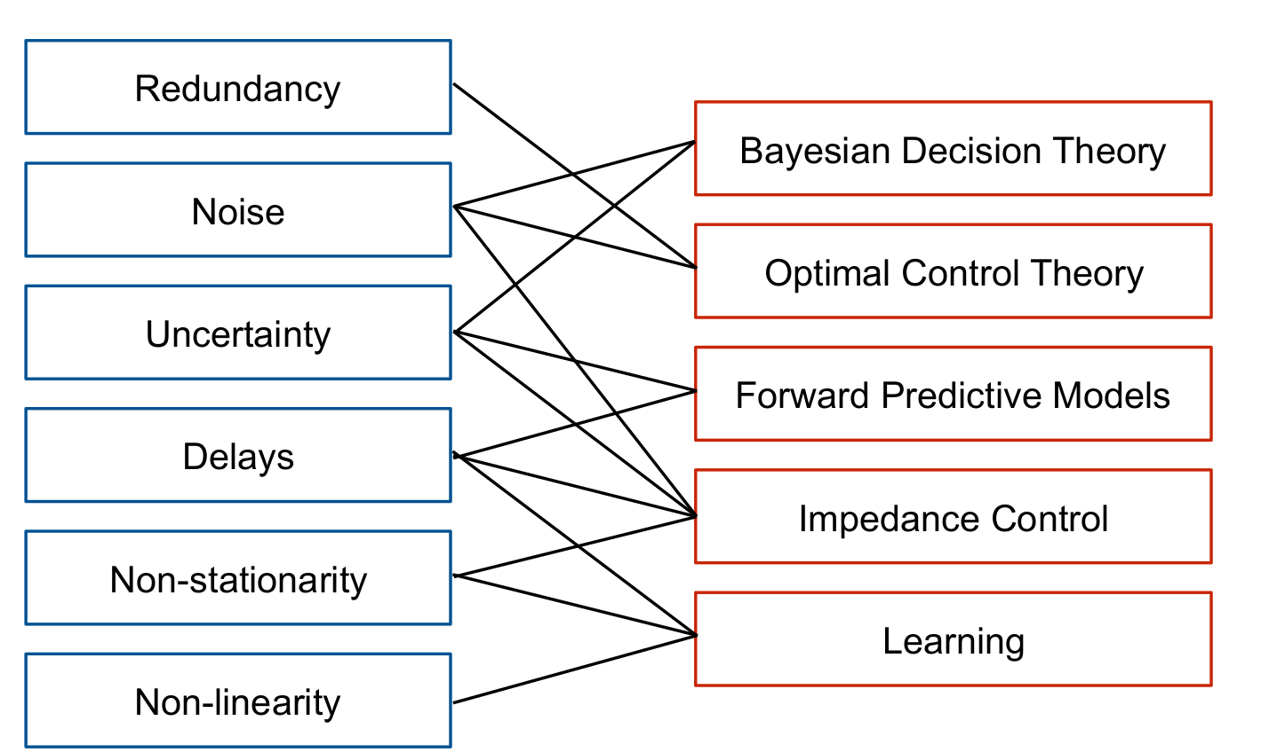
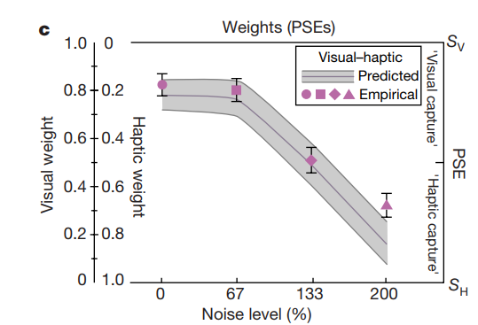
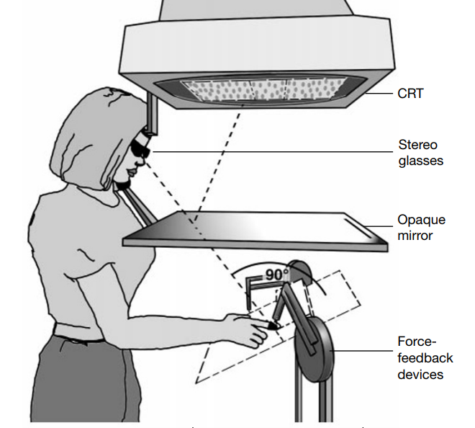
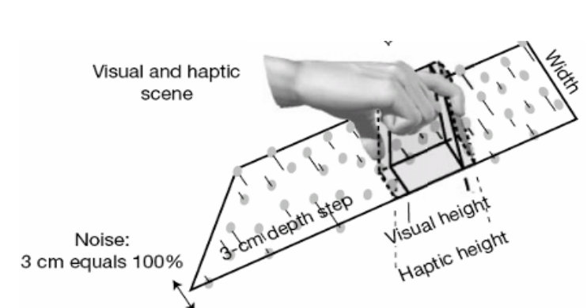
Computational Principles of Sensorimotor Control using the Example of Multisensory Integration
Maximilian Joas
Problems in Motor Control
Visual Haptic Integration
Question: How do humans combine the two signals in presence of noise?
Subjects had to compare the size of two objects
One comparision object had always the same size
One object with a discrepancy between visual and haptic size
The objects were shown sequential to the subjects for one second
Different levels of noise on visual signal, no noise on haptic signal
Subjects were forced to decide which object is taller
Figure 1: Overview of problems in motor control and computational ways to deal with these problems
Bayesian Decision Theory -
Multisensory Integration
Figure 4: “Weights and PSEs. Abscissa represents the noise level, left ordinate represents visual weight (wV; haptic weight is 1 - wV) and right ordinate represents the PSEs relative to S V and S H. Purple symbols represent observed visual weights obtained from regression analysis of PSEs. Shaded area represents predicted weights expected from within-modality discrimination” (Ernst and Banks, 2002).
Multisensory integration helps us to deal with uncertainty and noise. Distinct sensory modalities can represent the same information about the state of our body or the state of the external world (e.g., auditory and visual location of a noise source). When these different modalities are experimentally put in conflict, for example by mismatching the vision and sound of a human speaking, the percept is something intermediate between the percept of each input alone (McGurk and MacDonald, 1976). Even for normal sensory inputs, our sensory system is variable and can have biases. Because of thtat, the estimates from distinct modalities are not likely to be equal. Within the Bayesian framework, we can ask what is the most likely state of the world which showed the multiple sensory inputs. Such a Bayesian model predicts that a scalar estimate from two different modalities, such as the visual and haptic size of a held object, should be weighted and averaged to calculate an optimal estimate. Most importantly, the weighting of each modality should depend on its reliability, with the more reliable stimuli contributing more to the final estimate. This kind of model is supported by experimental studies of size estimation from visual and haptic cues (Ernst and Banks, 2002), location from visual and auditory cues (Körding et al., 2007b), and has been suggested to explain ventriloquism (Alais and Burr, 2004). The study by Ernst and Banks will be explained in the following.
Conclusion
Humans combine two sensory stimuli mathematical optimal using maximum likelihood estimation (Held, and Sabanés Bové, 2014) This is an estimation where the weights W of two stimuli XV and XH, are calculated according to their variance σ²:
Ф = W * X_{V} + (1-W) * X_{H,}
with W = σ_{H}² / ( σ_{H}² + σ_{V}²)
Figure 2: The experimental setup overview (Ernst and Banks, 2002).
Figure 3: The experimental setup detailed view (Ernst and Banks, 2002).
References
Alais, D., and Burr, D. (2004). The ventriloquist effect results from near-optimal bimodal integration. Curr. Biol.14, 257–262.
Ernst, M.O., and Banks, M.S. (2002). Humans integrate visual and haptic information in a statistically optimal fashion. Nature 415, 429–433.
Körding, K.P., Beierholm, U., Ma, W.J., Quartz, S., Tenenbaum, J.B., and Shams, L. (2007b). Causal inference in multisensory perception. PLoS One 2, e943.
Held, L., & Sabanés Bové, D. (2014). Applied statistical inference. Springer, Berlin Heidelberg, doi, 10, 978-3.
Maximilian Joas
University Leipzig
Department for Computer Science
E-Mail: maxjoas.mj@gmail.com
Contact

