Slide 1


Slide 2

WEB-BASED DIGITAL CERTIFICATE AUTHORITY MANAGEMENT (WCAMAN)

Slide 3
GROUP MEMBERS INTRODUCTION

Slide 4
🔹 Member 1
Name: Moazam Samah Khan
VU ID: BC200408672
Role in Project:
  Requirement Gathering & Analysis
  System Design (Architecture, Database, UML Diagrams)
  Backend Development (Node.js, Express.js, MySQL, Step-CA Integration, Step-CLI)
  Frontend Development (HTML, Bootstrap)
  Testing, Deployment & Documentation
📌 Note: This project has been developed individually without any group members.

Slide 5

INTRODUCTION OF PROJET

Slide 6
Overview
This project is a centralized Certificate Authority Management System (CAMS) that allows administrators to securely issue, manage, and audit digital certificates using Smallstep Step-CA. It integrates certificate issuance with a web-based UI, database storage, and audit logging to ensure traceability and security.

Slide 7
Purpose of the Project
To eliminate manual and error-prone certificate management processes.
To provide a centralized interface for issuing and tracking SSL/TLS certificates.
To enhance organizational security through controlled access, audit logging, and certificate traceability.
To support real-world enterprise use cases such as secure internal services, APIs, and applications.

Slide 8
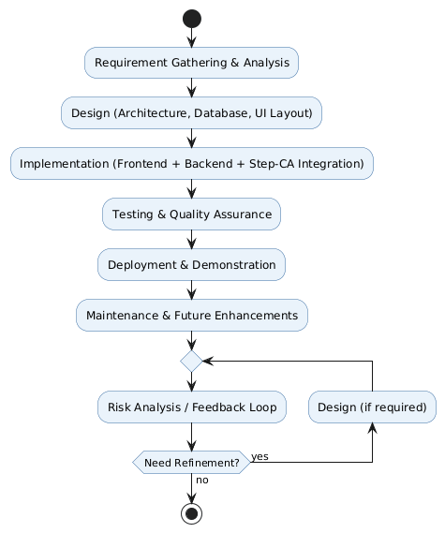
VU PROCESS MODEL

Slide 9
USE CASE DIAGRAM

Slide 10
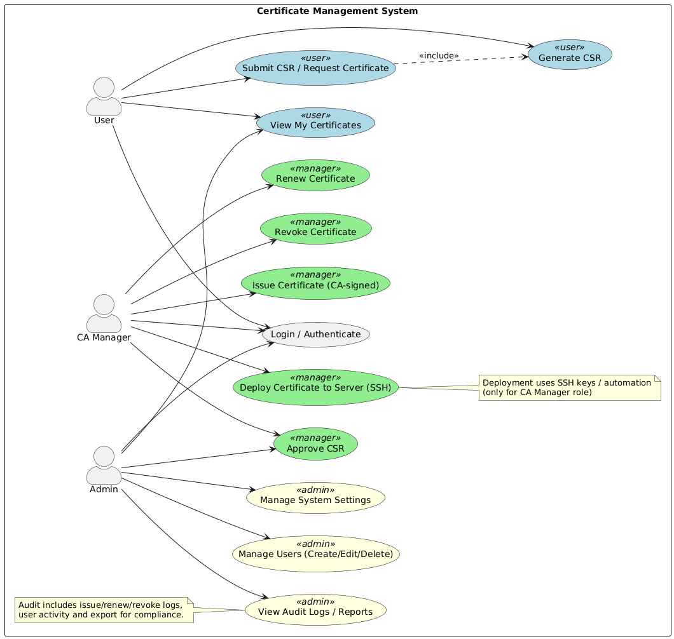

Slide 11
Core Business Rules / Functional Requirements

Slide 12
Role-Based Access Control (RBAC):
Only Admin can manage users, provisioners, and global system settings.
Certificate Manager can issue, renew, and revoke certificates but cannot change system settings.
Regular User can only request, download, and view their own certificates.

Slide 13
Certificate Issuance:
A certificate can only be issued if a valid CSR (Certificate Signing Request) is submitted.
Each certificate must be associated with a valid user in the system.

Slide 14
Certificate Renewal:
Certificates nearing expiry (within 7 days) can be renewed.
Renewal requires the existing certificate and private key for validation.

Slide 15
Certificate Revocation:
A certificate can only be revoked by an Admin or Certificate Manager.
Once revoked, the certificate status must be updated to Revoked in the database and CRL/OCSP must reflect the change.

Slide 16
Unique Certificate Constraint:
A user cannot hold two active certificates for the same domain/common name at the same time.
Audit Logging:
Every certificate action (issue, renew, revoke) must be logged with details: who performed the action, timestamp, IP address.
Audit logs are viewable only by Admin.

Slide 17
Authentication & Security:
All users must log in with OAuth2 / JWT-based authentication.
Two-Factor Authentication (2FA) must be enabled for Admin and Certificate Manager accounts.
Alerts & Notifications:
The system must send notifications (email/SMS) for certificates nearing expiry.
Alerts must also be generated for revoked or failed certificate requests.

Slide 18
System Integration:
The backend must integrate with step-ca for actual certificate lifecycle management.
The system must expose a REST API for external integrations (e.g., servers requesting certificates).
Compliance & Standards:
All certificates must follow X.509 standards.
TLS 1.3 must be enforced for all communication with the CA service.

Slide 19
ARCHITECTURE DIAGRAM

Slide 20
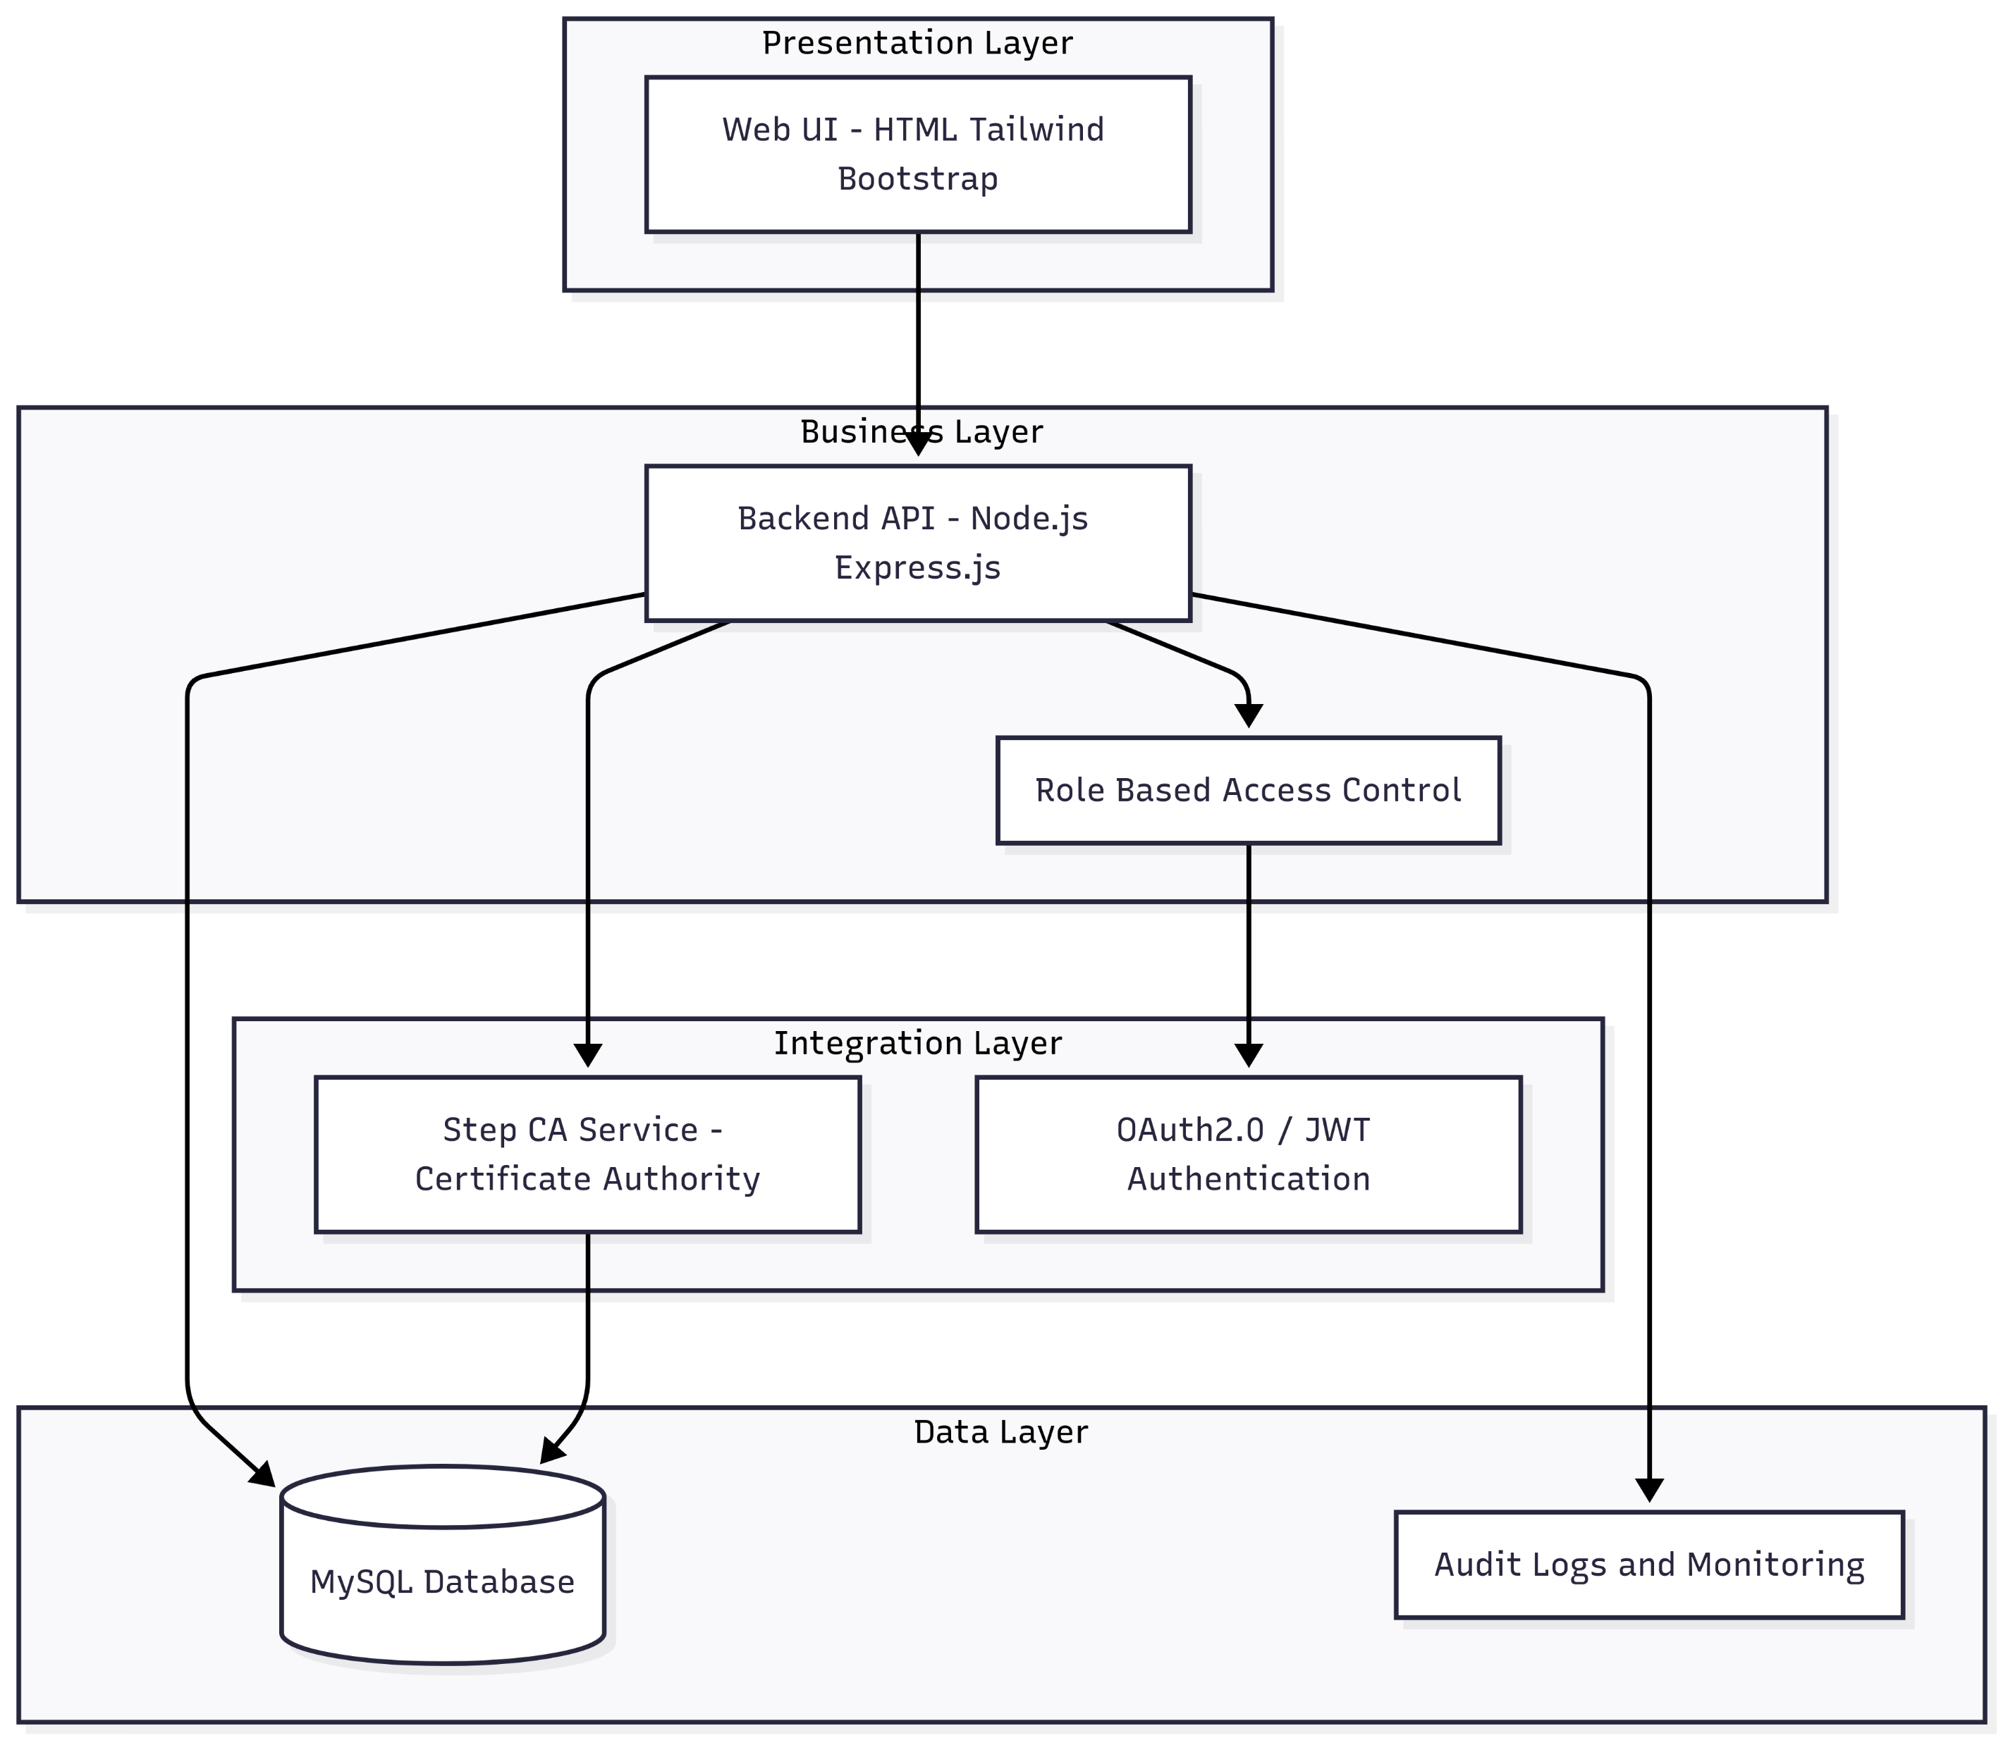

Slide 21
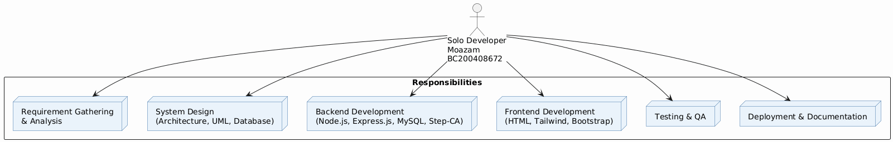
Team Structure

Slide 22
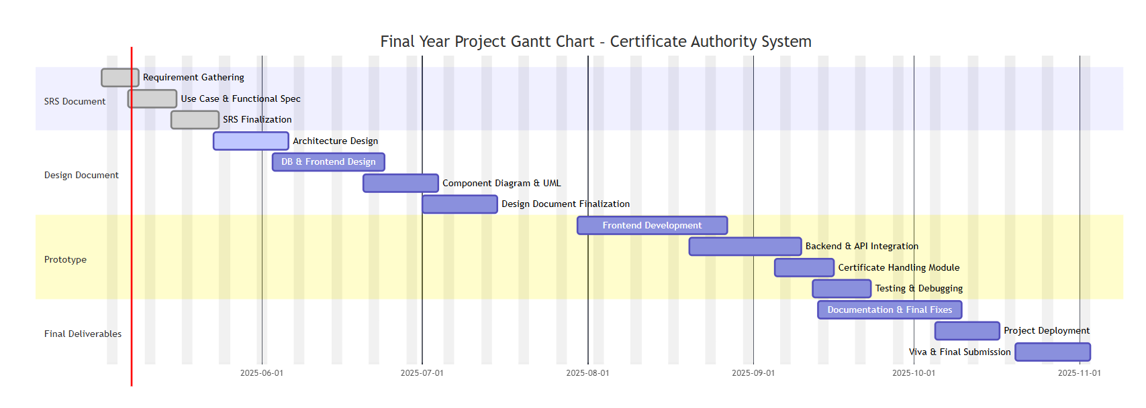
Project Schedule

Slide 23
SEQUENCE DIAGRAMS

Slide 24
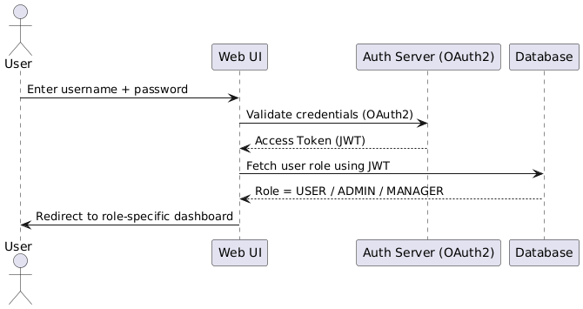

Slide 25
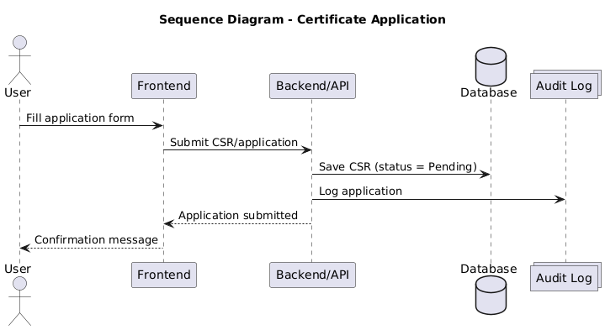

Slide 26
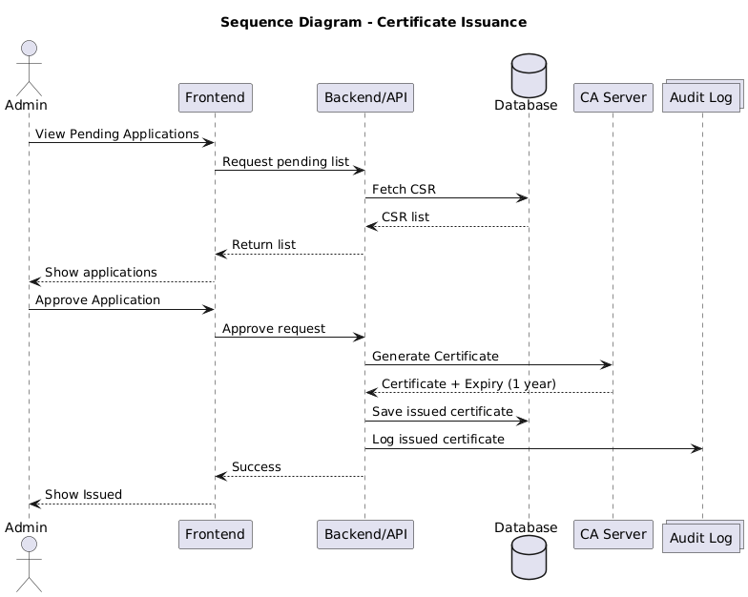

Slide 27
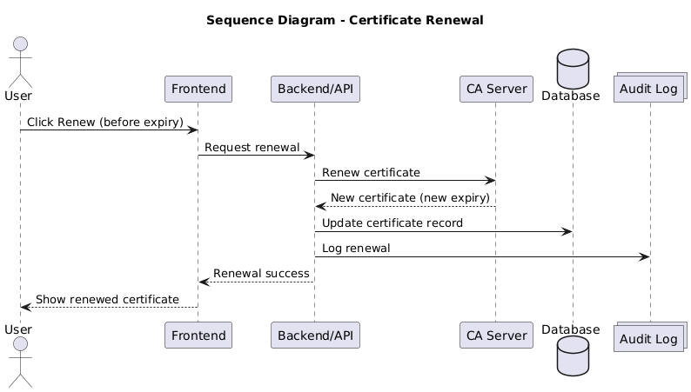

Slide 28
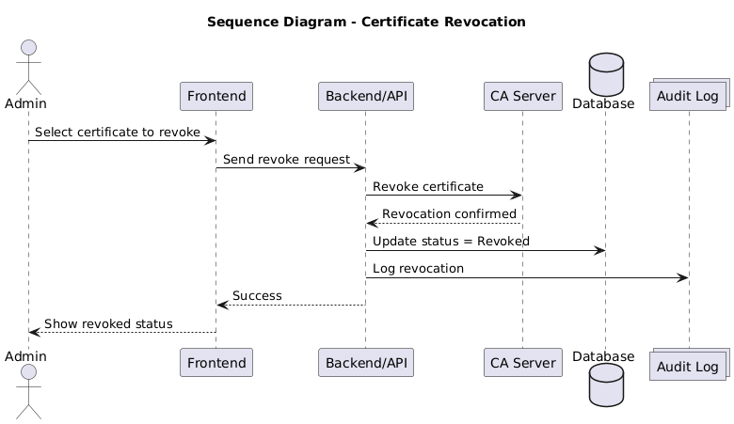

Slide 29
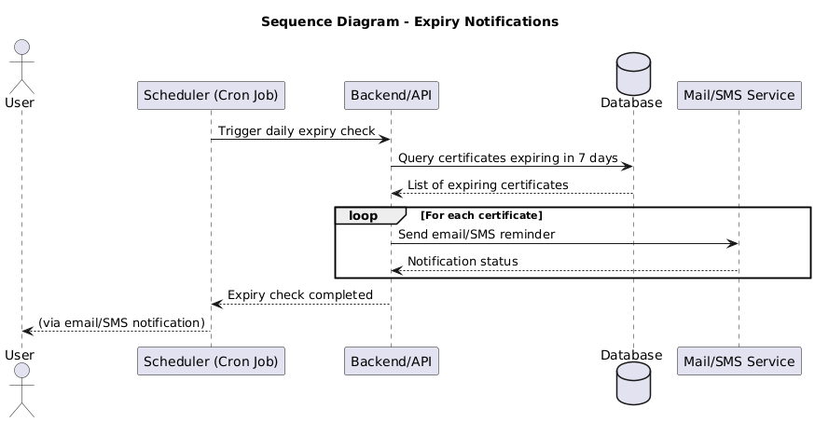

Slide 30
Logical Model/Class Diagram

Slide 31
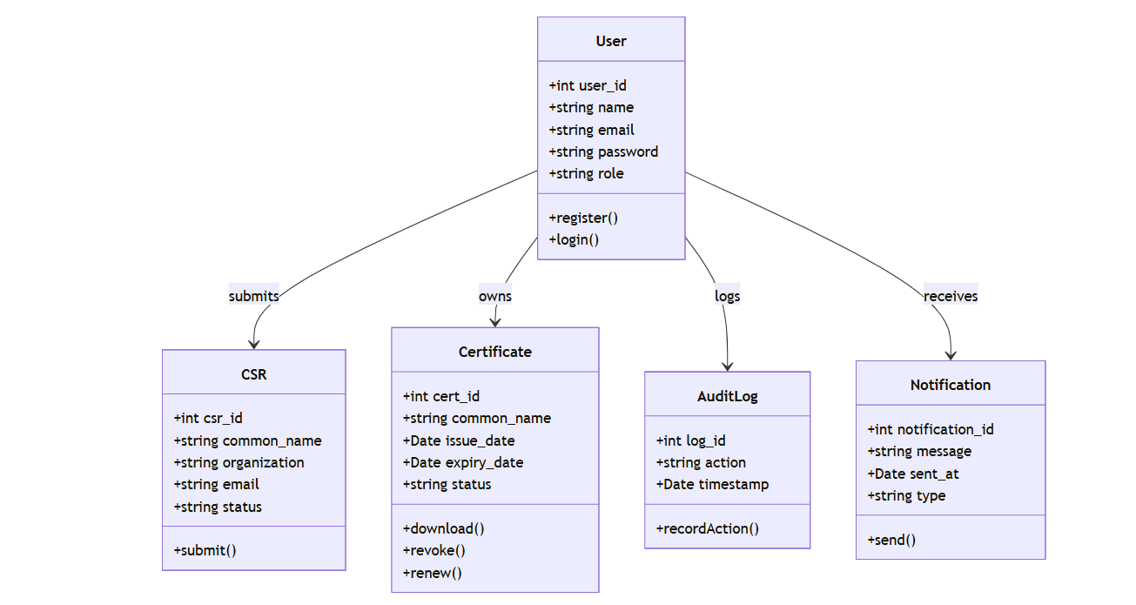

Slide 32
Entity-Relationship Diagram

Slide 33
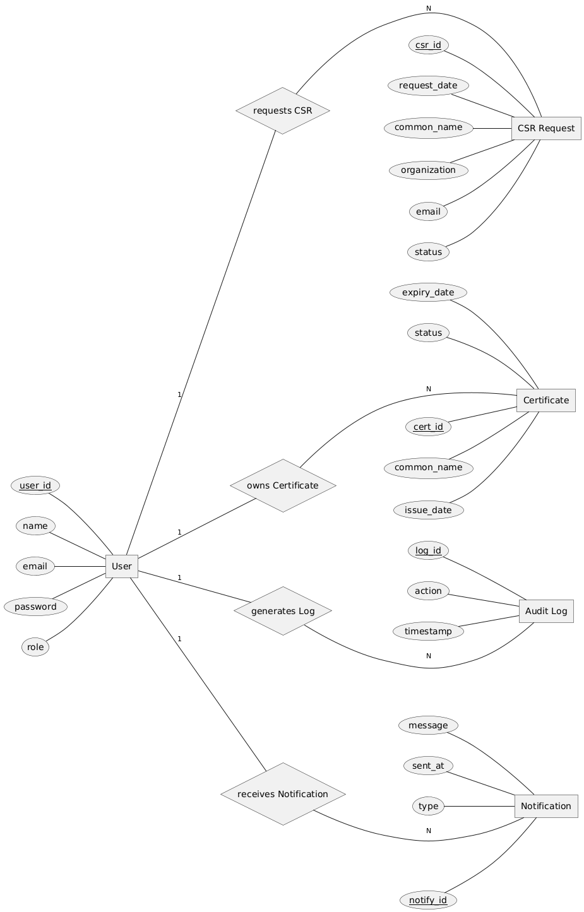

Slide 34
Database Diagram

Slide 35
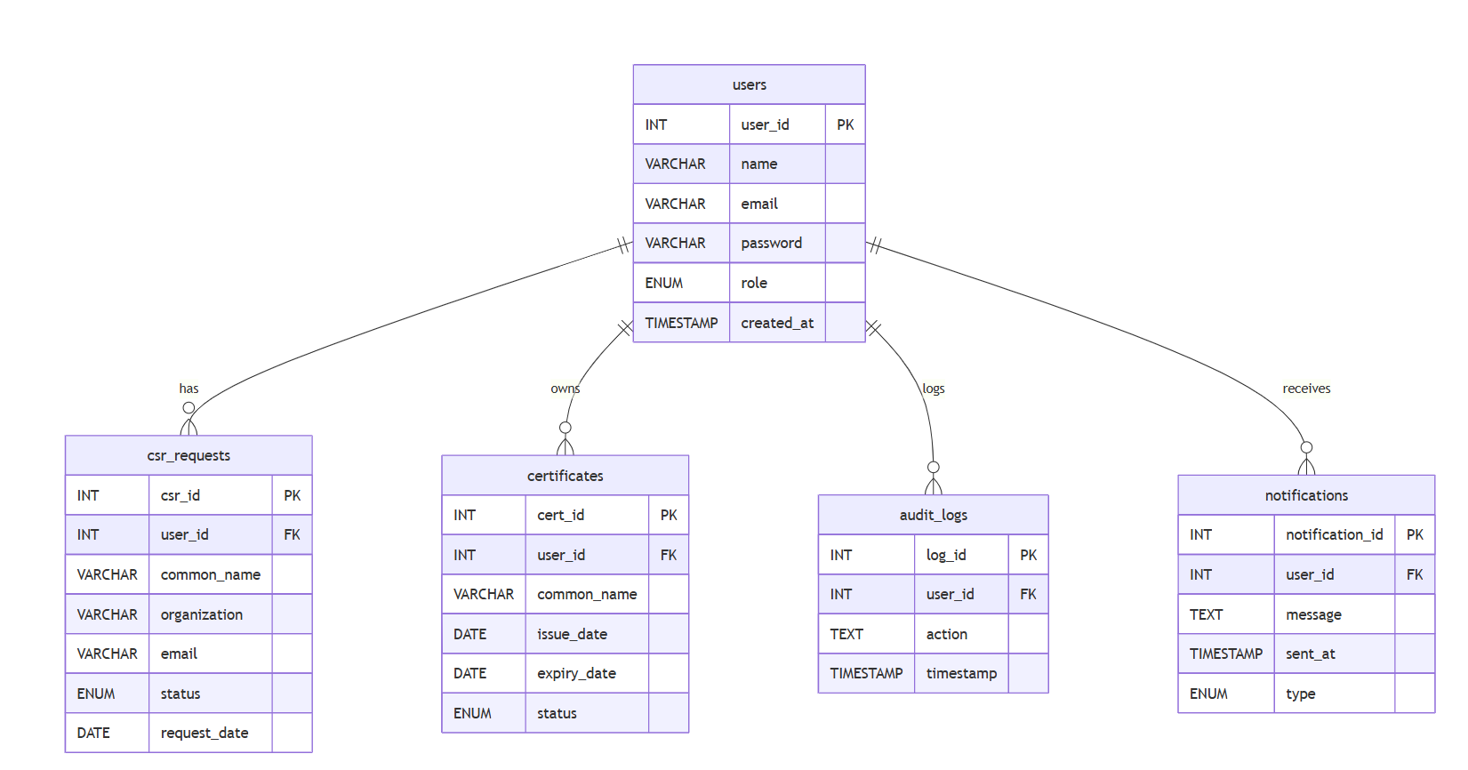

Slide 36
USER INTERFACES

Slide 37
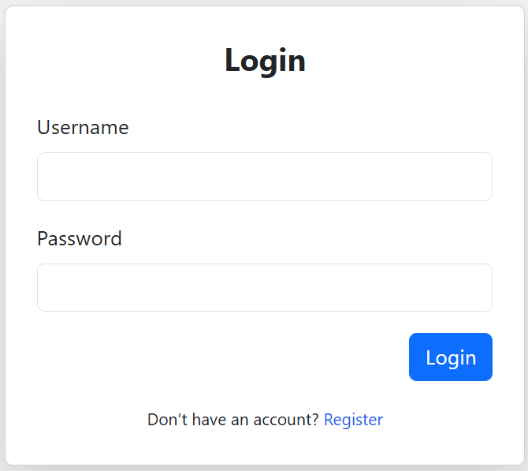
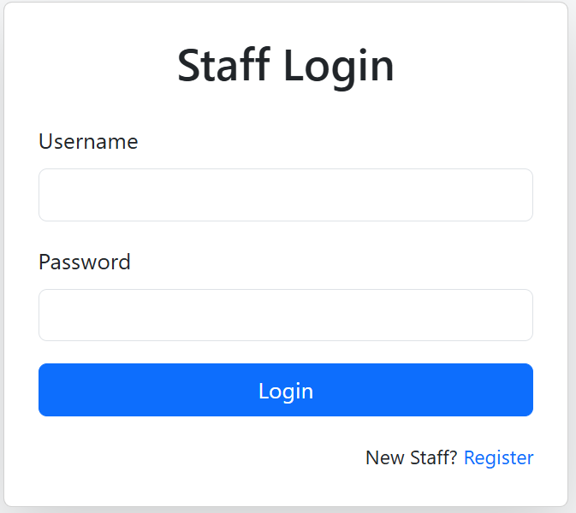
LOGIN PAGE

Slide 38
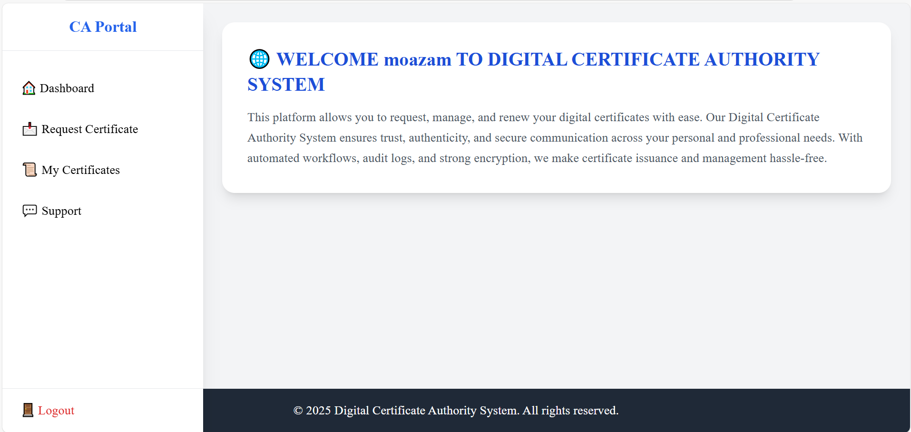
USER DASHBOARD

Slide 39
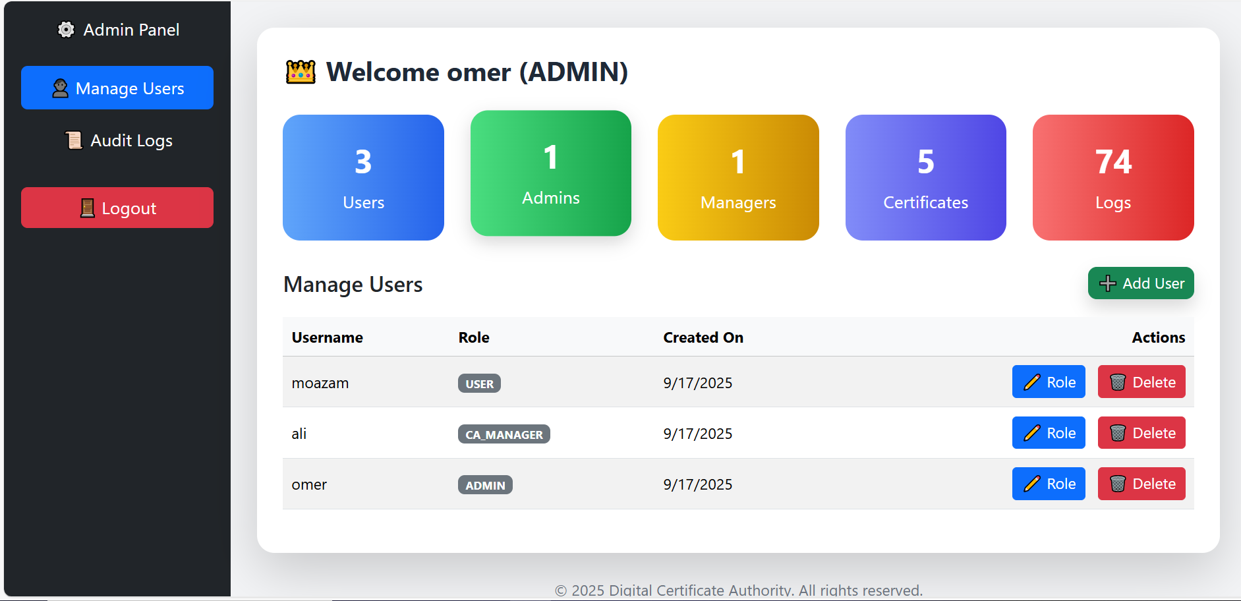
ADMIN DASHBOARD

Slide 40
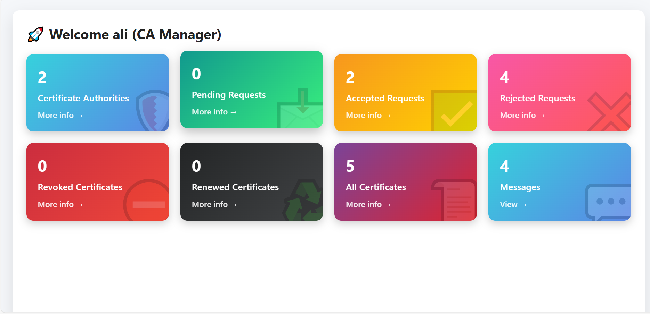
MANAGER DASHBOARD

Slide 41
TOOLS AND TECHNOLOGIES USED

Slide 42
🔹 Frontend Development
HTML, JavaScript – UI design
Bootstrap – Responsive styling & layouts
🔹 Backend Development
Node.js – Server-side runtime
Express.js – REST API framework
🔹 Database
MySQL – Relational database for storing users, certificates, logs

Slide 43
🔹 Certificate Authority
Step-CA (Smallstep Certificate Authority) – Digital certificate issuing, renewal, revocation
🔹 Authentication & Security
JWT / OAuth2.0 – Secure login & role- based access
TLS 1.3 – Encrypted communication
🔹 Deployment & Infrastructure
Docker – Containerization
WSL/Linux – Running step-ca service
PowerShell / Step-CLI – Certificate operations

Slide 44
THANK YOU

