Slide 1

Resume Parsing and Scoring System
By Moses Mugambi
Using Natural Language Processing to Extract Key Resume Details

Slide 2

Need for Resume Parsing
Old vs Modern Resume Parsing Methods
Project Overview
Dataset Overview/Analysis
Data Preprocessing
Model Development
Model Deployment (Streamlit App)
Further Improvements
Presentation
Overview

Slide 3

Problem Statement
Recruiters often spend hours manually screening resumes, leading to inefficiencies, inconsistencies, and potential bias in hiring. Traditional methods struggle to process diverse resume formats and extract relevant information accurately.
With the rise of AI and automation, resume parsing has become essential for streamlining recruitment, improving candidate selection, and enhancing HR efficiency.
Project Goal: Develop robust resume parser system that can accurately extract key details like skills and experience, and score/rank CVs making hiring faster and more efficient.

Slide 4

Previous Resume
Parsing Approaches
Traditional resume parsing relied on rule-based approaches, such as keyword matching and regular expressions.
Limited in handling variations in formatting, phrasing, and context.
Failed when resumes had different structures or unconventional wording.
Modern Resume Parsing Methods
Modern approaches use Natural Language Processing (NLP) and Machine Learning (ML) to extract information with greater accuracy.
Named Entity Recognition (NER) models can understand context, categorize job roles, and even rank candidates based on job relevance, making recruitment more efficient.

Slide 5

Project Overview
EDA (Exploratory Data Analysis).
Understanding the dataset
2. Data Cleaning.
Removing Special characters.
Data Preprocessing.
Tokenization BIO tagging, and Dataset conversion for training.
4. Machine Learning Model Development.
Train a transformer based model for NER
5. Streamlit App.
Create an interactive user interface incorporating
the model.

Slide 6

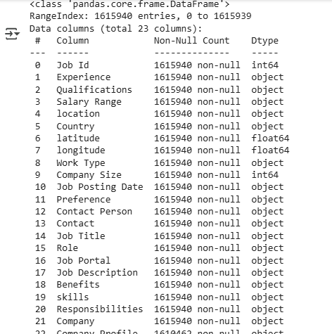
Data Sourcing:
The jobs dataset was sourced from Kaggle
CSV file with Job Roles and extracted texts (1.6 million entries and 23 columns)
Job Id:
Experience: .
Qualifications:
Salary Range:
Location:
Country:
Latitude:
Longitude:
Work Type:
Company Size:
Job Posting Date:
Preference:
Contact Person:
Contact:
Job Title:
Role:
Job Portal:
Job Description:
Benefits:
Skills:
Responsibilities:
Company Name:
Company Profile:

Slide 7

Data Cleaning and
Preprocessing
Removing unnecessary Columns

Slide 8

Exploratory Data Analysis

Slide 9
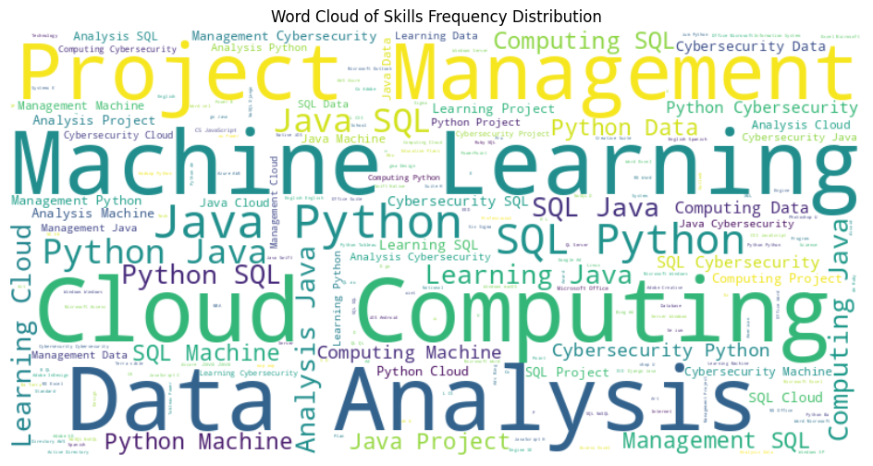
Exploratory Data Analysis

Slide 10
Modeling (Model Selection)
A BERT model was used for Named Entity Recognition.
BERT (Bidirectional Encoder Representations from Transformers), is a natural language processing (NLP)
model. It’s designed to understand the context of words in a sentence by considering both the left and right surrounding words.
Prior models like Word2Vec or GloVe were unidirectional (either left-to-right or right-to-left), which limited their ability to capture full context. BERT's bidirectional approach allows it to better understand the meaning of words in relation to their entire sentence.
Bidirectional Contextualization: BERT uses a transformer architecture to read the entire sequence of words at once, which helps in understanding the context better.
Pretraining and Fine-tuning: BERT is pretrained on large text corpora using unsupervised learning, making it
highly versatile for named entity recognition.
Transformers: The model is built on the transformer architecture, which relies on self-attention mechanisms
to weigh the importance of different words in a sentence.

Slide 11

Modelling Steps:
Raw Text : Start with the input text (e.g., "Software Engineer").
Tokenization : Split the text into tokens (e.g., [CLS] Software Engineer [SEP]).
Numerical Encoding : Convert tokens to integers (e.g., [101, 1034, 2045, 102]).
Embedding Conversion : Map integers to dense vectors (e.g., [0.01, -0.02, ...]).
Transformer Processing : Pass the embeddings through DistilBERT’s transformer
layers to generate contextualized representations.
Output : Use the final representations for tasks like skill extraction.

Slide 12

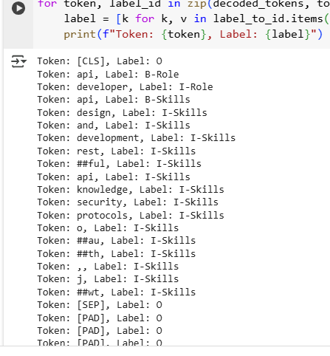
Tokenization :
Split the text into tokens
The tokenizer ensures that all input text conforms to
the format expected by DistilBERT.
Special Tokens :
[CLS]: Indicates the start of a sequence.
[SEP]: Indicates the end of a sequence.
Word Tokens : Words from the input text are split into
subwords or tokens based on the tokenizer's vocabulary.
## indicates that it is a subword continuation.
Padding Tokens : [PAD] tokens are added to ensure all
sequences have the same length (typically up to a
maximum length of 512).
Labels
Tokens are assigned labels corresponding to their entity type.
The labels follow the BIO (Begin-Inside-Outside) tagging scheme:
O : Outside any entity (not part of a named entity).
B- : Beginning of an entity (e.g., B-Role starts the "Role" entity).
I- : Inside an entity (e.g., I-Role continues the "Role" entity)

Slide 13

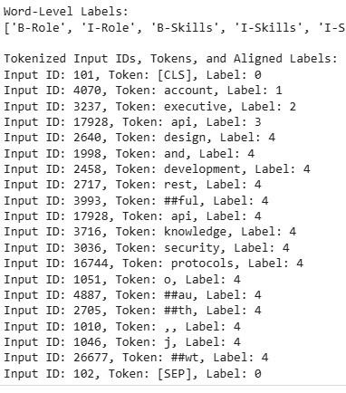
Numerical Encoding:
Once the text is tokenized, each token
is converted into a numerical
representation using the tokenizer’s
vocabulary.
Each token in the tokenizer’s
vocabulary is assigned a unique
integer ID.

Slide 14
3. Embedding Conversion
After numerical encoding, the integer token IDs are converted into dense vectors (embeddings) that
the model can process. This step transforms discrete numbers into continuous representations.
DistilBERT uses an embedding layer to map each token ID to a high-dimensional vector
(typically 768 dimensions for DistilBERT).
These embeddings capture semantic and positional information about the tokens, learned during pretraining.
These embeddings serve as the input to the DistilBERT model, enabling it to understand and process the text effectively.

Slide 15
Resume Scoring and Ranking
TF-IDF (Term Frequency Inverse Document Frequency) Vectorization
Cosine Similarity
TF-IDF converts text into numerical vectors, and cosine similarity
measures the match between resume and job description
vectors to rank resumes.

Slide 16
TF-IDF explained:
Term Frequency-Inverse Document Frequency, (TF-IDF) is a statistical measure used to evaluate the importance of a word in a document relative to a collection of documents (corpus). The idea behind TF-IDF is to weigh words based on how frequently they appear in a specific document (Term Frequency) while penalizing words that appear too often across all documents (Inverse Document Frequency). This helps identify words that are significant to a particular document but not overly common across the corpus.
It’s a weight that gives us a lot more information than just the number of times a word appears in a document.
TF – Term Frequency: measures how frequently a term/word appears in a document
IDF - Inverse Document Frequency: diminishes the weight of terms that occur very frequently in the document set and increases the weight of terms that occur rarely. It is calculated as the logarithmically scaled inverse fraction of the documents that contain a word.
TF-IDF is computed as a product of the Term Frequency and Inverse Document Frequency.

Slide 17
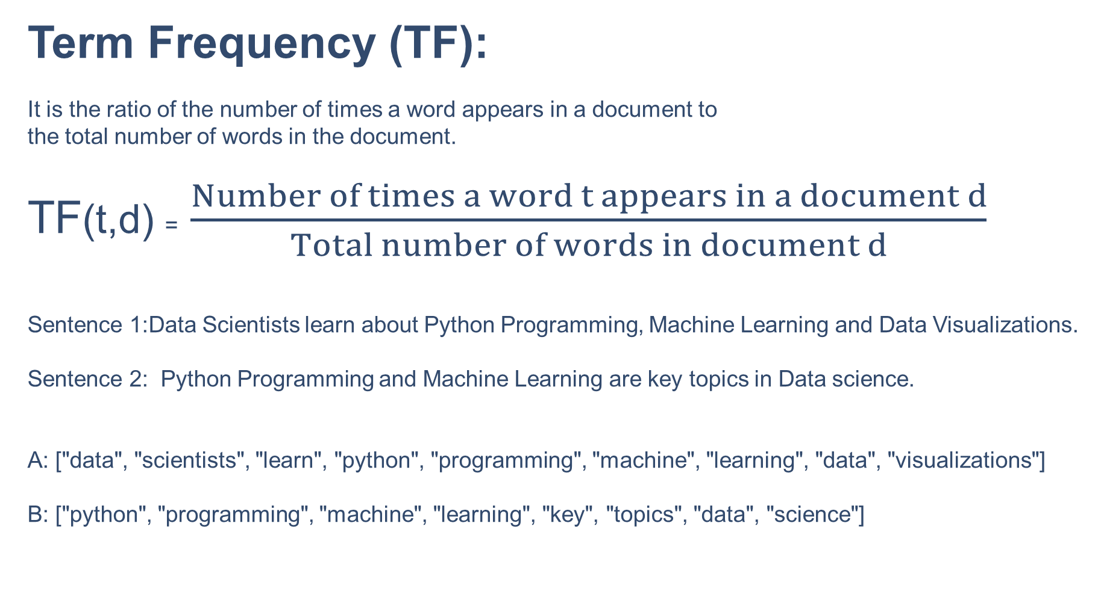
Term Frequency (TF):
It is the ratio of the number of times a word appears in a document to
the total number of words in the document.
TF(t,d) = $\frac{Number of times a word t appears in a document d}{Total number of words in document d}$
Sentence 1:Data Scientists learn about Python Programming, Machine Learning and Data Visualizations.
Sentence 2: Python Programming and Machine Learning are key topics in Data science.
A: ["data", "scientists", "learn", "python", "programming", "machine", "learning", "data", "visualizations"]
B: ["python", "programming", "machine", "learning", "key", "topics", "data", "science"]

Slide 18
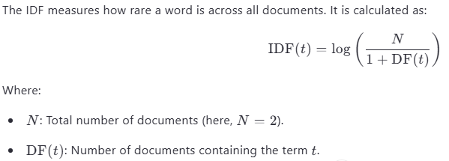
Inverse Document Frequency (IDF):

Slide 19
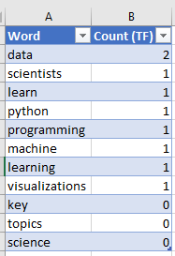
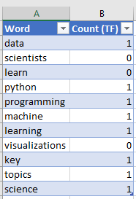
Term Frequency (TF) Calculation:
Sentence A Sentence B

Slide 20
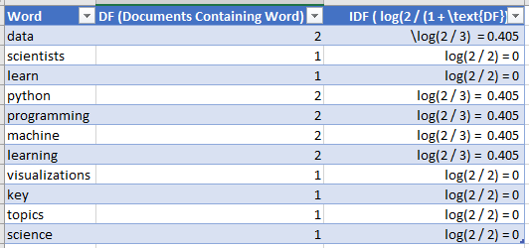
Inverse Document Frequency (IDF) Calculation:

Slide 21
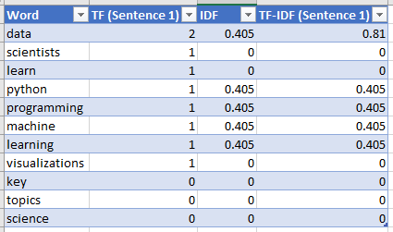
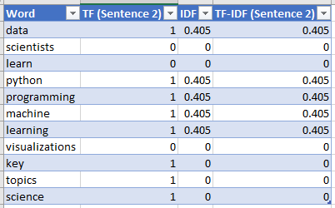
TF – IDF Calculation:
TF-IDF score for each word :TF-IDF(t,d) = TF(t,d)⋅IDF(t)
Final Vectors:
Sentence A: [0.810,0,0,0.405,0.405,0.405,0.405,0,0,0,0]
Sentence B: [0.405,0,0,0.405,0.405,0.405,0.405,0,0,0,0]

Slide 22
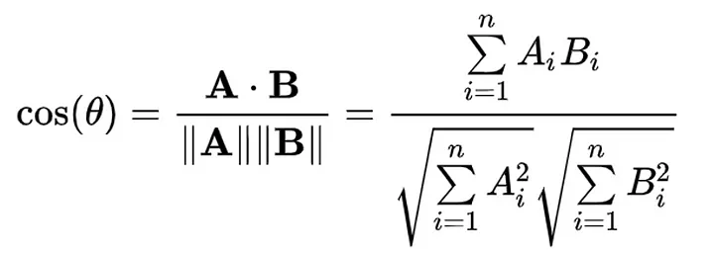
Cosine Similarity:
Cosine similarity is a metric used to measure how similar two vectors are,
regardless of their magnitude.
It calculates the cosine of the angle between two non-zero vectors in an
inner product space.
If two vectors are perfectly aligned (pointing in the same direction), their
cosine similarity will be 1. If they are orthogonal (perpendicular), the cosine similarity
will be 0. If they point in opposite directions, the cosine similarity will be -1.
A and B are the TF-IDF vectors for the resume and job description.
A⋅B is the dot product of the vectors.
∥A∥ and ∥B∥ are the magnitudes (norms) of the vectors.

Slide 23
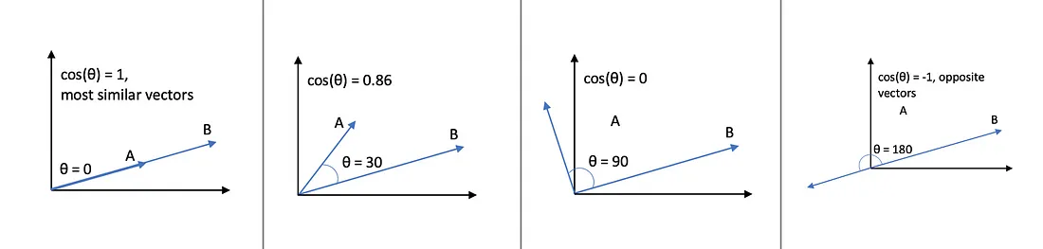
Cosine Similarity Continued:

Slide 24
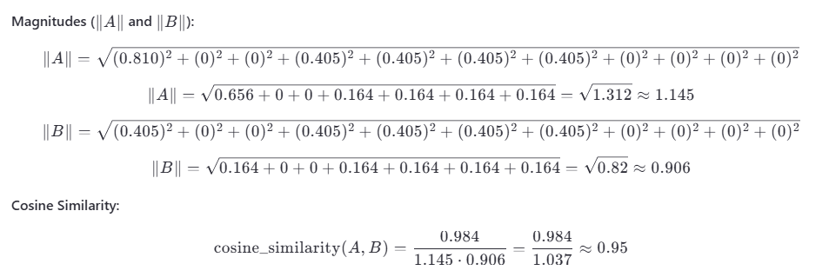
Cosine Similarity Calculation:
Sentence A: [0.810, 0, 0, 0.405, 0.405, 0.405, 0.405, 0, 0, 0, 0]
Sentence B: [0.405, 0, 0, 0.405, 0.405, 0.405, 0.405, 0, 0, 0, 0]
Dot Product (A⋅B):
A⋅B=(0.810⋅0.405)+(0⋅0)+(0⋅0)+(0.405⋅0.405)+(0.405⋅0.405)+(0.405⋅0.405)+(0.405⋅0.405)+(0⋅0)+(0⋅0)+(0⋅0)+(0⋅0)
A⋅B=0.328+0+0+0.164+0.164+0.164+0.164=0.984
A Cosine Similarity of 0.95 indicates that the two sentences are highly similar based on the shared keywords.

Slide 25

Streamlit App:
A streamlit app was developed for Model
deployment to allow an interactive
Visualization of the Resume Parsing Project

Slide 26

Challenges:
Lack of compute capacity to use a larger dataset.

Slide 27
Future Improvements
NER model training on a high quality large labelled dataset.
Highly interactive Streamlit app.

