Slide 1

Resume Parsing and Scoring System
By Moses Mugambi
Using Natural Language Processing to Extract Key Resume Details

Slide 2

Need for Resume Parsing
Old vs Modern Resume Parsing Methods
Project Overview
Dataset Overview/Analysis
Data Preprocessing
Model Development
Model Deployment (Streamlit App)
Further Development/Improvements
Capstone
Presentation
Overview

Slide 3

Problem Statement
Recruiters often spend hours manually screening resumes, leading to inefficiencies, inconsistencies, and potential bias in hiring. Traditional methods struggle to process diverse resume formats and extract relevant information accurately.
With the rise of AI and automation, resume parsing has become essential for streamlining recruitment, improving candidate selection, and enhancing HR efficiency.
Project Goal: Develop robust resume parser system that can accurately extract key details like skills, experience, etc, and rank CVs making hiring faster and more data-driven.

Slide 4

Previous Resume
Parsing Approaches
Traditional resume parsing relied on rule-based approaches, such as keyword matching and regular expressions.
Limited in handling variations in formatting, phrasing, and context.
Failed when resumes had different structures or unconventional wording.
Modern Resume Parsing Methods
Modern approaches use Natural Language Processing (NLP) and Machine Learning (ML) to extract information with greater accuracy.
Advanced models, such as Named Entity Recognition (NER) can understand context, categorize job roles, and even rank candidates based on job relevance, making recruitment more efficient.

Slide 5

Project Overview
Data Extraction.
Extracting text from pdf files
2. Data Cleaning .
Removing Special characters.
Data Preprocessing.
Tokenization and lemmatization.
4. Named Entity Recognition.
Create a structured dataset by extracting names, skills, companies, education, etc. Further data cleaning
and data preparation.
5. Machine Learning Model Development.
Build a BERT model for
Streamlit app Model deployment
Create an interactive user interface incorporating
the model.

Slide 6
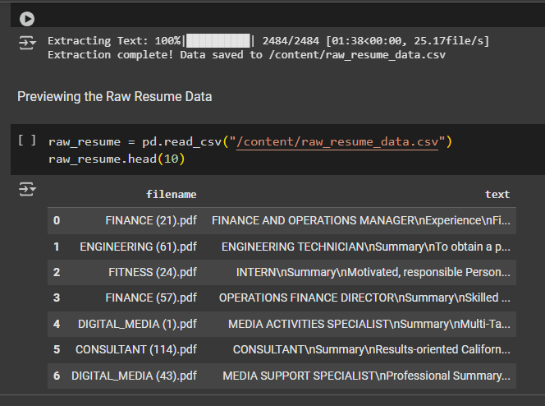
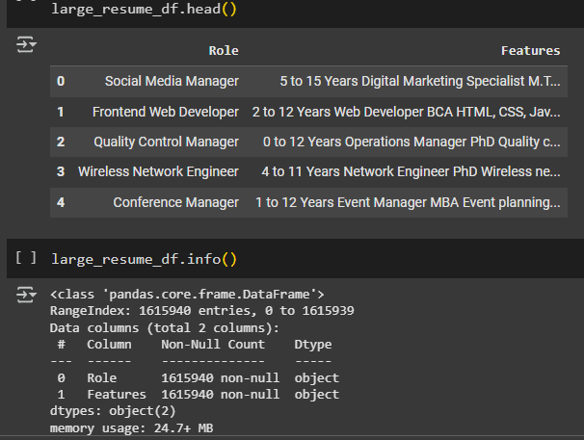
Data Sourcing
The two datasets were sourced from Kaggle
Raw resume pdfs files (2484 files)
CSV file with Job Roles and extracted texts (1.6 million entries)

Slide 7

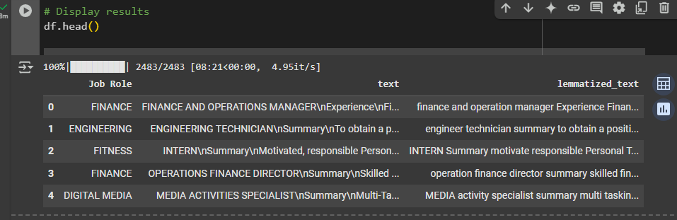
Data Cleaning and
Preprocessing
Before and After removing special characters
and applying lemmatization.
For NER stop words removal is not ideal

Slide 8
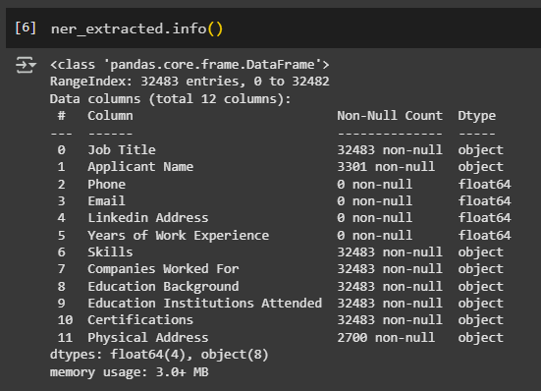
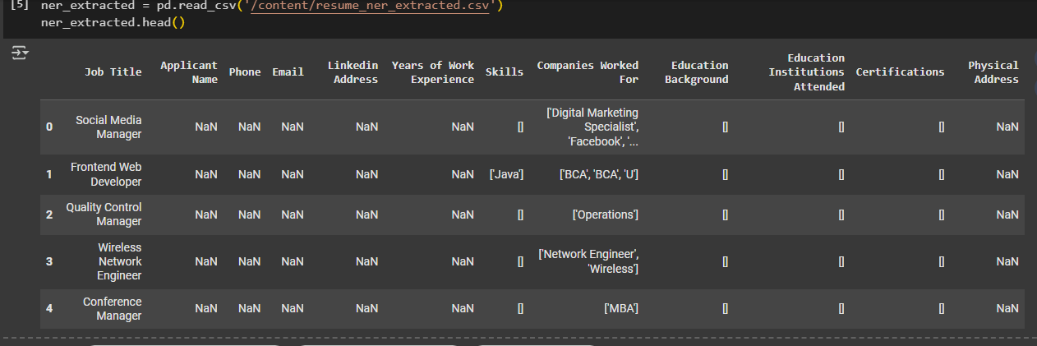
NER (Named Entity
Recognition) data Extraction

Slide 9
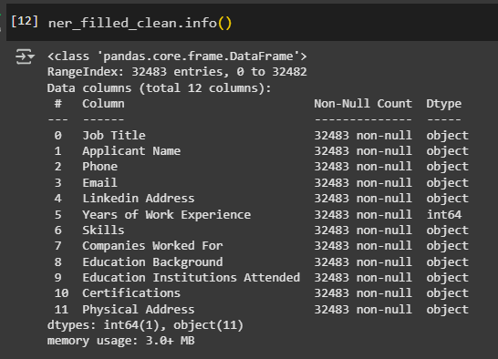
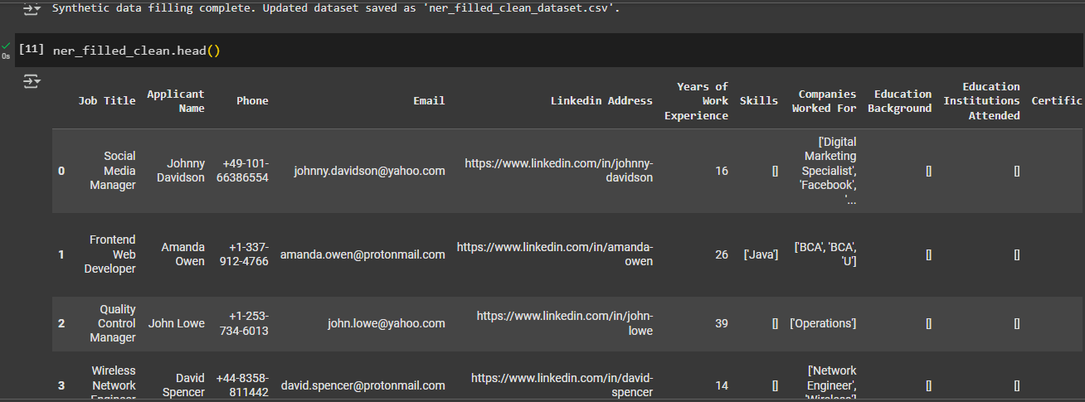
NER (Named Entity Recognition)
Filled with Synthetic values
Python Faker Library was used to fill in
Missing values

Slide 10


Slide 11
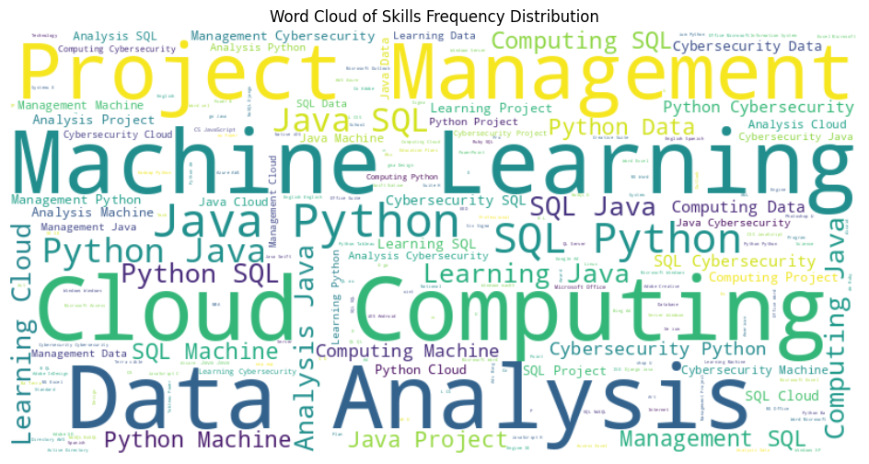

Slide 12
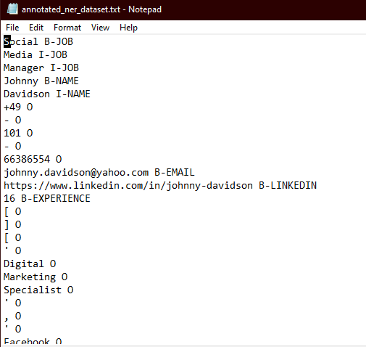
Modeling data preparation: Resume csv to annotated Bio formatted Data

Slide 13
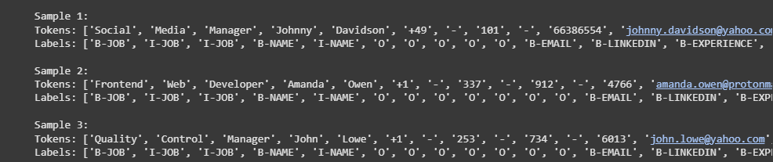
Modeling data preparation: formatted JSON data tokens.
Sentence Formation: Combines all resume fields into a single sequence per record.
Tokenization: Uses spaCy to split text into tokens.
BIO Tagging: Assigns B- (Beginning) , I- (Inside) ,tags to multi-word entities.
O tag: Denotes a token that is not part of any named entity.

Slide 14
Modeling (Model Selection)
A BERT model was used for Named Entity Recognition.
BERT (Bidirectional Encoder Representations from Transformers), is a natural language processing (NLP)
model. It’s designed to understand the context of words in a sentence by considering
both the left and right surrounding words. Unlike traditional models that read text sequentially
(left-to-right or right-to-left), BERT processes text in both directions, enabling it to capture the deeper meaning
and nuances of words.
Bidirectional Contextualization: BERT uses a transformer architecture to read the entire sequence of words at
once, which helps in understanding the context better.
Pretraining and Fine-tuning: BERT is pretrained on large text corpora using unsupervised learning, making it
highly versatile for named entity recognition.
Transformers: The model is built on the transformer architecture, which relies on self-attention mechanisms
to weigh the importance of different words in a sentence.

Slide 15

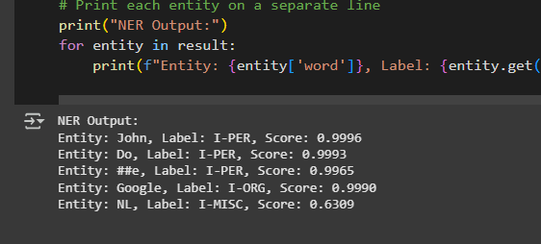
Modeling : Entity Extraction Results & evaluation

Slide 16
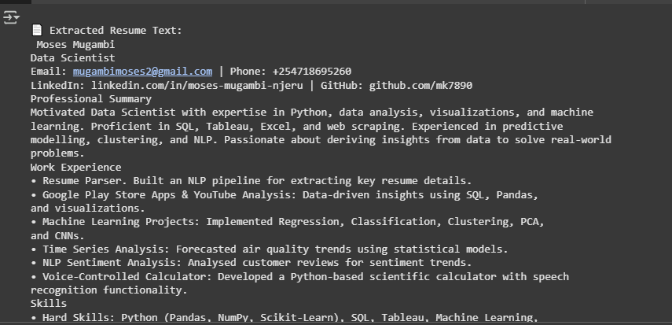
Modeling : Resume Text Extraction Results

Slide 17

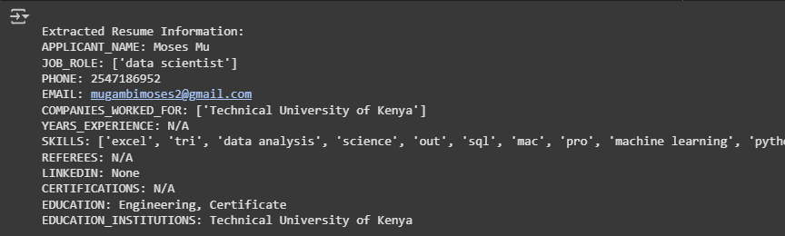
Modeling : Sample Resume NER Extraction Results

Slide 18
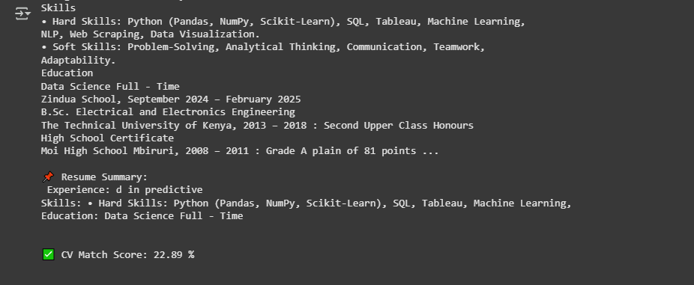
Modeling : Sample Resume CV Scoring Output

Slide 19

Streamlit App:
A streamlit app was developed for Model
deployment to allow an interactive
Visualization of the Resume Parsing Project

Slide 20
Challenges:
Lack of compute capacity to use a larger dataset.
Poor Streamlit app deployment

Slide 21
Future Improvements
Custom NER model training on a large labelled dataset.
Upgrade compute power for model training on a large dataset.
Batch resume handling.
Highly interactive Streamlit app.

