Slide 1

Big Data Analytics Project (Prof. Lodi)
Gas Sensor Array Temperature Modulation
-Farhad Bayrami
-Mahmut Kaan Molla

Slide 2
1) Setting Up The VM
1. Installing Oracle and Vagrant
2. Creating a vagrant file and setting up the Ubuntu/jammy64
3. Creating and starting the VM
4. Connecting to the VM with vagrant user
5. Setting up the ports
6. Creating the link to access Jupyter notebook

Slide 3
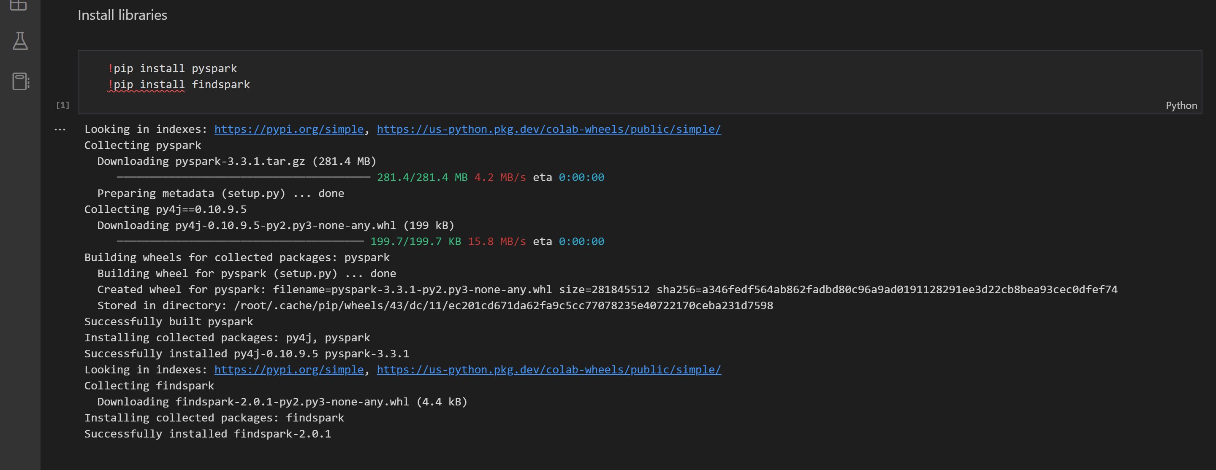
2) Creating The Spark Session

Slide 4
2) Problem description
There is a machine combines gases together and humidity in random fraction then injects them inside a heating chamber.
We have 14 electrical sensors inside the chamber that measures some physical parameters such as (CO, Humidity etc.)
We are taking the electrical resistances of these sensors as features in order to predict the amount of CO inside the chamber.

Slide 5
2) Experimental setting
We took our data from UCI website: https://archive.ics.uci.edu/dataset/487/gas+sensor+array+temperature+modulation
“Gas sensor array temperature modulation” dataset has 6938 views.
Contains 4095000 instances and
Mostly this dataset used for the tasks: Classification and Regression.

Slide 6
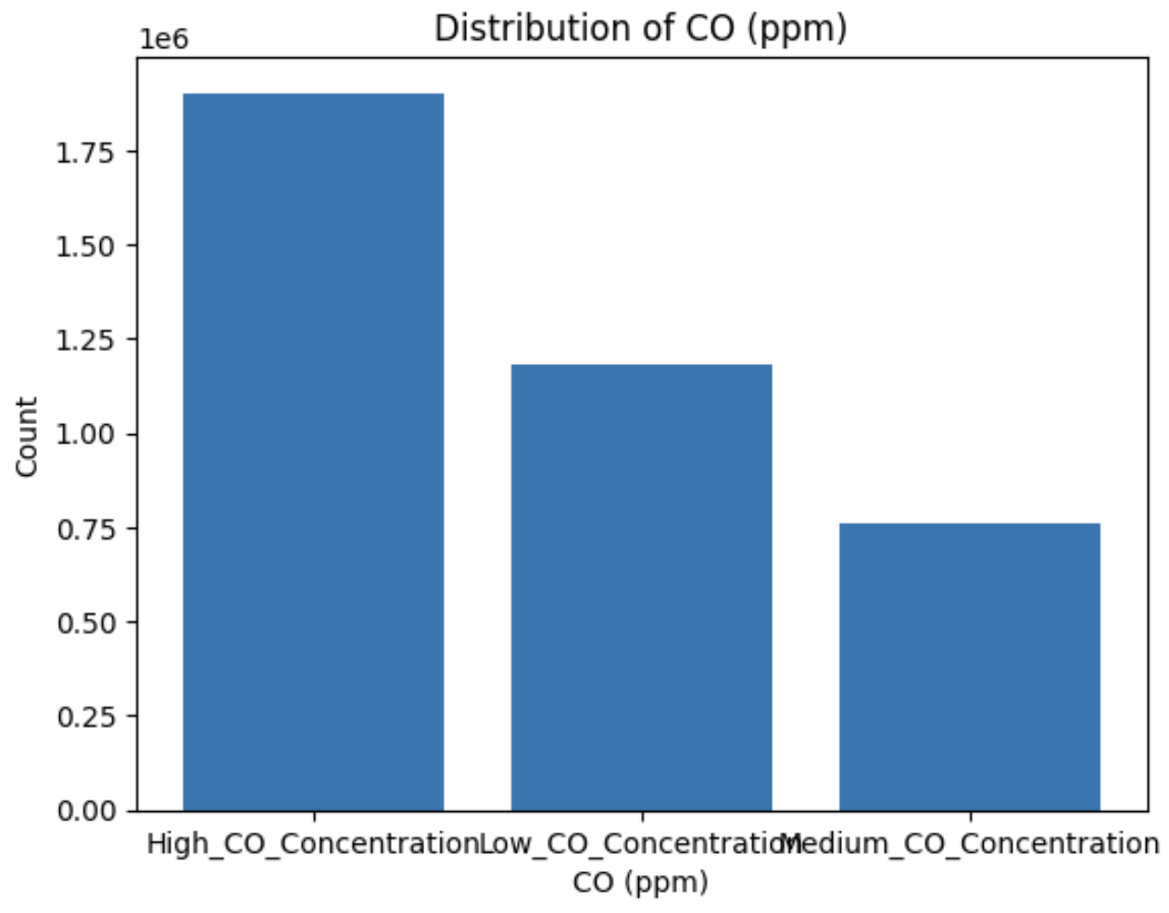
3) Exploratory analysis of the data:
We categorized the CO concentration levels into low, medium, or high concentrations based on predefined thresholds.

Slide 7
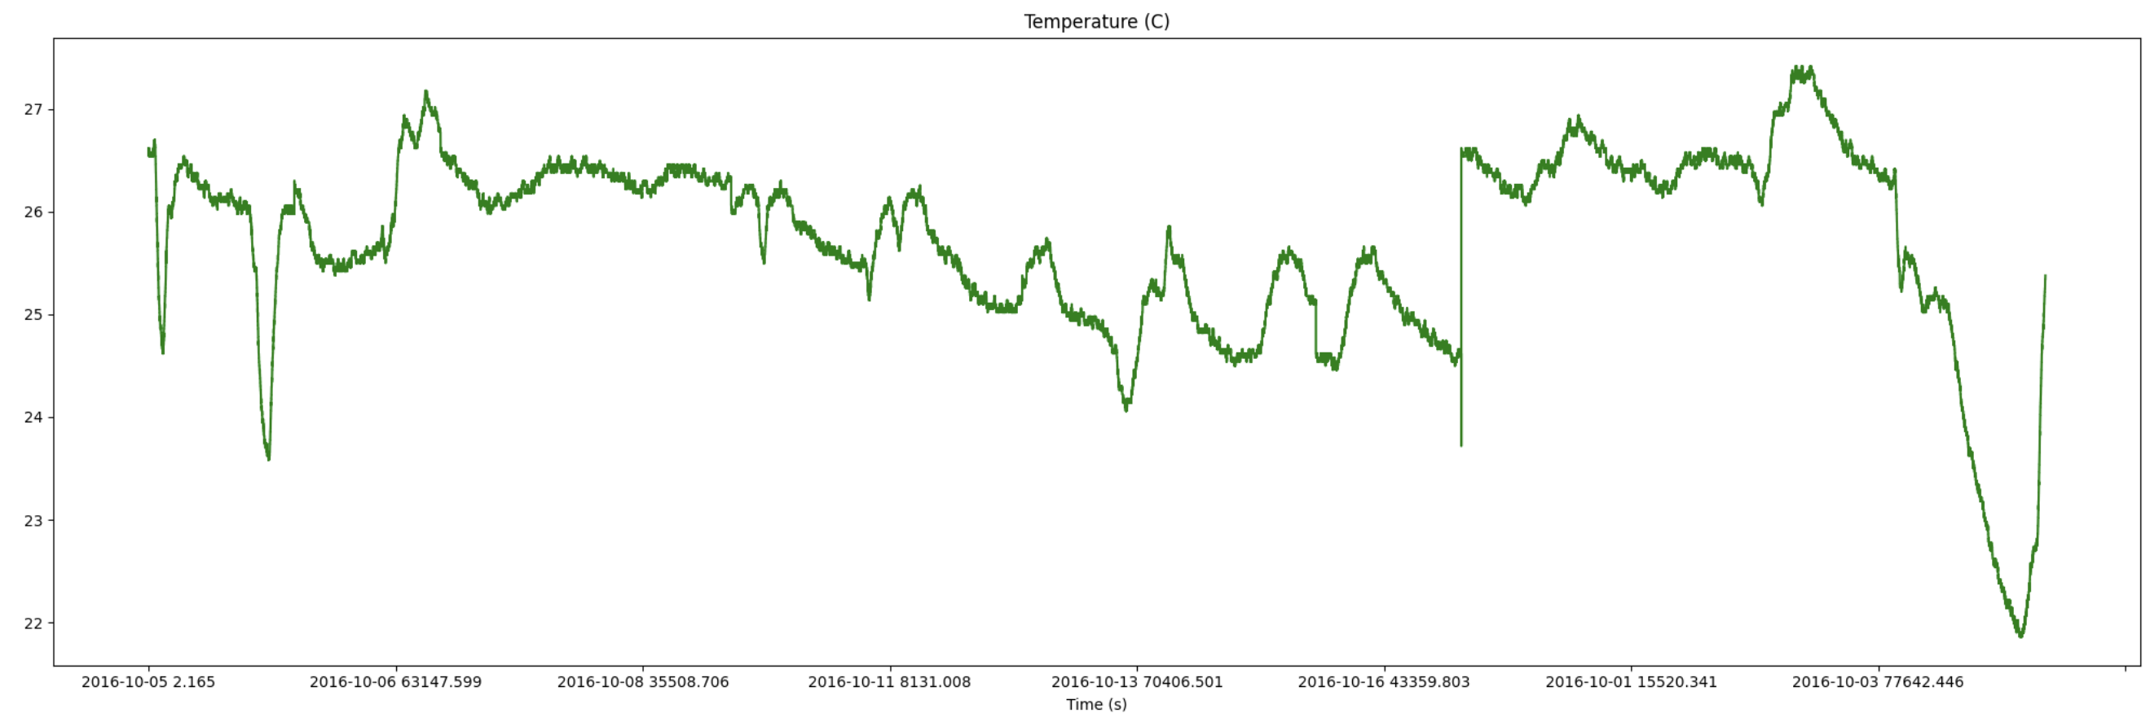
Observing Temperature
For managing the memory issues we sampled 10% of the data.

Slide 8
Distinct Values of Categorizable Data
Temperature = 35200
Heater Voltage = 4823
CO = 3559
Flow Rate = 25767
Since the Unique CO count is the lowest, the CO is a good choice for experimenting.

Slide 9
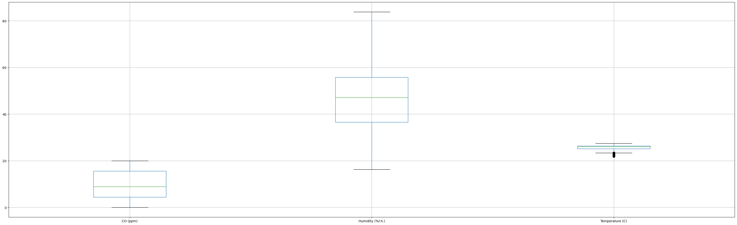
Boxplot of the Categorizable Data

Slide 10
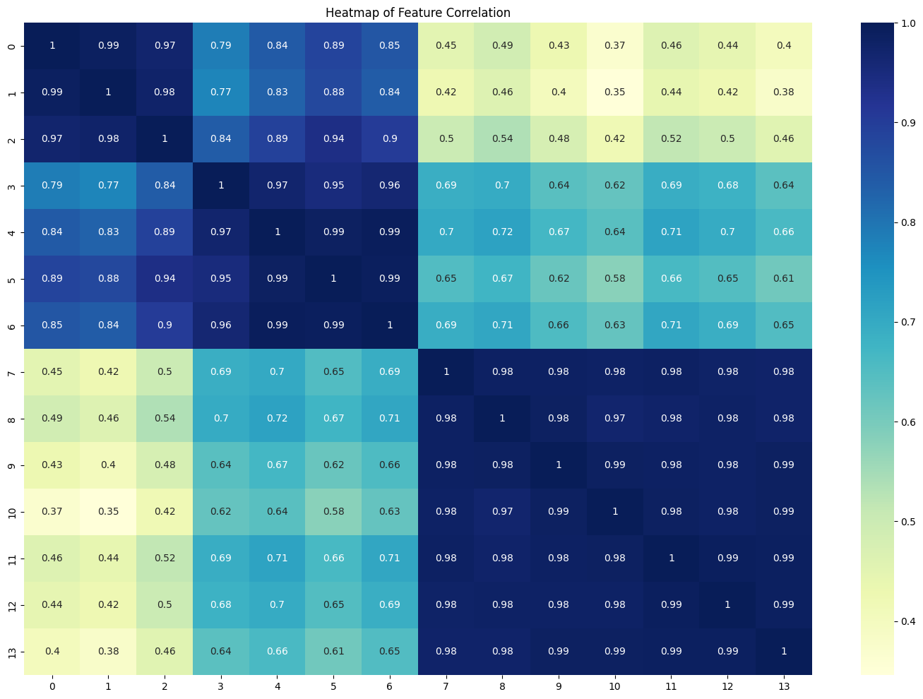
4) Correlation Map of the Data

Slide 11
4) Evaluation
We used supervised learning algorithms for our evaluation since we have CO with 3 labels.
For optimal performance of our algorithms, we need to standardize our features to ensure they're on the same scale.
To get our data ready for machine learning, we used the VectorAssembler, a transformer that combines a given list of columns into a single vector column. In this case, it's transforming our features into one single vector column, which we have labeled as 'features'.

Slide 12
4) Evaluation
We used BinaryClassificationEvaluator to evaluate the accuracy of the trained model's predictions. It compares the predicted labels (predictionCol) with the actual labels (labelCol) and computes the accuracy metric.
We used a pipeline that includes feature assembly, label indexing, feature scaling, and model training stages. The trained model (lr_model) is fitted to the training data (train_data) to predict the target labels based on the scaled features.

Slide 13
5) Models
Decision Tree Classifier
Accuracy = 0.86
Random Forest Classifier
Accuracy = 0.87
Logistic Regression
Accuracy = 0.83
Naive Bayes Classifier
Accuracy = 0.71

Slide 14
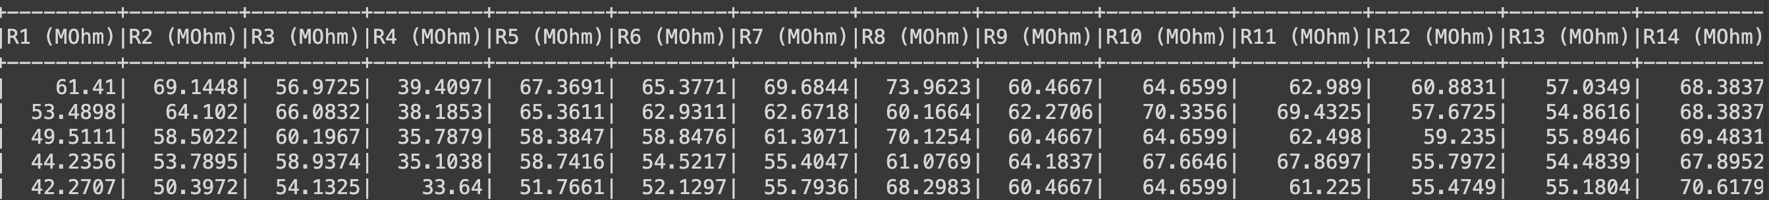
6) Experiment
According to our observations in Correlation Map of the Data, we saw that first three features of our data is oppositely correlated with the other ones. To gain some space and increase the performance of the models we removed them from our data. And calculated the accuracy one more time.

Slide 15
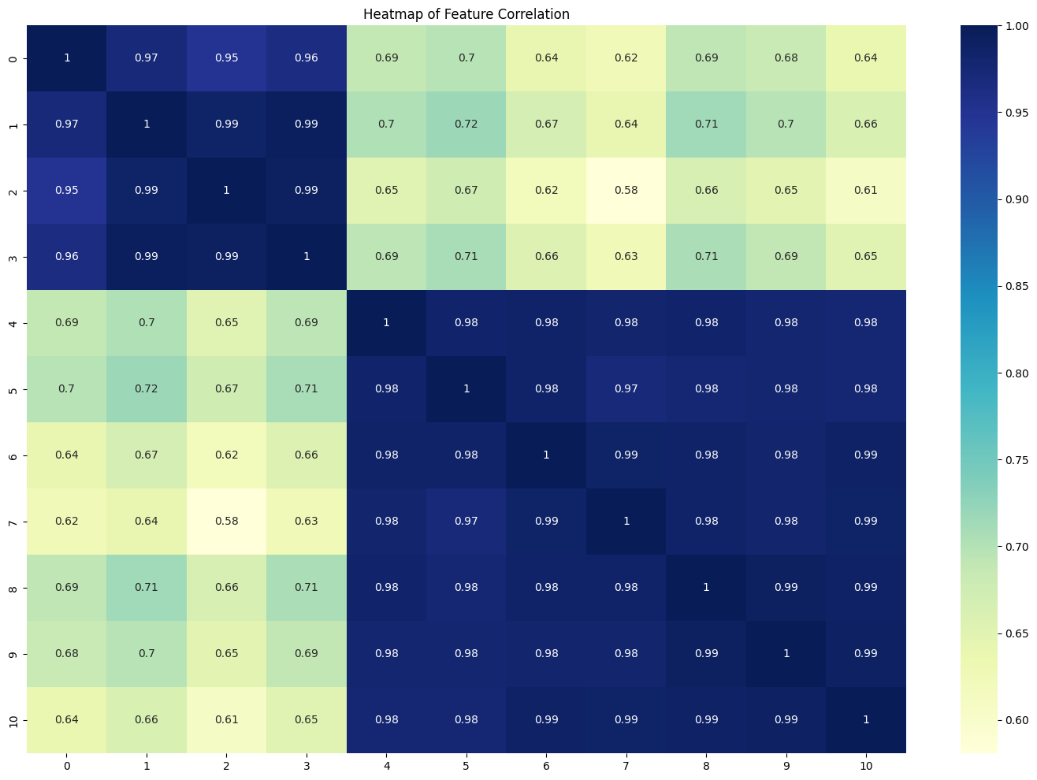
6) Experiment

Slide 16
7) Results of the Experiment
Decision Tree Classifier
Accuracy = 0.85
Random Forest Classifier
Accuracy = 0.86
Logistic Regression
Accuracy = 0.82
Naive Bayes Classifier
Accuracy = 0.66
Accuracy scores got lower after that experiment, but we use less memory.

Slide 17
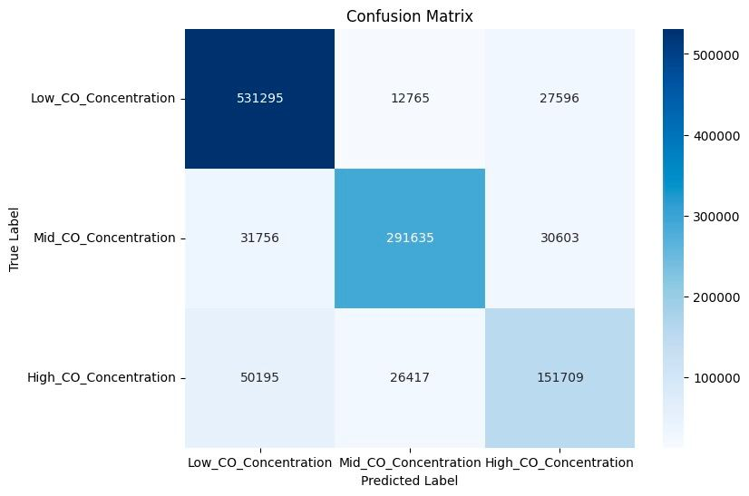

7) Results of the Experiment
Confusion Matrix of Decision Tree Classifier
Confusion Matrix of Random Forest

Slide 18
8) Discussion of results.
According to our experiments, removing the first 3 features did not change the accuracy that much and can be useful for memory.
On both experiments we saw that RandomForest and DecisionTree Classifiers are better.
To Decide which one is better, we plot confusion matricies and saw that Random Forest is the best model for this project.

Slide 19

Thank You

