Slide 1

CompTech
Computer and Laptop available for all users

Slide 2
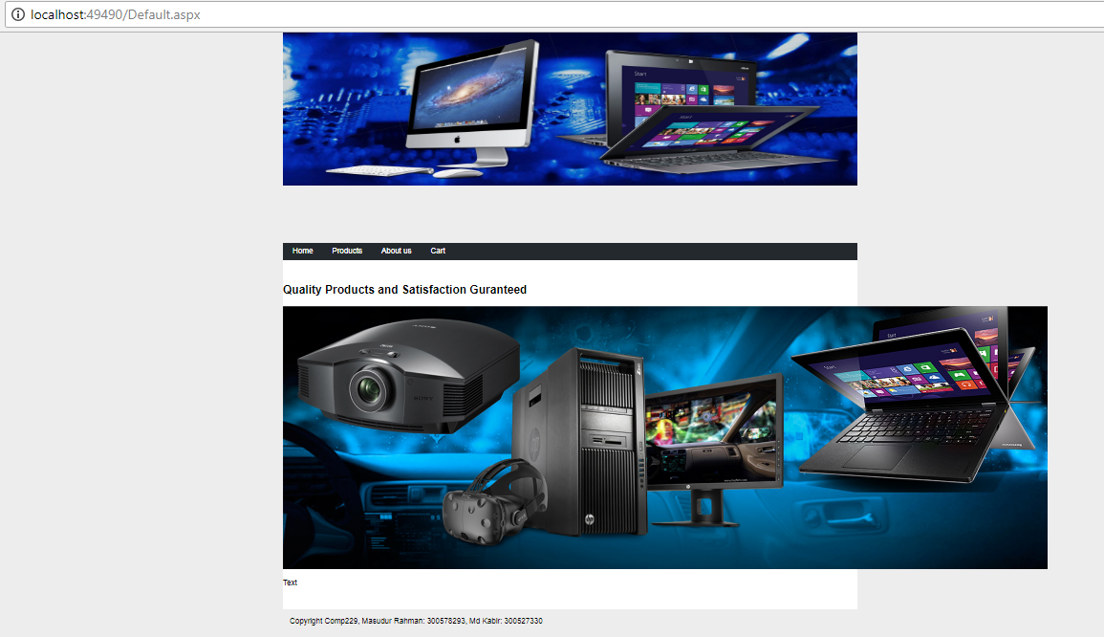
Home Page

Slide 3
Default.aspx
<%@ Page Title="" Language="C#" MasterPageFile="~/Master.Master" AutoEventWireup="true" CodeBehind="Default.aspx.cs" Inherits="CompTech.Default" %>
<asp:Content ID="Content1" ContentPlaceHolderID="head" runat="server">
</asp:Content>
<asp:Content ID="Content2" ContentPlaceHolderID="Content" runat="server">
<h2>
Quality Products and Satisfaction Guranteed
</h2>
<p>
<asp:Image ID="Image2" runat="server" ImageUrl="~/Images/banner2.jpg" />
</p>
<p>
Text
</p>
</asp:Content>

Slide 4
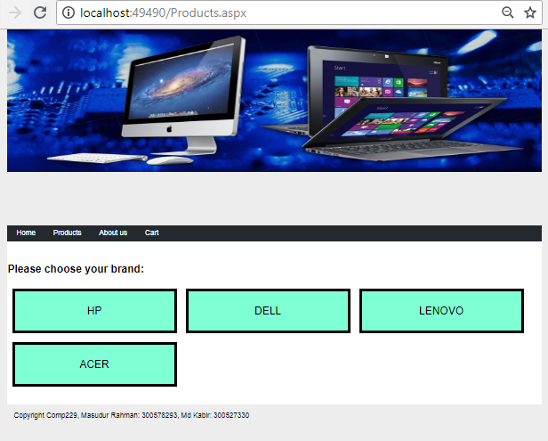
Products.aspx

Slide 5
Products.aspx
<%@ Page Title="" Language="C#" MasterPageFile="~/Master.Master" AutoEventWireup="true" CodeBehind="Products.aspx.cs" Inherits="CompTech.Products" %>
<asp:Content ID="Content1" ContentPlaceHolderID="head" runat="server">
</asp:Content>
<asp:Content ID="Content2" ContentPlaceHolderID="Content" runat="server">
<h2>Please choose your brand:</h2>
<asp:Panel ID="Panel2" runat="server">
<asp:Button ID="btnHp" runat="server" CssClass="CompBrand" Text="HP" />
<asp:Button ID="btnDell" runat="server" CssClass="CompBrand" Text="DELL" />
<asp:Button ID="btnLenovo" runat="server" CssClass="CompBrand" Text="LENOVO" />
<asp:Button ID="btnAcer" runat="server" CssClass="CompBrand" Text="ACER" />
<br /><p> </p>
<p style="clear:both;">
</p>
</asp:Panel>
</asp:Content>

Slide 6
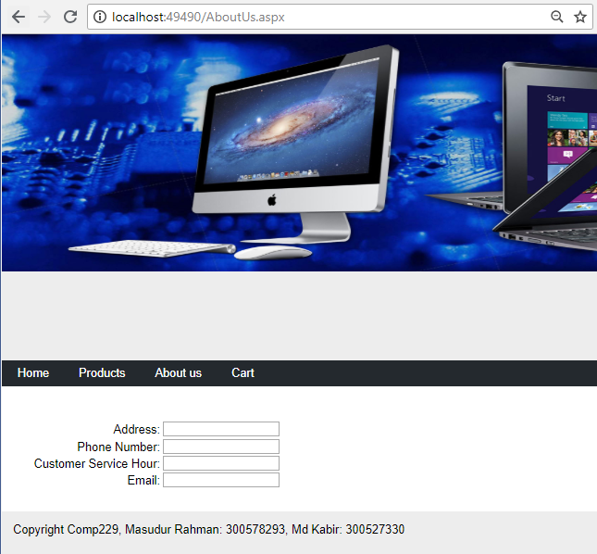
AboutUs.aspx

Slide 7
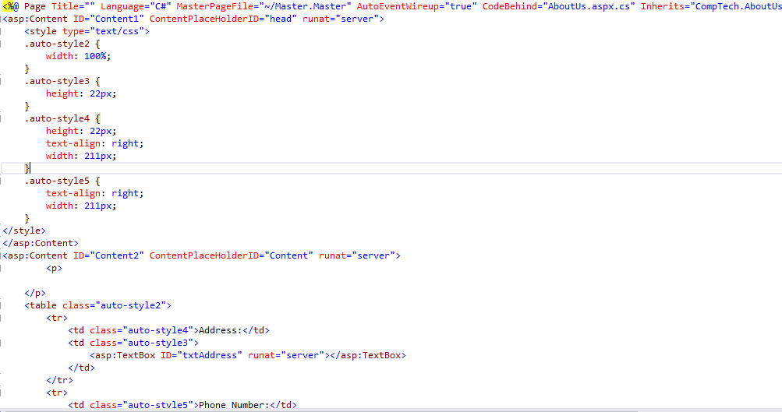
AboutUs.aspx

Slide 8
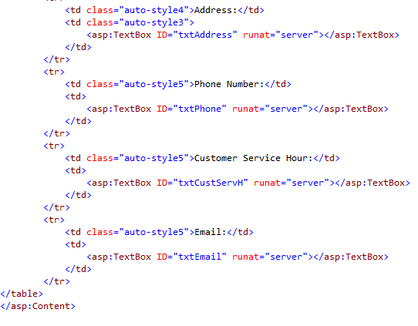

Slide 9
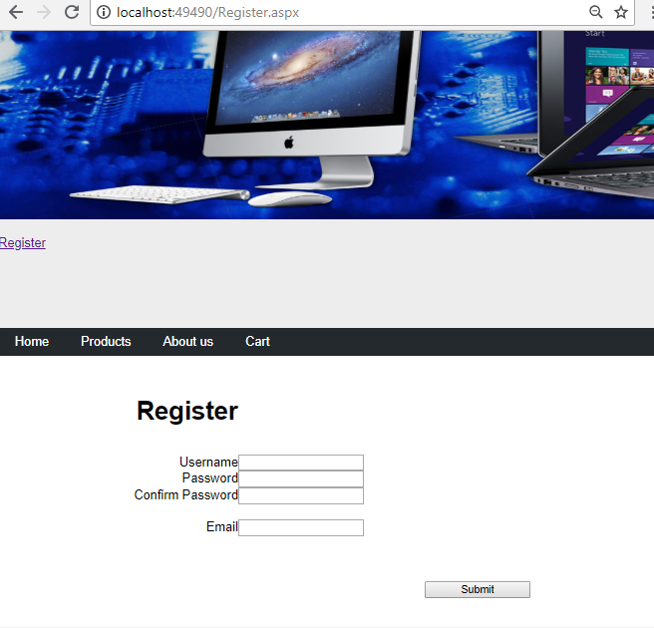
Register.aspx

Slide 10
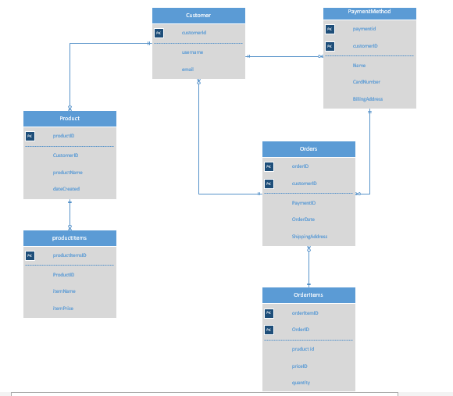
ERD

