Slide 1
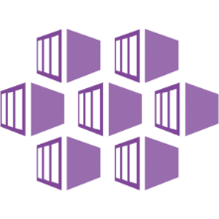
AKS: Deploying, Monitoring, and Managing.
Kristopher Turner
Platform Architect | NTT Data Services | Cloud and Platform Services
Microsoft MVP
A Husband, A Father of 3 Awesome Boys, A Homesteader, and a Texan!
about.me/kristopherjturner
#CountryCloudBoy

Slide 2
Introduction
Introduction
AKS Overview
Top scenarios
Open source culture
Resources

Slide 3

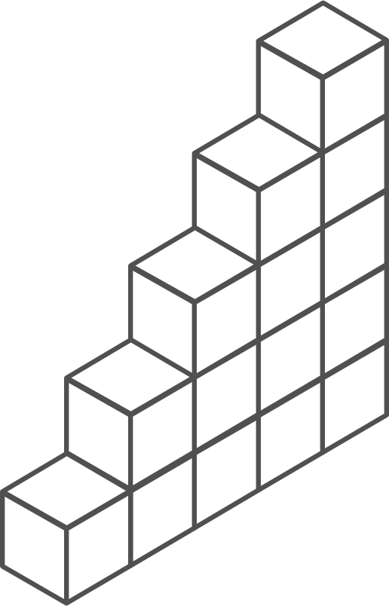
Containers and Kubernetes momentum
“By 2020, more than 50% of enterprises will run mission-critical, containerized cloud-native applications in production.”
Half of container environment is orchestrated.¹
77%
77% of companies² who use container orchestrators choose Kubernetes.
The average size of a container deployment has grown 75% in one year. ¹
Larger companies are leading the adoption.¹
75%
50%
Nearly 50% of organizations¹ running 1000 or more hosts have adopted containers.
¹ Datadog report: 8 Surprising Facts About Real Docker Adoption
² CNCF survey: cloud-native-technologies-scaling-production-applications

Slide 4
Kubernetes: the industry leading orchestrator
Portable
Public, private, hybrid, multi-cloud
Extensible
Modular, pluggable, hookable, composable
Self-healing
Auto-placement, auto-restart, auto-replication, auto-scaling

Slide 5
Kubernetes 101
Internet
Kubernetes control
Worker node
Kubernetes users communicate with API server and apply desired state
kubelet
kube-proxy
Master node
Docker
Master nodes actively enforce desired state on worker nodes
Prod
Prod
API server
Containers
Containers
Worker nodes support communication between containers
-controller-manager
-scheduler
Worker node
kubelet
kube-proxy
Worker nodes support communication from the Internet
replication, namespace, serviceaccounts, etc.
etcd
Docker
Prod
Prod
Containers
Containers
Notes:
Kubernetes Cluster is made of masters and nodes.
These are Linux host that can be VM’s, bare metal servers in your DC, or instances in a private or public cloud.
Masters (Control Plane):
Collection of system services that make up the control plane of the cluster.
Simple setup is single master. Good for labs and test environments.
Multi-master high availability is for production environments.
Master Services:
API Server (Grand Central Station for Kubernetes.) (Brains of the cluster)
All communication between components goes through the API.
The Cluster Store: It is currently based on etcd, a distributed database. NoSQL (Memory of the Cluster) (THANKS DOUG!)
Cluster state and config
No etcd no cluster!
The Controller Manager: Is a controller of all controllers. (Node controller, endpoints controller, namespace controller, etc.)
Helps maintain desired state.
The Scheduler: High level, the scheduler watches for new work task and assigns them to appropriate healthy nodes.
Affinity/anti-affinity, constraints, resources
Cloud Controller Manager: If running in Azure, Azure Stack, AWS, GCP, the control plane will be running a cloud controller manager. The job is to manage integrations with the underlying cloud technologies and services.
Kubernetes Node: (Formerly Minion)
Kubelet: The main Kubernetes agent. Runs on every node of the cluster. Could also use the terms node and Kubelet interchangeably.
Watches the API server for new work assignments.
Kubelet reports back to control plane (Master) to decide actions to take.
Talks to the container Engine.
Example: Pod fails to start on a node, kubelet is not responsible for finding another node. Reports back to control plane. Control plane decides what to do.
Container Engine (runtime): Preforms container related task.
Pulling images, Starting/Stopping containers
Kube-proxy: Responsible for local networking. Light weight load balancing
Kubernetes DNS: Internal DNS service in every node.

Slide 6
How managed Kubernetes on Azure works
Automated upgrades, patches
High reliability, availability
Easy, secure cluster scaling
Self-healing
API server monitoring
At no charge
Azure managed control plane
App/ workload definition
Self-managed master node(s)
Kubernetes API endpoint
etcd Store
User
API server
Scheduler
Controller Manager
Cloud Controller
Schedule pods over private tunnel
Customer VMs
Docker
Docker
Docker
Docker
Docker
Pods
Pods
Pods
Pods
Pods

Slide 7
From infrastructure to innovation
Managed Kubernetes empowers you to do more
Focus on your containers and code, not the plumbing of them
Responsibilities | DIY with Kubernetes | Managed Kubernetes on Azure
Containerization
Application iteration, debugging
CI/CD
Cluster hosting
Cluster upgrade
Patching
Scaling
Monitoring and logging
Customer
Microsoft

Slide 8
Azure Kubernetes Service (AKS) Overview
Introduction
AKS Overview
Top scenarios
Open source culture
Resources

Slide 9
AKS: Simplify the deployment, management, and operations of Kubernetes
Deploy and manage Kubernetes with ease
Accelerate containerized application development
Set up CI/CD in a few clicks
Secure your Kubernetes environment
Scale and run applications with confidence
Work how you want with open-source tools & APIs

Slide 10
Azure makes Kubernetes easy
Deploy and manage Kubernetes with ease
Task | The old way | With Azure
Create a cluster | Provision network and VMs Install dozens of system components including etcd Create and install certificates Register agent nodes with control plane | az aks create
Upgrade a cluster | Upgrade your master nodes Cordon/drain and upgrade worker nodes individually | az aks upgrade
Scale a cluster | Provision new VMs Install system components Register nodes with API server | az aks scale

Slide 11



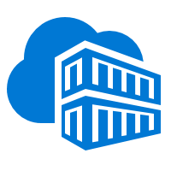


End to end experience
Helm chart
AKS production cluster
Front end
Inner loop
Azure Container Registry
Source code control
Azure Monitor
Azure DevSpaces
AKS dev cluster
Test
Business logic
Debug
Auto-build
Azure Pipelines/ DevOps Project
Database tier
CI/CD

Slide 12
Secure your Kubernetes environment
Control access through AAD and RBAC
Safeguard keys and secrets with Key Vault
Secure network communications with VNET and CNI
Compliant Kubernetes service with certifications covering SOC, HIPAA, and PCI

Slide 13


Scale and run with confidence
Built-in auto scaling
Global data center
Elastically burst using ACI
Geo-replicated container registry
Geo-replicated container registry
Azure Container Instances
Pod
Pod
Pod
Pod
Traffic manager
AKS clusters
Browser
Pod
Pod

Slide 14
Top scenarios
Introduction
AKS Overview
Top scenarios
Open source culture
Resources

Slide 15
Top scenarios for Kubernetes on Azure
Lift and shift to containers
Microservices
Machine learning
IoT
Cost saving
without refactoring your app
Agility
Faster application development
Performance
Low latency processing
Portability
Build once, run anywhere

Slide 16
Lift and shift to containers
Microservices
Machine learning
IoT
App modernization without code changes
Speed application deployments by using container technology
Defend against infrastructure failures with container orchestration
Increase agility with continuous integration and continuous delivery
Azure Container Registry
Kubernetes cluster
Existing application
CI/CD
Modernized application
Modernized application
Modernized application
Cloud Database

Slide 17
Lift and shift to containers
Microservices
Machine learning
IoT
Microservices: for faster app development
Monolithic
Microservices
Independent deployments
Improved scale and resource utilization per service
Smaller, focused teams
Large, all-inclusive app
Small, independent services
App
App
App

Slide 18
Lift and shift to containers
Microservices
Machine learning
IoT
Microservices: for faster app development
Monolithic
Microservices
Use Azure Dev Spaces to iteratively develop, test, and debug microservices targeted for AKS clusters.
Easily access to SLA-backed Azure Services such as Azure Database for MySQL using Open Service Broker for Azure (OSBA)
Azure Monitor provides a single pane of glass for monitoring over app telemetry, cluster-to-container level health analytics.
Large, all-inclusive app
Small, independent services
App
App
App

Slide 19
Open source culture
Introduction
AKS Overview
Top scenarios
Open source culture
Resources

Slide 20






















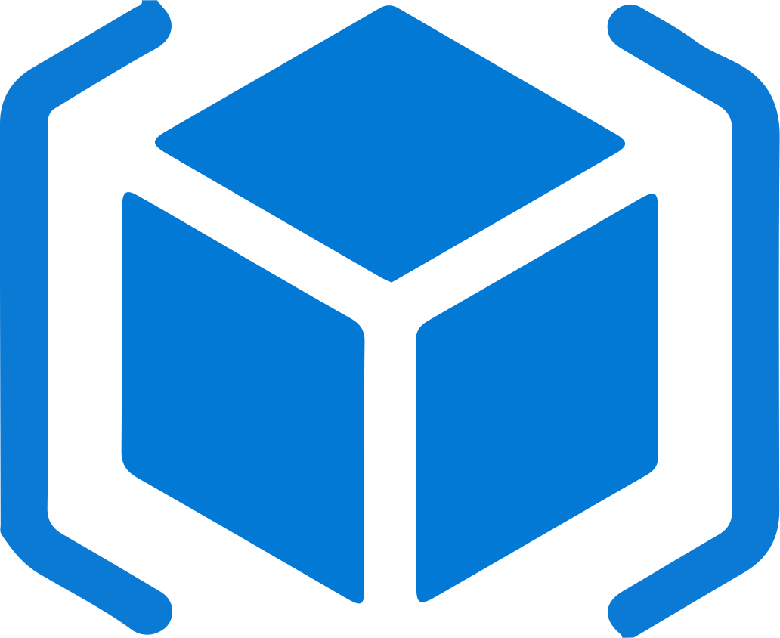

Work how you want with opensource tools and APIs
 | Development | DevOps | Monitoring | Networking | Storage | Security
Take advantage of services and tools in the Kubernetes ecosystem
…or… Leverage growing Azure support
RBAC
Azure Container Registry
AAD
Key Vault
Azure DevOps
ARM
VS Code
Azure Monitor
Azure VNET
Azure Storage

Slide 21
Microsoft contributes open source containers
#2 overall individual contributor to Kubernetes (Brendan Burns)
#4 overall individual contributor to Docker (John Howard)
#1-3 overall individual contributors to Helm
70 Microsoft employees have made contributions to Kubernetes

Slide 22
Resources
Introduction
AKS Overview
Top scenarios
Open source culture
Resources
Demos

Slide 23
Demo
Get started easily with AKS
Set up CI/CD in simple steps with DevOps Project

Slide 24
Resources
Introduction
AKS Overview
Top scenarios
Open source culture
Resources

Slide 25
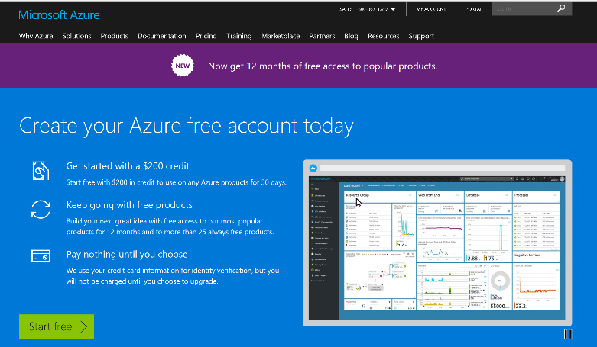
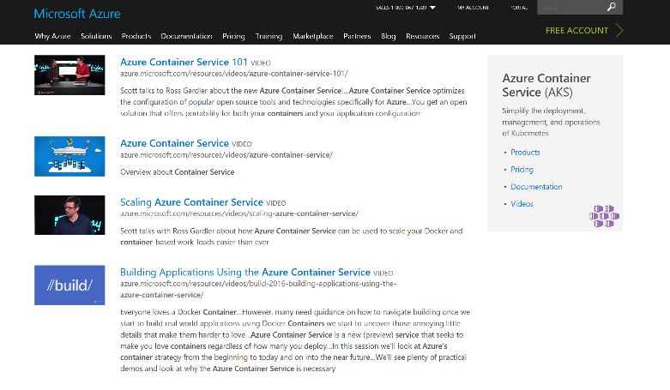
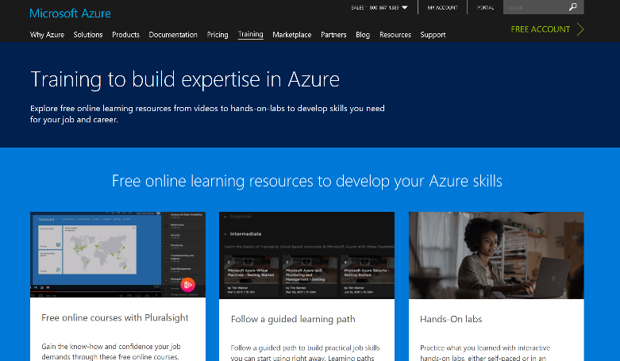
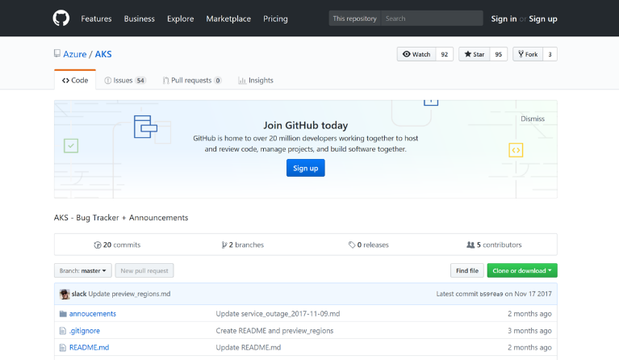
AKS resources
Azure Kubernetes Service (AKS)
Containers on Azure pitch deck
Smart Hotel 360 Demo
Documentation resources
Ebook for distributed systems
Distributed system HoL
AKS HoL
Sign up for a free Azure account
Check out the Azure container videos page
Hone your skills with Azure training
Get the code from GitHub

