Slide 1

Life Organizer
Instant Scheduling App
Alice Yu, Kaizena Ma, Emmanuel Butor, Xiao Qing Yu
CruzHacks 2020

Slide 2
How It Works
Take a picture of a schedule, prescriptions, etc with
Or import a photo you already have on your phone
Life Organizer scans this photo
Any event recognized is automatically added to the app’s calendar

Slide 3
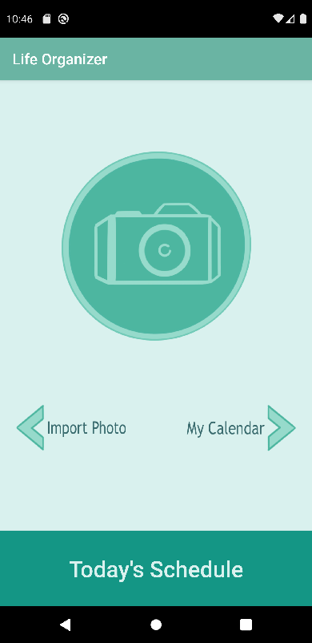
App Design
Large, bright buttons: attention and easy access
‘Camera’, main mechanic
‘Today’s Schedule’, likely needed readily accessible
Smaller arrows for navigation
‘Import Photo’, scan pictures not taken through app
‘My Calendar’, monthly overview of activities

Slide 4
How It’s Made
Microsoft’s Azure:
Cloud
Provides cognitive service that scans images for keywords
Creates a JSON file that is parsable
Android Studio:
Official IDE for developing android apps
Provides all the tools necessary to design our app and add functionality to it
Contacts Azure to integrate their scanning services

Slide 5
Who It’s For
People who need help staying organized:
Makes organizing more simple
Students:
Instantly add all your classes (and jobs) to your calendar
People on medication:
Never forget to take your pills
Everyone!

Slide 6
Credits
App Design (Front-end):
Kaizena Ma: Button designs, initial app design, UI/UX
Alice Yu: App design implementation through Android Studio, connect app to phone’s Gallery, UI/UX
Xiao Qing Yu: App design implementation, connect app to phone’s Camera, add Calendar, UI/UX
Back-end:
Emmanuel Butor: use of Azure’s cognitive tools, parsing JSON files
Kaizena Ma: parsing JSON files
Xiao Qing Yu: Calendar & scheduling implementation

