Slide 1
Best Location for a Motel
in
Calcasieu Parish
Louisiana

Slide 2
Table of Contents
Introduction
Description of the Data
Methodology
Results
Discussion
Conclusion

Slide 3
Introduction
The main objective of this project is to find an ideal location which is suitable to start a new motel in the neighborhoods of Calcasieu Parish.
Stakeholders
Econo Lodge is an economy motel chain based in the United States and Canada. Econo Lodge is the second-largest brand in the Choice Hotels system. Choice Hotels plans to add more new-construction properties to the Econo Lodge brand and would like to start a new Econo Lodge near Calcasieu Parish, Louisiana. Therefore my goal is to determine an ideal location around the neighborhood of Calcasieu Parish that is suitable to start a Motel Business.
Location
Calcasieu Parish is part of the Lake Charles, with a population of 194,138. Lake Charles has the biggest casino market in the state of Louisiana. Calcasieu Parish was created March 24, 1840, from the parish of Saint Landry, one of the original nineteen civil parishes established by the Louisiana Legislature in 1807. It is also located near the Beaumont–Port Arthur (Texas), Lafayette, and Alexandria metropolitan areas. As the population in this area grew over the years, the original Calcasieu Parish has since been divided into five smaller parishes. Louisiana state has total of 36 Parish(borough) and 304 neighborhoods.

Slide 4
Description of the Data
This project required two datasets.
The first dataset is available on Wikipedia that contains the list of municipalities of Louisiana. The link address to the dataset is https://en.wikipedia.org/wiki/List_of_municipalities_in_Louisiana. We can extract data in the panda data-frame by scraping the html link stated above. This dataset contains the data about all the neighborhood of the Louisiana State, their populations and population density.This dataset contains the information about 36 borough and it’s 304 neighborhoods.
The second dataset contains the information about the latitude and longitude of the neighborhood of Calcasieu Parish of Louisiana. This dataset is also extracted scraping the web page as stated above and combining the geographical information from a csv file

Slide 5
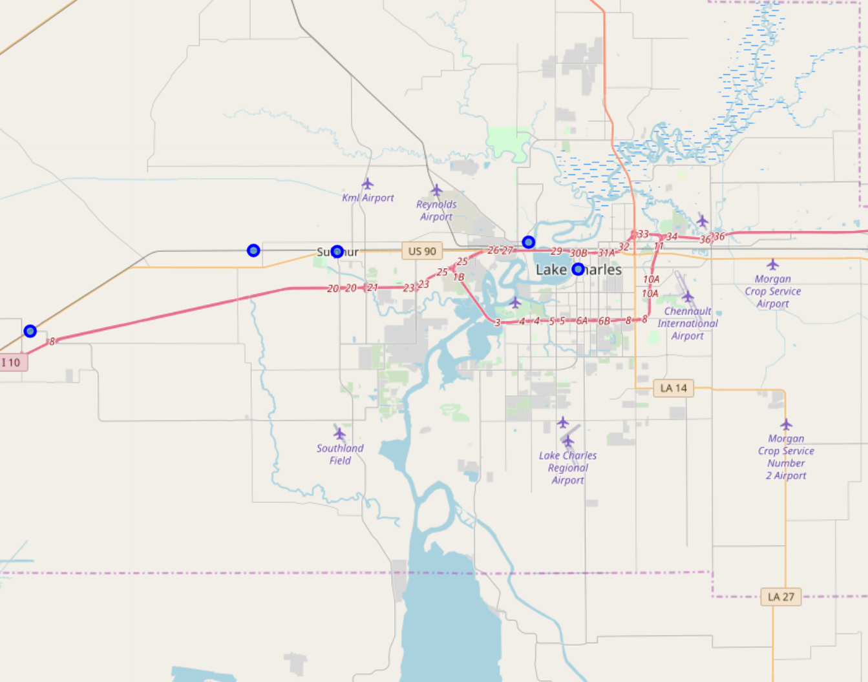
Map of Calcasieu Parish

Slide 6
Methodology
In this section we are exploring the important attributes that plays the vital role in solving the business problem and collect the data about them using the Foursquare API.
Merge data - Eliminate all the data that doesn't belong to the Calcasieu, Parish, replace all null value with 0 and Merge the final data frame with population data
Prepare Data for k-means classification model - Borough and Neighborhood in this dataset is a categorical variable and Latitude and Longitude are not important attributes for our model.

Slide 7
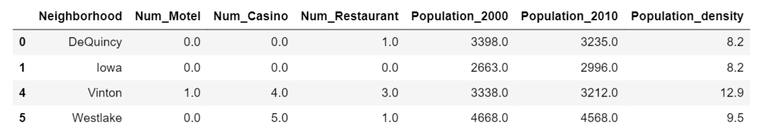
Result
K-means Clustering •K-means Clustering algorithms is used in order to segment the neighborhood of Calcasieu parish based on the attributes discussed above. Since, the size of the neighborhood is small, we'll use 3 as the number of clusters.

Slide 8
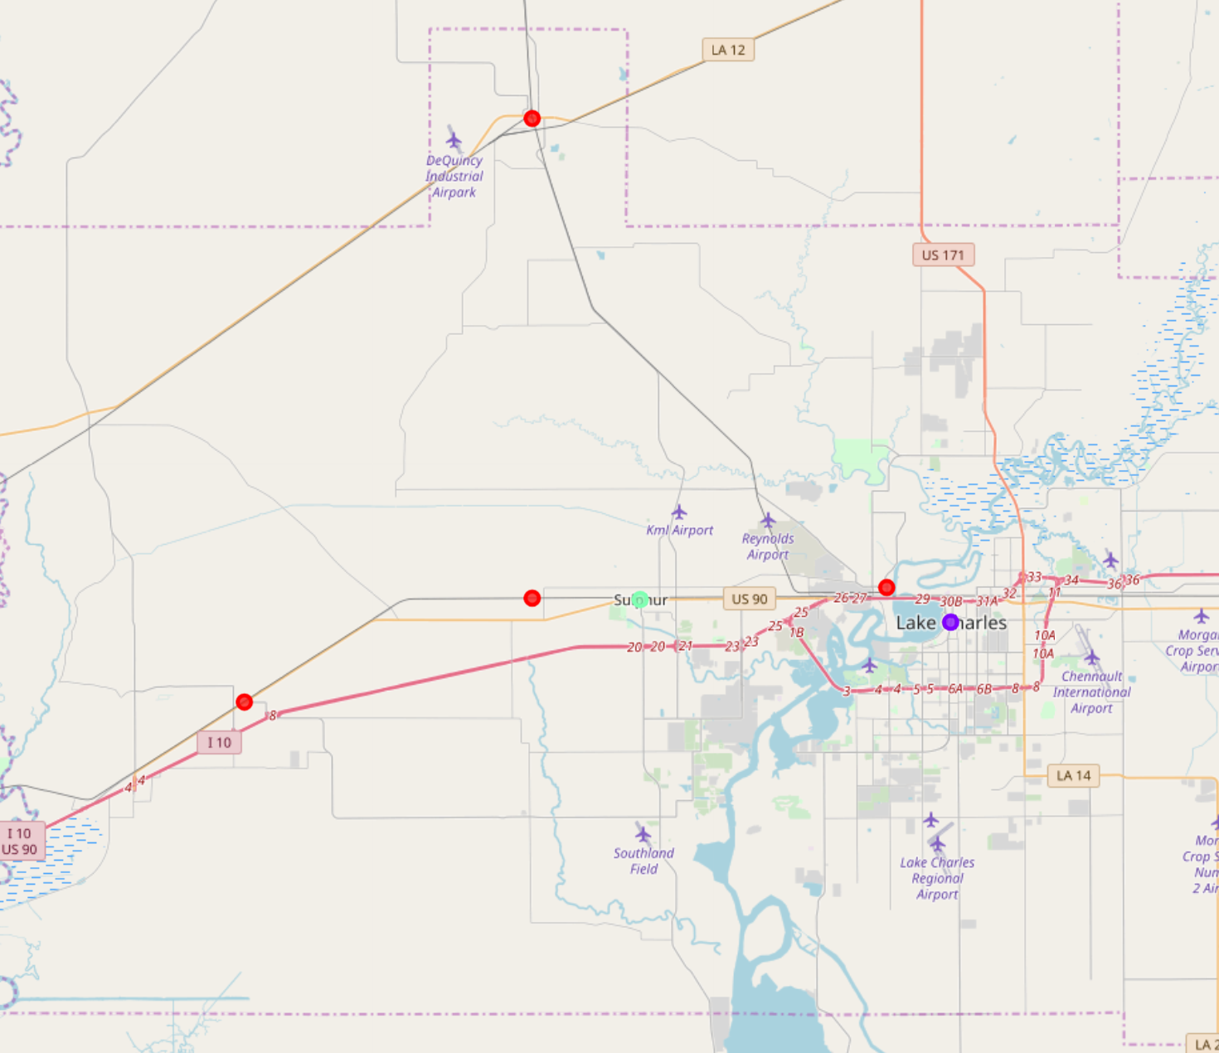
Result

Slide 9
Discussion
Cluster 1
The results suggests that the numbers of Casinos, and Restaurants are less as compared to cluster two. In addition, population density is also very low in all the neighborhood of cluster one. Comparing the population in the period of 2000 to 2010, the rate of increase in population is significantly low.
Hence, it will not be wise decision to start the Motel in neighborhood occupied by this cluster.
Cluster 2
There are higher numbers of Casinos, and Restaurants in cluster two as compared to other clusters. In addition, population density is also significantly high in comparison to other clusters. But, Comparing the population in the period of 2000 to 2010, the rate of increase in population is significantly low. Even though the number of Motel is same as Cluster three, but the number of Casino and Restaurants are high.
Hence, I would recommended cluster two neighborhoods an ideal destination to start Motel business.
Cluster 3
The results suggests that the numbers of Casinos, and Restaurants are less as compared to cluster two. In addition, population density is also very low in the neighborhood of cluster three
Hence, it will not be wise decision to start the Motel in neighborhood occupied by this cluster.

Slide 10
Conclusion
The main objective of this project is to demonstrate the concepts of recommendation systems/techniques that are used to solve the real business problems. In our case, we developed a model that can easily help us to determine the best location in Calcasieu Parish of Lousiana to start a Motel business. The result from our model recommended us that cluster two only neighborhood Lake Charles, La is the ideal location to start the Motel business.

