Slide 1

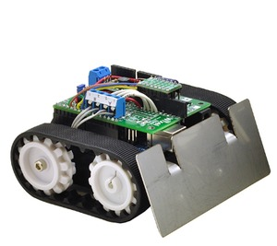
Robo Eigenbau Steuerung
Smartphone
Laptop
Tablet
RoboServer.py
AccessPoint
Web-Sockets
(Autobahn Py)
Browser
Fake DNS
Caminterface.py
RoboControl.html
WLAN local
MotorInterface.py
Lightnterface.py
VideoStream
WebServer
VirtualJoystick.js
Raspberry Pi 2
Raspi2.local
Lichtschalter
Web-Sockets
(Autobahn.js)
HiPower
LED
Motorcontroller
Qik_2s9v1
PiCam
Linker Antrieb
Motor0
Rechter Antrieb
Motor1

