Slide 1
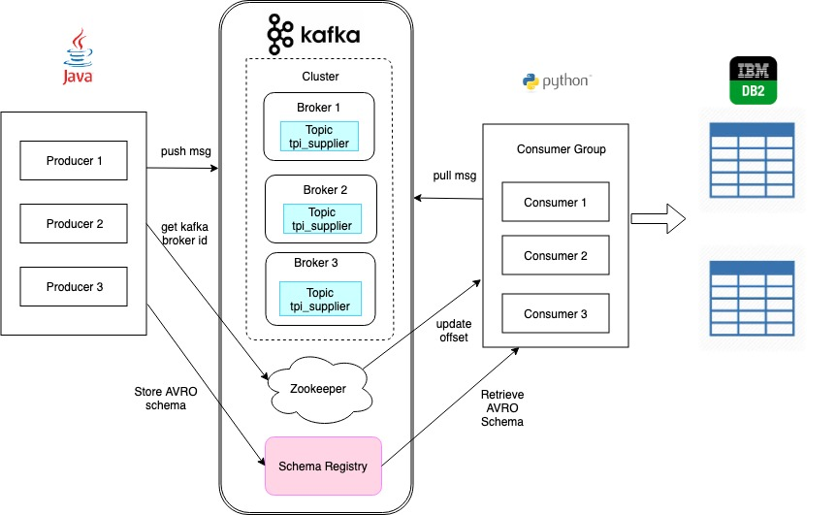

Slide 2
Capability | Description
High Throughput | Can process millions of messages
Distributed | Supports message partitioning over Kafka servers and distributing consumption over a cluster of consumer
Replication | Messages can be replicated within and across cluster
Scalability | Highly scalable with no downtime
Durability | Message persisted on disk and intra-cluster replication supported
Persistence | Persists messages to disk;from disk can be persisted in Hadoop and other systems as needed.
Stream Processing | Can be used with real-time streaming applications like Spark
Hadoop Support | Fully supported in Hadoop platform
Client Support | Multiple client support - Java, Python, C, C++.Ruby, JavaScript etc.

Slide 3
