Slide 1



Prompting APIs, Structured Outputs
Sourangshu Bhattacharya
Associate Professor
CSE, IIT Kharagpur

Slide 2
What We'll Cover
Prompting and APIs
HuggingFace Inference API
Local hosting
Free-hosted models
Applications
Question Answering
Text summarization, code generation
Classification, reasoning
Structured Outputs
Output Validation
Constrained Decoding

Slide 3
Start with a Question
When we execute functions using OpenAI’s response API using the “tools” option, where the does the function actually gets executed?
On the user’s machine.
On the OpenAI servers.
On a combination of the user’s machine and some other (third party) servers.
On a combination of the user’s machine and OpenAI servers.

Slide 4



Answer
When we execute functions using OpenAI’s response API using the “tools” option, where does the function actually get executed?
On the user’s machine.
On the OpenAI servers.
On a combination of the user’s machine and some other (third party) servers.
On a combination of the user’s machine and OpenAI servers.
Why: OpenAI’s “tools” option does not execute anything on OpenAI’s servers. The model only decides that a function should be called and returns the function name plus arguments as structured output. It is the calling application — running on the user’s / developer’s own machine or infrastructure — that must actually run the function and, if needed, send the result back to the model in a follow-up API call.

Slide 5
Prompting APIs
HuggingFace API

Slide 6

Other ways of running LLMs
HuggingFace is a central hub where developers and researchers share and collaborate on AI models and Tasks.
Model Hub: Over 2 million open models, contributed by various individuals and organisations.
Transformers Library: A popular open-source Python library that makes it easy to download and use pre-trained models.
Providers allow running open-source models on their servers – rate limited.
There are three primary ways of running Open-source models:
Approach 1: Run using HuggingFace API locally.
Approach 2: Run using requests or OpenAI API on the HuggingFace providers using HF authentication.
Approach 3: Run locally using Ollama or other methods, and access through the requests API.

Slide 7
Approach 1: Transformers Locally
Step 1 — Install
🖥️ Runs on your machine using PyTorch
✅ MPS speed-up
device='mps' uses your M3 GPU — much faster than CPU
✅ float16
torch_dtype=torch.float16 cuts memory use in half
✅ Needs torch
torch + transformers must be installed locally
pip install transformers huggingface_hub
Step 2 — Load model & run on Apple Silicon (MPS)
import torch from transformers import AutoTokenizer, AutoModelForCausalLM model_id = "google/gemma-2-2b-it" tokenizer = AutoTokenizer.from_pretrained(model_id) model = AutoModelForCausalLM.from_pretrained(model_id) device = "mps" if torch.backends.mps.is_available() else "cpu" model = model.to(device) inputs = tokenizer("What is quantum computing?", return_tensors="pt").to(device) outputs = model.generate(**inputs, max_new_tokens=100) print(tokenizer.decode(outputs[0], skip_special_tokens=True))

Slide 8
Approach 2: Hugging Face Hosted Inference API
Step 1 — Install (minimal!)
☁️ No GPU, no torch needed
☁️ No local GPU
Inference runs on HF servers — zero setup for your machine
🐢 Slower
Network latency adds delay vs running locally
⚠️ Rate limits
Free tier is throttled — upgrade for production use
pip install requests
Step 2 — Get a free token at huggingface.co/settings/tokens, then call the API
import requests API_URL = " https://router.huggingface.co/v1/chat/completions" headers = {"Authorization": "Bearer YOUR_HF_TOKEN"} response = requests.post(
API_URL, headers=headers,
json={ "messages": [{"role": "user", "content": "What is quantum computing?"}], "model": "Qwen/Qwen3-32B:nscale"} ) print(response.json())

Slide 9
Approach 3: Ollama (Local, Zero-Config, Optimized)
Step 1 — Install Ollama & pull a model
brew install ollama ollama run llama3 # downloads & starts the model automatically
🦙 Easiest way for bigger models
🚀 Best for 7B+ models
Runs Llama 3, Mistral, Gemma with one command
🔒 Fully private
Everything stays local — no data sent anywhere
📦 No torch needed
Ollama bundles its own runtime; only requests required
Step 2 — Call from Python via REST (no torch, no transformers)
import requests response = requests.post(
"http://localhost:11434/api/generate",
json={
"model": "llama3",
"prompt": "What is quantum computing?",
"stream": False } ) print(response.json()["response"])
3 / 4

Slide 10
HuggingFace – Local inference
① Import libraries
torch = math/tensor engine.
transformers = model toolkit.
import torch
from transformers import AutoTokenizer, AutoModelForCausalLM
model_name = "google/gemma-2-2b-it"
tokenizer = AutoTokenizer.from_pretrained(model_name)
model = AutoModelForCausalLM.from_pretrained(model_name)
device = "mps" if torch.backends.mps.is_available() else "cpu"
model = model.to(device)
inputs = tokenizer("What is quantum computing?", return_tensors="pt").to(device)
outputs = model.generate(**inputs, max_new_tokens=1000)
print(tokenizer.decode(outputs[0], skip_special_tokens=True))
② Name the model
A string that identifies which AI to download from Hugging Face.
③ Load tokenizer & model
Downloads the vocabulary + 4B-parameter neural network.
④ Choose GPU or CPU
Picks MPS (Apple GPU) if available, otherwise falls back to CPU.
⑤ Ask, generate & print
Tokenizes the question → generates tokens → decodes to text.

Slide 11
HuggingFace – Local inference
import torch
Loads PyTorch — the math engine that runs all the tensor calculations.
import torch
from transformers import AutoTokenizer, AutoModelForCausalLM
from transformers import …
Brings in two ready-made classes from Hugging Face:
AutoTokenizer and AutoModelForCausalLM.
model_name = " google/gemma-2-2b-it "
AutoTokenizer
Downloads the vocabulary so words → numbers match what the model learned.
tokenizer = AutoTokenizer.from_pretrained(model_name)
model = AutoModelForCausalLM.from_pretrained(model_name, dtype=torch.float16)
AutoModelForCausalLM
Loads 4 billion parameters — the 'brain' of the AI.
dtype=torch.float16
Uses 16-bit numbers instead of 32-bit — halves memory use with barely any quality loss.

Slide 12
HuggingFace – Local inference
torch.backends.mps.is_available()
device = "mps" if torch.backends.mps.is_available() else "cpu"
print(f"Using device: {device}")
model = model.to(device)
Returns True on Apple Silicon Macs, False everywhere else.
model.to(device)
Moves all model weights to the chosen device so the model and inputs are in the same place.
"mps"
"cuda"
"cpu"
Apple Silicon GPU
NVIDIA GPU
Fallback
Available on Mac M1/M2/M3/M4. Much faster than CPU for AI.
Not in this code, but possible. Fastest option overall.
Always available — slower but works on any computer.

Slide 13
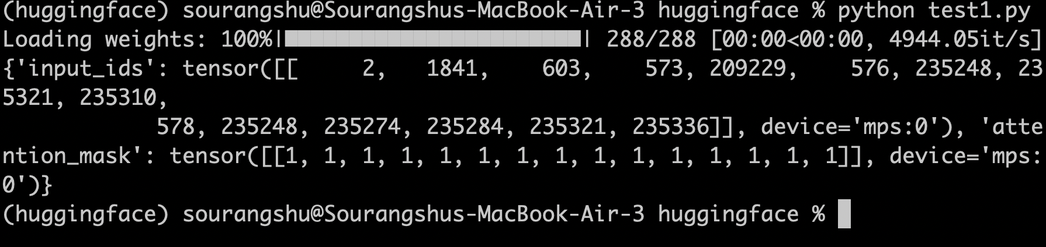
HuggingFace – Local inference
tokenizer("...")
inputs = tokenizer("What is quantum computing?", return_tensors="pt").to(device)
Splits the question into tokens and maps each to its integer ID from the vocabulary.
return_tensors="pt"
"pt" = PyTorch. Wraps the IDs in a tensor so the model can process them.
Print
.to(device)
Moves the tensor to the same device as the model (GPU or CPU) — required for compatibility.

Slide 14
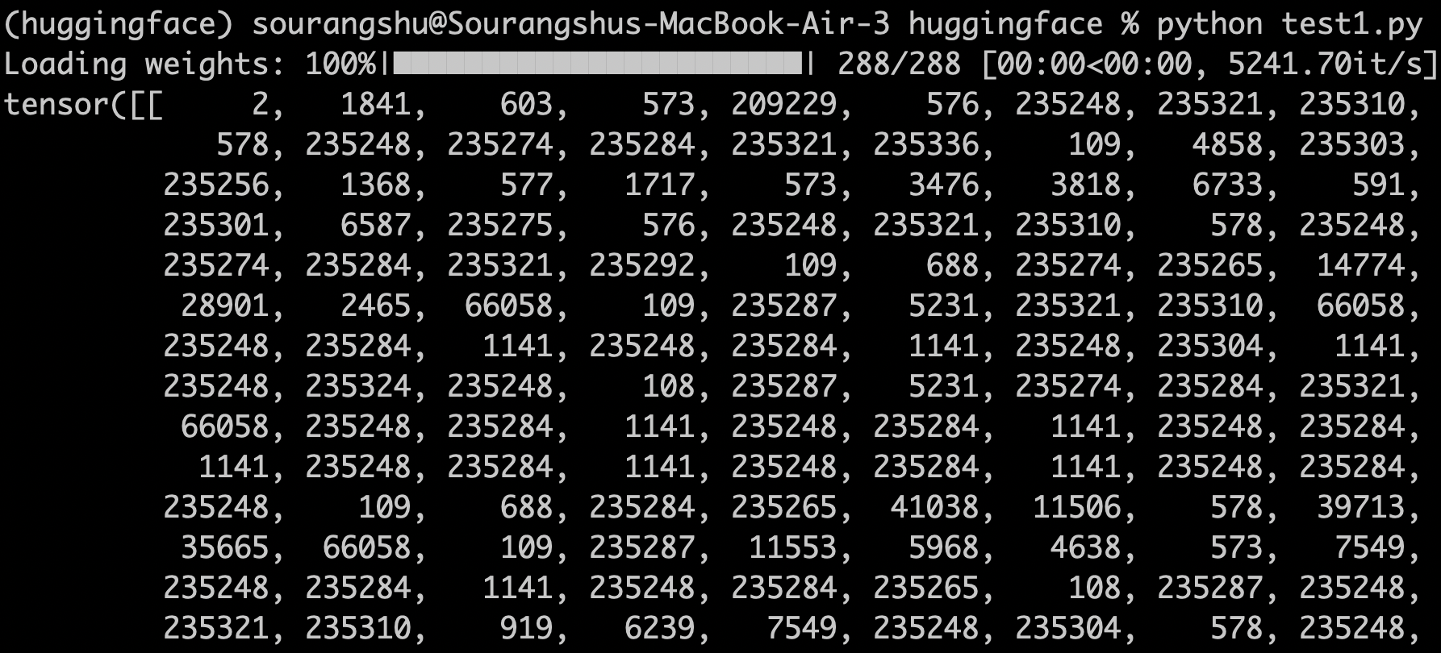
HuggingFace – Local inference
model.generate()
Runs the neural network iteratively, predicting the next token until done.
outputs = model.generate(**inputs, max_new_tokens=1000)
print(tokenizer.decode(outputs[0], skip_special_tokens=True))
**inputs (double-star unpacking)
Expands the dict — passes each key/value as a named argument to generate().
Print “outputs”
max_new_tokens=1000 & decode()
Caps output length (~750 words). decode() converts token IDs back to readable text.

Slide 15
Comparing All Three Approaches
Criterion
🖥️ Transformers
(Local)
☁️ HF Inference
API
🦙 Ollama
(Local)
Needs torch?
✅ Yes
❌ No
❌ No
Needs internet?
❌ No
✅ Yes
❌ No
Speed
⚡ Fast (MPS/GPU)
🐢 Slow (network)
⚡ Fast (local)
Privacy
🔒 Full
⚠️ Data sent to HF
🔒 Full
Setup effort
🔧 Medium
✅ Very easy
✅ Easy (brew)
Model variety
🌐 Thousands
🌐 Thousands
📦 Popular ones
Free?
✅ Yes (hardware)
✅ Yes (rate limited)
✅ Yes
Best for
Research, fine-tune
Quick prototypes
7B+ models, daily use

Slide 16
Question
What is the unique advantage of using the Huggingface transformer APIs over other APIs?
Access to free compute.
Access to free models.
Access to open-source models with all the inner functioning.
Ability to run the model on the local machine.

Slide 17
Answer
What is the unique advantage of using the Huggingface transformer APIs over other APIs?
Access to free compute.
Access to free models.
Access to open-source models with all the inner functioning.
✓
Ability to run the model on the local machine.
Why
Hosted APIs like OpenAI's give you only black-box access — a prompt in, a completion out, with no visibility into weights or architecture. The Huggingface transformers library instead loads actual open-source model checkpoints, so you can inspect layers, attention maps, hidden states, and modify or fine-tune the model directly — free compute, free models, and local execution are side benefits of this, not the distinguishing feature itself.

Slide 18
Prompting APIs
Example Applications

Slide 19
Designing Prompts for Different Tasks
In the next few slides, we will cover a few examples of common tasks using different prompts
Tasks covered:
Question Answering
Text Summarization
Text Classification
Code Generation
Reasoning

Slide 20
Open-Domain vs. Closed-Domain QA
Closed-Domain QA
The answer must be extracted or derived strictly from a given passage. The model isn't expected to use outside knowledge.
Example (SQuAD): given a Wikipedia passage on the Eiffel Tower and the question “Who designed the Eiffel Tower?”, the model must locate “Gustave Eiffel” in that passage.
Open-Domain QA
No passage is given. The model must rely on knowledge learned during training (or retrieved externally) to answer directly.
Example (MMLU): “Which of the following is the powerhouse of the cell?” A) Nucleus B) Mitochondria C) Ribosome D) Golgi apparatus — answerable only from prior knowledge.
Industry Applications
Enterprise knowledge search & RAG assistants — closed-domain, grounded in internal wikis, contracts, and policy documents.
Customer support chatbots — closed-domain, grounded in product manuals and help-center articles to avoid incorrect claims.
Medical / legal Q&A assistants — closed-domain, grounded in verified documents to reduce hallucination risk.
Search engines & voice assistants (Siri, Alexa, Google featured snippets) — open-domain, general world-knowledge Q&A.
Trivia platforms & exam-prep tutors — open-domain, broad general-knowledge quizzing (similar in spirit to MMLU).

Slide 21
Question Answering
You need a prompt that answers strictly from the given context and avoids inventing information. Which prompt fits best?
Prompt A
Using your knowledge and the context below, give the most complete and thorough answer you can. Context: {context} Question: {question} Answer:
Prompt B
Answer the question based only on the context below. Keep the answer short and concise. Respond “Unsure about answer” if not sure. Context: {context} Question: {question} Answer:
Prompt C
Context: {context} Question: {question} Answer the question.

Slide 22
Question Answering
Answer & Explanation
Prompt A
Using your knowledge and the context below, give the most complete and thorough answer you can. Context: {context} Question: {question} Answer:
✗ Needs improvement — “using your knowledge” invites the model beyond the context, risking facts not actually present in the source.
Prompt B
Answer the question based only on the context below. Keep the answer short and concise. Respond “Unsure about answer” if not sure. Context: {context} Question: {question} Answer:
✓ Best choice — grounds the answer strictly in the context and gives a fallback for missing information, keeping responses short and reliable.
Prompt C
Context: {context} Question: {question} Answer the question.
✗ Needs improvement — no instruction to stay concise or admit uncertainty, so the model may guess confidently when the context lacks the answer.

Slide 23
ARC-Easy Dataset
ARC-Easy (AI2 Reasoning Challenge)
Grade-school-level (3rd–9th grade) science QA
Dataset from the Allen Institute for AI (Clark et al., 2018).
The easier half of ARC; the harder half (ARC-Challenge) contains questions that simple retrieval / word co-occurrence baselines fail to answer.
Dataset statistics
Total: 5,197 questions (of 7,787 in all of ARC)
Train: 2,251 · Dev: 570 · Test: 2,376
4 answer options per question, single correct answer
Sourced from standardized U.S. state science exams
Example Question
Which of these is the best reason for exercising on space flights?
A. to increase strength for moving around in the cabin
B. to keep from becoming overweight on a space mission
C. to minimize the loss of muscle mass due to microgravity
D. to ensure that bodily fluids do not tend to collect in the feet
✓ Correct answer: C — microgravity causes muscle atrophy; exercise minimizes that loss.

Slide 24
Evaluation Program Overview
Evaluates 3 QA prompt designs against a local Qwen3 model via Ollama's OpenAI-compatible API
Configuration & Defaults
DEFAULT_BASE_URL / DEFAULT_API_KEY / DEFAULT_MODEL, each overridable via environment variables or CLI flags, plus a DISABLE_THINKING toggle for Qwen3's reasoning mode.
Prompt Templates (A / B / C)
prompt_a / prompt_b / prompt_c build the three prompt variants from the MCQ slides — constrained+fallback, open-ended reasoning, and bare — sharing a common format_options() helper.
Data Loading
load_arc_easy_subset() pulls a reproducible random subset of ARC-Easy's test split via Hugging Face datasets, filtered to standard 4-option questions.
Model Query
query_model() calls the OpenAI-compatible chat.completions endpoint, passing extra_body={"think": False} to skip Qwen3's reasoning pass.
Answer Extraction
extract_letter() pulls an A/B/C/D answer out of raw model text with a layered fallback: exact match, then “answer is X” patterns, then last standalone letter.
Evaluation Loop & Reporting
run_evaluation() runs every example through all three prompts and grades them; print_report() summarizes accuracy and parse rate per prompt.

Slide 25
Code Walkthrough
run_evaluation()
def run_evaluation(client, model, examples):
results = {name: PromptResult(name)
for name in PROMPTS}
for example in tqdm(examples):
question = example["question"]
choices = example["choices"]
correct_letter = example["answerKey"]
for name, (build_prompt, max_tok)
in PROMPTS.items():
result = results[name]
result.total += 1
prompt = build_prompt(
question, choices)
raw = query_model(
client, model,
prompt, max_tok)
pred = extract_letter(raw)
if pred is None:
result.failures.append(
(question, "unparseable"))
else:
result.parsed += 1
if pred == correct_letter:
result.correct += 1
else:
result.failures.append(
(question, "mismatch"))
return results
Data Loading & Evaluation Loop
load_arc_easy_subset()
def load_arc_easy_subset(n, seed):
"""Load a random n-question subset
of ARC-Easy (test split), keeping
only 4-option questions so A-D
formatting stays clean."""
dataset = load_dataset(
"allenai/ai2_arc", "ARC-Easy",
split="test")
dataset = dataset.filter(
lambda ex: len(
ex["choices"]["text"]) == 4)
rng = random.Random(seed)
indices = rng.sample(
range(len(dataset)),
k=min(n, len(dataset)))
return dataset.select(indices)

Slide 26
Code Walkthrough: Querying the Model
test-prompts-test.py
query_model()
def query_model(client, model,
user_prompt, max_tokens):
extra_body = {}
if DISABLE_THINKING:
# Ollama: skip Qwen3's reasoning
# pass for hybrid-reasoning models
extra_body["think"] = False
response = client.chat.completions.create(
model=model,
messages=[{"role": "user",
"content": user_prompt}],
temperature=0.0,
max_tokens=max_tokens,
extra_body=extra_body)
return response.choices[0]
.message.content
format_options()
def format_options(choices):
# ARC-Easy choices are a dict
# with "text"/"label" keys
option_texts = choices["text"]
labels = (choices["label"]
if "label" in choices
else LETTERS)
return "\n".join(
f"{label}. {text}"
for label, text in
zip(labels, option_texts))

Slide 27
Code Walkthrough: Querying & Reporting
test-prompts-test.py
query_model()
def query_model(client, model,
user_prompt, max_tokens):
extra_body = {}
if DISABLE_THINKING:
# Ollama: skip Qwen3's reasoning
# pass for hybrid-reasoning models
extra_body["think"] = False
response = client.chat.completions.create(
model=model,
messages=[{"role": "user",
"content": user_prompt}],
temperature=0.0,
max_tokens=max_tokens,
extra_body=extra_body)
return response.choices[0]
.message.content
print_report()
def print_report(results, n_examples):
print(f"\nResults over {n_examples}
random questions\n")
header = (f"{'Prompt':40s}"
f"{'Accuracy':>12s}
{'Parse Rate':>14s}")
print(header)
print("-" * len(header))
for name, result in results.items():
print(f"{name:40s}
{result.accuracy:>11.1%}
{result.parse_rate:>13.1%}")

Slide 28
Evaluation Results
20-question ARC-Easy subset, per-prompt accuracy and parse rate by model
Qwen3-1.5B (context length 2000)
Phi-4-mini (3.8B)
Prompt | Accuracy | Parse Rate
A — constrained + fallback | 95.0% | 95.0%
B — open-ended reasoning | 55.0% | 95.0%
C — bare, no format | 95.0% | 100.0%
Prompt | Accuracy | Parse Rate
A — constrained + fallback | 90.0% | 100.0%
B — open-ended reasoning | 85.0% | 100.0%
C — bare, no format | 80.0% | 100.0%
Takeaway
Prompt A's constrained-format-plus-fallback design holds up consistently well across both model sizes. Prompt B (open-ended reasoning) hits the smaller Qwen3-1.5B hardest — accuracy drops to 55% even though the parse rate stays at 95%, meaning the model still answers cleanly, it just reasons its way to the wrong option more often when asked to elaborate before committing. Phi-4-mini, being larger, is more robust to that same prompt weakness.

Slide 29
Text Summarization
Key Challenges
Faithfulness / hallucination — the summary states facts not actually present in the source text.
Balancing brevity vs. coverage — omitting details the reader needs, or barely shortening the original.
Extractive vs. abstractive trade-off — copying source sentences is safe but rigid; paraphrasing risks factual drift.
Weak automatic evaluation — metrics like ROUGE reward word overlap, not whether the summary is actually correct.
Example
Input: “Apple reported Q3 2024 revenue of $85.8B, up 5% YoY, driven by strong iPhone 15 sales and Services growth. Regulatory pressure in the EU and China remains a headwind.”
Prompt: Summarize for a retail investor in under 30 words, focusing on revenue growth and risks.
Output: “Apple’s Q3 revenue grew 5% YoY to $85.8B on strong iPhone and Services sales; EU/China regulatory pressure is a key risk ahead.”
Popular Dataset
CNN/DailyMail
~300K news article–summary pairs: 287K train / 13K val / 11K test
Articles paired with human-written “highlight” bullet summaries
The standard benchmark for extractive & abstractive summarization, scored with ROUGE
Industrial Applications
News aggregation & personalized briefings
Meeting / earnings-call transcript summarization
Legal & compliance document digests
Customer support ticket/thread summarization
Email and inbox thread summarization

Slide 30

Text Summarization: Executive
INPUT PROMPT (ZERO-SHOT)
MODEL RESPONSE
Q3 Summary
Summarize the following earnings call transcript for a retail investor. Focus on quarterly revenue growth and forward-looking risks. Keep it under 100 words.
Apple reported a 5% YoY revenue increase, driven by strong iPhone 15 sales and services growth. Key forward-looking risks include regulatory challenges in the EU and competitive pressure in the Chinese smartphone market.
[Transcript: Apple Q3 2024 Call...]

Slide 31
Text Summarization
You need a concise, investor-focused summary of an earnings call, under 100 words. Which prompt fits best?
Prompt A
Summarize the following earnings call transcript. [Transcript: ...]
Prompt B
Summarize the earnings call transcript in as much detail as possible, including every number mentioned, for a retail investor. [Transcript: ...]
Prompt C
Summarize the following earnings call transcript for a retail investor. Focus on quarterly revenue growth and forward-looking risks. Keep it under 100 words. [Transcript: ...]

Slide 32
Text Summarization
Answer & Explanation
Prompt A
Summarize the following earnings call transcript. [Transcript: ...]
✗ Needs improvement — no audience, focus, or length constraint; the summary could run long, skip key risks, or stay overly technical.
Prompt B
Summarize the earnings call transcript in as much detail as possible, including every number mentioned, for a retail investor. [Transcript: ...]
✗ Needs improvement — “as much detail as possible” and “every number” work against the goal of a summary, likely producing a long, unfocused reply.
Prompt C
Summarize the following earnings call transcript for a retail investor. Focus on quarterly revenue growth and forward-looking risks. Keep it under 100 words. [Transcript: ...]
✓ Best choice — specifies the audience, the focus areas, and a firm length limit, so the output stays concise and relevant.

Slide 33
Text Classification
Key Challenges
Class imbalance — rare categories (e.g., fraud, abuse) get under-predicted since most examples are “normal.”
Ambiguous / overlapping labels — a single piece of text can genuinely belong to more than one category.
Domain shift — a classifier trained on one domain (movie reviews) degrades on another (product reviews).
Consistent, machine-readable output — open-ended labels break downstream automation expecting a fixed label set.
Example
Input: “The delivery took forever, but the food was amazing.”
Task: Sentiment classification (Positive / Negative / Mixed)
Output: Mixed — negative delivery experience, positive food quality; a single Positive/Negative label would lose real information here.
Industrial Applications
Spam & content-moderation filtering
Customer support ticket routing / triage
Brand & social-media sentiment monitoring
Email / document categorization for records management
Intent detection in chatbots and voice assistants
Popular Dataset
SST-2 (Stanford Sentiment Treebank, GLUE)
~67,349 train / 872 dev / 1,821 test sentences
Movie-review sentences labeled Positive / Negative (binary)
A standard sentiment-classification benchmark within the GLUE suite

Slide 34
Text Classification
You're auto-tagging support tickets and need consistent, machine-readable labels. Which prompt fits best?
Prompt A
Assign relevant tags to this support ticket from this list only: [Auth, Billing, Technical, Urgent]. Output only the matching tag names as a comma-separated list. Ticket: {ticket}
Prompt B
Read this support ticket and assign tags that describe the issue. Ticket: {ticket}
Prompt C
Assign relevant tags to this support ticket from this list: [Auth, Billing, Technical, Urgent]. Explain your reasoning for each tag you choose. Ticket: {ticket}

Slide 35
Text Classification
Answer & Explanation
Prompt A
Assign relevant tags to this support ticket from this list only: [Auth, Billing, Technical, Urgent]. Output only the matching tag names as a comma-separated list. Ticket: {ticket}
✓ Best choice — fixes the label set and the output format, so results stay consistent and easy to parse downstream.
Prompt B
Read this support ticket and assign tags that describe the issue. Ticket: {ticket}
✗ Needs improvement — no fixed label set, so the model can invent new categories each time, breaking consistency across tickets.
Prompt C
Assign relevant tags to this support ticket from this list: [Auth, Billing, Technical, Urgent]. Explain your reasoning for each tag you choose. Ticket: {ticket}
✗ Needs improvement — the label set is fine, but open-ended reasoning turns the output into free text instead of a clean, parseable list.

Slide 36
Code Generation
Key Challenges
Functional correctness — code that looks right can still fail on edge cases or produce subtly wrong output.
Hallucinated APIs — models sometimes call functions, libraries, or parameters that don’t actually exist.
Security vulnerabilities — generated code can include insecure patterns without being flagged as such.
Evaluation is hard — text-similarity metrics like BLEU correlate poorly with whether the code actually runs.
Example
Prompt: Write a Python function to calculate the Fibonacci sequence up to n terms using an iterative approach. Include basic comments.
def fibonacci(n):
a, b, result = 0, 1, []
for _ in range(n):
result.append(a)
a, b = b, a + b
return result
Popular Dataset
HumanEval (OpenAI, 2021)
164 hand-written Python problems, each with a docstring and ~7.7 unit tests on average
Evaluated with pass@k — probability at least one of k samples passes all tests
Original Codex model: ~28.8% pass@1, rising to ~72% pass@100
Industrial Applications
AI pair-programming / in-IDE code completion
Automated test case generation
Boilerplate & scaffolding generation for new services
Natural-language-to-SQL query generation
Code review assistance & refactoring suggestions

Slide 37
Code Generation
You need a simple, well-documented iterative Python function. Which prompt fits best?
Prompt A
Write code to calculate Fibonacci.
Prompt B
Write a Python function to calculate the Fibonacci sequence up to n terms using an iterative approach. Include basic comments.
Prompt C
Write the most optimized, production-grade Python implementation of Fibonacci possible, and explain every optimization technique used in detail.

Slide 38
Code Generation
Answer & Explanation
Prompt A
Write code to calculate Fibonacci.
✗ Needs improvement — no language, approach, or documentation requested; output is unpredictable and may default to an undocumented recursive version.
Prompt B
Write a Python function to calculate the Fibonacci sequence up to n terms using an iterative approach. Include basic comments.
✓ Best choice — specifies the language, the approach (iterative), and asks for comments, leaving little room for ambiguity.
Prompt C
Write the most optimized, production-grade Python implementation of Fibonacci possible, and explain every optimization technique used in detail.
✗ Needs improvement — over-specifies scope for a simple example, likely producing a bloated, overly complex response instead of a clear solution.

Slide 39
Reasoning
Key Challenges
Error propagation — one wrong intermediate step derails every step that follows it.
Unfaithful chain-of-thought — written reasoning doesn’t always reflect what actually determined the answer.
Arithmetic / logical slips — small computational errors inside an otherwise sound reasoning chain.
Latency & cost — longer reasoning chains improve accuracy but multiply token usage and response time.
Example
Prompt: Sally has 3 brothers. Each brother has 2 sisters. How many sisters does Sally have? Think step by step.
Output: Sally is one of the sisters. Each brother has 2 sisters — that’s 2 sisters total, including Sally. So Sally has 1 sister.
Popular Dataset
GSM8K (Grade School Math 8K)
~8,500 grade-school math word problems: 7,473 train / 1,319 test
Each problem needs 2–8 steps of basic arithmetic reasoning to solve
A standard benchmark for evaluating chain-of-thought / multi-step reasoning
Industrial Applications
Financial analysis & forecasting tools
Multi-step customer troubleshooting / technical support
Scientific research assistants (hypothesis + derivation support)
Strategic planning & decision-support tools
Math / logic tutoring systems

Slide 40
Reasoning
You want the model to reliably work through a multi-step problem instead of jumping to an answer. Which prompt fits best?
Prompt A
Sally has 3 brothers. Each brother has 2 sisters. How many sisters does Sally have?
Prompt B
Think step by step to solve this, but only output the final answer — don't show any of your reasoning. Sally has 3 brothers. Each brother has 2 sisters. How many sisters does Sally have?
Prompt C
Sally has 3 brothers. Each brother has 2 sisters. How many sisters does Sally have? Think step by step.

Slide 41
Reasoning
Answer & Explanation
Prompt A
Sally has 3 brothers. Each brother has 2 sisters. How many sisters does Sally have?
✗ Needs improvement — without a step-by-step cue, the model is more likely to pattern-match to a quick answer instead of reasoning carefully.
Prompt B
Think step by step to solve this, but only output the final answer — don't show any of your reasoning. Sally has 3 brothers. Each brother has 2 sisters. How many sisters does Sally have?
✗ Needs improvement — self-contradictory: it asks for step-by-step reasoning while suppressing the reasoning output, losing the accuracy benefit.
Prompt C
Sally has 3 brothers. Each brother has 2 sisters. How many sisters does Sally have? Think step by step.
✓ Best choice — the “think step by step” cue prompts the model to reason through the relationships before answering, improving accuracy.

Slide 42
Reasoning: Strategy
MODEL RESPONSE
INPUT PROMPT (LOGIC)
The Solution
1. Take Chicken across
2. Return alone; take Fox across
3. Take Chicken back; take Grain across
4. Return alone; take Chicken across
A farmer needs to cross a river with a fox, a chicken, and a bag of grain. He can only carry one at a time. If left alone, fox eats chicken; chicken eats grain. How can he cross?
Reasoning: Key move is returning with the chicken to prevent loss.

Slide 43
Question
Which of the following tasks is not suitable to be performed by prompting LLMs?
Classifying resumes of individuals into different skillsets.
Forecasting stock prices
Generating a summary of US – Iran war updates.
Creating a resume for a job application

Slide 44
Answer
Which of the following tasks is not suitable to be performed by prompting LLMs?
Classifying resumes of individuals into different skillsets.
Forecasting stock prices.
Generating a summary of US – Iran war updates.
Creating a resume for a job application.
Why: Forecasting stock prices is a quantitative time-series prediction task — it depends on modelling numerical patterns, volatility, and market signals over time, not on reasoning over or generating language. LLMs are prompted with text and produce text; they have no real access to live market data and no built-in numerical forecasting mechanism, so prompting alone cannot reliably predict future prices. The other three tasks (classification, summarization, generation) are all language-understanding or language-generation tasks that LLMs are well suited to handle via prompting.

Slide 45
Structured Outputs
Output Validation

Slide 46
Where Structured Output Is Required
Three everyday LLM tasks where free-form text breaks downstream systems — and the exact shape each one needs:
Tool / Function Calling
Document & Form Extraction
Agent Action Selection
An agent’s chosen function and its arguments must match that function’s exact signature so your code can call it directly.
Format needed:
{"name": "get_weather",
"arguments": {"city": "Mumbai",
"unit": "celsius"}}
Benchmark challenge: on BFCL and tau-bench, models ace single-turn calls but still struggle to track context across multi-turn tool use.
Invoices, resumes, and scanned forms must be converted into the fixed fields a database or workflow expects.
Format needed:
{"vendor": "Acme Corp",
"invoice_date": "2026-03-14",
"line_items": [...],
"total": 452.10}
Benchmark challenge: CORD and SROIE (receipts), FUNSD/Kleister (forms), DocILE (invoice localization+extraction). Nested fields like line items are hard to score, and hallucinated fields cost as much as missed ones.
A ReAct-style agent must pick one action from a fixed set and supply well-typed arguments to it.
Format needed:
{"action": "search_web",
"action_input":
"IIT KGP admissions"}
Benchmark challenge: on MCP-Bench and similar multi-hop tests, 5–15% error per call compounds fast across long action chains.
3 / 15

Slide 47
More Places Structured Output Shows Up
Three more tasks that demand a fixed schema, not prose:
Database Writes & ETL
Third-Party API Requests
Classification & Routing
An LLM-parsed record must match a database table’s column names and types exactly before it can be inserted.
Format needed:
{"customer_id": 4821,
"sku": "SKU-2291",
"qty": 3}
Benchmark challenge: on Spider, accuracy nears 85%, but on messy, ambiguous real schemas like BIRD-Interact it drops to about 33%.
Calling an external API — search, maps, payments — requires a request body matching that API’s own schema, not the model’s wording.
Format needed:
{"rewritten_query":
"AI advancements",
"domains_allow_list": [...]}
Benchmark challenge: on API-Bank and ToolBench, hallucinating APIs and mis-extracting parameters are still the top failure modes.
Support tickets and messages must be routed using one label from a fixed set of categories, not free text.
Format needed:
{"category": "billing",
"confidence": 0.92}
Benchmark challenge: MTOP and CLINIC150 routing accuracy quietly falls apart on long-tail intents and cross-lingual, non-native query phrasing.
4 / 15

Slide 48
LLMs Don’t Always Return Clean JSON
Asking the model to “return JSON” is fragile — two common failure modes:
✗ Markdown code block in response
✗ Prose with embedded JSON
resp.choices[0].message.content:
'''
```json
{
"name": "pydantic",
"author": "Samuel Colvin"
}
```
'''
import json
json.loads(response)
# JSONDecodeError: Expecting value
# line 1 column 1 (char 0)
resp.choices[0].message.content:
"""
Ok here's the author of pydantic:
Samuel Colvin, and the name of
this library is:
{ "name": "pydantic",
"author": "Samuel Colvin" }
"""
import json
json.loads(response)
# JSONDecodeError: Expecting value
# line 1 column 1 (char 0)
✓ Solution: Use Pydantic + OpenAI Tool Calling
Pydantic auto-generates a JSON Schema from your model class. Passing it via OpenAI’s tools parameter forces the model to return valid, structured JSON — guaranteed, every time.

Slide 49
Pydantic: Schema Validation for Python
Unlike plain dataclasses, Pydantic defines a schema that validates types, coerces values, and auto-generates JSON Schema:
Type Coercion
Validation Errors
JSON Schema
Automatically converts compatible types — string "10" becomes integer 10. No manual casting.
Clear, actionable errors when data can’t be coerced. Catches LLM hallucinations before they propagate.
model_json_schema() generates the exact schema for OpenAI tool calling — no hand-writing JSON.
Defining a Pydantic model:
Auto-generated schema:
from pydantic import BaseModel
class Person(BaseModel):
name: str
age: int
# Validates AND coerces types
p = Person(name="Sam", age="10")
# Person(name='Sam', age=10)
# age is now int, not str!
Person.model_json_schema()
# {
# "properties": {
# "name": {"title":"Name","type":"string"},
# "age": {"title":"Age", "type":"integer"}
# },
# "required": ["name","age"],
# "title": "Person",
# "type": "object"
# }
3 / 13

Slide 50
dataclass vs Pydantic: The Critical Difference
Dataclasses accept wrong types silently. With LLM outputs this causes hidden bugs — Pydantic catches them immediately:
✗ @dataclass — Silent type failure
✓ BaseModel — Validates on construction
from dataclasses import dataclass
@dataclass
class Person:
name: str
age: int
Person(name="Sam", age="10")
# >>> Person(name='Sam', age='10')
# age is STILL a string!
Person(name="Sam", age="10").age + 1
# >>> TypeError: can only concatenate
# str (not "int") to str
from pydantic import BaseModel
class Person(BaseModel):
name: str
age: int
Person(name="Sam", age="10")
# >>> Person(name='Sam', age=10)
# age coerced to int ✓
Person(name="Sam", age="10").age + 1
# >>> 11 ✓
Person(name="Sam", age="13.4")
# >>> ValidationError!
When LLMs return “42” (string) instead of 42 (integer), Pydantic fixes it automatically — or raises a clear error if conversion is impossible. This is essential for reliable LLM pipelines.
4 / 13

Slide 51
Validation Errors: Catching LLM Mistakes Early
When a type cannot be coerced, Pydantic raises a detailed ValidationError — far better than a cryptic runtime crash later:
from pydantic import BaseModel
class Person(BaseModel):
name: str
age: int
# "13.4" cannot be safely converted to int
Person(name="Sam", age="13.4")
# ValidationError: 1 validation error for Person
# age
# Input should be a valid integer,
# unable to parse string as an integer
# [type=int_parsing, input_value='13.4',
# input_type=str]
Exact field name
The error names the failing field ('age'), not a generic message. Easy to map back to your model.
Human-readable reason
'unable to parse string as an integer' tells you exactly what Pydantic tried and why it failed.
Input context included
Shows input_value='13.4' and input_type=str so you can reproduce and debug instantly.
Why this matters with LLMs:
LLMs hallucinate field values. Without validation, a string “unknown” in an integer field silently breaks downstream code. Pydantic surfaces the error at parse time, before it can propagate into your application.
5 / 13

Slide 52
The Naive Approach: Asking for JSON in Text
The simplest approach — prompting the model to return JSON in the message content — is fragile:
from pydantic import BaseModel
from openai import OpenAI
client = OpenAI()
class PythonPackage(BaseModel):
name: str
author: str
resp = client.chat.completions.create(
model="gpt-3.5-turbo",
messages=[{
"role": "user",
"content": "Return the name and author
of pydantic in a JSON object."
}]
)
# May fail — output format is not guaranteed:
PythonPackage.model_validate_json(
resp.choices[0].message.content
)
No format guarantee
Nothing forces the model to return raw JSON. It may add markdown fences, prose, or explanations.
model_validate_json()
Parses clean JSON fine, but raises JSONDecodeError if the response contains anything extra.
Inconsistent behavior
Sometimes works (greedy sampling returns clean JSON), sometimes not — making bugs hard to reproduce.
Next: use OpenAI’s tool calling to guarantee the output format →
6 / 13

Slide 53
Tool Calling Forces Structured Output
OpenAI’s tools parameter accepts a JSON Schema and forces the model to conform — but writing it by hand is painful:
# Must write the full JSON schema by hand:
tools=[{
"type": "function",
"function": {
"name": "Requirements",
"description": "Packages and first authors.",
"parameters": {
"$defs": {"Package": {
"properties": {
"name": {"title":"Name", "type":"string"},
"author": {"title":"Author","type":"string"},
},
"required": ["name","author"],
"type": "object"
}},
"properties": {
"packages": {"items":{"$ref":"#/$defs/Package"},
"type":"array"}
},
"required": ["packages"], "type": "object"
}
}
}]
# result: json.loads(resp...tool_calls[0].function.arguments)
$defs for nested models
Nested structures need $defs with $ref pointers. Complex models become deeply nested JSON objects.
Every field by hand
Each property name, type, and title must be written manually. One typo silently breaks the schema.
Maintenance nightmare
Every field rename or type change requires updating both the Python class AND the JSON schema.
⚠️ This is just for ONE model with TWO fields. Real schemas are far larger. There is a better way →
7 / 13

Slide 54
Tool Calling Forces Structured Output
OpenAI’s tools parameter accepts a JSON Schema and forces the model to conform — but writing it by hand is painful.
Pydantic generates the complete JSON schema from your model class — one call replaces 20+ lines of hand-written JSON:
from typing import List
from pydantic import BaseModel
from openai import OpenAI
client = OpenAI()
class PythonPackage(BaseModel):
name: str
author: str
class Packages(BaseModel):
packages: List[PythonPackage]
resp = client.chat.completions.create(
model="gpt-3.5-turbo",
messages=[{"role":"user","content":"Pydantic and FastAPI?"}],
tools=[{"type":"function","function":{
"name": "Requirements",
"parameters": Packages.model_json_schema(),
}}],
tool_choice={"type":"function","function":{"name":"Requirements"}},
)
result = Packages.model_validate_json(
resp.choices[0].message.tool_calls[0].function.arguments
)
PythonPackage
Inner model defines the shape of each item. Pydantic handles nested $defs automatically.
model_json_schema()
Replaces all 20+ lines of hand-written JSON. If you rename a field in Python, the schema updates too.
tool_choice
Forces the model to call this specific function — guaranteeing the output is structured JSON.
model_validate_json()
Parses AND validates the response in one step, returning a fully typed Packages instance.

Slide 55
Structured Output Works on SLMs Too
Ollama's native format parameter forces small local models to conform to a JSON Schema — no tool-calling API needed:
import ollama
from typing import List
from pydantic import BaseModel
class PythonPackage(BaseModel):
name: str
author: str
class Packages(BaseModel):
packages: List[PythonPackage]
resp = ollama.chat(
model="qwen3:4b",
messages=[{"role": "user",
"content": "Pydantic and FastAPI?"}],
format=Packages.model_json_schema(),
)
print(resp.message.content)
result = Packages.model_validate_json(
resp.message.content
)
print(result)
qwen3:4b
Only 4B parameters, running fully local via Ollama — no OpenAI-scale model or cloud API required.
Packages.model_json_schema()
Pydantic still generates the schema. Nested $defs for the inner PythonPackage list are handled automatically.
format=schema
Ollama's native structured-output hook — constrains decoding directly, more reliable on small models than forced tool_choice.
model_validate_json()
Same validation step as the cloud version: parses and type-checks the SLM's output into a real Packages instance.

Slide 56
Instructor: The Cleanest API
The instructor library wraps OpenAI to handle schema generation, tool calling, and validation automatically:
import instructor
from openai import OpenAI
# Wrap the client once:
client = instructor.patch(OpenAI())
# Pass your Pydantic model directly:
packages = client.chat.completions.create(
model="gpt-3.5-turbo",
messages=[{"role":"user","content":"Pydantic and FastAPI?"}],
response_model=Packages,
)
# Result is already a typed Packages object:
assert isinstance(packages, Packages)
assert isinstance(packages.packages[0], PythonPackage)
instructor.patch()
Wraps the OpenAI client. Adds response_model support and handles retries. One-time setup.
response_model=
The key parameter — pass any Pydantic class. Instructor handles schema generation and tool calling.
Typed return value
The return IS the Pydantic object. No parsing step, no json.loads(). Fully type-safe.
Not just OpenAI — instructor works with any provider that supports the OpenAI API format, including Mistral, Anyscale, and others.
pip install instructor # then instructor.patch(your_client)
9 / 13

Slide 57
Nested Models for Complex Structures
Pydantic supports deeply nested models — ideal for complex LLM outputs like search queries, reports, or API payloads:
import datetime
from typing import List
from pydantic import BaseModel
class DateRange(BaseModel):
start: datetime.date
end: datetime.date
class SearchQuery(BaseModel):
rewritten_query: str
published_daterange: DateRange
domains_allow_list: List[str]
async def execute(self):
return api.search(json=self.model_dump())
datetime.date
Pydantic validates ISO date strings like '2023-09-17' automatically — no manual strptime() needed.
Nested model
DateRange is referenced directly in SearchQuery. Pydantic generates the correct $defs/$ref schema.
model_dump()
Serializes the entire nested structure — including all sub-models — to a plain dict for API calls.
# Example validated instance:
# SearchQuery(rewritten_query="novel developments in AI",
# published_daterange=DateRange(start=date(2023,1,1), end=date(2023,12,15)),
# domains_allow_list=["arxiv.org"])
10 / 13

Slide 58
Semantic Search Query Understanding
A search engine that rewrites user queries into a structured payload — without the user knowing the internal API shape:
import instructor, datetime
from openai import OpenAI
client = instructor.patch(OpenAI())
def search(query: str) -> SearchQuery:
return client.chat.completions.create(
model="gpt-4",
response_model=SearchQuery,
messages=[
{
"role": "system",
"content": f"You are a query understanding system."
f" Today is {datetime.date.today()}"
},
{"role": "user", "content": query}
],
)
result = search("recent advancements in AI")
Structured output:
{
"rewritten_query":
"novel developments
advancements in AI
machine learning",
"published_daterange": {
"start": "2023-01-01",
"end": "2023-12-15"
},
"domains_allow_list":
["arxiv.org"]
}
Fully typed • validated dates • ready for the API • user sees none of this
The model rewrites the user query AND adds a date range and domain filter — the user just types natural language.
11 / 13

Slide 59
Prompting Tips for Pydantic Models
Well-designed Pydantic models self-document the output format. A few tips for getting the best results:
Use descriptive field names
Add Field(description=...)
Field names become part of the schema. rewritten_query is clearer than q — the model reads field names as hints about what to fill in.
Use Field(description='...') to give the LLM extra context about what each field should contain.
Nest models for clarity
Use Optional for uncertain fields
DateRange is clearer than start_date + end_date as flat fields. Nesting communicates the relationship and generates better schema.
If an LLM might not always return a value, mark it Optional[str] = None. Pydantic handles missing fields gracefully.
Example: Field with description
from pydantic import BaseModel, Field
class SearchQuery(BaseModel):
rewritten_query: str = Field(
description="Expanded, keyword-rich version of the user query"
)
12 / 13

Slide 60
Question
Which of the following statements is true?
Pydantic is only used for output validation.
Instructor does schema validation.
Pydantic can generate and validate schema.
Instructor automatically generates the tool calls from pydantic schema.

Slide 61
Answer
Which of the following statements is true?
Pydantic is only used for output validation.
Instructor does schema validation.
Pydantic can generate and validate schema.
✓
Instructor automatically generates the tool calls from pydantic schema.
Why
Pydantic's model_json_schema() generates the JSON Schema from a model class, and model_validate_json() parses and validates a response against it — both generation and validation happen on the Pydantic side, not inside the LLM client or instructor library.

Slide 62
Structured Outputs
Constrained Generation and decoding

Slide 63
What Is Constrained Generation?
Constrained generation restricts which tokens an LLM can output at each step, ensuring results that conform to specific structures or rules. It underpins key production AI features:
JSON Output
Valid URLs
OpenAI Structured Output strict mode,
Ollama structured outputs, JSON mode
Enforce http:// prefix, domain name format
and valid path structure with a RegEx
Custom Schemas
LLaMA.cpp Grammar
Dates, phone numbers, order IDs — any
format expressible as a regular expression
Constraint-based sampling enabling
local models to produce structured output

Slide 64
How LLMs Generate Text — Token by Token
Prompt
Step 1
Step 2
Step 3
Step 4
Step N
"2, 4, 8,"
16
32
64
128
...
At each step the model evaluates every token in its vocabulary (~50,000 tokens):
16
← highest probability wins
32
the
is
,
64
.
and
128
a
\n
256
🔁 Autoregressive: each token is chosen using all previous tokens as context — generation is sequential
📊 The model outputs a probability (logit) for EVERY vocabulary token at each step
🎯 Greedy sampling picks the max-probability token; multinomial sampling adds creative diversity

Slide 65
Logits: The Raw Probability Scores
Before a token is picked, the model outputs a logit (log-probability) for every vocabulary item. These raw scores are passed through softmax to yield probabilities:
P(token i) = exp(Li) / Σ exp(Lj) where Li = logit for token i | Masking = setting Li to −∞ (so exp(−∞) = 0)
What are logits?
Example: logit distribution over digits 0–9
Raw unnormalized log-probability scores output by the model's final linear layer — one per vocabulary token.
(Greedy sampling picks the highest →)
"0"
"1"
Greedy vs. Multinomial
"2"
"3"
Greedy: always pick the highest logit.
Multinomial: sample proportionally. Temperature t→0 approaches greedy.
"4"
"5"
"6"
Why -∞ for masking?
"7"
Setting a logit to −∞ makes exp(−∞)=0, so that token gets zero probability — it can never be sampled.
Greedy picks '7'
"8"
"9"

Slide 66
The Masking Mechanism
Rule: "Allow odd numbers only at the start or after an even number"
→ If last token was odd (e.g. "3"), set all odd-digit logits to −∞
BEFORE masking (sequence: "123")
AFTER masking odds (only evens valid)
All digits can be next token
Odd digits 1,3,5,7,9 set to −∞
"0"
"0"
"1"
"1"
−∞
"2"
→
"2"
"3"
"3"
−∞
"4"
"4"
"5"
"5"
−∞
"6"
"6"
"7"
"7"
−∞
"8"
"8"
"9"
"9"
−∞

Slide 67
Constraints as Rules — Step-by-Step Masking
Rule: "Odd numbers allowed only at the start of a sequence, or after an even number"
✓ Valid Sequences
✗ Invalid Sequences
Generating '1247' — which tokens are valid at each step?
22222
1235
Start
After '1'
After '2'
After '4'
1234567
11
0
0
0
0
24142167
148233
1
1
1
1
2
2
2
2
10203040
357
3
3
3
3
4
4
4
4
5
5
5
5
= valid
6
6
6
6
7
7
7
7
= masked
8
8
8
8
9
9
9
9

Slide 68
Setup — Load Model & Tokenizer
We use SmolLM2-360M-Instruct — a small 360M-parameter model that runs on a free Colab CPU/GPU:
AutoModelForCausalLM
from transformers import AutoTokenizer, AutoModelForCausalLM
model_name = "HuggingFaceTB/SmolLM2-360M-Instruct"
model = AutoModelForCausalLM.from_pretrained(model_name, device_map="auto")
tokenizer = AutoTokenizer.from_pretrained(model_name)
Loads the full neural network with all 360M parameters, placed automatically on the best available device.
AutoTokenizer
Downloads the vocabulary and converts between raw text and integer token IDs that the model processes.
device_map="auto"
Automatically places model layers on GPU if available, otherwise CPU — no manual .to() needed.
To inspect logits during generation, pass these options to model.generate():
model_output = model.generate(
**model_inputs,
max_new_tokens=20,
output_logits=True, # return raw logit tensors
return_dict_in_generate=True # required alongside output_logits
)
# model_output.logits → tuple of L tensors, each shape (B, vocab_size)
# model_output.sequences → token IDs including prompt

Slide 69
Tokenization — The Bridge Between Text and Numbers
The tokenizer converts text to integer IDs (what the model sees) and back. This is critical for constrained generation:
tokenizer.encode()
# Encode text → token IDs
model_inputs = tokenizer.encode("A list of colors: red, blue")
# >> [49, 1398, 282, 4683, 42, 2382, 28, 4461]
# Decode each token ID → string
[tokenizer.decode(token_id) for token_id in model_inputs]
# >> ['A', ' list', ' of', ' colors', ':', ' red', ',', ' blue']
# ↑ note the leading space — tokens carry spacing
Splits the string into tokens and returns a list of integer IDs — these are what the model works with directly.
tokenizer.decode(id)
Converts a single token ID back to its string. Tokens often have a leading space (e.g. ' list', ' red').
Leading spaces matter!
The token for http is ' http' not 'http'. Your regex must account for this — the article uses ' ?https?' at the start.
⚠ Key Insight: Constraints Operate on Tokens, Not Characters
• Your constraint rules (e.g. a regex) work on text, but the model generates integer token IDs
• A single token can represent multiple characters — '128' may be one token, not three digits
• SmolLM2 tokenizes each number 0–9 as a single token, making numeric constraints straightforward
• For general text, always test which strings are single tokens vs. multi-token sequences

Slide 70
LogitsMask — A Simple Token Allowlist
Our first LogitsProcessor subtracts a large value from all tokens NOT in an allowed set, effectively masking them:
from transformers import LogitsProcessor
import torch
class LogitsMask(LogitsProcessor):
def __init__(self, allowed_token_ids):
self.allowed_token_ids = set(allowed_token_ids)
def __call__(self, input_ids, scores):
mask = torch.ones_like(scores) * -10 # penalise all tokens
for token_id in self.allowed_token_ids:
mask[:, token_id] = 0 # zero penalty for allowed
scores = scores + mask
return scores
LogitsProcessor (base class)
HuggingFace hook called at every generation step with the current input_ids and scores (logits) tensors.
torch.ones_like(scores) * -10
Creates a mask of −10 for every token. Using −torch.inf drives probability to exactly zero.
mask[:, token_id] = 0
Exempts each allowed token from the penalty. Batch dimension (:) handles multiple sequences at once.
Usage — restrict output to digits and spaces only:
allowed_token_ids = [tokenizer.encode(t, add_special_tokens=False)[0] for t in list("0123456789 ")]
allowed_token_ids += [tokenizer.eos_token_id] # always allow EOS
model_output = model.generate(**model_inputs, max_new_tokens=20,
logits_processor=[LogitsMask(allowed_token_ids)])
# Output: ' 16 32 64 128 256 51' ← no commas!

Slide 71
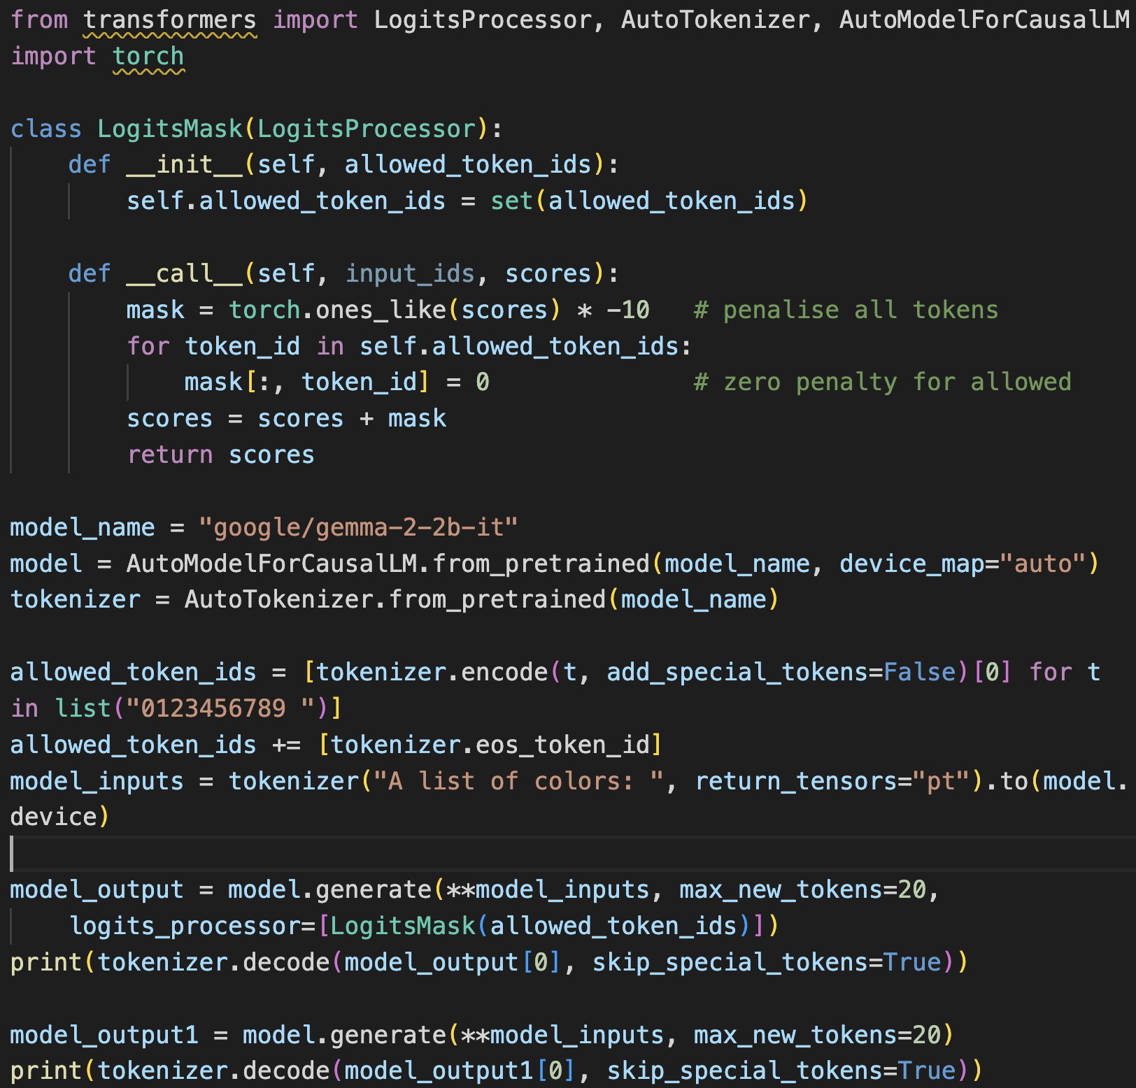
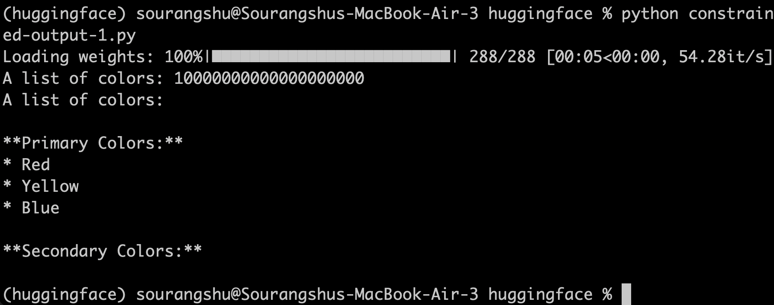
LogitsMask — A Simple Token Allowlist

Slide 72
RegexMask — Constraining to Any Regular Expression
Instead of a fixed allowlist, we test at each step whether appending each vocabulary token keeps the output consistent with a RegEx. The python regex library supports partial matching:
from transformers import LogitsProcessor
import regex, torch
class RegexMask(LogitsProcessor):
def __init__(self, regex_pattern, tokenizer, subtract=torch.inf):
self.regex = regex_pattern
self.tokenizer = tokenizer
self.vocab_map = {tid: tokenizer.decode(tid)
for tid in tokenizer.get_vocab().values()}
self.start_index = 0 # set to prompt length before use
self.subtract = subtract
def __call__(self, input_ids, scores):
# Decode output so far (excluding prompt)
partial = self.tokenizer.decode(input_ids[0, self.start_index:])
allowed = [self.tokenizer.eos_token_id] # always allow EOS
for token_id, token_str in self.vocab_map.items():
# partial=True: match even if string is not yet complete
if self.regex.match(partial + token_str, partial=True):
allowed.append(token_id)
mask = -self.subtract * torch.ones_like(scores)
for tid in allowed:
mask[:, tid] = 0
scores = scores + mask
return scores
vocab_map
Pre-computes the string for every token ID once — avoids repeated decode calls inside the hot loop.
start_index
Offsets into input_ids so we only match the generated output, not the original prompt text.
partial=True
Key! The regex library's partial match returns True if the string is consistent with the pattern so far — not yet complete.
EOS always allowed
Model can stop generation at any point, even if the current output doesn't yet satisfy the full regex.

Slide 73
Partial Regex Matching
Standard re.match() fails on incomplete strings. The regex library's partial=True returns a match if the string is consistent with the pattern so far:
import regex
# URL regex (allows optional leading space for token boundary)
regex_http = regex.compile(r" ?https?:\/\/(www\.)?\w{1,256}\.\w{1,6}\/?$")
# Standard match: FAILS on incomplete URL
regex_http.match("http://test.")
# >> None ← because "http://test." is not yet a complete valid URL
# Partial match: SUCCEEDS — "http://test." could still become valid
regex_http.match("http://test.", partial=True)
# >> <regex.Match object; span=(0,12), match='http://test.', partial=True>
Why partial matching?
regex vs re — key difference
At step 5 we've output 'http://' — this isn't a complete URL but tokens like 'www' should still be allowed.
Python's built-in re module does NOT support partial matching. Install the regex package: pip install regex
Wiring RegexMask into model.generate():
rm = RegexMask(regex_http, tokenizer)
rm.start_index = len(tokenizer.encode(prompt)[0]) # skip the prompt
output = model.generate(**model_inputs, max_new_tokens=50, logits_processor=[rm])

Slide 74
URL Generation — Constrained vs Unconstrained
Prompt: "One of the most common web addresses is:"
✗ Unconstrained Output
✓ Constrained Output
One of the most common web
addresses is:
www.google.com
This is a well-known and
widely used search engine...
One of the most common web
addresses is: http://www.google.com
RegEx used:
?https?:\/\/(www.)?\w{1,256}\.\w{1,6}\/?$
↑ note leading ' ?' for token space
✗ No 'http://' prefix
✓ Correct http:// prefix enforced
✗ Unnecessary blank line
✓ Domain format validated
✗ Extra text after URL
✓ No trailing prose

Slide 75
Multinomial Sampling — Many Valid Outputs
Constrained generation works with both greedy and multinomial (random) sampling. The same regex constraint applied with do_sample=True produces diverse yet always-valid URLs:
#1 http://www.example.com/
#2 http://www.google.com
#3 http://www.somewebsite.com/path/to/file
#4 http://www.google.com/search
#5 https://www.google.com/
#6 http://localhost.com
#7 https://www.google.com/maps/search/
#8 http://www.google.com/search?hl=en
All outputs satisfy the regex — diversity comes from multinomial sampling, validity is guaranteed by the logit mask.

Slide 76
Question
Which of the following is not enforced by the LogitsProcessor?
Only allowed token are generated.
Some of the allowed token are generated preferentially.
The output follows the input Grammer completely.
Partial Matches from Nested grammers

Slide 77
Answer
Which of the following is not enforced by the LogitsProcessor?
Only allowed token are generated.
Some of the allowed token are generated preferentially.
✓
The output follows the input Grammer completely.
Partial Matches from Nested grammers
Why
A LogitsProcessor enforces a hard constraint: at each step it masks out (sets to -inf) any token not allowed by the grammar, so only valid tokens can be sampled and the final output follows the grammar completely. It does not reweight or prefer among the tokens that remain allowed — the relative ordering there still comes from the model's own logits, not from the processor.

Slide 78
LogitsProcessor vs Structured Decoding
Why token-by-token masking falls short
LogitsProcessor
Structured Decoding
Correctness
Grammar/parse state ensures every token keeps output on a valid path
No lookahead — can paint itself into a corner mid-sequence
Abstraction
Specify a JSON schema or regex; the library handles token-level details
You reason in tokens: BOS collisions, multi-token digits, context sensitivity
State awareness
Live DFA tracks parse state — allowed tokens change as output grows
Same mask regardless of what has been generated so far
Prohibition
Precomputed token masks per grammar state — forbidden tokens truly impossible
Soft penalty (–10) can be overcome by strong logits; –inf risks NaN
Use LogitsProcessor for simple flat constraints (digits-only, yes/no). Use structured decoding when grammar correctness matters (JSON, nested schemas, regex).

Slide 79
How OpenAI Structured Decoding Ensures Valid JSON Output
Core Idea Structured decoding constrains token generation so that every step remains consistent with a predefined JSON schema.
1
Schema-Constrained Token Selection
2
Incremental Parsing (Prefix Validity)
3
Finite-State / Automaton Guidance
Only tokens keeping output valid under the schema are allowed at each step.
Invalid continuations (missing quotes, wrong brackets) are pruned before sampling.
Partially generated output is continuously checked against JSON grammar + schema.
Ensures proper nesting of {}, [], correct key-value structure, and type consistency.
Schema compiled into a state machine; decoding follows valid transitions only.
e.g., after "key": → must produce a valid value; after value → must produce , or }
4
Type Enforcement
5
Required Fields Tracking
6
Controlled Termination
"age" → only numeric tokens allowed; "name" → must be a string.
Prevents semantic invalidity, not just syntax errors.
Decoder tracks which required fields are still missing.
Prevents early termination until all required keys are generated.
Generation stops only when JSON is syntactically complete.
All schema constraints must be fully satisfied before output ends.
Result: Always produces syntactically valid JSON and schema-compliant structure. Eliminates need for post-hoc parsing fixes or retries.

Slide 80




Thank you
Teaching Assistants (IITKGP)
Instructor
Suman Bera
Debamalya Chakrabarty
Sagnik Basu
Sourangshu Bhattacharya
sourangshu@cse.iitkgp.ac.in

