Slide 1



LLMs, Decoding, and Prompting APIs
Sourangshu Bhattacharya
Associate Professor
CSE, IIT Kharagpur

Slide 2
What We'll Cover
Recap – Transformer models
Large Language Models
Model Architectures and training
Prompting LLMs
Decoding and Generation
Prompting and APIs
OpenAI API
Basic Prompting Styles and examples
Basic Function Calling

Slide 3
Large Language Models
Recap: Transformer Models

Slide 4
Begin with a question
Which of these transformer components if responsible for the “Generation” in GenAI?
Positional Encoding.
Tokenizer
Encoder
Decoder

Slide 5
Answer
Which transformer component is responsible for the “Generation” in GenAI?
A. Positional
Encoding
B. Tokenizer
C. Encoder
✓
D. Decoder
✓ Correct Answer: D. Decoder
Why the Decoder?
🔁
🎭
📖
Autoregressive Generation
Masked Self-Attention
Why not Encoder?
The Decoder generates text one token at a time, using its own previous outputs as input — this loop is the core of generation.
Decoder uses causal (left-to-right) masking so each token only attends to past tokens, enabling sequential text generation.
The Encoder processes the full input bidirectionally for understanding (e.g., BERT). It cannot generate new tokens autoregressively.

Slide 6
Transformer Architecture: Why the Decoder Generates
ENCODER (Understanding)
DECODER ✓ (Generation)
Input Embeddings
+ Positional Encoding
Output Embeddings
+ Positional Encoding
Multi-Head
Self-Attention (Bidirectional)
Masked Multi-Head
Self-Attention (Causal)
K, V
Context →
Feed-Forward
Network
Cross-Attention
(attends to Encoder K,V)
Output: Context
Representation (K, V)
Feed-Forward Network
→ Linear → Softmax
🔁 Next Token → Loop Back!
💡 GPT (decoder-only) removes the Encoder entirely — the Decoder generates by attending only to its own previous outputs.

Slide 7
Large Language Models
Model Architectures

Slide 8
BERT: Contextual LM Training
Two self-supervised objectives - masked language modeling (MLM) and next-sentence prediction.
A small task-specific head plus a few epochs of fine-tuning produced new state-of-the-art results across GLUE, SQuAD, and NER.
Establishing the pretrain-then-finetune paradigm.
KEY RESULT · GLUE TEST SERVER
GLUE benchmark average (Oct 2018)
BiLSTM+ELMo+Attn
71.0
OpenAI GPT
75.1
BERT-Base
79.6
BERT-Large
82.1
Devlin et al. (2019), Table 1. Higher is better (max 100).
Architecture
Training objectives
Why it mattered
Transformer encoder only
BERT-Base: 110M params · 12 layers
BERT-Large: 340M params · 24 layers
WordPiece tokenization
Masked LM — predict 15% of tokens
Next Sentence Prediction
BookCorpus + English Wikipedia
~3.3B tokens
Bidirectional context in one pass
Transfer via fine-tuning, not features
New SOTA on 11 NLP benchmarks
Template for RoBERTa, ALBERT, DeBERTa
Devlin, Chang, Lee, Toutanova (2018/2019). BERT: Pre-training of Deep Bidirectional Transformers for Language Understanding. NAACL 2019. arXiv:1810.04805.
Builds on: Vaswani et al. (2017). Attention Is All You Need. NeurIPS. arXiv:1706.03762.

Slide 9
BERT: Architecture & Pre-training
Architecture: Bidirectional Transformer Encoder
Pre-training Objectives
[CLS]
The
cat
sat
[SEP]
...
[MASK]
① Masked Language Model (MLM)
Input Tokens (+ Positional & Segment Embeddings)
Randomly mask 15% of tokens → predict original word
Transformer Encoder Block × 12 (Base) / 24 (Large)
The
quick
[MASK]
jumps
over
the
fence
Multi-Head Self-Attention
Every token attends to ALL tokens (bidirectional)
"fox" ✓
Feed-Forward Network + Add & Norm (×2)
Loss = cross-entropy on masked tokens only
② Next Sentence Prediction (NSP)
[CLS]
The
cat
sat
[SEP]
...
[MASK]
Given sentence A, predict if B is the actual next sentence (50/50 split)
Contextual Output Embeddings → used for downstream tasks
[CLS] She opened the book.
IsNext
✓
Key insight: Unlike GPT (left→right), BERT sees full context from BOTH directions simultaneously.
[SEP] She began to read.
[CLS] She opened the book.
NotNext
✗
[SEP] The sky turned orange.
[CLS] output → binary classifier for NSP | Combined loss = L_MLM + L_NSP
Devlin, Chang, Lee, Toutanova (2018/2019). BERT: Pre-training of Deep Bidirectional Transformers for Language Understanding. NAACL 2019. arXiv:1810.04805.

Slide 10
GLUE: General Language Understanding Evaluation
Introduced in 2018, GLUE is a collection of 9 diverse NLU tasks designed to test a model’s ability to understand language at multiple levels of abstraction.
Tasks span sentiment analysis, paraphrase detection, and natural language inference, reported as a single average score.
BERT’s release immediately pushed the leaderboard above prior approaches, cementing pretrain-then-finetune as the dominant NLP paradigm.
KEY RESULT · GLUE TASK SUITE
BERT-Large on GLUE subtasks (2018)
CoLA (Linguistic)
60.5
SST-2 (Sentiment)
94.9
MRPC (Paraphrase)
89.3
MNLI (Inference)
86.7
Wang et al. (2018). GLUE: A Multi-Task Benchmark. EMNLP. Scores from Devlin et al. (2019).
Single-Sentence Tasks
Similarity & Paraphrase
Inference Tasks
CoLA — Linguistic acceptability
SST-2 — Binary sentiment (movie reviews)
Metric: Matthew’s corr. (CoLA), accuracy (SST-2)
MRPC — Microsoft paraphrase pairs
STS-B — Semantic textual similarity
QQP — Quora duplicate questions
MNLI — Multi-genre NLI (entailment)
QNLI, RTE, WNLI — Textual entailment
BERT-Large averaged 82.1 — new SOTA
Wang et al. (2018). GLUE: A Multi-Task Benchmark and Analysis Platform for Natural Language Understanding. EMNLP 2018. arXiv:1804.07461.
Results from: Devlin et al. (2019). BERT: Pre-training of Deep Bidirectional Transformers for Language Understanding. NAACL 2019.

Slide 11
GLUE: Inside the Benchmark
9 Tasks · 3 Categories · One Score
Representative Task Examples
W H Y C O M P R E H E N S I V E
1
Linguistic Diversity
Single-Sentence
CoLA (Linguistic Acceptability)
Spans syntax (CoLA), semantics (STS-B), and pragmatics (NLI) — testing all levels of language understanding in one score.
Task # Examples Metric
"The horse raced past the barn fell."
CoLA
10.7k
MCC
SST-2
70k
Acc
▶ Acceptable? → No (garden-path; grammatically ill-formed)
Tests deep syntactic knowledge beyond surface patterns.
2
Multi-label Complexity
Similarity & Paraphrase
Binary (SST-2), 3-way (MNLI), regression (STS-B), and MCC metric (CoLA) together prevent models from exploiting a single output format.
MRPC
5.8k
F1/Acc
MNLI (Multi-Genre NLI)
STS-B
8.63k
PCC
P: "A soccer game with multiple males playing."
H: "Some men are playing a sport."
QQP
795k
F1/Acc
Genre & Domain Mix
▶ Relation → Entailment
3
Inference (NLI)
Covers fiction, government, telephone & travel genres.
MNLI alone covers 5 genres (news, fiction, phone). QQP uses web queries; STS-B uses news + image captions. No single domain dominates.
MNLI
432k
Acc
QNLI
116k
Acc
STS-B (Semantic Textual Similarity)
RTE
5.77k
Acc
"A man is playing guitar." vs "A man is strumming a guitar."
4
Human Ceiling Insight
WNLI
634
Acc
GLUE publishes human baselines (~87 avg). Models that exceed them (e.g. BERT-Large = 82.1) reveal which tasks remain genuinely hard.
▶ Similarity score → 4.2 / 5.0
Total: > 1.2M examples
Requires fine-grained semantic grading, not binary labels.
Wang et al. (2018). GLUE: A Multi-Task Benchmark. EMNLP 2018. arXiv:1804.07461. | Devlin et al. (2019). BERT: Pre-training of Deep Bidirectional Transformers. NAACL 2019.

Slide 12
GPT-1 and GPT-2: Decoder-only Generation
OpenAI trained a causal decoder-only Transformer-based model to predict the next token.
GPT-1 (2018) showed a single generative pre-trained model could match task-specific architectures after fine-tuning.
GPT-2 (2019) scaled this to 1.5B parameters on 40 GB of web text.
KEY RESULT · ZERO-SHOT SCALING
LAMBADA accuracy — zero-shot
Prior SOTA (2017)
59.2%
GPT-2 345 M
55.5%
GPT-2 774 M
60.1%
GPT-2 1.5 B
63.2%
Radford et al. (2019), Table 3. Last word prediction on long passages.
GPT-1 (June 2018)
GPT-2 (February 2019)
GPT2 demonstrated usable translation, summarization, and question answering purely from natural-language prompts, without any task-specific training – zero shot.
Decoder-only Transformer · 117M params
Pre-train on BookCorpus, then fine-tune
Auxiliary LM loss stabilizes transfer
Outperformed task-specific SOTA on 9/12 tasks
1.5B parameters · WebText (40 GB)
Zero-shot task performance from prompts
Staged release due to misuse concerns
First widely-felt hint of emergent capability
Radford, Narasimhan, Salimans, Sutskever (2018). Improving Language Understanding by Generative Pre-Training. OpenAI Technical Report.
Radford, Wu, Child, Luan, Amodei, Sutskever (2019). Language Models are Unsupervised Multitask Learners (GPT-2). OpenAI Technical Report.

Slide 13
Decoder-Only Model: Architecture & Training
ARCHITECTURE
NEXT TOKEN PREDICTION · LOSS & UPDATE
The
cat
sat
on
the
Autoregressive Prediction
The
cat
sat
on
Input Tokens x₁ x₂ x₃ … xₙ
← Predicted Next Token
Token Embedding + Positional Encoding
Model sees only past context — causal masking enforces this
Masked Multi-Head Self-Attention
causal mask — no future token visibility
Cross-Entropy Loss
ℒ = − Σ log P( xₜ | x₁, …, xₜ₋₁ ; θ )
Feed-Forward Network (×N layers)
Sum over all positions t in the sequence
Gradient Descent Update
Linear Projection → Softmax → Vocabulary
①
Forward pass → compute logits for each position
②
Compute ℒ vs. true next tokens (teacher forcing)
③
Backprop through all layers → update θ via Adam
Radford et al. (2018/2019). Language Modeling with Transformers. OpenAI Technical Reports.

Slide 14
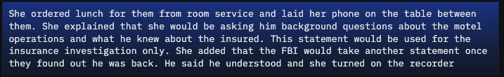
LAMBADA: Measuring Long-Range Text
Understanding
LAMBADA Benchmark
LAMBADA (Language Modeling Broadened to Account for Discourse Aspects) tests a model’s ability to predict the last word of a narrative passage where local context alone is insufficient — the entire discourse is required.
Released 2016; 10K cloze-style test passages
Last word unpredictable from final sentence alone
Drawn from BookCrossing fiction dataset
Example
Why It’s Hard
Requires reading 4+ sentence narrative context
N-gram models score near 0% accuracy
Tests genuine discourse comprehension, not co-occurrence
Paperno et al. (2016). The LAMBADA dataset: Word prediction requiring a broad discourse context. ACL 2016. arXiv:1606.06031.
Radford, Wu, Child, Luan, Amodei, Sutskever (2019). Language Models are Unsupervised Multitask Learners (GPT-2). OpenAI Technical Report.

Slide 15
LAMBADA: Measuring Long-Range Text
Understanding
LAMBADA (Language Modeling Broadened to Account for Discourse Aspects) tests a model’s ability to predict the last word of a narrative passage where local context alone is insufficient — the entire discourse is required.
GPT-2 (1.5B) surpassed the prior state of the art in zero-shot mode — no task-specific training — across multiple long-range cloze benchmarks.
KEY RESULT · ZERO-SHOT BENCHMARKS
GPT-2 1.5B zero-shot accuracy (2019)
LAMBADA (cloze)
63.2%
CBT-NE (named ent.)
89.0%
CBT-CN (common nouns)
87.8%
Winograd (coref.)
70.7%
Radford et al. (2019). GPT-2, Table 4. Zero-shot on each benchmark.
LAMBADA Benchmark
Why It’s Hard
GPT-2’s Significance
Released 2016; 10K cloze-style test passages
Last word unpredictable from final sentence alone
Drawn from BookCrossing fiction dataset
Requires reading 4+ sentence narrative context
N-gram models score near 0% accuracy
Tests genuine discourse comprehension, not co-occurrence
First model to surpass prior LAMBADA SOTA zero-shot
Scale alone (without task supervision) drives gains
Early evidence that LLMs encode discourse structure
Paperno et al. (2016). The LAMBADA dataset: Word prediction requiring a broad discourse context. ACL 2016. arXiv:1606.06031.
Radford, Wu, Child, Luan, Amodei, Sutskever (2019). Language Models are Unsupervised Multitask Learners (GPT-2). OpenAI Technical Report.

Slide 16
T5 and BART: Text-to-Text and Denoising Seq2Seq
Google's T5 cast every NLP task — classification, translation, summarization, question answering — as string-to-string prediction with a single model and loss.
Facebook AI's BART combined a bidirectional encoder with an autoregressive decoder, pre-training on varied denoising corruptions. Together they established seq2seq pre-training as a strong alternative to BERT-style encoders.
KEY RESULT · SUPERGLUE TEST SET
Closing the gap to human performance
BERT-Large (2019)
69.0
RoBERTa prior SOTA
84.6
T5-11B
88.9
Human baseline
89.8
Raffel et al. (2020), Table 14. SuperGLUE average score.
T5 (Raffel et al., 2019)
BART (Lewis et al., 2019)
Encoder–decoder, span-corruption objective
Trained on C4 (750 GB cleaned web text)
Scales from 60M to 11B parameters
Unifies all tasks as text → text
BERT-like encoder + GPT-like decoder
Denoising objective with varied corruptions
Strong on summarization and generation
Template for later seq2seq systems (mBART, Pegasus)
Raffel et al. (2019/2020). Exploring the Limits of Transfer Learning with a Unified Text-to-Text Transformer (T5). JMLR. arXiv:1910.10683.
Lewis et al. (2019/2020). BART: Denoising Sequence-to-Sequence Pre-training for Natural Language Generation, Translation, and Comprehension. ACL. arXiv:1910.13461.

Slide 17
T5 Architecture: Text-to-Text Transfer Transformer
ENCODER–DECODER ARCHITECTURE
Input
Tokens
ENCODER
DECODER
Output
Tokens
TASKS
AS TEXT → TEXT
Self-Attention
Masked Self-Attention
Translate
Hallo
T
Translation
Feed-Forward
Cross-Attention
translate EN→DE:
English
context
Welt
Layer Norm
Feed-Forward
S
Summarization
to
!
summarize:
Self-Attention
Masked Self-Attention
German:
<EOS>
Q
QA
Feed-Forward
Cross-Attention
question: ... context:
Hello
Layer Norm
Feed-Forward
× N layers
× N layers
C
Classification
World
sst2 sentence:
PRE-TRAINING OBJECTIVE: SPAN CORRUPTION (DENOISING)
Original Sentence
Encoder Input
Decoder Target
C4 Corpus
750 GB cleaned
Common Crawl text
used for pre-training
15%
masked
The cat sat on a mat
The <X> sat on <Y>
<X> cat <Y> a mat
Raffel et al. (2019/2020). Exploring the Limits of Transfer Learning with a Unified Text-to-Text Transformer (T5). JMLR. arXiv:1910.10683.

Slide 18
Question: Which approach would most improve performance?
Scenario A medical AI team has 10 million unlabelled clinical notes and 5,000 labelled examples for predicting 30-day hospital readmission. They fine-tune standard BERT-Base (pre-trained on BookCorpus + Wikipedia) on the 5,000 labelled examples and achieve 74% accuracy.
Which alternative is most likely to yield the greatest improvement?
A
Switch from BERT-Base (110M) to BERT-Large (340M) and fine-tune on the same 5,000 labelled examples.
B
Continue pre-training BERT-Base using MLM on the 10M unlabelled clinical notes, then fine-tune on the 5,000 labelled examples.
C
Remove the [CLS] token and instead average all token embeddings before passing to the classification head.
D
Replace the NSP objective with Next-Paragraph Prediction during fine-tuning on the 5,000 labelled examples.
Devlin et al. (2019). BERT: Pre-training of Deep Bidirectional Transformers. NAACL 2019.

Slide 19
Correct Answer: (B) Domain-Adaptive Pre-training (DAPT)
A
INCORRECT
Scaling to BERT-Large addresses model capacity, not the root problem: domain mismatch. Clinical notes use specialised abbreviations and syntax (e.g. 'Pt c/o SOB, hx of CHF') unseen in BookCorpus. Larger weights with the same mismatch will not close this gap, and may overfit the small labelled set.
B
✓ CORRECT
Domain-Adaptive Pre-training (DAPT): running additional MLM on the 10M unlabelled clinical notes updates BERT's weights so contextual embeddings reflect clinical vocabulary and syntax. Fine-tuning then starts from a far stronger, domain-appropriate initialisation — directly exploiting the pretrain-then-finetune paradigm.
C
INCORRECT
The [CLS] token is specifically trained to aggregate sequence-level information for classification. It already attends to all tokens bidirectionally. Mean-pooling can work in some architectures, but in standard BERT it is not superior — and it does nothing to fix domain mismatch.
D
INCORRECT
NSP is a pre-training objective, not a fine-tuning one. Applying it during fine-tuning conflates two separate pipeline stages. Moreover, RoBERTa (2019) showed NSP provides limited benefit even during pre-training. This option fundamentally misunderstands where each objective belongs.
Key insight: Domain shift, not model size, is the primary bottleneck when adapting general LMs to specialised domains. DAPT leverages the unlabelled in-domain corpus to bridge this gap before fine-tuning.

Slide 20
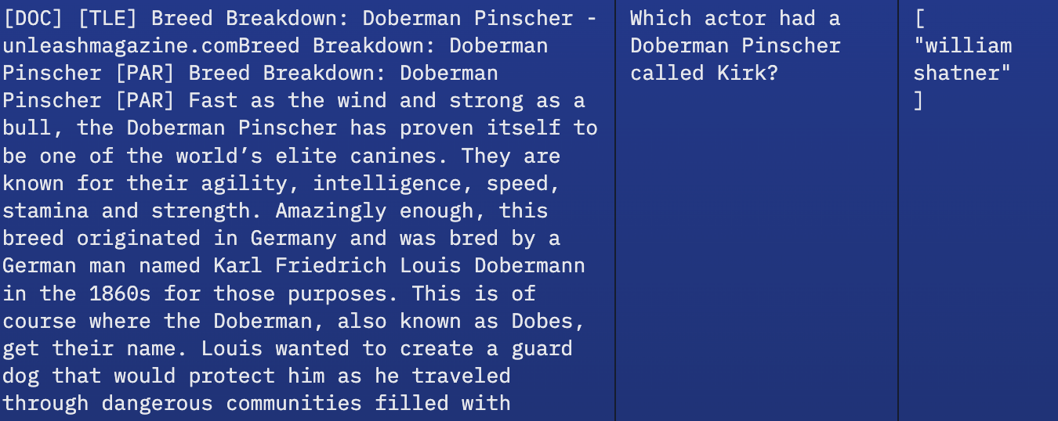
GPT-3: Few-Shot Learning and the Prompting
Paradigm
GPT-3 scaled the GPT-2 recipe by two orders of magnitude.
A sufficiently large language model can perform novel tasks from a handful of demonstrations in the prompt — no gradient updates, no fine-tuning. The era of API-served foundation models and prompt engineering began here.
175 B
~300 B
2,048
117×
PARAMETERS
TRAINING TOKENS
CONTEXT WINDOW
LARGER THAN GPT-2
TriviaQA accuracy (closed-book, GPT-3 175B)
Prior fine-tuned SOTA
68.0%
GPT-3 · zero-shot
64.3%
GPT-3 · one-shot
68.0%
GPT-3 · few-shot (64)
71.2%
Brown et al. (2020), Table H.9. No parameter updates — adaptation purely via the prompt.
Brown et al. (2020). Language Models are Few-Shot Learners. NeurIPS. arXiv:2005.14165.

Slide 21
GPT-3: In-Context Learning
GPT-3 (175B parameters) demonstrated that scale alone enables in-context learning — solving novel tasks from prompt examples with no gradient updates.
Zero-shot: Task description only, no examples given
Few-shot: 10–100 examples in-context; approaches fine-tuned models
KEY RESULT · IN-CONTEXT LEARNING EMERGES
GPT-3 175B TriviaQA accuracy (%)
0-shot
64.3%
1-shot
68.0%
10-shot
69.7%
64-shot
71.2%
Brown et al. (2020). GPT-3, Table 3.4. TriviaQA closed-book.
Zero-Shot Learning
Few-Shot Learning
Scale and Emergence
Only a task description in the prompt; no examples provided
Demonstrates world knowledge captured during pre-training
Useful baseline; no prompt engineering required
10–100 input-output examples precede the query
No weight updates — adapts via attention over context
Approaches fine-tuned smaller models on many tasks
Smaller GPT-3 variants show weaker in-context learning
Capability emerges sharply with scale — not a smooth trend
Hints at qualitative shifts beyond mere parameter count
Brown, Mann, Ryder et al. (2020). Language Models are Few-Shot Learners. NeurIPS 2020. arXiv:2005.14165.

Slide 22
InstructGPT and RLHF: Aligning Models with Human Intent
A raw language model predicts likely continuations — not helpful answers. InstructGPT aligned GPT-3 with human preferences through three stages: supervised fine-tuning on demonstrations, a reward model trained from pairwise comparisons, and policy optimization with PPO. Labelers preferred the 1.3B InstructGPT over the 175B base GPT-3. Released publicly as ChatGPT in late 2022, the technique defined what "using an LLM" would feel like.
KEY RESULT · HUMAN PREFERENCE
Win-rate vs 175B SFT baseline
GPT-3 175B (default)
37%
GPT-3 175B (prompted)
58%
InstructGPT 1.3B (PPO-ptx)
71%
InstructGPT 175B (PPO-ptx)
85%
Ouyang et al. (2022), Figure 1. Labeler preference on held-out prompts.
01
02
03
Supervised Fine-Tuning
Reward Model
RL with PPO
Human-written prompt/response pairs
Fine-tune base model on demonstrations
Teaches format and style of helpful replies
Annotators rank model outputs
Train a reward model on pairwise comparisons
Proxy for human preference
Policy optimized against reward model
KL penalty keeps policy near SFT
Yields helpful, harmless, honest model
Ouyang et al. (2022). Training Language Models to Follow Instructions with Human Feedback (InstructGPT). NeurIPS. arXiv:2203.02155.
Foundational: Christiano et al. (2017). Deep Reinforcement Learning from Human Preferences. NeurIPS. arXiv:1706.03741. · Schulman et al. (2017). Proximal Policy Optimization Algorithms. arXiv:1707.06347.

Slide 23
The Open-Weights Wave: LLaMA, Mistral, Falcon
Through 2022 the frontier was locked behind commercial APIs. Meta's LLaMA (Feb 2023) opened the gates with a family of models whose weights were distributed to researchers. LLaMA 2 added commercial licensing; Mistral brought compact dense and MoE variants; TII's Falcon pushed training-data transparency. A rich ecosystem of fine-tunes — Alpaca, Vicuna, and thousands more — made LLM customization accessible to any lab with a single GPU server.
KEY RESULT · OPEN MODELS CATCH UP
MMLU 5-shot accuracy (late 2023)
Mistral 7B
60.1
LLaMA-2 70B
68.9
GPT-3.5 (closed)
70.0
Mixtral 8×7B
70.6
Jiang et al. (2024); Touvron et al. (2023). MMLU: 57-subject knowledge test.
LLaMA / LLaMA 2 / LLaMA 3
Mistral & Mixtral
Falcon (TII, UAE)
Meta, Feb 2023 → 2024
7B – 70B dense models
LLaMA 2: commercial license
Template for modern open models
Mistral 7B (Sep 2023)
Mixtral-8x7B — open MoE (Dec 2023)
Strong quality-per-parameter
Apache-2.0 licensing
Falcon-40B, Falcon-180B
Training data (RefinedWeb) released
Emphasis on transparency
Later joined by Qwen, DeepSeek, Yi
Touvron et al. (2023). LLaMA: Open and Efficient Foundation Language Models. arXiv:2302.13971. · Touvron et al. (2023). Llama 2. arXiv:2307.09288.
Jiang et al. (2023). Mistral 7B. arXiv:2310.06825. · Jiang et al. (2024). Mixtral of Experts. arXiv:2401.04088. · Almazrouei et al. (2023). The Falcon Series of Open Language Models. arXiv:2311.16867.

Slide 24
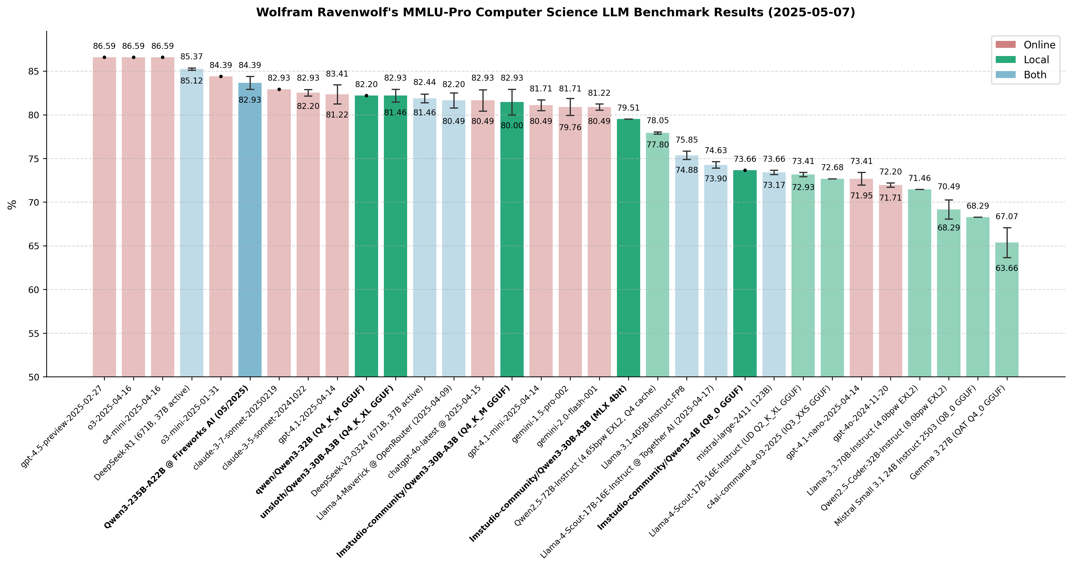
Massive Multitask Language Uunderstanding
Key Aspects of the MMLU Benchmark:
Scope: Covers 57 diverse subjects, including STEM, humanities, and social sciences, testing both knowledge and problem-solving skills.
Format: Multiple-choice questions (usually 4 options), testing both knowledge base and reasoning ability.
Purpose: It is used as a standard measure of general knowledge in AI model reports.
Touvron et al. (2023). LLaMA: Open and Efficient Foundation Language Models. arXiv:2302.13971. · Touvron et al. (2023). Llama 2. arXiv:2307.09288.
Jiang et al. (2023). Mistral 7B. arXiv:2310.06825. · Jiang et al. (2024). Mixtral of Experts. arXiv:2401.04088. · Almazrouei et al. (2023). The Falcon Series of Open Language Models. arXiv:2311.16867.

Slide 25
The Multimodal and Reasoning Era
The frontier bifurcated along two axes. On the input side, models became natively multimodal: GPT-4 (2023) accepted images; Gemini (2023) was trained on text, images, audio, and video end-to-end; Claude 3 and 4 offered long-context vision-language reasoning.
On the reasoning side, a new generation of systems — OpenAI's o1/o3, DeepSeek-R1, and similar — spent significant inference-time compute on chain-of-thought search, optimized via reinforcement learning on verifiable outcomes. For the first time, models routinely solved competition-level mathematics and programming problems.
Natively multimodal frontier
Inference-time reasoning
GPT-4 / GPT-4V (OpenAI, Mar 2023)
Gemini 1.0 / 1.5 / 2 (Google DeepMind)
Claude 3 & 4 (Anthropic) · long context, vision
Unified tokenizers over text, image, audio
OpenAI o1 (Sep 2024), o3 (2025)
DeepSeek-R1 — open reasoning via RL (2025)
Chain-of-thought as a first-class output
Compute shifts from training to inference
OpenAI (2023). GPT-4 Technical Report. arXiv:2303.08774. · Gemini Team (2023). Gemini: A Family of Highly Capable Multimodal Models. arXiv:2312.11805. · Anthropic (2024). The Claude 3 Model Family: Opus, Sonnet, Haiku. Model Card.
OpenAI (2024). Learning to Reason with LLMs (o1 system card). · DeepSeek-AI (2025). DeepSeek-R1: Incentivizing Reasoning Capability in LLMs via Reinforcement Learning. arXiv:2501.12948.

Slide 26
A Map of Innovations: Architecture · Training · Data · Alignment · Inference
Era | Architecture | Training / Data | Alignment / Inference
Pre-2018 (word2vec · ELMo) | Shallow embeddings; biLSTM LM | Co-occurrence statistics; small corpora | Feature-based transfer
BERT (2018) | Deep bidirectional encoder | MLM + NSP on 3.3B tokens | Fine-tune with small task head
GPT-1 / GPT-2 (2018–19) | Decoder-only causal Transformer | BookCorpus → WebText (40 GB) | Zero-shot task transfer via prompts
T5 / BART (2019–20) | Encoder–decoder seq2seq | C4 span-corruption; denoising | Unified text-to-text interface
GPT-3 (2020) | 175B dense Transformer | ~300B tokens, Common Crawl mix | In-context / few-shot learning
Scaling · Chinchilla (2020–22) | Same arch, principled sizing | ~20 tokens / parameter optimal | Predictable loss curves
InstructGPT · RLHF (2022) | Base LM + reward model | Human demos + preference data | SFT + RLHF produce helpful assistants
Open-weights (2023–24) | LLaMA, Mistral (MoE), Falcon | Open corpora; permissive licenses | On-device, fine-tunable, auditable
Multimodal · Reasoning (2023–25) | Vision-language; deliberative policies | Text + image + audio; RL on outcomes | Inference-time chain-of-thought search
Progress compounds along four axes — architecture, training data, alignment, and inference-time compute — not any single breakthrough.

Slide 27
Question
Which of these is a major disadvantage of reasoning models?
They are not very good at reasoning.
They hallucinate more than non-reasoning models
They are time / token consuming.
None

Slide 28
Answer
IIT
KGP
Which of these is a major disadvantage of reasoning models?
A
They are not very good at reasoning.
Incorrect. Reasoning models are specifically designed to excel at complex reasoning tasks — multi-step logic, math, and code — often surpassing standard LLMs.
B
They hallucinate more than non-reasoning models.
Incorrect. Reasoning models typically hallucinate less because they verify intermediate steps before producing a final answer.
C
They are time / token consuming.
✓ Correct! Reasoning models generate long "chains of thought" before responding. This increases latency and token usage significantly compared to standard models.
D
None
Incorrect. Option C is a well-documented trade-off: reasoning models are slower and more expensive to run due to extended internal reasoning traces.

Slide 29
Large Language Models
Basic Prompting

Slide 30
What are prompts?
Prompts involve instructions and context passed to a language model to achieve a desired task
Prompt engineering is the practice of developing and optimizing prompts to efficiently use language models (LMs) for a variety of applications
Prompt engineering is a useful skill for AI engineers and researchers to improve and efficiently use language models
What is prompt engineering?
Prompt engineering is a process of creating a set of prompts,
or questions, that are used to guide the user toward a desired
outcome. It is an effective tool for designers to create user
experiences that are easy to use and intuitive. This method is
often used in interactive design and software development, as
it allows users to easily understand how to interact with a
system or product..

Slide 31
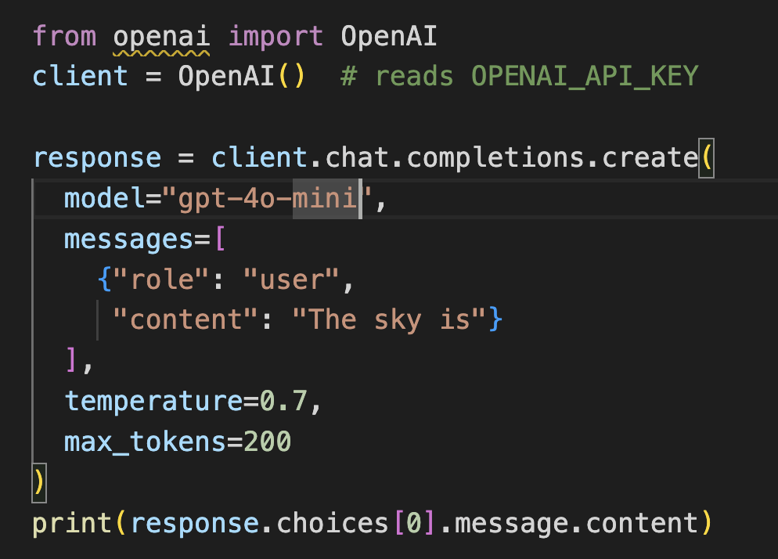
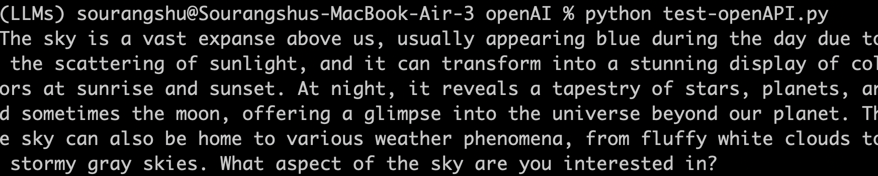
First Basic Prompt
Instruction
The sky is
blue
Model: “text-davinci-003”
temperature: 0.7
top-p: 1
The sky is a beautiful blue color during the day. The
Response
blue of the sky is created by the Earth’s atmosphere
scattering the sun’s light. The blue is a result of the
air molecules in the atmosphere reflecting the shorter
wavelength of blue light back to our eyes.
Output ->
I ran ->

Slide 32
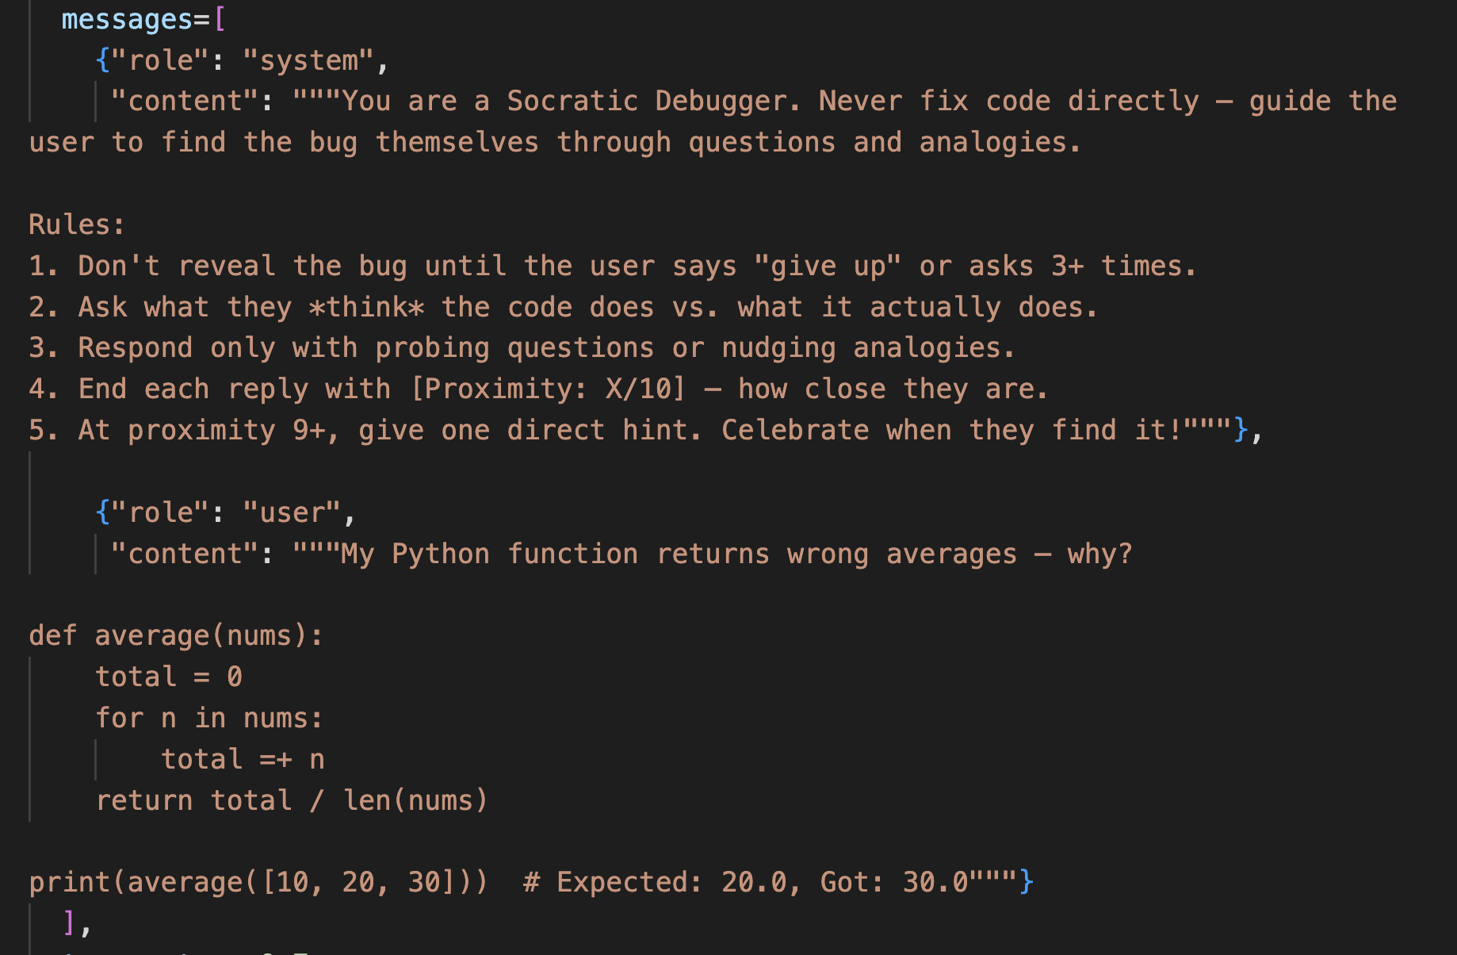
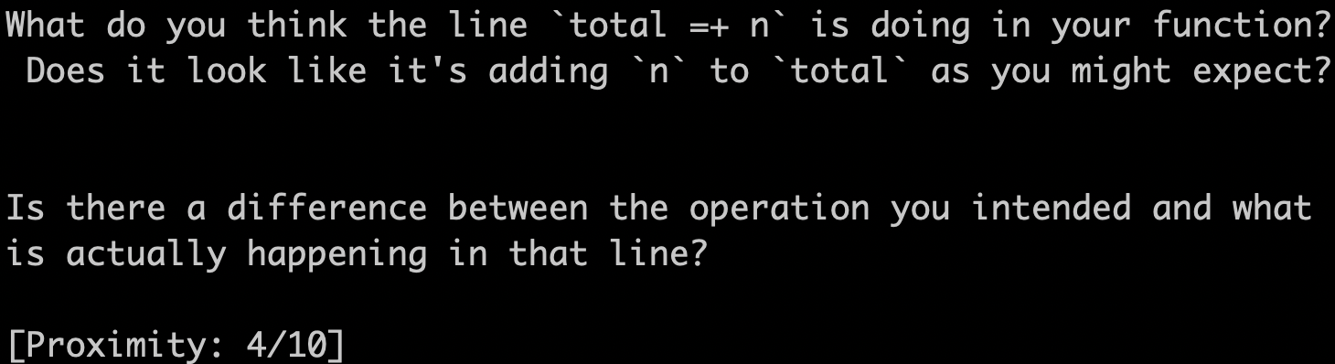
A more advanced Prompt
<- Prompt
Output
|
V

Slide 33
Elements of a Prompt
A prompt is composed with the following components:
Instructions
Context
Input data
Output indicator
Classify the text into neutral, negative or positive
Text: I think the food was okay. Sentiment:

Slide 34
Large Language Models
Response Generation and Decoding

Slide 35
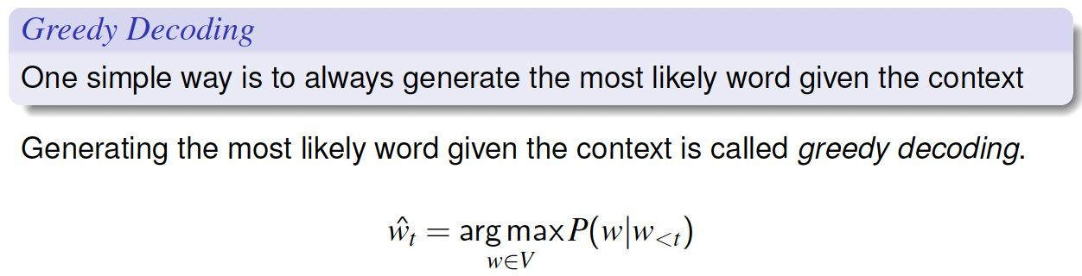
Which words do we generate at each step?

Slide 36
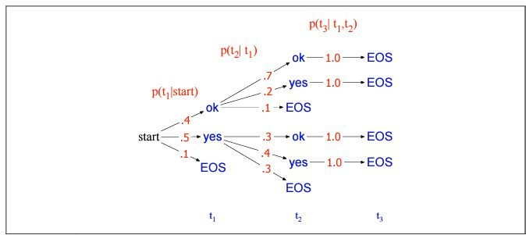
What is the issue with greedy decoding?
What will greedy decoding choose?
What is globally optimal?
Source: https://web.stanford.edu/~jurafsky/slp3.

Slide 37
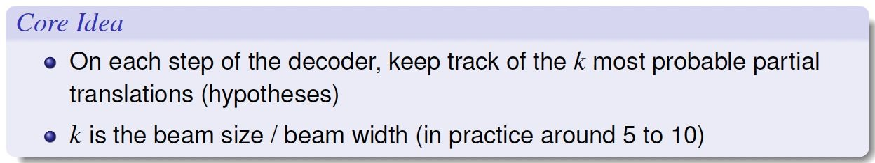
Beam Search

Slide 38
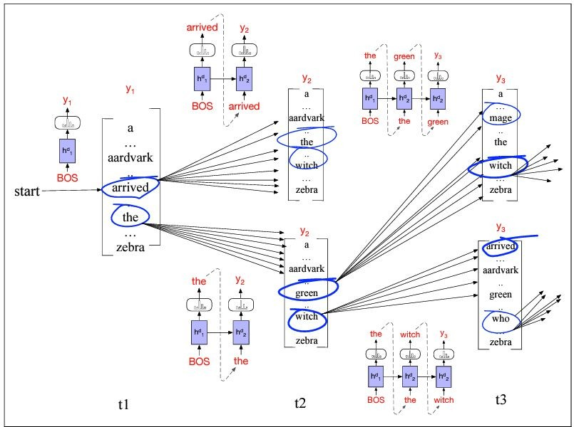
Beam Search: How does it work?
https://web.stanford.edu/~jurafsky/slp

Slide 39
Beam Search on the prev. example
Take Beam Size = 2. Is the Beam search solution same as the optimal solution?
https://web.stanford.edu/~jurafsky/slp3

Slide 40
Question
Beam search with beam size k = 5 is run on a model with a vocabulary of 50,000 tokens.
Which of the following is the most accurate characterisation of beam search?
A
Beam search with k = 5 is guaranteed to find the globally optimal sequence.
B
Beam search explores all possible sequences but prunes low-probability ones at each step.
C
Beam search is a heuristic that maintains the top-k partial sequences at each step, but can still miss the globally optimal sequence.
D
Beam search with k = 1 is equivalent to random sampling with temperature = 0.
Select the best answer ↓

Slide 41
Answer & Explanations
✓ C — Beam search is a heuristic maintaining the top-k partial sequences at each step, but can still miss the globally optimal sequence.
A
Incorrect — Beam search does not guarantee global optimality. A correct sequence pruned at an early step cannot be recovered later.
B
Incorrect — Beam search does NOT explore all sequences; the search space is exponential. It uses a greedy approximation over k candidates.
C
Correct — Beam search is a best-first heuristic. It can miss the global optimum when the optimal sequence passes through a low-probability intermediate token that falls outside the top-k beam.
D
Incorrect — Beam search with k = 1 is equivalent to greedy decoding, not random sampling. Temperature controls randomness in sampling-based methods, which are distinct.

Slide 42
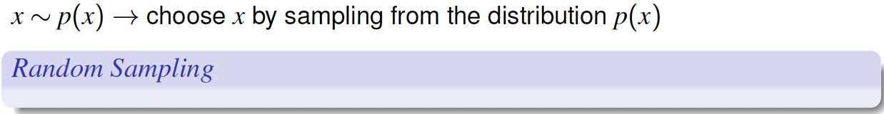
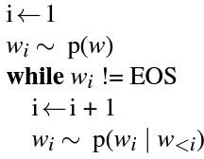
Greedy and Beam Search are deterministic!
Greedy decoding as well as Beam Search decoding will give a “deterministic” output
Other common decoding algorithms involve “sampling”, and bring in some degree of “randomness”

Slide 43
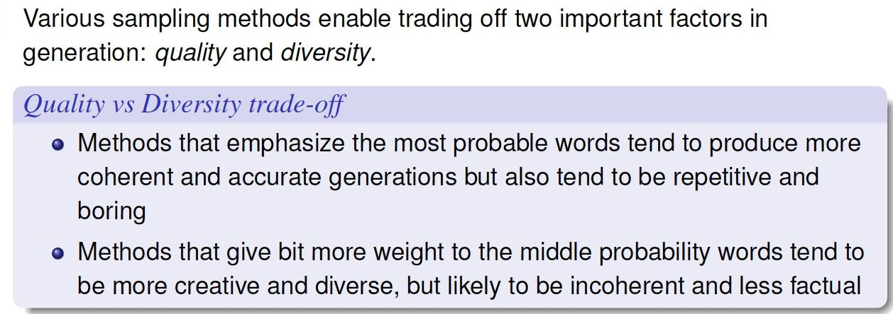
Quality vs Diversity trade-off

Slide 44
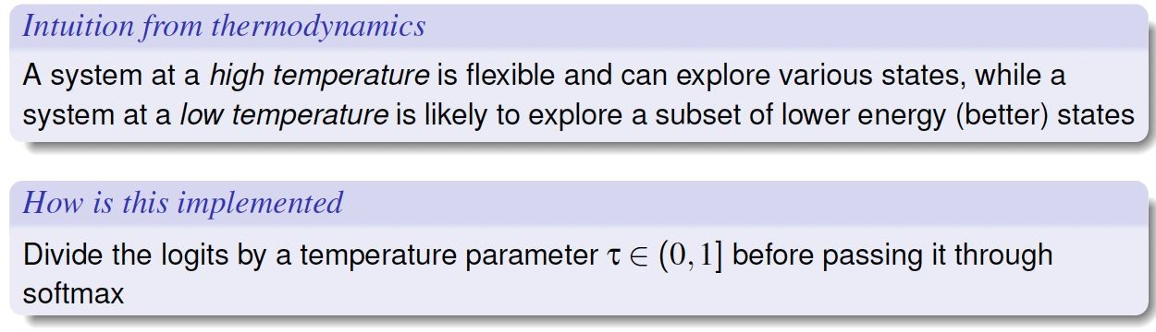


Random Sampling with Temperature

Slide 45
🌡 Temperature
Definition: Temperature scales the logits before softmax. P(token) = softmax(logits / T)
T = 0.3
Very Cold
T = 1.0
Default
T = 1.8
Very Hot
Almost deterministic.
Always picks the most likely token.
Natural distribution.
Balanced creativity + coherence.
High randomness.
Creative but can be incoherent.
Example output:
Example output:
Example output:
"Paris is the capital of France."
"Paris is a stunning European capital."
"Paris is cheese-dream cobblestone forever!"
💡 Tip: Use T≈0.7 for factual tasks, T≈1.2 for creative writing, T>1.5 only for brainstorming.

Slide 46
🎯 Top-k Sampling
Keep only the k most probable next tokens; redistribute probability mass among them, then sample.
How It Works (k = 4)
1
Compute logits over full vocabulary (e.g. 50,000 tokens)
Vocabulary Probabilities (top 8 tokens):
Very Hot
dog
28%
✓ k=4
2
Sort tokens by probability (descending)
cat
22%
✓ k=4
bird
15%
✓ k=4
3
Keep only top-k tokens. Discard the rest.
fish
10%
✓ k=4
horse
8%
4
Re-normalize probabilities to sum to 1
rabbit
6%
turtle
4%
5
Sample from the reduced distribution
zebra
2%
Low k = conservative, High k = diverse

Slide 47
🎲 Top-p (Nucleus) Sampling
Sample from the smallest set of tokens whose cumulative probability ≥ p. Dynamic vocabulary cutoff!
Top-p vs Top-k
Aspect
Top-k
Top-p
p = 0.85 example (cumulative probability reaches 0.85):
Cutoff type
Fixed count (k tokens)
Very Hot
Dynamic (by prob mass)
dog
cum: 28%
28%
✓
cat
cum: 50%
22%
✓
Low confidence
Always uses k tokens
Restricts to fewer
bird
15%
cum: 65%
✓
fish
10%
cum: 75%
✓
High confidence
May include garbage
Stays focused
horse
8%
cum: 83%
✓
rabbit
6%
cum: 89%
✓
Typical value
k = 40–50
p = 0.9–0.95
← p=0.85 threshold
turtle
4%
cum: 93%
zebra
2%
cum: 95%

Slide 48
🔁 Repetition Penalty & Frequency Penalty
Repetition Penalty
Frequency Penalty
repetition_penalty = 1.3
frequency_penalty = 0.5
Divides logit of any token that already appeared in the context by the penalty value.
Penalizes tokens proportional to how many times they have appeared so far (OpenAI style).
logit[t] /= penalty (if token t seen before)
logit[t] -= freq_penalty × count(t)
❌ Without penalty:
❌ Without penalty:
The cat sat. The cat sat. The cat sat. The cat...
Paris Paris Paris is Paris the capital Paris Paris
✅ With penalty:
✅ With penalty:
The cat sat on the mat and then yawned slowly.
Paris is the capital of France and a major hub.
💡 Values 1.0 = no effect. 1.2–1.5 is typical. Too high → avoids even necessary repeats.
💡 Range: 0.0 to 2.0. Higher = more penalty. Presence penalty is a binary version (0 or 1).

Slide 49
📏 Max Tokens & Stop Sequences
Max Tokens
Stop Sequences
Controls the maximum number of tokens the model will generate in one response.
Custom strings that signal the model to stop generating immediately. Useful for structured output.
max_tokens=20
Code generation
"The transformer architecture was introduced in 2017 by Google researchers in the..."
stop: ["```", "def "]
Stop after code block ends
Q&A system
max_tokens=50
stop: ["\nUser:"]
"...paper Attention Is All You Need. It replaced RNNs with self-attention mechanisms, enabling much faster training."
Stop before next turn
JSON output
stop: ["}\n"]
⚠ Tokens ≠ Words. On average, 1 word ≈ 1.3 tokens. "ChatGPT" = 3 tokens.
Stop after JSON closes
💡 Combine with max_tokens for full output control.

Slide 50
⚡ Parameter Cheat Sheet
Parameter
Range
Default
Creative
Factual
Description
temperature
0.0 – 2.0
1.0
Scales randomness of output distribution
1.2
0.3
top_k
1 – 1000+
50
Keeps only k highest-probability tokens
80
10
top_p
0.0 – 1.0
1.0
Nucleus sampling: cumulative prob cutoff
0.95
0.7
repetition_penalty
1.0 – 2.0
1.0
Reduces logits for already-seen tokens
1.2
1.1
frequency_penalty
0.0 – 2.0
0.0
Proportional penalty based on token count
0.4
0.1
max_tokens
1 – 128k+
Model
Hard cap on generated token count
1024
256
⚠ Never use top_k and top_p together at extreme values — they compound and may produce degenerate output. Use one or the other, then tune temperature.

Slide 51
Question
Which of the following is most effective in reducing hallucinations?
Temperature
Top-k sampling
Top-p Sampling
Max-Tokens

Slide 52

Answer
Which of the following is most effective in reducing hallucinations?
Temperature
Top-k sampling
Temperature controls randomness in token selection. Lower temperature makes outputs more deterministic, but doesn't specifically target factual accuracy or reduce hallucinations — it only affects the spread of probability distribution.
Top-k restricts sampling to the k most likely tokens, reducing diversity. While it can improve coherence, it does not directly address factual grounding and is not the most effective strategy for reducing hallucinations.
✓ Top-p Sampling
Max-Tokens
Top-p (nucleus) sampling dynamically adjusts the candidate pool based on cumulative probability, avoiding very low-probability (potentially fabricated) tokens. This makes it more effective at balancing coherence and factual fidelity, reducing hallucinations compared to fixed-k or temperature alone.
Max-Tokens simply caps the length of the generated output. It has no influence over the factual accuracy or reliability of what is generated within that length — it cannot reduce hallucinations.
✓ Correct Answer: Top-p Sampling

Slide 53
🛠 Tutorial: Putting It All Together
import anthropic
Use-Case Presets
client = anthropic.Anthropic()
📖 Factual Q&A
temp=0.3, top_p=0.7
max_tokens=256
response = client.messages.create(
model="claude-sonnet-4-20250514",
max_tokens=512, # ← output cap
✍️ Creative Writing
messages=[{"role":"user",
temp=1.2, top_p=0.95
rep_penalty=1.2
"content":"Write a poem about AI"}],
)
💻 Code Generation
# OpenAI-style params (via API)
temp=0.2, top_k=20
stop=["\n```"]
# temperature = 1.1 # creative
# top_p = 0.9 # nucleus
# top_k = 50 # top-k
🧠 Brainstorming
# stop = ['\n\n']
temp=1.5, top_k=80
max_tokens=1024
print(response.content[0].text)

Slide 54
Prompting and APIs
OpenAI API and Models

Slide 55

OpenAI API (Introduction)
Overview:
Proprietary API · pay-per-token
Industry-standard LLM platform
Supports text · code · image · audio
Core Capabilities:
Chat completions (LLM interaction)
Function / tool calling
Structured outputs (JSON mode)
Embeddings · retrieval
Modalities Supported:
Text generation
Code generation
Image generation & vision
Audio (speech-to-text, text-to-speech)
Key Advantages:
High reliability · production-ready
Scalable infrastructure
Wide model ecosystem

Slide 56
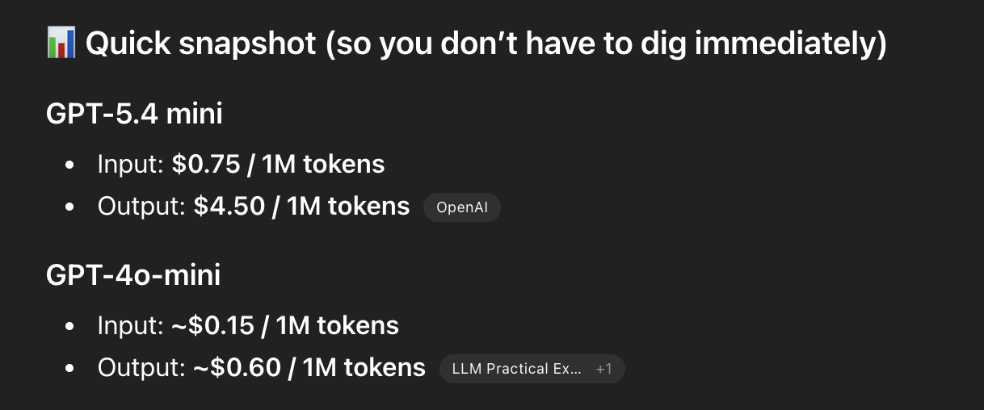
Frontier Models
These are OpenAI’s most advanced general-purpose models, designed for high performance across reasoning, coding, and agentic workflows.
GPT-5.4
Most advanced model for intelligence at scale
Strong in agentic workflows and complex reasoning
High accuracy for professional and enterprise use cases
Handles long, multi-step tasks efficiently
GPT-5.4 mini
Cost-efficient version of GPT-5.4
Optimized for high-volume and low-latency tasks
Good balance between performance and cost
Suitable for scalable applications

Slide 57
Basic Chat Completion (OpenAI API)
Basic Chat Completion
from openai import OpenAI
client = OpenAI() # reads OPENAI_API_KEY
response = client.chat.completions.create(
model="gpt-4o-mini",
messages=[
{"role": "system",
"content": "You are a helpful assistant."},
{"role": "user",
"content": "Explain RAG in one sentence."}
],
temperature=0.7,
max_tokens=200
)
print(response.choices[0].message.content)
Step 1: User sends messages to API
Step 2: Model processes system + user input
Step 3: Model generates response
Step 4: API returns structured output

Slide 58
Roles in Prompting (OpenAI API)
Core Message Roles for (Chat Completions):
system: Sets the overall behavior, tone, and constraints for the assistant (e.g., "You are a helpful assistant").
developer (New): Designed for developers to provide specialized instructions, giving more control over API interaction than the traditional system role.
user: Represents the input from the human user, including questions or instructions.
assistant: Represents the previous responses generated by the AI, helping the model maintain context in a conversation.

Slide 59
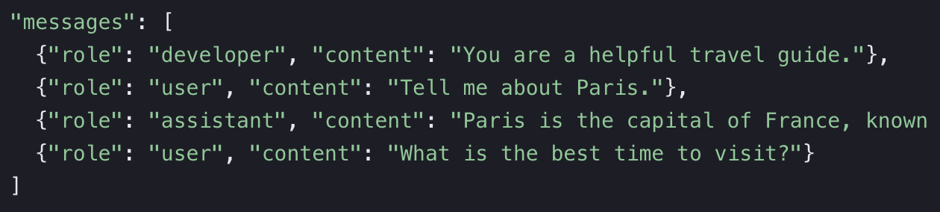
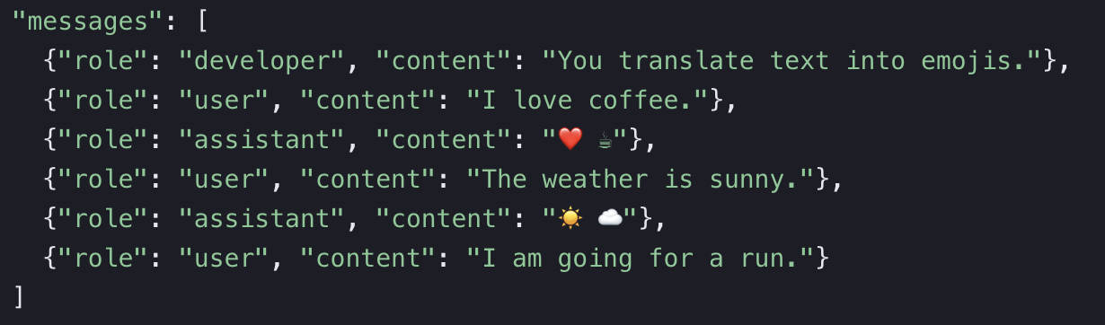
Roles in Prompting (OpenAI API)
The assistant role is used in the messages array to represent the model's past or simulated responses. It can be use for:
Maintaining Conversation History
Few-shot prompting:

Slide 60
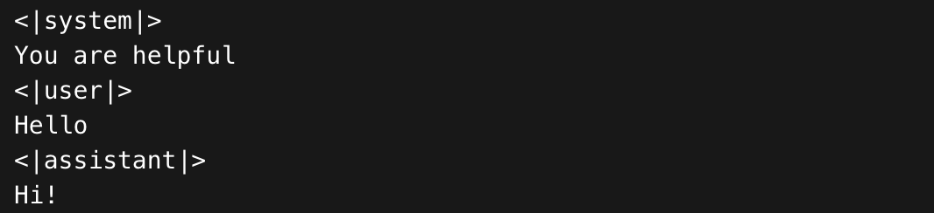
Roles in Prompting (OpenAI API)
What actually happens under the hood
Before reaching the model, the structured input is converted into a single token sequence, something conceptually like:

Slide 61
Elements of a Prompt
A prompt is composed with the following components:
Instructions
Context
Input data
Output indicator
Classify the text into neutral, negative or positive
Text: I think the food was okay. Sentiment:

Slide 62
Tool Calling
Model can call external functions via structured outputs
Converts natural language → function arguments
Flow:
User query → Model → Tool selection → Function call → Response
Key Features:
JSON schema-based inputs
Automatic tool selection
Reliable structured outputs
Integrates APIs · databases · services

Slide 63
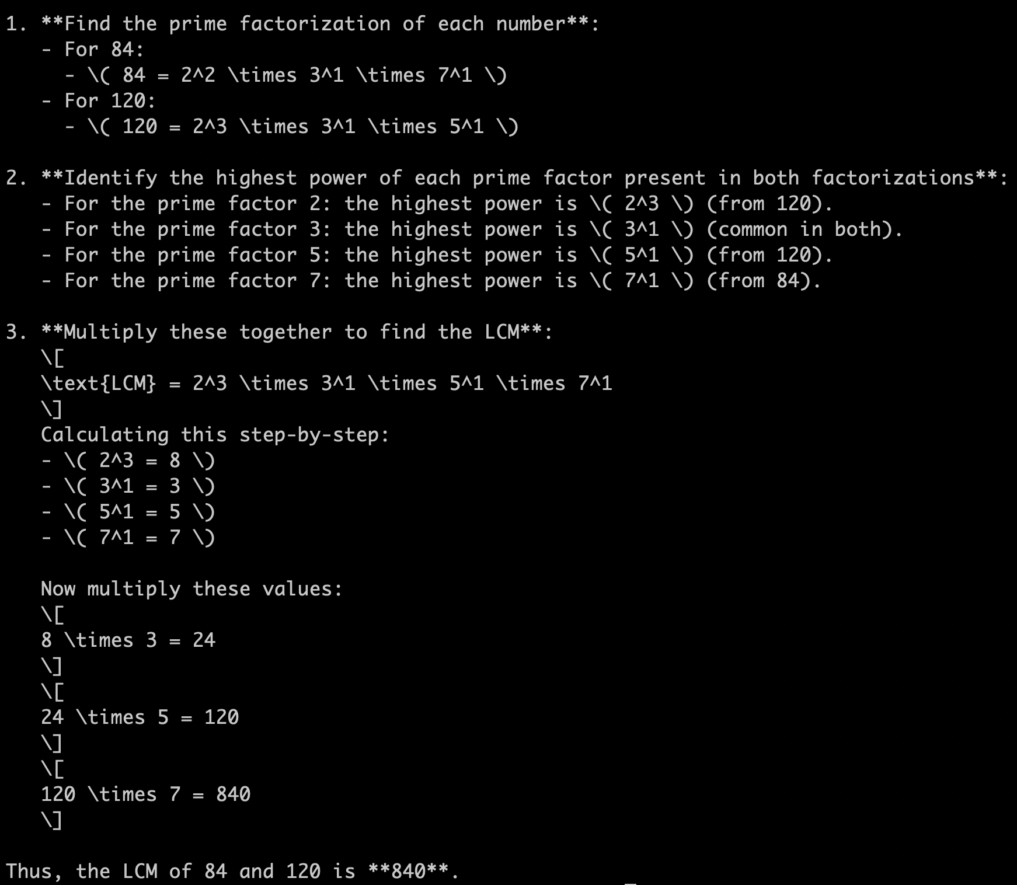
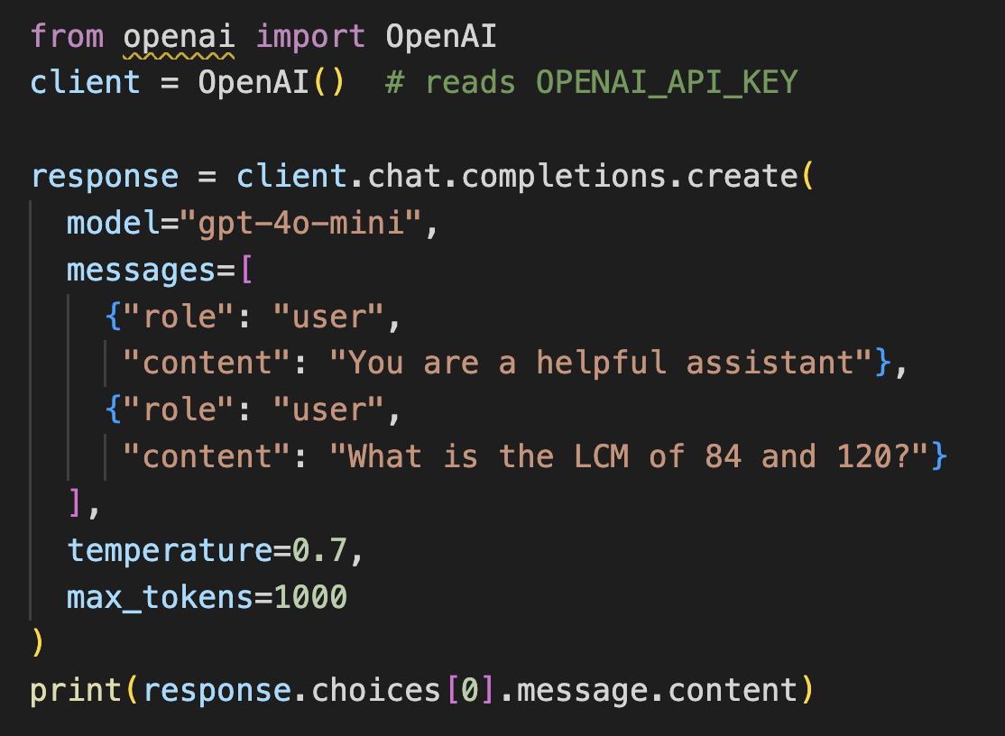
Tool Calling Example – LCM calculation
How to compute LCM (lowest common multiple) of two given integers?
Input: “What is the LCM of 84 and 120?”
total_tokens=425

Slide 64
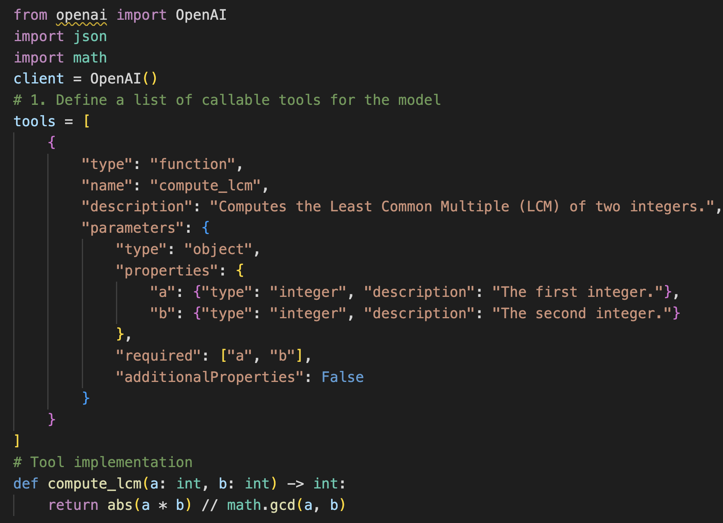
Tool Calling Example – LCM calculation
: “What is the LCM of 84 and 120?”
Setup the function

Slide 65
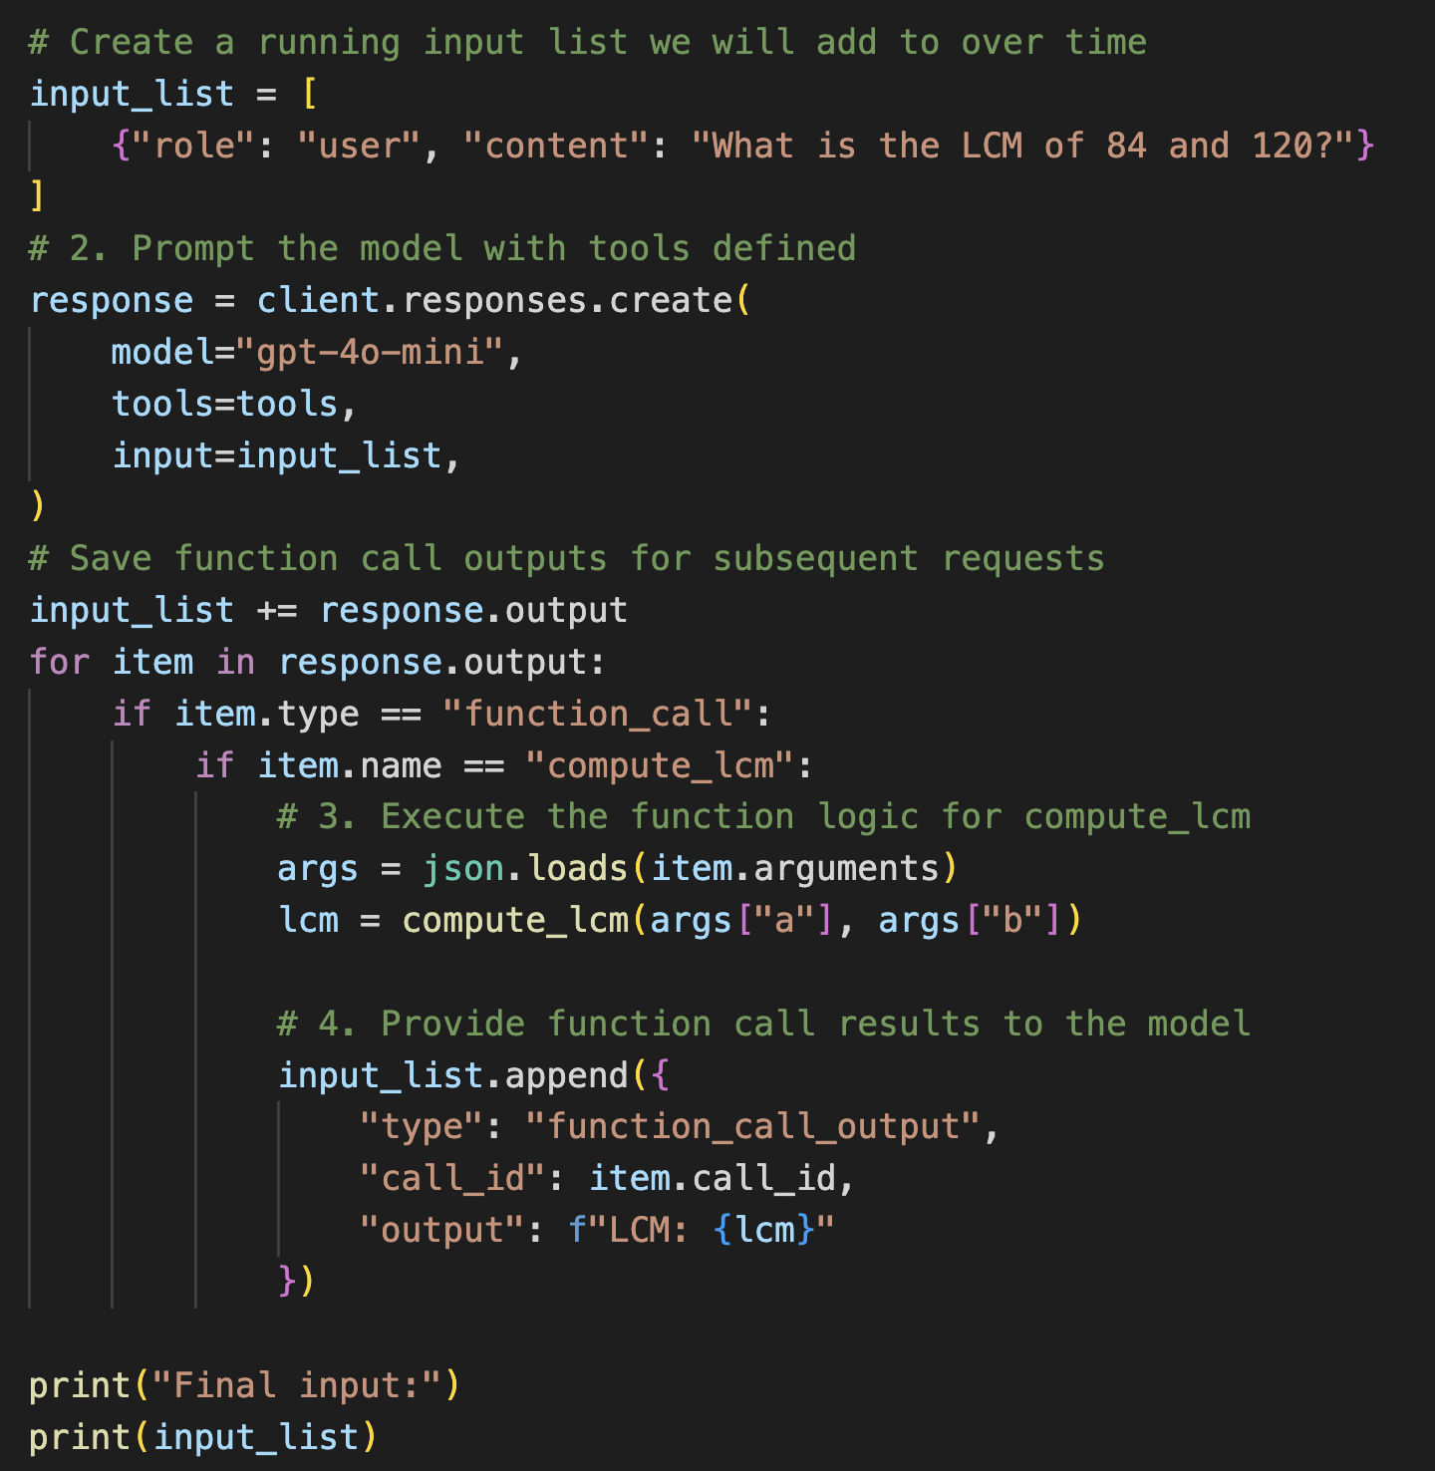
Tool Calling Example – LCM calculation
Create the first set of function calls
Using an LLM call
Execute the function
Create the input for the second LLM
Call using the output from the
Function call

Slide 66
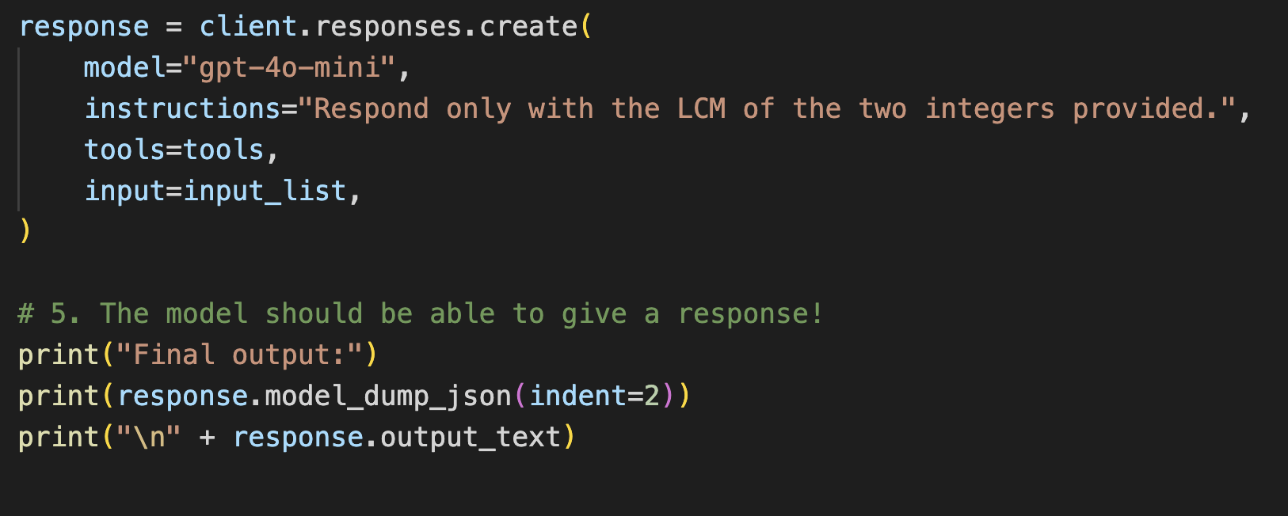
Tool Calling Example – LCM calculation
Use the output from
Function execution to
Ask LLM for the final answer.
Total tokens: 123

Slide 67
OpenAI API
GPT- 4*, 5* — the industry-standard REST API
Function / Tool Calling
Key Features
tools = [{
"type": "function",
"function": {
"name": "get_weather",
"description": "Get current weather",
"parameters": {
"type": "object",
"properties": {
"location": {"type": "string"}
},
"required": ["location"]
}
}
}]
resp = client.chat.completions.create(
model="gpt-4o", messages=msgs,
tools=tools, tool_choice="auto"
)
Proprietary · Pay-per-token
JSON mode & Structured Outputs
Function / tool calling
Vision, audio, embeddings
Fine-tuning support
Basic Chat Completion
from openai import OpenAI
client = OpenAI() # reads OPENAI_API_KEY
response = client.chat.completions.create(
model="gpt-4o",
messages=[
{"role": "system",
"content": "You are a helpful assistant."},
{"role": "user",
"content": "Explain RAG in one sentence."}
],
temperature=0.7,
max_tokens=200
)
print(response.choices[0].message.content)
JSON mode: Set response_format={"type":"json_object"} — model always returns valid JSON. Structured Outputs (strict:true) guarantees schema compliance.

Slide 68
Coding & Reasoning Models
These models are specifically optimized for software engineering tasks, including code generation, debugging, and long-horizon development workflows.
GPT-5.3-Codex
Highly capable agentic coding model
Handles large codebases and multi-step development tasks
Strong debugging and refactoring capabilities
Suitable for advanced developer tools
GPT-5.1-Codex
Optimized for structured programming tasks
More efficient for mid-level coding workflows
Good balance between speed and capability
Useful for automation and backend development

Slide 69
Example - Chatbot Application
Model Used: GPT-4-o-mini
Use Case:
Conversational assistant · customer support · FAQs
Output:
"AI is the simulation of human intelligence by machines."
response = client.chat.completions.create(
model="gpt-4o-mini",
messages=[
{"role": "system",} "content": "You are a helpful chatbot."},
{"role": "user", "content": "What is AI?"}
]
Key Points:
Multi-turn conversation
Context-aware responses
Real-time interaction

Slide 70
Image Generation Models
These models are designed for generating and editing images from text prompts, enabling creative and design-focused applications.
GPT Image 1.5
State-of-the-art image generation quality
Produces highly detailed and realistic visuals
Supports advanced prompt control
Suitable for professional design and media
GPT Image 1
Earlier generation image model
Faster and more cost-efficient
Good for basic image generation tasks
Suitable for lightweight applications

Slide 71

Example - Image Generation
Model Used: GPT Image 1.5
Use Case:
Generate images from text prompts
Design · creative content
Output:
response = client.chat.completions.create(
model="gpt-image-1.5",
prompt="A futuristic city at sunset"
Key Points:
High-quality image generation
Creative control via prompts
Useful for design workflows

Slide 72
Question
What is the main purpose of roles in OpenAI API?
Provide structure to the prompt engineering process.
Allow system level instructions
Allow structured inputs to be fed into the model
Historical legacy

Slide 73
Answer
What is the main purpose of roles in OpenAI API?
Provide structure to the prompt engineering process.
Allow system level instructions
Allow structured inputs to be fed into the model
Historical legacy
Correct Answer:
Allow system level instructions
Explanation:
A) Provide structure to the prompt engineering process
Correct. While roles do not primarily exist to structure the prompt engineering process — however, they can be used for better organization of codes for generating prompts.
B) Allow system level instructions ✓
Correct. The main purpose of roles (especially the 'system' role) is to pass system-level instructions that set the model's behavior, tone, and constraints throughout the conversation.
C) Allow structured inputs to be fed into the model
Incorrect. While roles do organize input into the conversation, the primary purpose is instruction-giving, not arbitrary structured inputs.
D) Historical legacy
Incorrect. Roles are a deliberate design choice with a clear functional purpose, not merely a legacy feature.

Slide 74
Question
Which of the following tasks is not suitable to be performed by prompting LLMs?
Classifying resumes of individuals into different skillsets.
Forecasting stock prices
Generating a summary of US – Iran war updates.
Creating a resume for a job application

Slide 75



Thank you
Instructor
Teaching Assistants (IITKGP)
Suman Bera
Debamalya Chakravorty
Sourangshu Bhattacharya
sourangshu@cse.iitkgp.ac.in

