Slide 1



RNN, Transformer Architecture and Attention
Niloy Ganguly
Professor
IIT Kharagpur

Slide 2
Recurrent Neural Networks (RNNs) & LSTMs
RNN Applications & CNN vs. RNN
Natural Language Processing
Time Series & Audio
Machine Translation
Sentiment Analysis
Named Entity Recognition
Text Generation / LLMs
Speech Recognition
Music Generation
Stock Price Forecasting
Anomaly Detection in Signals
CNN vs. RNN — At a Glance
Aspect
CNN
RNN
Best For
Spatial / grid data
Sequential / temporal data
Memory
None (feedforward)
Hidden state across timesteps
Key Op.
Convolution + pooling
Recurrent weight updates
Famous
ResNet, EfficientNet
LSTM, GRU, Transformer

Slide 3
Recurrent Neural Networks (RNNs) & LSTMs
What is Sequential Data?
Key Insight
Data where order matters
Each element depends on previous ones
Standard networks treat inputs independently and fail
Traditional feedforward networks assume inputs are independent.
But in "The cat sat on the ___", predicting the next word requires remembering ALL previous words.
We need a model with memory.
Text & NLP
Audio & Speech
Time Series
DNA Sequences
Video Frames
Stock Prices

Slide 4
Vanilla RNN (No Gates)
RNN cell
h0
RNN cell
h1
RNN cell
h2
RNN cell
h3
x₀
x₁
x₂
x₃
Update rule: hₜ = tanh( Wₕ · hₜ₋₁ + Wₓ · xₜ + b )
No forget gate · No input gate · No cell state — just hₜ carrying memory through time

Slide 5
RNN — Mathematics
Hidden State Update
hₜ = tanh( Wₕ · hₜ₋₁ + Wₓ · xₜ + b )
Output Computation
yₜ = g( Wᵧ · hₜ )
Loss (Cross-Entropy)
L = − Σₜ log P(yₜ | x₁…xₜ)
xₜ = input hₜ = hidden state Wₕ, Wₓ, Wᵧ = learnable weights b = bias

Slide 6
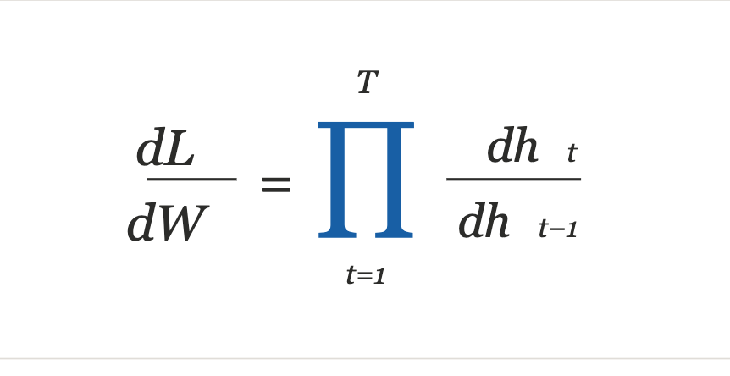
Training RNNs & The Gradient Problem
Backprop Through Time (BPTT)
Step 1 — Compute gradients at every time step
At each time step t, backpropagate through the unrolled RNN:
∂Lt / ∂Wh
Unfold RNN across T time steps
Compute gradients at each step
Sum gradients and update weights
Gradient = chain of partial derivatives
Step 2 — Accumulate across all time steps
∂L / ∂Wh = Σt ∂Lt / ∂Wh
Sum the gradient contributions from every time step.
Step 3 — Update Whh once
Apply a single weight update using the accumulated gradient.
Wh ← Wh − η · ∂L/∂Wh

Slide 7
RNN in Action
Example: predicting next word in "The cat sat on the ___"
t = 1
t = 2
t = 3
t = 4
xₜ = x₁
xₜ = x₂
xₜ = x₃
xₜ = x₄
input: "The"
input: "cat"
input: "sat"
input: "on"
hₜ = h₁
h₁
hₜ = h₂
h₂
hₜ = h₃
h₃
hₜ = h₄
tanh(Wₕhₜ₋₁ + Wₓxₜ + b)
tanh(Wₕhₜ₋₁ + Wₓxₜ + b)
tanh(Wₕhₜ₋₁ + Wₓxₜ + b)
tanh(Wₕhₜ₋₁ + Wₓxₜ + b)
ŷₜ = g(Wᵧhₜ)
ŷₜ = g(Wᵧhₜ)
ŷₜ = g(Wᵧhₜ)
ŷₜ = g(Wᵧhₜ)
predicts: "cat"
predicts: "sat"
predicts: "on"
predicts: "the"
L1 = −log P(ŷ1)
L2 = −log P(ŷ2)
L3 = −log P(ŷ3)
L4 = −log P(ŷ4)
Hidden Update
Output
Total Loss
hₜ = tanh( Wₕ·hₜ₋₁ + Wₓ·xₜ + b )
yₜ = g( Wᵧ · hₜ )
L = −Σₜ log P(yₜ | x₁…xₜ)
Input xₜ
Hidden hₜ
Output ŷₜ
Loss Lₜ
Recurrent hₜ→hₜ₊₁
Deep Learning · IIT Kharagpur

Slide 8

Quiz 1
A team feeds 50,000-word legal rulings into a vanilla RNN for case outcome classification. Critical evidence appears in the opening paragraphs.
Observation : The model fails on long documents despite performing well on short ones.
Question: What best explains this failure?
(A) Earlier information becomes harder to preserve as sequence length grows.
(B) Earlier information gets amplified and becomes more important over time.
(C) RNNs remember all timesteps equally well regardless of length.

Slide 9
Quiz 1
A team feeds 50,000-word legal rulings into a vanilla RNN for case outcome classification. Critical evidence appears in the opening paragraphs.
Observation : The model fails on long documents despite performing well on short ones.
Question: What best explains this failure?
(A) Earlier information becomes harder to preserve as sequence length grows.
(B) Earlier information gets amplified and becomes more important over time.
(C) RNNs remember all timesteps equally well regardless of length.
✅

Slide 10


Quiz 1 (Explanation)
What best explains this failure?
Earlier information becomes harder to preserve as sequence length grows.
Correct. Each RNN timestep overwrites the hidden state with new input. Over 50,000 words, the signal from opening paragraphs is diluted to near-zero — the model effectively cannot see the evidence that matters.
A
Earlier information gets amplified and becomes more important over time.
The opposite is true. RNNs do not amplify distant signals — each new token update moves the hidden state away from earlier content. Amplification would require a dedicated mechanism like attention.
B
RNNs remember all timesteps equally well regardless of length.
This directly contradicts the observed failure pattern. If all timesteps were remembered equally, the model would perform the same on short and long documents — but it does not.
C
Signal strength of opening paragraph evidence →
Word 10
Word 100
Word 500
Word 1000
Word 5000
Word 50000
Key insight — An RNN hidden state is a single vector updated at every token. Over 50,000 steps, the opening paragraph's signal decays to near-zero. This is the vanishing information problem.

Slide 11
Training RNNs & The Gradient Problem
Backprop Through Time (BPTT)
Vanishing Gradient
Unfold RNN across T time steps
Compute gradients at each step
Sum gradients and update weights
Gradient = chain of partial derivatives
When |dhₜ/dhₜ₋₁| < 1, the product shrinks exponentially. Gradients approach 0 — network stops learning long-range dependencies.
Exploding Gradient
When |dhₜ/dhₜ₋₁| > 1, the product grows exponentially causing NaN weights. Fix: clip gradients at a threshold.
Solution: LSTM (Long Short-Term Memory)
Notes:
Typical Window Sizes in RNNs
By task type
TaskTypical Sequence Length (T)NotesSentiment analysis50–200 tokensShort-medium sentencesLanguage modeling35–100 tokensClassic PTB benchmark uses 35Machine translation20–50 tokensBefore attention was standardSpeech recognition100–1000 framesEach frame ~10ms of audioMusic generation500–2000 stepsLong dependencies neededStock prediction30–90 timestepsDays/weeks of history
The Practical Problem
Plain RNNs effectively only remember ~10–20 timesteps in practice, even if T is set to 100. Beyond that, gradients vanish and the network stops learning from earlier context.
This is why:
Truncated BPTT is commonly used — instead of backpropagating through all T steps, you only go back k steps (typically k = 20–50). It's an approximation but much more stable.
LSTMs/GRUs were invented to extend the effective memory window to hundreds of timesteps
Transformers (with attention) handle 512–8192+ tokens without this limitation at all
Rule of Thumb
For vanilla RNNs, anything beyond ~20 steps starts suffering from vanishing gradients. LSTMs push this to ~100–300. Transformers effectively have no hard limit.
So "window size" is as much about what the architecture can actually learn from as what you set T to be.

Slide 12
RNN with Forget & Input Gates
Forget Gate (fₜ)
Input Gate (iₜ)
Hidden State (hₜ)
Input (xₜ)
Cell State Cₜ (conveyor belt — passes through forget & input gates)
Forget
Gate fₜ
Forget
Gate fₜ
Forget
Gate fₜ
Forget
Gate fₜ
Input
Gate iₜ
Input
Gate iₜ
Input
Gate iₜ
Input
Gate iₜ
RNN cell
h0
RNN cell
h1
RNN cell
h2
RNN cell
h3
x₀
x₁
x₂
x₃
fₜ decides what to forget · iₜ decides what new info to write · hₜ flows right as the rolling memory

Slide 13
Long Short-Term Memory (LSTM)
The Key Innovation: A dedicated Cell State Cₜ
LSTM adds a 'conveyor belt' (cell state) that carries information across many steps with minimal modification — solving the vanishing gradient problem.
01 Forget Gate
02 Input Gate
Decides which information to throw away from the cell state. Outputs values between 0 (forget all) and 1 (keep all).
Decides which new information to store in the cell state. Works with a tanh layer to create new candidate values.
03 Cell State
04 Output Gate
Updates the old cell state: discard irrelevant info (via forget gate) then add new important info (via input gate).
Decides what the next hidden state should be, filtering the updated cell state through sigmoid and tanh.

Slide 14
LSTM — Full Mathematics
01 Forget Gate
02 Input Gate
fₜ = σ( Wf · [hₜ₋₁, xₜ] + bf )
iₜ = σ( Wi · [hₜ₋₁, xₜ] + bi )
02 Candidate
03 Cell State
C~ₜ = tanh( Wc · [hₜ₋₁, xₜ] + bc )
Cₜ = fₜ ⊙ Cₜ₋₁ + iₜ ⊙ C~ₜ
04 Output Gate
04 Hidden State
oₜ = σ( Wo · [hₜ₋₁, xₜ] + bo )
hₜ = oₜ ⊙ tanh( Cₜ )
σ = sigmoid ⊙ = element-wise multiply [hₜ₋₁, xₜ] = concatenation

Slide 15
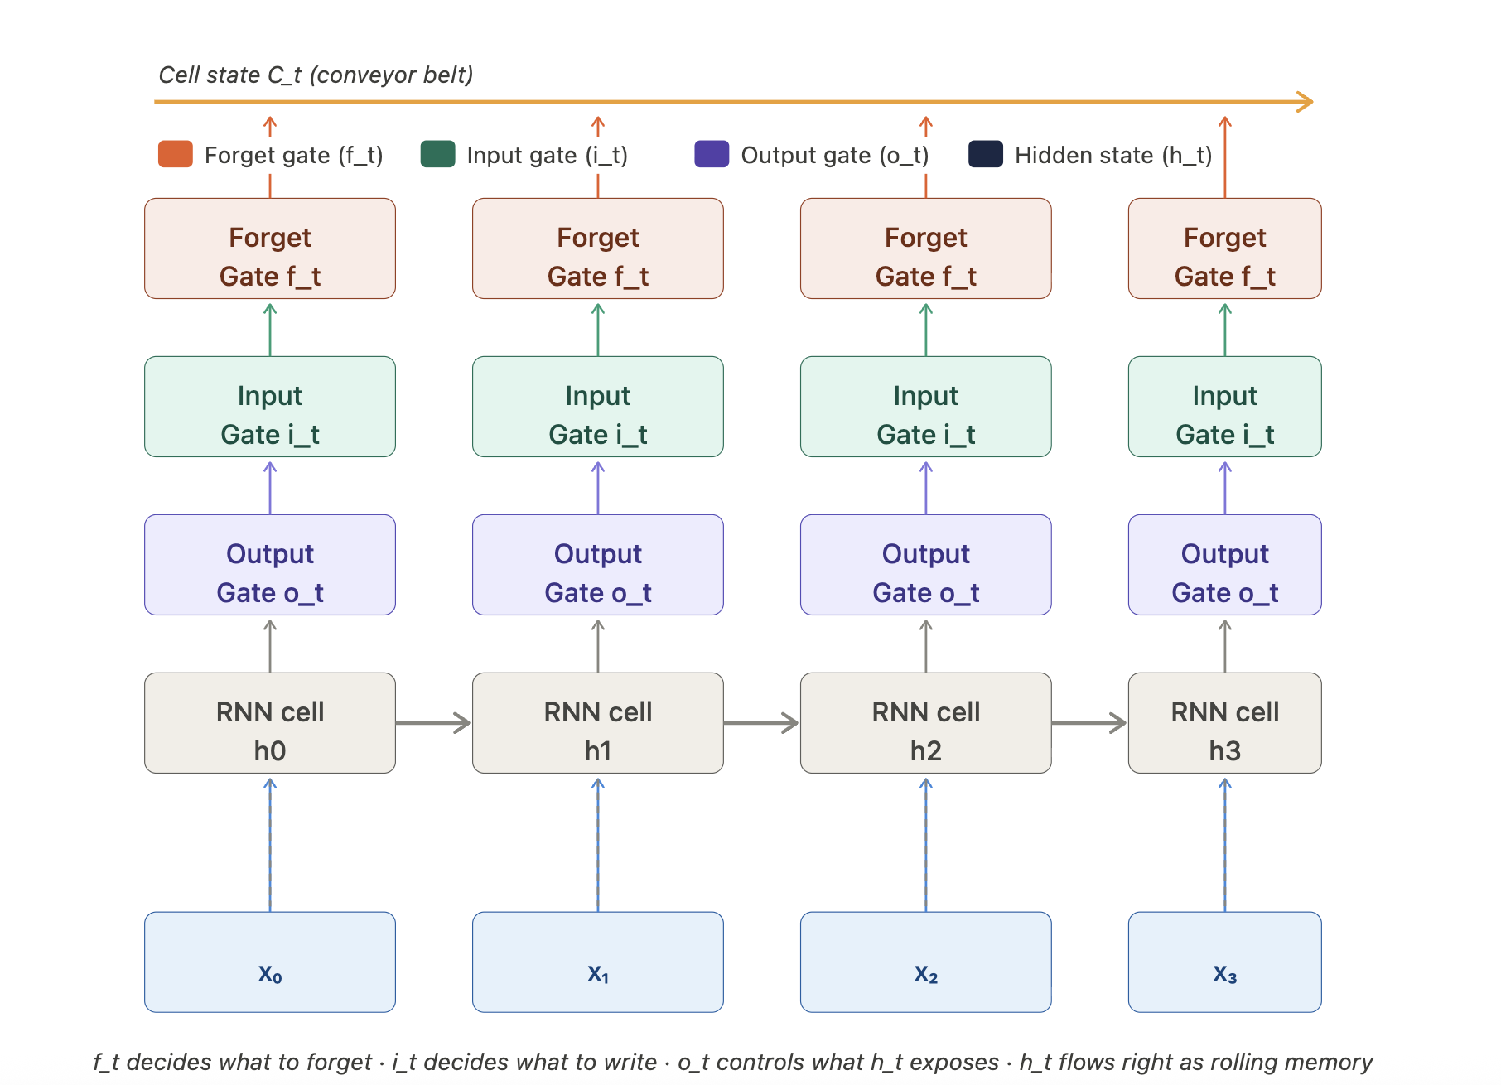
Long Short-Term Memory (LSTM)

Slide 16
LSTM — Long Short-Term Memory
Cell state Cₜ — long-term memory highway
σ Sigmoid σ
Why LSTM?
Vanilla RNNs suffer from vanishing gradients — they forget information from many timesteps ago.
LSTM (Hochreiter & Schmidhuber, 1997) solves this with a cell state — a "memory highway" that runs straight through time with only minor linear interactions, letting gradients flow unchanged over long sequences.
LSTMs use three learnable gates to regulate what to forget, what to store, and what to output.
Outputs 0–1; acts as a soft gate (0=closed, 1=open).
f
Forget gate
fₜ = σ(Wf·[hₜ₋₁, xₜ] + bf)
Decides what % of old cell state to erase. 0 = forget all, 1 = keep all.
i
⊙ Hadamard ⊙
Input gate
iₜ = σ(Wi·[hₜ₋₁, xₜ] + bi)
Element-wise multiply — applies gate mask to a vector.
Decides which new values to write into cell state.
C̃
Cell update
C̃ₜ = tanh(Wc·[hₜ₋₁, xₜ] + bc)
⊕ Element-wise +
Candidate values to add: Cₜ = fₜ⊙Cₜ₋₁ + iₜ⊙C̃ₜ
o
Adds old memory × forget + new info × input.
Output gate
oₜ = σ(Wo·[hₜ₋₁, xₜ] + bo)
Hₜ = oₜ ⊙ tanh(Cₜ) — filtered cell state → hidden.

Slide 17
LSTM: Worked Example (1 timestep)
Toy setup: hₜ₋₁ = 0.5 (prev hidden), xₜ = 1.0 (input), Cₜ₋₁ = 0.3 (prev cell). All weights = 0.5, all biases = 0.
f
Forget gate
i
Input gate
C̃
Cell candidate
o
Output gate
fₜ = σ(0.5×[0.5+1.0])
iₜ = σ(0.5×[0.5+1.0])
C̃ₜ = tanh(0.5×[0.5+1.0])
oₜ = σ(0.5×[0.5+1.0])
= σ(0.75) ≈
= σ(0.75) ≈
= tanh(0.75) ≈
= σ(0.75) ≈
fₜ ≈ 0.679
iₜ ≈ 0.679
C̃ₜ ≈ 0.635
oₜ ≈ 0.679
Cₜ
Cell state update: Cₜ = fₜ ⊙ Cₜ₋₁ + iₜ ⊙ C̃ₜ
hₜ
Hidden state: hₜ = oₜ ⊙ tanh(Cₜ)
= 0.679 × 0.3 + 0.679 × 0.635
= 0.679 × tanh(0.635)
= 0.204 + 0.431 = 0.635
= 0.679 × 0.561
Cₜ ≈ 0.635
hₜ ≈ 0.381
Summary — one LSTM timestep
Inputs
hₜ₋₁=0.5, xₜ=1.0
Cₜ₋₁=0.3
Forget gate
fₜ=0.679
(keep 67.9% of Cₜ₋₁)
Input+Candidate
iₜ=0.679, C̃ₜ=0.635
(new info to write)
New cell state
Cₜ=0.635
(updated memory)
Output
hₜ=0.381
(next hidden state)
→
→
→
→

Slide 18
How LSTM Maintains Gradients: The Chain Rule Connection
Connecting dL/dW → dL/dc_t → dc_T/dc_t → product of forget gates
1
Chain rule: how loss depends on weights
dL/dW = Σ_t (dL/dc_t) · (dc_t/dW)
Sum over all timesteps — W is shared across all of them
2
Expanding dL/dc_t via the cell state chain
dL/dc_t = (dL/dc_T) · (dc_T/dc_t)
Loss at final step T flows back to step t through the cell state path
3
The key derivative — cell state to cell state
dc_t/dc_{t-1} = f_t
From c_t = f_t ⊙ c_{t-1} + i_t ⊙ c̃_t
differentiating w.r.t. c_{t-1} gives f_t directly
chain rule
across steps
→
dc_T/dc_t = ∏(k=t+1 → T) f_k
Product of forget gates
— not tanh derivatives!
f_k ≈ 1
Gradient passes unchanged
f_k ≈ 0
Gradient blocked
f_k learned
Network controls flow
network remembers → ∏f_k ≈ 1
network forgets → ∏f_k ≈ 0
gates are trained, not fixed

Slide 19
Limitation of RNN Models
Slow Computation for Longer Sequences
Can not be done in parallel due to timesteps dependencies
Vanishing Gradient or Exploding Gradient Problem
Limited amount Information into hidden state
History is forgotten after number of time steps
Long range dependence

Slide 20
Problem 1: The Information Bottleneck
Everything must compress into one fixed-size vector
100 input tokens
Fixed cell state dimension
w1
w2
w3
w4
w5
w6
w7
w8
w9
…
c₁₀₀ is exactly the same size as c₁. A sequence of 1000 tokens gets no more space than a sequence of 10. The longer the input, the greater the compression.
(100 tokens total, only first 9 shown)
▼ compress all into one vector ▼
Early tokens get overwritten
c₁₀₀
Each new token competes for the same fixed vector space. Even if f_t ≈ 1 (forget gate open), new writes via i_t ⊙ C̃_t still push out older content.
ONE fixed vector
Transformer solution: don't compress
Transformers keep all token representations in memory. At each step, attention directly retrieves whichever tokens are needed. No bottleneck.
(w₁, …, w₁₀₀) → c₁₀₀ Even perfect gradient flow cannot recover lost information

Slide 21
Problem 2: No Direct Access — The Jump Problem
Token 10 needs token 3 — but must travel through every step in between
LSTM — sequential chain (path length = 7 hops):
t=3
t=4
t=5
t=6
t=7
t=8
t=9
t=10
⚠ irrelevant tokens — signal from t=3 must pass through here
LSTM
Transformer
3
4
5
6
7
8
9
10
3
1 hop
10
8
1 hop
3→4→5→6→7→8→9→10 Path length: 7 Token 3's signal must pass through 6 irrelevant intermediate states. Information dilutes with each hop.
9
1 hop
3 ─────────► 10 Path length: 1 Direct attention to any token regardless of distance. No intermediate states required.
Path length argument: LSTM solves gradient flow but not selective access. Transformers solve both by attending directly.

Slide 22
Quiz 2
An LSTM is trained to read a 2,000-word legal contract and answer questions about it. When asked:
"Who are the three parties involved in the contract, and what obligations does each party have?"
the model consistently identifies two of the parties correctly but misses the third, even though all three parties are mentioned in different parts of the document.
Which of the following is the most reasonable engineering response?
(A) Run the LSTM three times, each time asking about one party only, to reduce memory pressure.
(B) Double the hidden state size — more dimensions means more room to store all three parties.
(C) Break the contract into three chunks and run the LSTM separately on each chunk.
(D) None of them.

Slide 23
Quiz 2
An LSTM is trained to read a 2,000-word legal contract and answer questions about it. When asked:
"Who are the three parties involved in the contract, and what obligations does each party have?"
the model consistently identifies two of the parties correctly but misses the third, even though all three parties are mentioned in different parts of the document.
Which of the following is the most reasonable engineering response?
(A) Run the LSTM three times, each time asking about one party only, to reduce memory pressure. (Engineering Work Around)
(B) Double the hidden state size — more dimensions means more room to store all three parties. (scaling the existing architecture)
(C) Break the contract into three chunks and run the LSTM separately on each chunk. (preprocessing trick)
(D) None of them. (Architectural Redesign)
✅

Slide 24
Quiz 2 (Explanation)
A
Run the LSTM three times, once per party
This changes the task entirely. In a real pipeline you cannot always re-run the model with different questions: the input may not be available again, the pipeline runs in real-time, and you still haven't fixed the underlying memory problem. It patches one question, not the architecture.
B
Double the hidden state size
More dimensions give more room, but the hidden state is still a single compressed vector that must represent everything at once. Compression always loses information. At 2,000 words, even a 1024-dimension vector will still drop early content: you are making the bottle bigger, not removing the bottleneck.
C
Break the contract into three chunks
This destroys cross-chunk context. Party 3 may be defined in chunk 1 and their obligation described in chunk 3. Running each chunk independently means the model never sees the full picture: it is like solving a puzzle with the pieces in separate rooms.

Slide 25
ELMo & BiLSTM
Contextual embeddings — same word, different vectors

Slide 26
ELMo: Embeddings from Language Models
→ fwd
→ fwd
→ fwd
→ fwd
→ fwd
I
went
to
the
bank
← bwd
← bwd
← bwd
← bwd
← bwd
→ "bank" gets context from BOTH directions before producing its vector
ELMo
# pip install allennlp
from allennlp.commands.elmo import ElmoEmbedder
elmo = ElmoEmbedder()
sent1 = ["I", "deposited", "money", "at", "the", "bank"]
sent2 = ["She", "sat", "on", "the", "river", "bank"]
emb1 = elmo.embed_sentence(sent1) # shape: (3, 6, 1024)
emb2 = elmo.embed_sentence(sent2) # shape: (3, 6, 1024)
# "bank" in financial context vs river context
bank_finance = emb1[2][5] # layer 2, position 5
bank_river = emb2[2][5] # layer 2, position 5
from numpy.linalg import norm
import numpy as np
sim = np.dot(bank_finance, bank_river) / (norm(bank_finance)*norm(bank_river))
print(f"Similarity: {sim:.3f}") # ~0.54 — different!
Notes:
ELMo Code Walkthrough
The code demonstrates ELMo's key superpower: the same word gets different vectors depending on context.
Setup & Model
pythonfrom allennlp.commands.elmo import ElmoEmbedder
elmo = ElmoEmbedder()
Loads a pretrained ELMo model. Internally this is a 2-layer bidirectional LSTM trained on a large corpus.
Two sentences with ambiguous "bank"
pythonsent1 = ["I", "deposited", "money", "at", "the", "bank"] # financial bank
sent2 = ["She", "sat", "on", "the", "river", "bank"] # river bank
Both sentences contain "bank" at position 5 — but with completely different meanings.
Embedding shape: (3, 6, 1024)
pythonemb1 = elmo.embed_sentence(sent1) # shape: (3, 6, 1024)
emb2 = elmo.embed_sentence(sent2) # shape: (3, 6, 1024)
The three dimensions mean:
DimensionSizeMeaningFirst33 layers: character CNN + LSTM layer 1 + LSTM layer 2Second66 tokens in the sentenceThird1024vector size per token per layer
Extracting "bank" from layer 2
pythonbank_finance = emb1[2][5] # layer 2, position 5
bank_river = emb2[2][5] # layer 2, position 5
[2] = top LSTM layer (most context-sensitive), [5] = 6th token = "bank". Layer 2 is chosen because it captures the most semantic meaning — lower layers capture syntax.
Cosine similarity
pythonsim = np.dot(bank_finance, bank_river) / (norm(bank_finance) * norm(bank_river))
# prints ~0.54
Cosine similarity of 0.54 means the two "bank" vectors are moderately different — not completely unrelated (same spelling, same grammar), but clearly distinct because ELMo has seen their different contexts. A static embedding (Word2Vec, GloVe) would give 1.0 — identical vectors regardless of context.
The key insight
Static embeddings: bank (financial) == bank (river) ← same vector always
ELMo embeddings: bank (financial) ≠ bank (river) ← context changes the vector
This is what made ELMo a breakthrough in 2018 — it was the first widely-used contextual embedding, directly inspiring BERT which took the same idea further using Transformers instead of LSTMs.

Slide 27
ELMo: Embeddings from Language Models
Peters et al., 2018 — AllenNLP
The core idea: context changes meaning
❌ Before ELMo — Static Embeddings
✓ ELMo — Contextual Embeddings
"bank" in "river bank"
[0.2, 0.7 …]
"bank" in "river bank"
[0.1, 0.9 …]
← identical!
← different!
"bank" in "bank account"
[0.2, 0.7 …]
"bank" in "bank account"
[0.8, 0.2 …]
Same word → same vector, always. Context ignored.
Same word → different vector based on full sentence.
ELMo Architecture — 3 Layers per Token
Layer 2
I
went
to
the
bank
Semantic meaning — word sense, coreference, context. Used for NLP tasks.
BiLSTM (top)
Layer 1
→ fwd / ← bwd
I
went
to
the
bank
Syntactic structure — POS tags, chunking, dependency roles.
BiLSTM (bottom)
Layer 0
I
went
to
the
bank
Word form — morphology, spelling, handles unknown words.
Char CNN
ELMo(token) = γ · ( s₀·layer₀ + s₁·layer₁ + s₂·layer₂ ) s₀, s₁, s₂ = task-specific learned weights (softmax normalised)

Slide 28
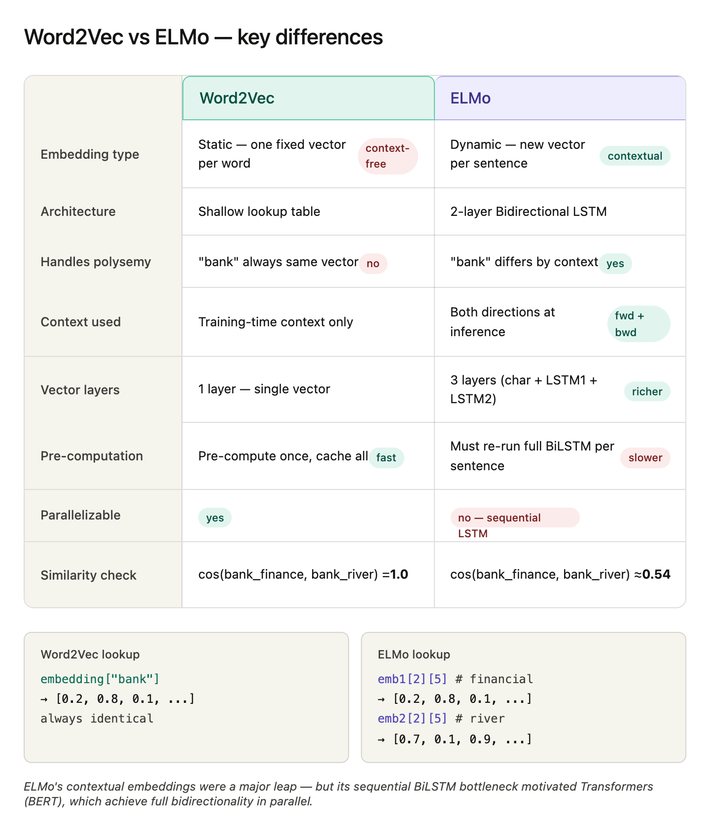
Notes:
Layer 0 — Character-based Embedding (Token Layer)
This is the input layer, not an LSTM layer. It processes the raw characters of each word through a CNN to produce an initial embedding.
Why characters, not words?
Handles out-of-vocabulary words naturally — it has never "seen" a word before, only characters
Captures morphology — "running", "runner", "runs" share character patterns, so their embeddings start similar
No vocabulary limit
What it captures: Surface form — spelling, morphology, word shape
"unhappiness" → char CNN → [vector based on u,n,h,a,p,p,i,n,e,s,s]

Slide 29
ELMo: Layer Stacking — Output of One Layer Feeds Next
Input tokens
"I"
"went"
"to"
"the"
"bank"
Layer 0
e1
e2
e3
e4
e5
Character-level CNN
→ morphology, spelling
Character CNN
Raw characters
(no context yet)
e vectors
feed into →
▼
▼
▼
▼
▼
Layer 1
h¹1
→
h¹2
→
h¹3
→
h¹4
→
h¹5
BiLSTM reads all e vectors
→ syntax, POS tags
BiLSTM — 1st
←
←
←
←
Reads e₁…e₅
(layer 0 outputs)
h¹ vectors
feed into →
▼
▼
▼
▼
▼
Layer 2
h²1
→
h²2
→
h²3
→
h²4
→
h²5
BiLSTM reads all h¹ vectors
→ semantics, word sense
BiLSTM — 2nd
←
←
←
←
Reads h¹₁…h¹₅
(layer 1 outputs)
ELMo(token) = γ·(s₀·e₅ + s₁·h¹₅ + s₂·h²₅)
emb[0][4] = e₅ (char) emb[1][4] = h¹₅ (syntax) emb[2][4] = h²₅ (semantic)
3 vectors weighted & summed → 1 final context-rich embedding

Slide 30
Quiz 3
You are evaluating two LSTM configurations on a document classification task — a standard LSTM and a larger LSTM with double the hidden size. On short documents under 30 words, both models perform equally well at 91% accuracy. However, when tested on longer documents of 200 or more words, the standard LSTM drops to 67% while the larger LSTM drops to 71%. Based on this trend, what do you predict will happen at 500+ words and what is your engineering decision?
Both models will keep dropping but the large LSTM will maintain its ~4% advantage — increasing hidden size further should help.
Both models will drop sharply and converge near the same low accuracy — hidden size stops being the deciding factor and sequence length itself becomes the bottleneck.
Only the standard LSTM will drop further — the large LSTM has enough capacity to stabilize at 500+ words.
Both models will drop sharply, but stacking LSTM layers rather than widening them will recover accuracy.

Slide 31
Quiz 3
You are evaluating two LSTM configurations on a document classification task — a standard LSTM and a larger LSTM with double the hidden size. On short documents under 30 words, both models perform equally well at 91% accuracy. However, when tested on longer documents of 200 or more words, the standard LSTM drops to 67% while the larger LSTM drops to 71%. Based on this trend, what do you predict will happen at 500+ words and what is your engineering decision?
Both models will keep dropping but the large LSTM will maintain its ~4% advantage — increasing hidden size further should help.
Both models will drop sharply and converge near the same low accuracy — hidden size stops being the deciding factor and sequence length itself becomes the bottleneck. ✅
Only the standard LSTM will drop further — the large LSTM has enough capacity to stabilize at 500+ words.
Both models will drop sharply, but stacking LSTM layers rather than widening them will recover accuracy.

Slide 32
Quiz 3 (Explanation)
Both models keep dropping but the large LSTM maintains its ~4% advantage — keep increasing hidden size.
The +4% is already diminishing returns. At 500 words the decay worsens and the gap shrinks further — not holds.
1
Both models drop sharply and converge near the same low accuracy — sequence length becomes the bottleneck, not hidden size.
All model sizes show the same collapse → architectural problem, not capacity. Both still compress 500 words into one fixed vector.
2
Only the standard LSTM drops further — the large LSTM has enough capacity to stabilize at 500+ words.
Capacity does not stop sequential overwriting. Both models still produce one final vector — larger just has more dimensions, not fewer steps.
3
Both drop sharply, but stacking LSTM layers (depth) instead of widening (width) will recover accuracy.
Depth adds representational power but each layer still collapses the sequence into one hidden state — same bottleneck, more layers.
4
Key insight — When all model sizes show the same sharp drop, it is a structural signal, not a capacity problem. The bottleneck is the architecture itself.

Slide 33
Limitations of Pre-Attention Models
Key issues that motivated the development of Attention Mechanisms
01
02
03
04
05
Fixed-Length Context Bottleneck
Vanishing & Exploding Gradients
Poor Long-Range Dependencies
No Parallelism in Training
Uniform Treatment of Input
Encoder-decoder models compressed entire sequences into one fixed-size vector — causing severe information loss for long inputs.
RNNs suffered from gradients shrinking to zero or growing uncontrollably during backpropagation, blocking long-range learning.
Information from early tokens had to pass through many steps, getting diluted before reaching later positions in the sequence.
RNNs process tokens sequentially — each step depends on the previous — making them slow to train and difficult to scale.
All input tokens were weighted equally when generating output, with no mechanism to selectively focus on what matters most.

Slide 34
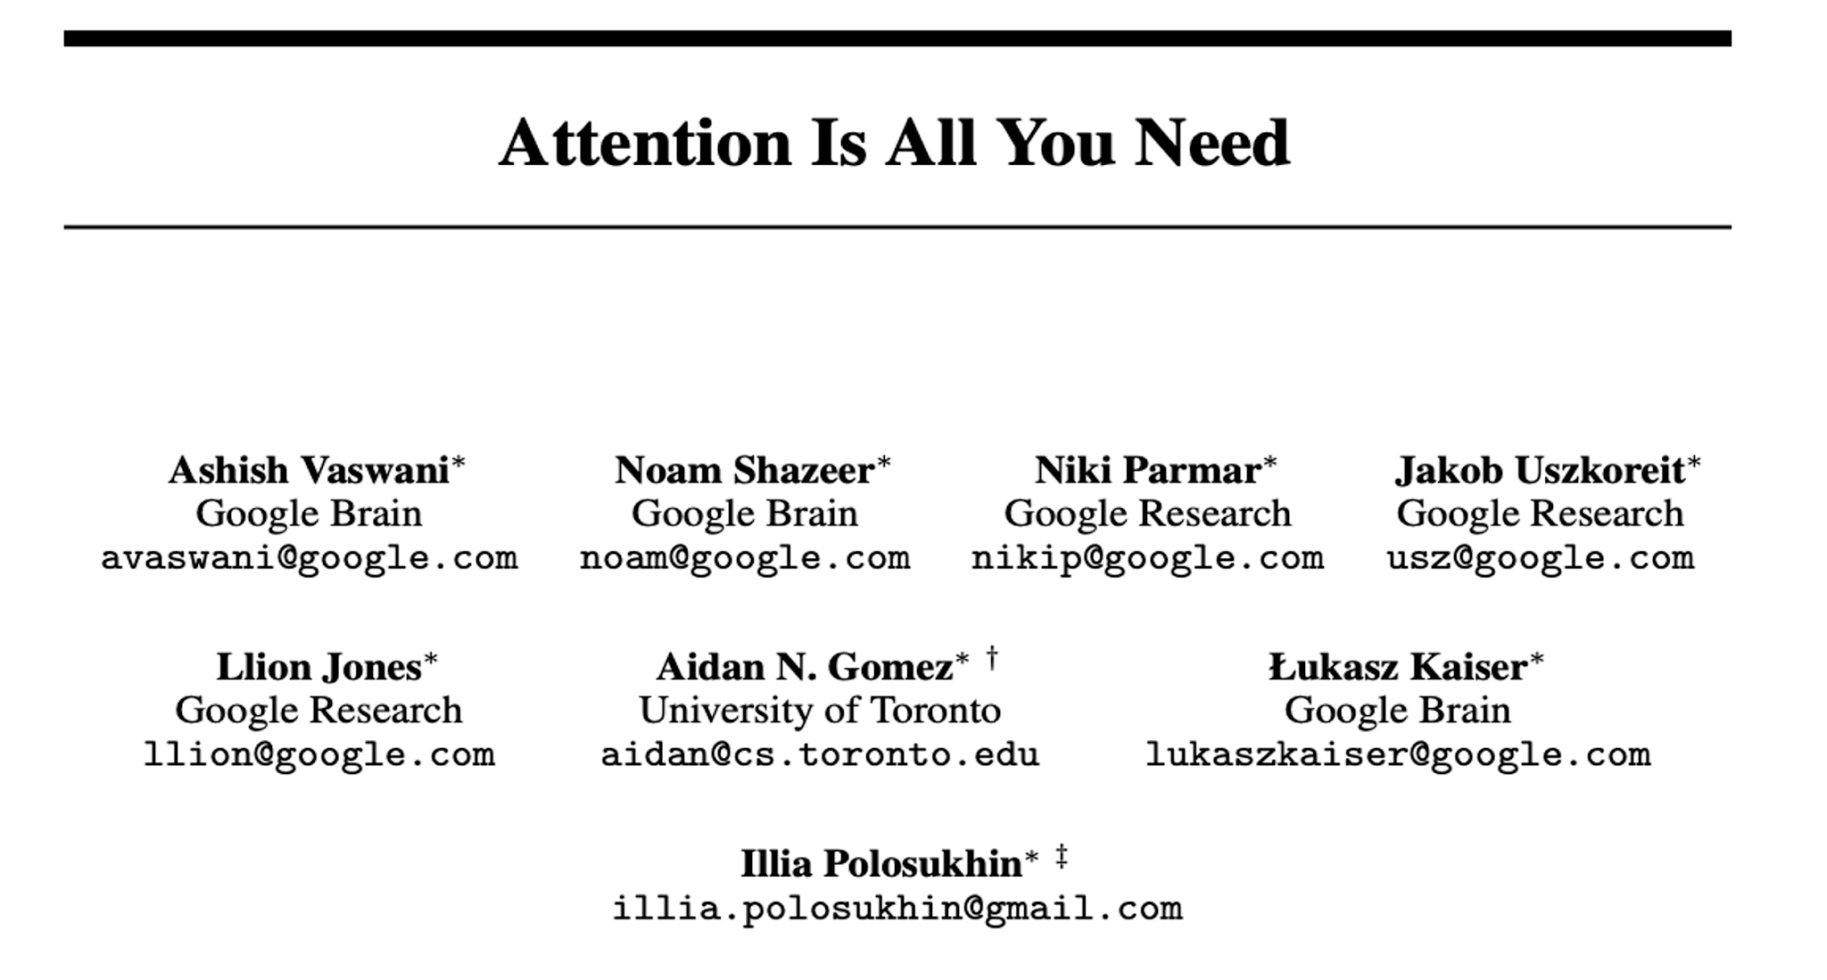
Attention Based Model: Transformer
https://www.youtube.com/watch?v=LWMzyfvuehA

Slide 35
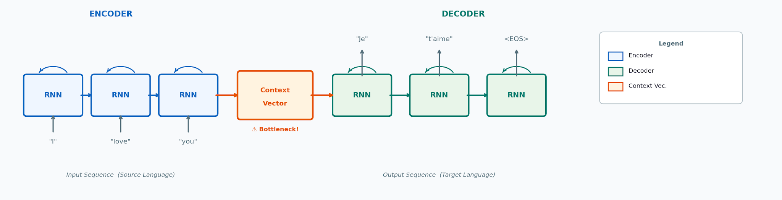
Seq2Seq Model with RNN
How Encoder–Decoder RNNs process sequences — and where they fall short
① Encoder reads input tokens step-by-step, updating its hidden state at each token.
② The final hidden state becomes the Context Vector — a single fixed-size summary of all input.
③ The Decoder generates output tokens one at a time, conditioned only on this one context vector.
⚠ Key flaw: all input information is forced through one bottleneck vector, losing detail for long sequences.

Slide 36
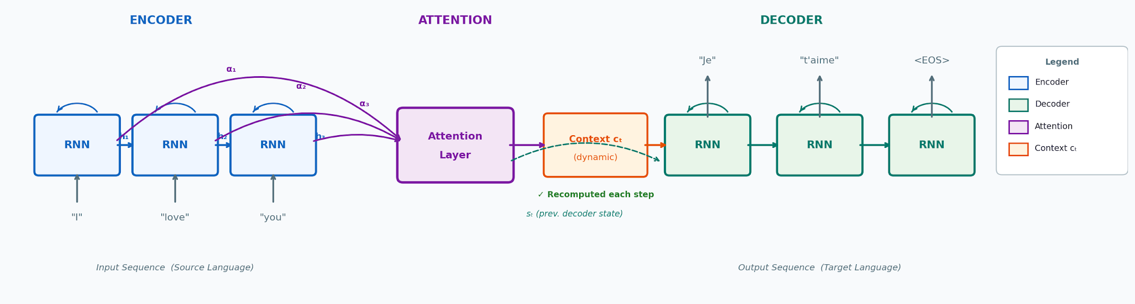
Seq2Seq with Attention Layer
How the Attention mechanism transforms the Encoder–Decoder architecture
① All hidden states retained
Instead of a single final vector, all encoder hidden states h₁…hₙ are passed forward.
② Dynamic context per step
Attention computes a weighted sum (αᵢ) of encoder states for each decoder step.
③ Context cₜ recomputed
A fresh context vector cₜ is computed at every decoder timestep, focusing on what's relevant.
✓ Bottleneck eliminated
Long-range dependencies are captured directly — no information is lost through a single vector.

Slide 37

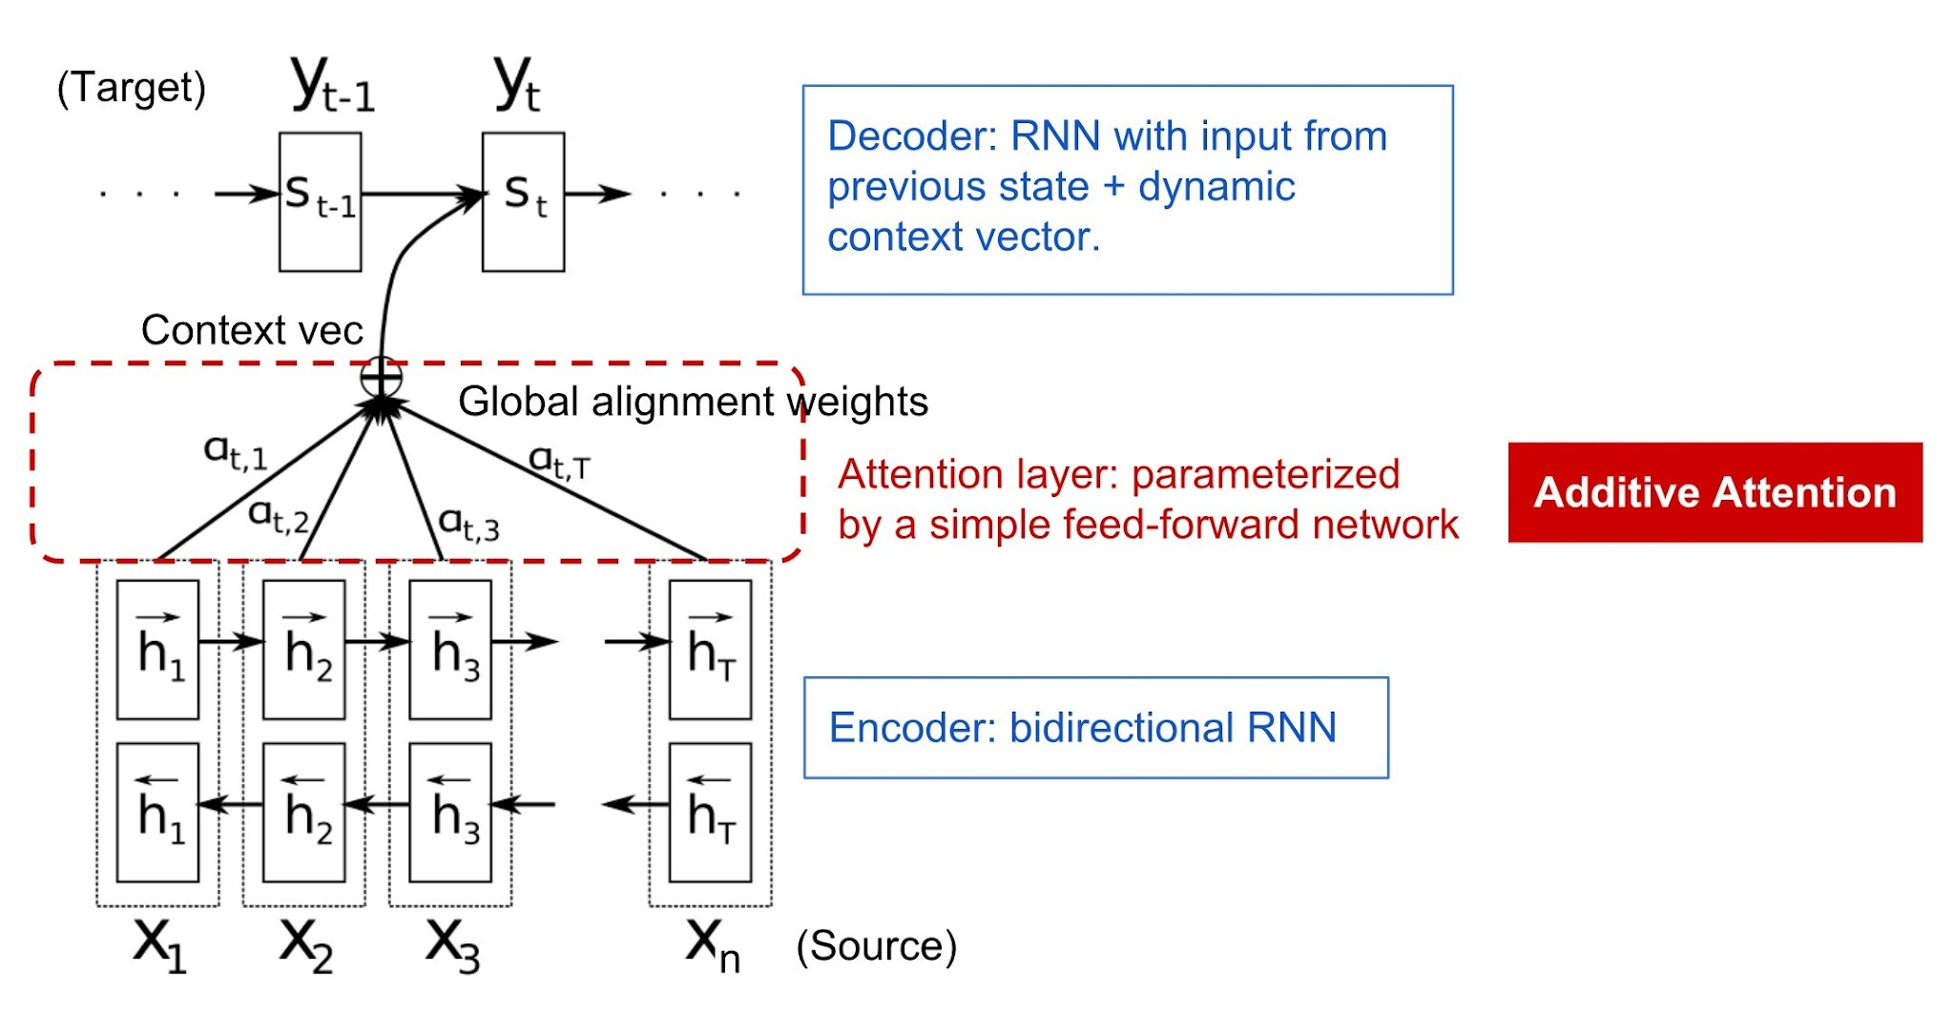

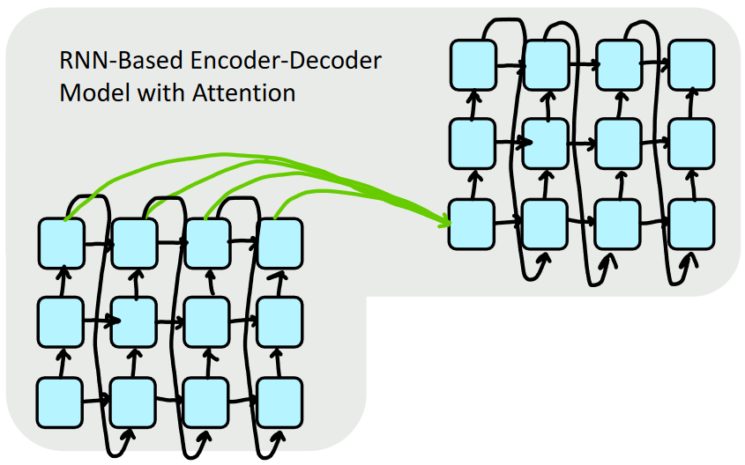
The Attention Idea
Attention treats each word’s representation as a query to access and incorporate information from a set of values.
Bahdanau et al., 2015. Stanford NLP Course: CS224N

Slide 38
Why Attention Alone Wasn't Enough
Remaining limitations that led to Self-Attention and the Transformer architecture
Limitations of RNN + Attention
Transformer Solutions
01 Still Sequential (RNN)
The RNN encoder/decoder processed tokens one at a time — no parallelisation across a sequence.
02 One-Directional Attention
Attention only ran decoder→encoder. Tokens within the encoder couldn't attend to each other.
⚡ Full Parallelism
RNNs removed entirely — all tokens processed simultaneously.
↔ Self-Attention
Every token attends to every other token in the same sequence, bidirectionally.
➜
03 Weak Long-Range in Encoder
Encoder states were still shaped by sequential RNN steps — early tokens got diluted before being attended to.
04 O(n) Information Path
Information still traveled through n recurrent steps to connect two distant tokens.
led to
◎ O(1) Dependency Path
Any two tokens connect directly in one attention step, regardless of distance.
✦ Multi-Head Attention
Multiple heads capture different relationship types in parallel.
05 No Intra-Sequence Attention
Tokens couldn't ask 'what in this same sequence is relevant to me?' — the key idea of self-attention.
06 No Positional Structure
No built-in sense of position — any order had to be implicitly learned through the RNN.
⊕ Positional Encodings
Explicit position signals added to embeddings — order without recurrence.
✓ Attention is All You Need
Vaswani et al. 2017: one unified architecture for encode, decode, and cross-attend.
Notes:
3 — Weak Long-Range in Encoder
The problem setup
In RNN + Attention (pre-Transformer), the encoder was still a sequential RNN:
x₁ → h₁ → h₂ → h₃ → h₄ → h₅ → h₆
"The cat sat on the mat"
The attention mechanism then let the decoder look at all encoder hidden states h₁…h₆. Sounds fine — but the problem is what's inside those hidden states.
Why early tokens get diluted
To reach h₆, the information from x₁ ("The") had to travel through:
x₁ → h₁ → h₂ → h₃ → h₄ → h₅ → h₆
Each arrow is a tanh transformation and a matrix multiply. By the time h₆ is computed, the signal from x₁ has been overwritten, mixed, and compressed through 5 intermediate steps.
So when the decoder attends to h₆, it's not really attending to "The" cleanly — it's attending to a blurry version of it. The attention mechanism fixes decoder-to-encoder access, but not encoder-internal quality.
Analogy
Imagine summarising a book by reading it through 6 people playing telephone. Even if you can ask any person a question, their answer about chapter 1 is already corrupted by chapters 2–6 passing through them.
05 — No Intra-Sequence Attention
The problem
In RNN + Attention, attention only ran in one direction: decoder → encoder.
Encoder: h₁ h₂ h₃ h₄ h₅
↑ ↑ ↑ ↑ ↑
Decoder: d₁ (attends to all hᵢ)
The encoder tokens could not attend to each other. So when encoding "bank" in "I went to the river bank", the encoder RNN for "bank" only knew about previous words through the hidden state chain — not through direct attention to "river".
Why this matters
Consider encoding the sentence:
"The trophy didn't fit in the suitcase because it was too big"
What does "it" refer to — trophy or suitcase? To resolve this, the encoder needs "it" to directly attend to both "trophy" and "suitcase" and compare. But with RNN encoding, "it" can only access earlier words through the degraded hidden state — no direct lookup is possible within the encoder itself.
The fix: Self-Attention
Transformers introduce self-attention where every token in the encoder attends to every other token in the same sequence:
"bank"
↑ ↑ ↑ ↑ ↑
"I" "went" "to" "the" "river"
Now "bank" directly queries "river", "went", "I" all at once — in one step, with learned attention weights — and builds a representation that is already context-aware before any decoding happens. This is what makes BERT (encoder-only Transformer) so powerful at understanding tasks.
How they connect
RNN + AttentionTransformerEncoder qualityTokens diluted through chainEvery token directly attends to all othersWithin-encoder lookupImpossible — no self-attentionO(1) — one attention step to any tokenDecoder accessGood (attention to hᵢ)Good (cross-attention)
Both problems share the same root cause: the RNN forces sequential processing, which makes direct token-to-token communication within the encoder impossible. Self-attention kills both problems at once.
~

Slide 39

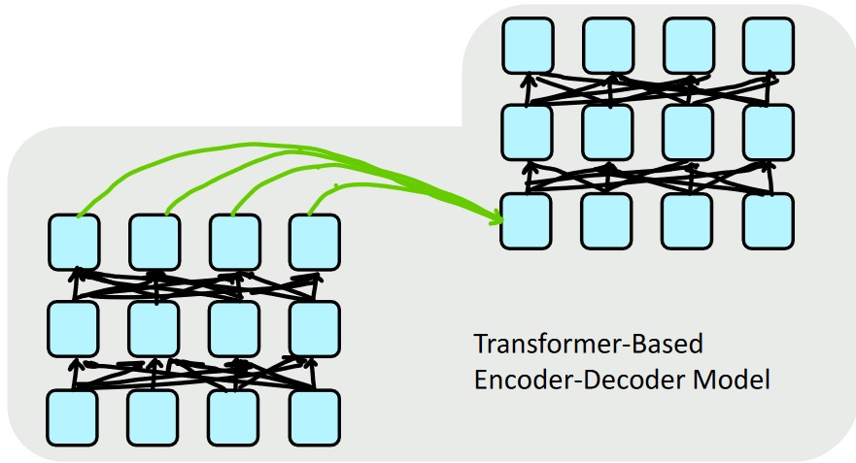

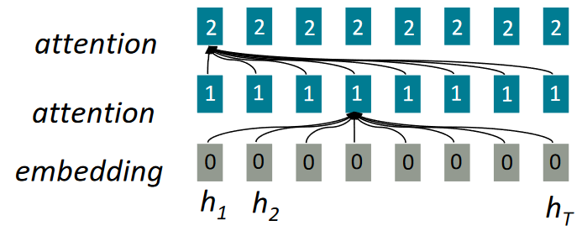
The Self Attention Idea
ELMO and Self-attention is encoder-encoder (or decoder-decoder) attention where each word attends to each other word within the input (or output).
Stanford NLP Course: CS224N
Notes:
Left Diagram — ELMo's 3-Layer Structure
This shows how ELMo produces a single embedding for one token (say h₁).
Layer 2 [ 2 2 2 2 2 2 2 2 ] ← top BiLSTM layer
Layer 1 [ 1 1 1 1 1 1 1 1 ] ← bottom BiLSTM layer
Layer 0 [ 0 0 0 0 0 0 0 0 ] ← raw character CNN embedding
h₁ h₂ h₃ h₄ h₅ h₆ h₇ hT
What are 0, 1, 2?
They are layer indices — not values. Each token has a representation at each of the 3 layers:
NumberLayerWhat it captures0Character CNN embeddingRaw word form — spelling, morphology (e.g. "running" vs "run")1BiLSTM Layer 1Syntactic info — POS tags, sentence structure2BiLSTM Layer 2Semantic info — word meaning, context, coreference
This is why in the code from your previous slide, emb1[2][5] specifically picked layer 2 to compare "bank" meanings — because layer 2 is the most semantically rich.
What does "attention" mean on the left?
The two "attention" labels on the left are pointing to the weighted combination step. ELMo doesn't just use one layer — it computes a learned weighte
d sum of all 3 layers:
ELMo(token) = γ · (s₀·layer0 + s₁·layer1 + s₂·layer2)
Where s₀, s₁, s₂ are task-specific softmax weights learned during fine-tuning. For a syntax task, the model learns to weight layer 1 more. For a semantic task, it weights layer 2 more. This is the core innovation of ELMo over fixed embeddings.
Right Diagram — Transformer Encoder-Decoder
This shows the full Transformer architecture with two separate stacks.
┌─────────────────┐
│ DECODER stack │ ← generates output tokens
│ (3 layers shown)│
└────────┬────────┘
↑ green arrows = cross-attention
┌────────┴────────┐
│ ENCODER stack │ ← reads input tokens
│ (3 layers shown)│
└─────────────────┘
The black arrows (within each stack)
These are self-attention connections — every token attending to every other token in the same layer. You can see each node connects to all nodes in the layer above it. This is what solves the "no intra-sequence attention" problem from your previous slide.
The green arrows (crossing between stacks)
These are cross-attention connections — the decoder attending to the encoder's output. Notice they go from all encoder positions to the decoder. This is the classic attention mechanism (like Bahdanau attention) but now operating on top of fully self-attended representations — so the encoder states are already high quality, unlike the diluted RNN hidden states.
How the two diagrams connect
ELMo (left)Transformer (right)ArchitectureBiLSTM layersSelf-attention layersPer-token representation3 layers, weighted sumcontextual via self-attentionContextBoth directions via BiLSTMBoth directions via self-attentionKey limitationStill sequentialFully parallel
ELMo was the bridge idea — contextual embeddings via layers — and the Transformer took the same layered thinking but replaced the sequential LSTM with parallel self-attention, solving the remaining problems shown in your previous slide.

Slide 40
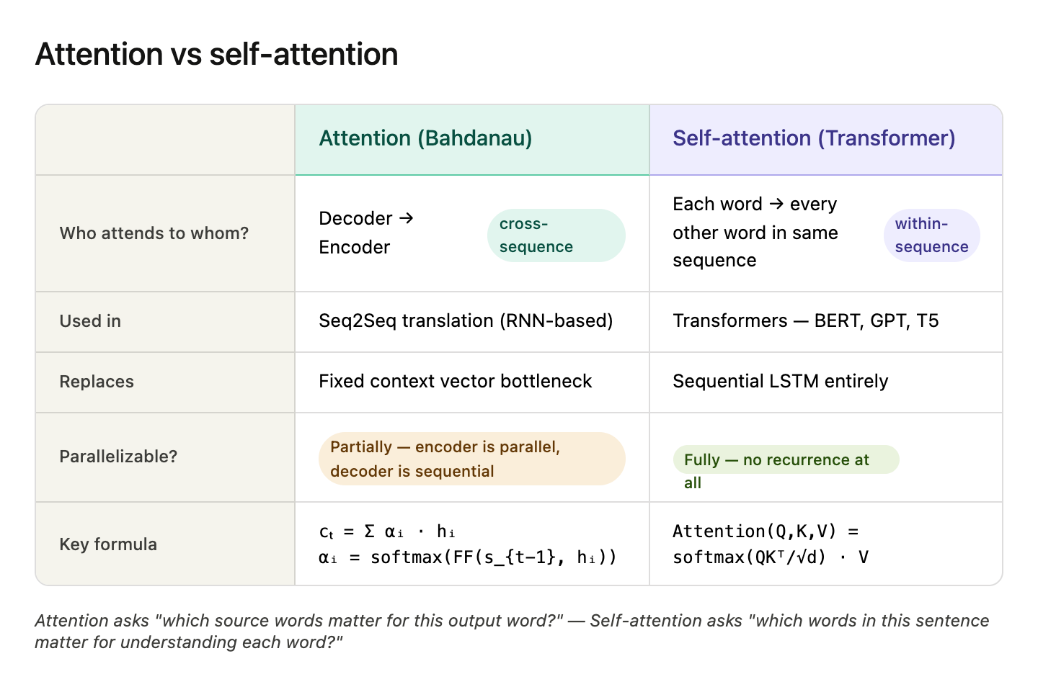

Slide 41
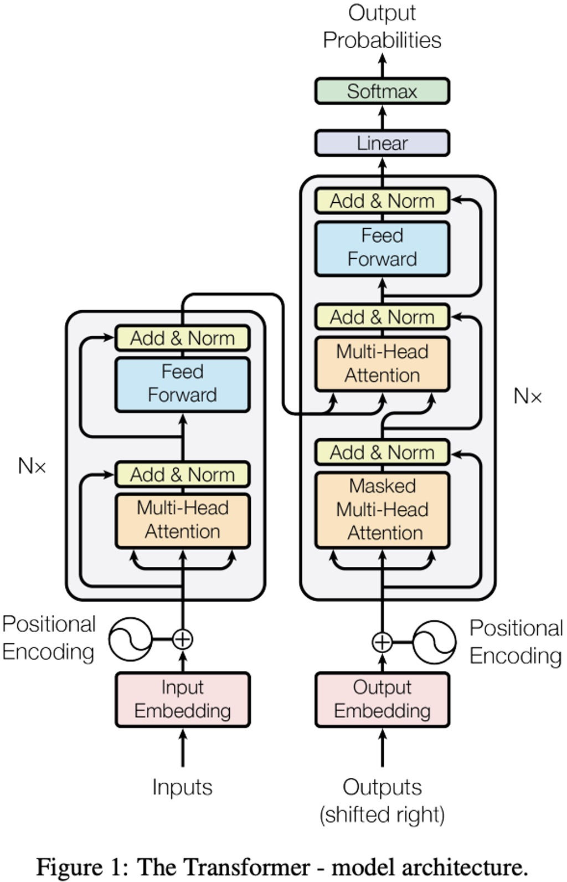
Attention Based Model: Transformer

Slide 42
What is Self-Attention?
Each element looks at all others and decides how much to focus on each.
"The animal didn't cross the street because it was too tired."
👉 What does "it" refer to?
1
Compare
2
Weight
3
Understand
Compare it with every other word
Assign higher weight to animal
Use weights to build
contextual meaning
Key Property
Every token can directly interact with every other token — no sequential propagation needed (unlike RNNs).
Long-range dependencies
Parallel computation
Dynamic context understanding

Slide 43
Query, Key, Value — Step by Step
"The animal didn't cross the street because it was too tired."
Q
Query
K
Key
V
Value
What I am
looking for
What I
represent
What information
I carry
→ it asks: who am I?
→ animal says: I'm a noun
→ actual content to share
Attention scores for "it":
Output for "it":
Word | Key meaning | Score | Weight
animal | noun, living thing | 5.0 | 0.70
tired | adjective | 3.0 | 0.20
street | noun, location | 1.0 | 0.05
others | ... | small | ~0
Output it = 0.70 × Vanimal + 0.20 × Vtired + …
"it" becomes:
"something like animal,
with context of being tired"

Slide 44
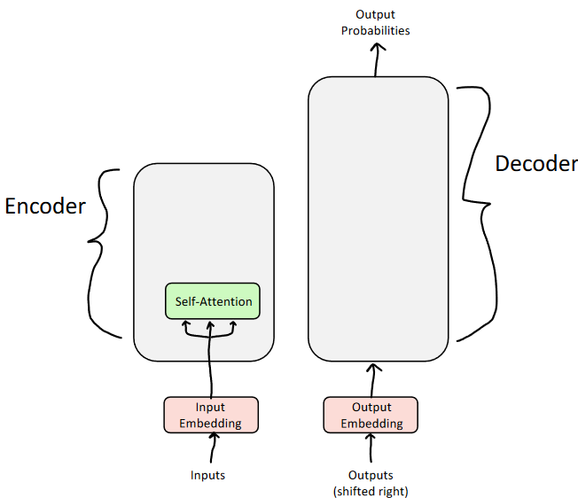
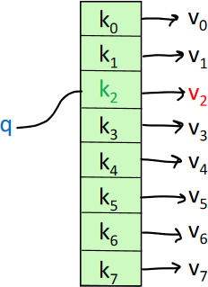
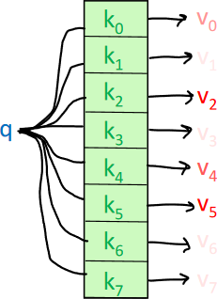
The (Self) Attention Mechanism
Attention as a "fuzzy" or approximate hashtable
To look up a value, we compare a query against keys in a table
In a hashtable (shown on the bottom left):
Each query (hash) maps to exactly one key-value pair
In (self-)attention (shown on the bottom right)
Each query matches each key to varying degrees.
We return a sum of values weighted by the query-key match.

Slide 45
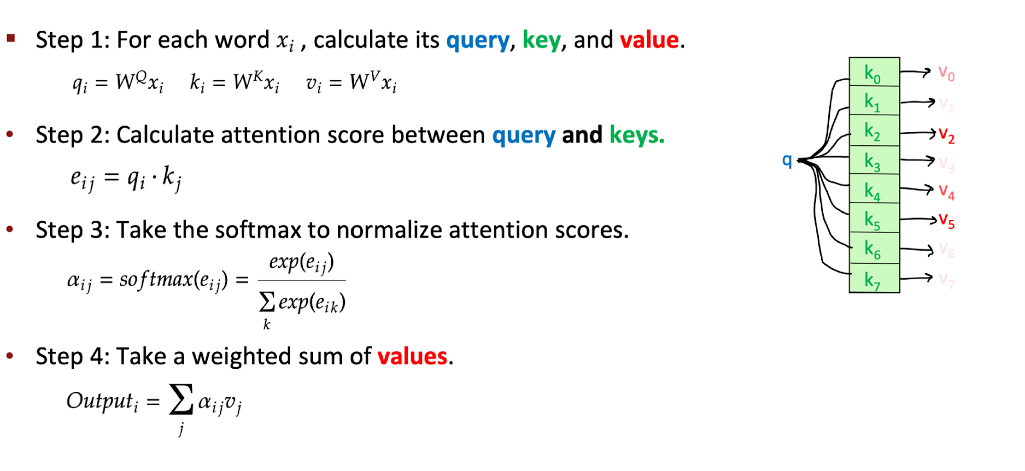
Recipe for Self-Attention in the Transformer Encoder
x_{(i +1)} = o_{i}

Slide 46
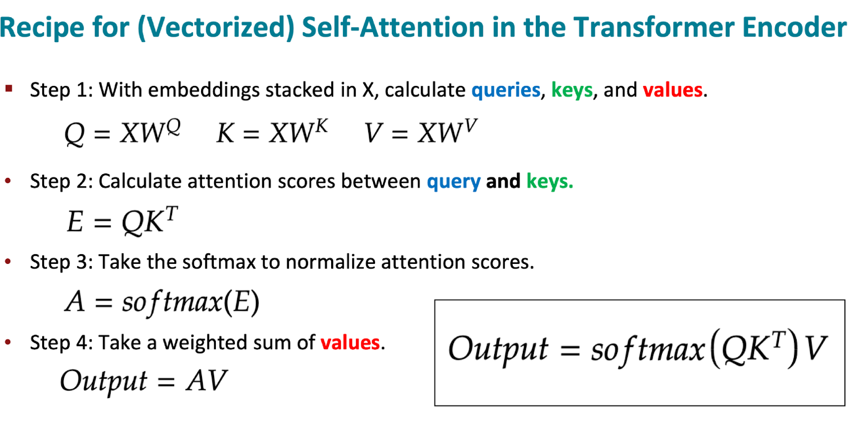
Recipe for (Vectorized) Self-Attention in the Transformer Encoder
Notes:
Matrix Representation

Slide 47
Tiny Self-Attention — Step by Step
2 tokens: x₁ = "animal", x₂ = "it" · embedding dim d = 2
Input X
WV (weights)
[ 1 1 ]
Output = A · V
[ 1 0 ]
[ 1 0 ]
"animal"
[ 0 1 ]
V = X × WV
0.73·[1,1] + 0.27·[1,0]
Q = K = X (WQ=WK=I)
[ 1 1 ]
= [1.0, 0.73]
Scores = QKᵀ
[ 1 0 ]
[ 1 0 ]
"it"
→
Attention A = softmax(Scores)
[ 0 1 ]
0.27·[1,1] + 0.73·[1,0]
= [1.0, 0.27]
softmax([1,0]) = [0.73, 0.27]
softmax([0,1]) = [0.27, 0.73]
[ 0.73 0.27 ]
[ 0.27 0.73 ]
"it" has non-zero 2nd component → influenced
by "animal" (which carries meaning [1,1])
Notes:
Each Column of V = One Feature Dimension
V = [[1, 1], ← "animal"
[1, 0]] ← "it"
↑ ↑
Col 1 Col 2
Reading down each column:
Column 1Column 2"animal"11"it"10MeaningBoth tokens have thisOnly "animal" has this
What does each column represent?
Column 1 = [1, 1] — a feature that both tokens share
"animal" → 1 ✓
"it" → 1 ✓
This could be thought of as "is a noun-like thing" — both "animal" and "it" function as nouns grammatically. Both carry this signal equally.
Column 2 = [1, 0] — a feature that only "animal" has
"animal" → 1 ✓
"it" → 0 ✗
This is the discriminating dimension — something "animal" has that "it" doesn't. Concrete semantic content. Real-world entity. Meaning that can be transferred.

Slide 48
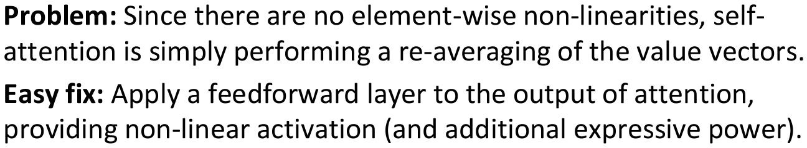
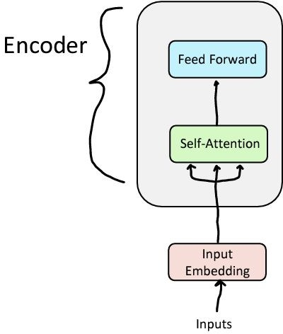
Feed-forward Layer

Slide 49
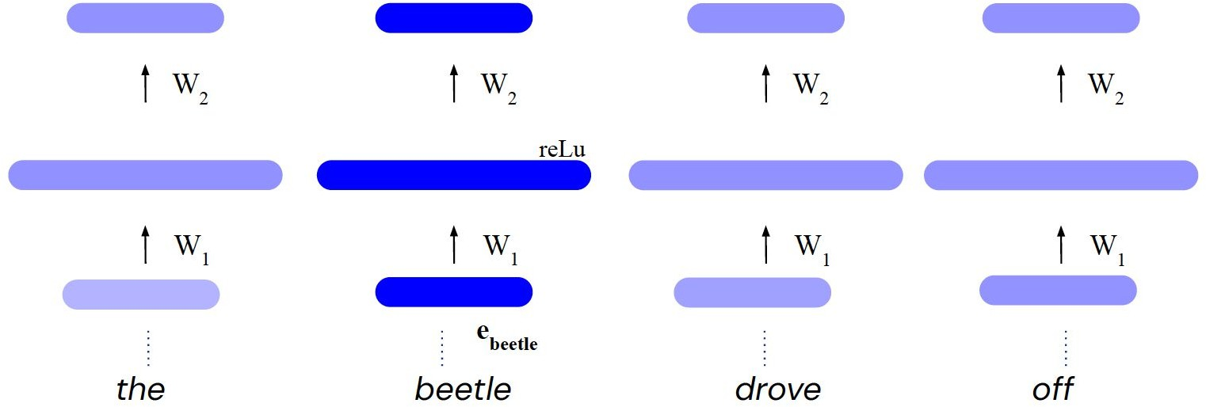
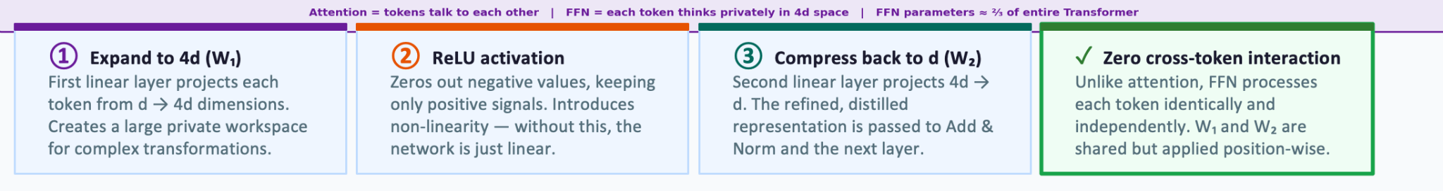
Feed-forward Layer
Source: https://deepmind.com/learning-resources/deep-learning-lecture-series-2020
Notes:
x_beetle enters FFN
↓
W₁ detects: "this is an insect" pattern fires
"this is a Volkswagen" pattern also fires
↓
ReLU kills weak/negative activations — keeps only strong pattern matches
↓
W₂ writes back: insect features + vehicle features blended
↓
output has enriched "beetle" — context-dependent meaning stored

Slide 50
How to make this work for deep networks?
Repeat 6 times
Training Trick #1: Residual Connections Training Trick #2: LayerNorm
Training Trick #3: Scaled Dot Product Attention
https://web.stanford.edu/class/cs224n/

Slide 51
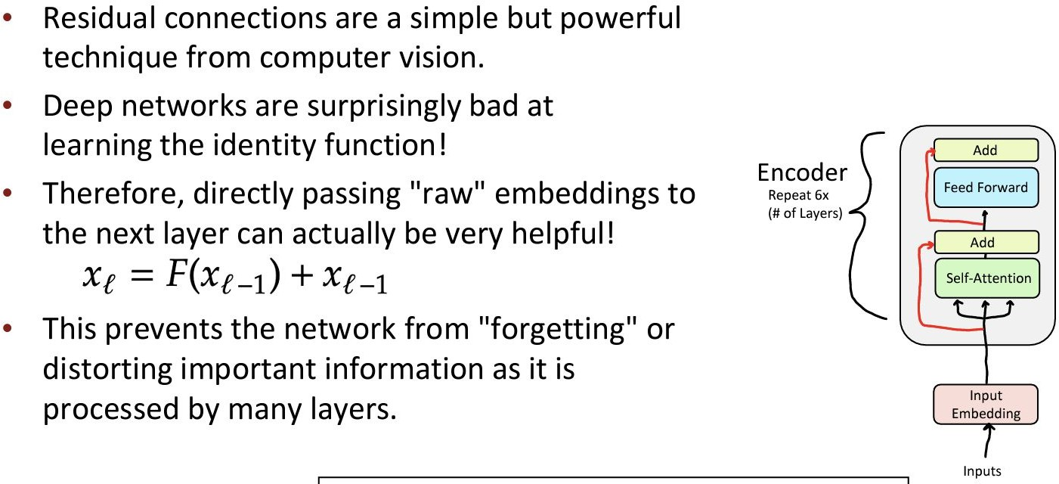
Training Trick #1: Residual Connections

Slide 52
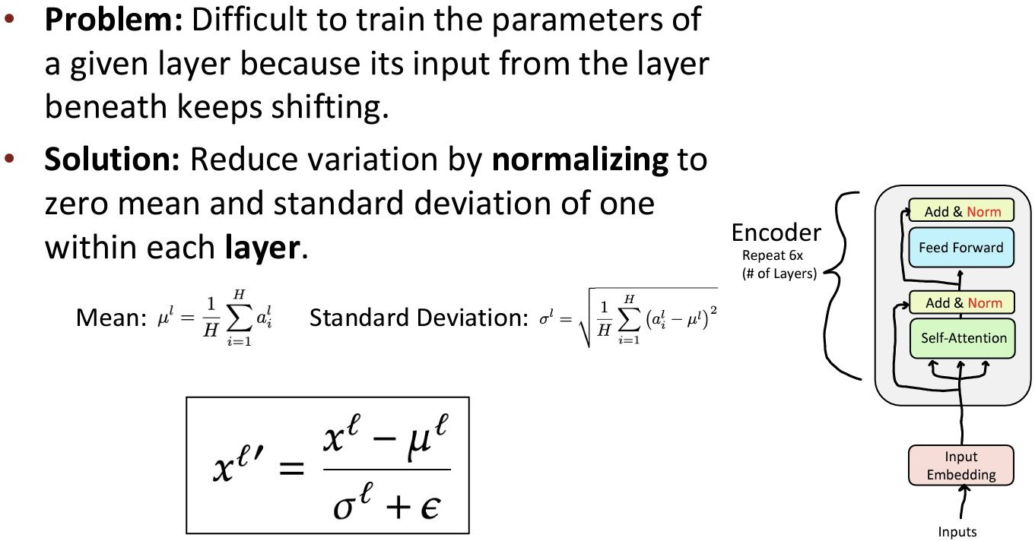
Training Trick #2: Layer Normalization
https://web.stanford.edu/class/cs224n/

Slide 53
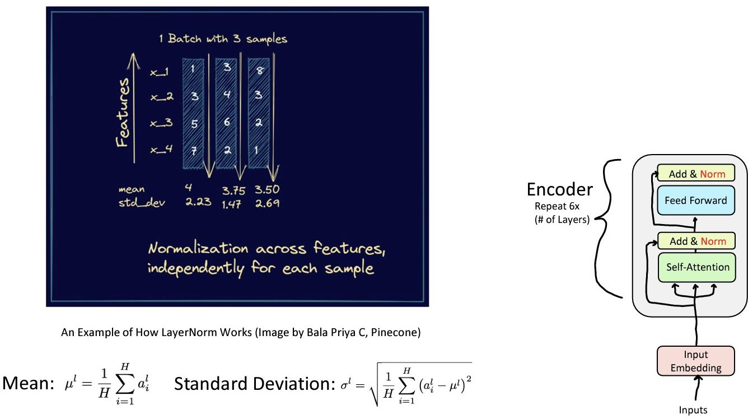
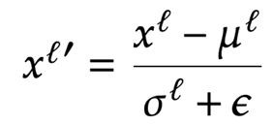
Training Trick #2: Layer Normalization
https://web.stanford.edu/class/cs224n/

Slide 54
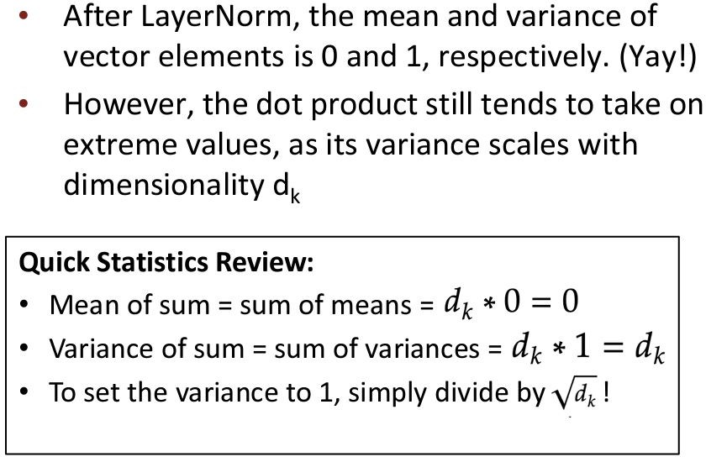
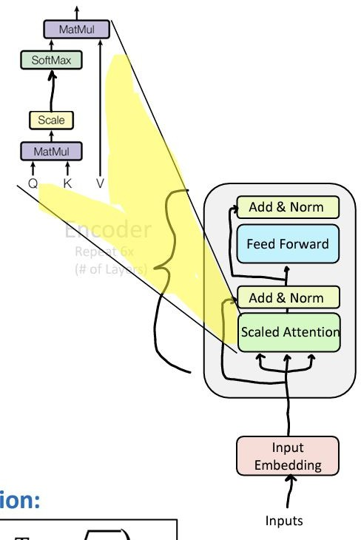
Training Trick #3: Scaled Dot Product Attention
https://web.stanford.edu/class/cs224n/

Slide 55
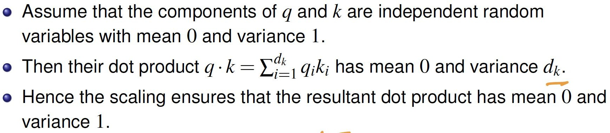
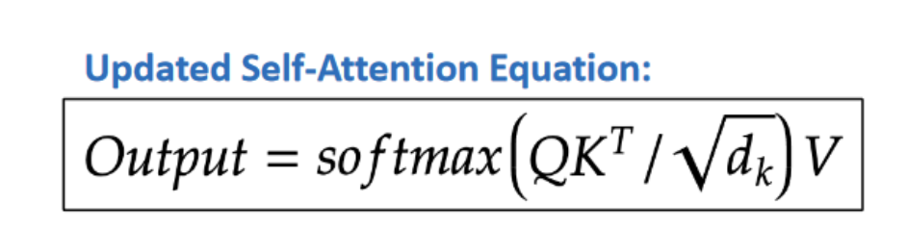
Training Trick #3: Scaled Dot Product Attention

Slide 56
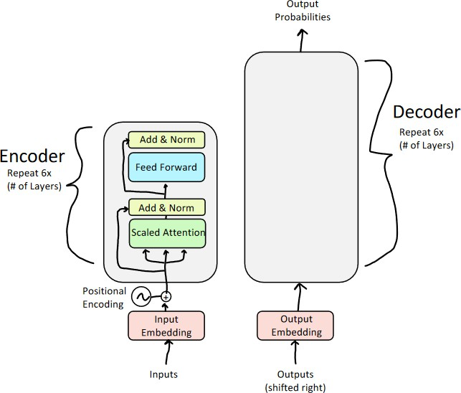
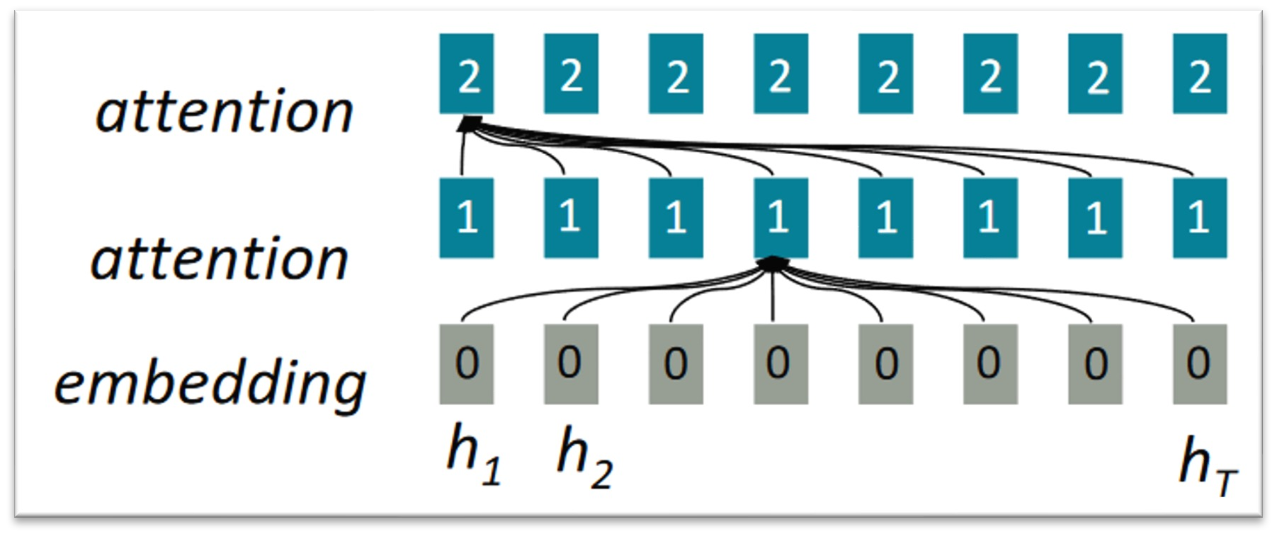
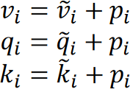
Positional Encoding
Sense of position is lost

Slide 57
Quiz 4
Why are Positional Encodings added to the input embeddings in a Transformer model?
A) To reduce the total number of parameters in the model.
B) To allow the model to process tokens sequentially like an RNN.
C) To provide the model with information about the order or position of words, since the attention mechanism itself is permutation-invariant (it doesn't inherently know word order).
D) To normalize the input data before it enters the Multi-Head Attention layer.

Slide 58

Quiz 4
Why are Positional Encodings added to the input embeddings in a Transformer model?
A) To reduce the total number of parameters in the model.
B) To allow the model to process tokens sequentially like an RNN.
C) To provide the model with information about the order or position of words, since the attention mechanism itself is permutation-invariant (it doesn't inherently know word order).
D) To normalize the input data before it enters the Multi-Head Attention layer.
Explanation : Unlike RNNs, which process words one by one, Transformers process all words in a sequence simultaneously. Without Positional Encodings, the model would treat the sentence "The cat chased the mouse" exactly the same as "The mouse chased the cat."

Slide 59
Quiz 4 (Explanation)
To reduce the total number of parameters in the model.
Positional encodings add no trainable parameters (sinusoidal) or very few (learned). Parameter count is not the purpose.
A
To allow the model to process tokens sequentially like an RNN.
Partially misleading. PEs inject order information but the Transformer still processes all tokens in parallel — not sequentially. The mechanism differs fundamentally from an RNN.
B
✔️
To provide the model with information about the order or position of words, since attention is permutation-invariant and does not inherently know word order.
Correct. Self-attention computes the same output regardless of token order. PEs break this symmetry by injecting position signals, letting the model distinguish 'cat chased mouse' from 'mouse chased cat'.
C
To normalize the input data before it enters the Multi-Head Attention layer.
Normalization is handled by Layer Norm, applied after (not before) the attention sublayer. PEs serve a completely different purpose.
D
Why B is tempting but wrong: Positional encodings DO convey order — so B sounds correct. But 'sequential like an RNN' is the wrong framing. Transformers still process all tokens simultaneously in parallel. PEs give the attention mechanism position signals; they do not make the model sequential. C is more precise: PEs exist specifically because self-attention is permutation-invariant.
Without PEs: "The cat chased the mouse" = "The mouse chased the cat" (identical to the model) · With PEs: word order is distinguishable

Slide 60
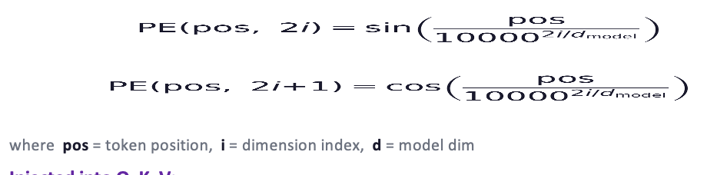
Positional Encoding
Sense of position is lost
Self-attention is permutation-invariant — token order is invisible to the model.
Positional encodings are added to token embeddings to inject sequence order.
import math
class PositionalEncoding(nn.Module):
def __init__(self, d=512, max_len=512):
attention
2
2
2
2
2
2
2
2
super().__init__()
pe = torch.zeros(max_len, d)
attention
1
1
1
1
1
1
1
1
pos = torch.arange(0, max_len).float()
pos = pos.unsqueeze(1) # (max_len, 1)
embedding
0
0
0
0
0
0
0
0
div = torch.exp(
torch.arange(0, d, 2).float()
* -(math.log(10000.0) / d))
pe[:, 0::2] = torch.sin(pos * div)
pe[:, 1::2] = torch.cos(pos * div)
self.register_buffer('pe', pe.unsqueeze(0))
v_i = v~_i + p_i q_i = q~_i + p_i k_i = k~_i + p_i
def forward(self, x):
# x: (B, seq_len, d_model)
x = x + self.pe[:, :x.size(1)].to(x.device)
return x

Slide 61
Injecting Order into Attention
import torch, math
def positional_encoding(max_len, d_model):
pe = torch.zeros(max_len, d_model)
pos = torch.arange(max_len).unsqueeze(1).float() # (max_len, 1)
div = torch.exp(torch.arange(0, d_model, 2).float()
* -(math.log(10000.0) / d_model))
pe[:, 0::2] = torch.sin(pos * div) # even dims: sine
pe[:, 1::2] = torch.cos(pos * div) # odd dims: cosine
return pe # shape: (max_len, d_model)
# In the full model:
class TransformerEmbedding(nn.Module):
def __init__(self, vocab_size, d_model, max_len=512):
super().__init__()
self.token_emb = nn.Embedding(vocab_size, d_model)
self.pos_enc = positional_encoding(max_len, d_model)
def forward(self, x):
tok = self.token_emb(x) # learned token meaning
pos = self.pos_enc[:x.size(1)].to(x.device) # fixed position signal
return tok + pos # element-wise sum!
Why sinusoidal?
🔢 Deterministic
No training needed for positions
📐 Unique per position
Each pos has a unique fingerprint
📏 Relative distances
PE(pos+k) is a linear fn of PE(pos)
♾️ Generalizes
Works beyond training sequence lengths

Slide 62
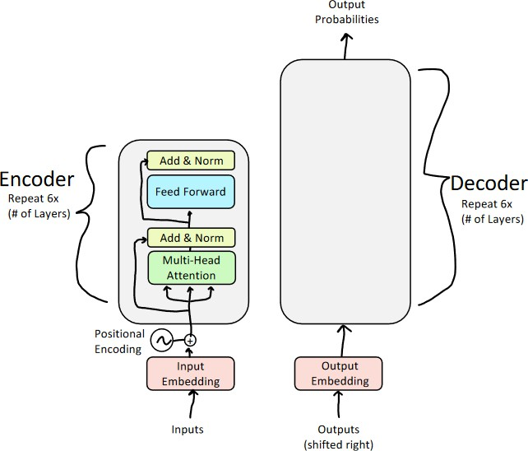
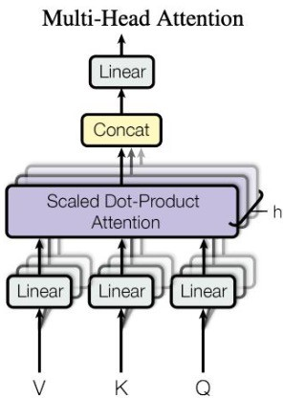
Multi-Head Attention

Slide 63
Why Multiple Heads?
One attention head captures one type of relationship. Language has many.
Single Attention Head
Multi-Head Attention
→
One Q,K,V → captures only one type of relationship
h independent heads → captures h different relationship types
Coreference
Verb–Object
H1
H2
Example: "it" → "animal"
Example: "cross" → "street"
Semantic sim.
Positional
H3
H4
Example: "tired" → "animal"
Example: nearby tokens
MultiHead(X) = Concat( head₁ … headₕ ) · Wᴼ headᵢ = softmax( QᵢKᵢᵀ / √dₖ ) Vᵢ

Slide 64



Thank you
Instructor
Teaching Assistants (IITKGP)
Image 3
Niloy Ganguly
niloy@cse.iitkgp.ac.in
Sombit Bose
Shrimon Mukherjee

