Slide 1
Data Carpentry Reproducible Reports Using RMarkdown
January 17, 2019
Maria Kamenetsky
mkamenetsky@wisc.edu
@mkamenets
Adapted from Karl Broman and Data Carpentry curriculum

Slide 2
Key Concepts
Why Rmarkdown?
Basics of RMarkdown
challenge!
R code chunks
challenge!
Code chunk options
challenge!
Inline R code
Other output formats

Slide 3
Why Rmarkdown?
Combines text, code, figures.
Write papers without having to remember to swap figures, change cell values in tables.
Automatically generate reports.
Reproducible documents.

Slide 4
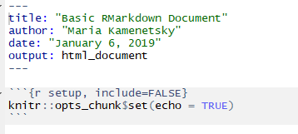
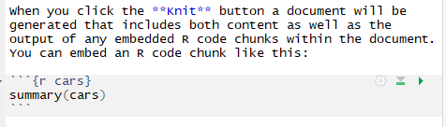
Basics of RMarkdown
Click to knit
Header
Code chunk/global options
Text
Code chunk

Slide 5
Markdown
Bold: **a bolded statement** double asterisks
Italics: *an italicized statement* single asterisks
Code-type font: `code-type font here` back-ticks
(Bulleted list):
- First item
- First sub-item
- Second item
(HTML headers):
# Header 1
## Header 2
### Header 3

Slide 6
Challenge #1
Make a new Rmarkdown document.
Delete all of the R code chunks and write a bit of Markdown (some sections, italicized/bold text, itemized list).
Knit to HTML

Slide 7

R code chunks
Name of code chunk
Begins R code chunk
Code chunk/global options
Ends R code chunk
Short-cut for new code chunk: CTRL+ALT+i

Slide 8
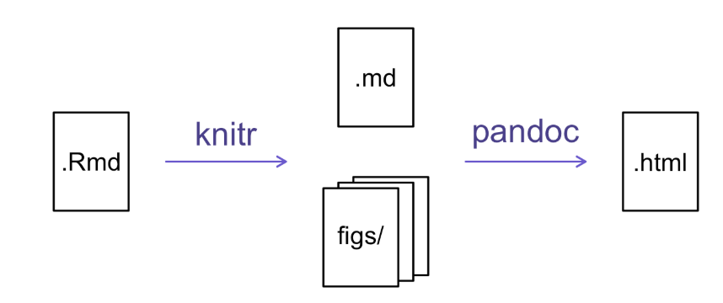
How Does the HTML File Get Made?

Slide 9
CHALLENGE #2
Add code chunks to an RMarkdown file to:
Load the ggplot2 package
Hint: library(_____)
Read in the portal data
portal_clean.csv
Create a plot of your choice!
Example geoms to use:
geom_point()
geom_boxplot()
geom_line()
2

Slide 10
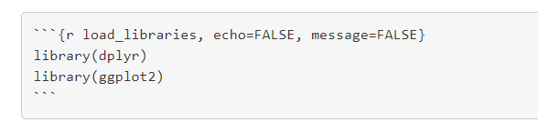
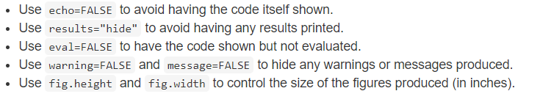
Code chunk options
Code chunk options

Slide 11

Code chunk options: Local vs. Global
Global chunk options – set options for entire RMarkdown document (beginning of document):
Local chunk options – set options for each code chunk separately

Slide 12
CHALLENGE #3
Use chunk options to control the size of a figure and hide the code.
2

Slide 13
Inline R code
Make values in your report reproducible with inline R code. Syntax:
`r _________`

Slide 14
CAPSTONE PROJECT
Create and compile an Rmarkdown report:
Load the portal_clean.csv data.
Create boxplots of weight by sex.
Create a histogram of hindfoot lengths.
Create a scatterplot of hindfoot length vs. weight for the species “DM”, “DO”, and “DS”.
Use different colors for the three species, and put the three species in different panels.
Create a line plot of the counts of “DM” in “Rodent Exclosure” plots over time.
Create a table of “DM” by plot type for the year 1977.
2

